Slide 1
Sensitivity Analysis with SALib (Python)
Jon Herman
Associate Professor, Civil & Environmental Engineering
UC Davis

Slide 2
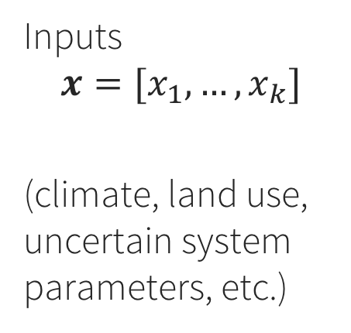
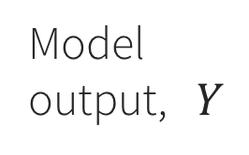
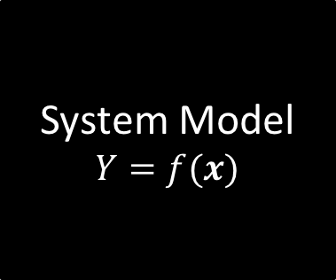
Which uncertain inputs have the most influence on model outputs?
System Model
$$Y=f(x)$$
Model output, $Y$
Inputs
$$x=[x_{1},…,x_{k}]$$
(climate, land use, uncertain system parameters, etc.)

Slide 3
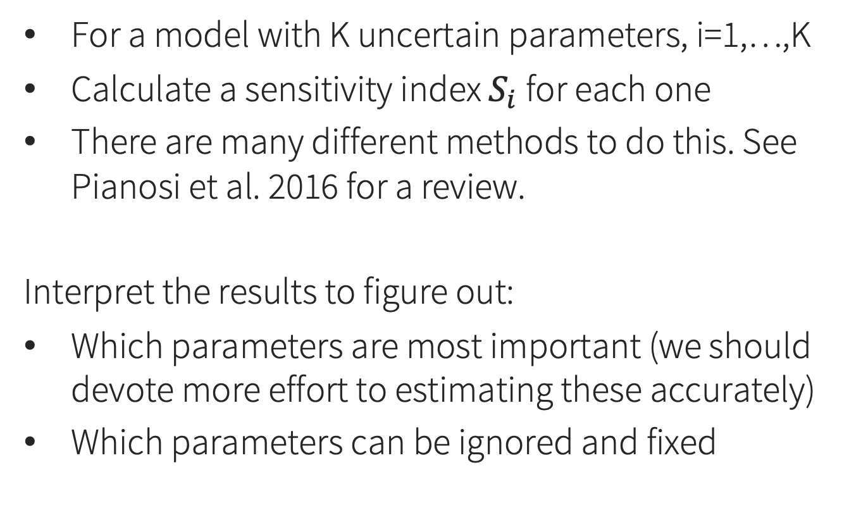
Sensitivity analysis in general
For a model with K uncertain parameters, i=1,…,K
Calculate a sensitivity index $S_{i}$ for each one
There are many different methods to do this. See Pianosi et al. 2016 for a review.
Interpret the results to figure out:
Which parameters are most important (we should devote more effort to estimating these accurately)
Which parameters can be ignored and fixed

Slide 4
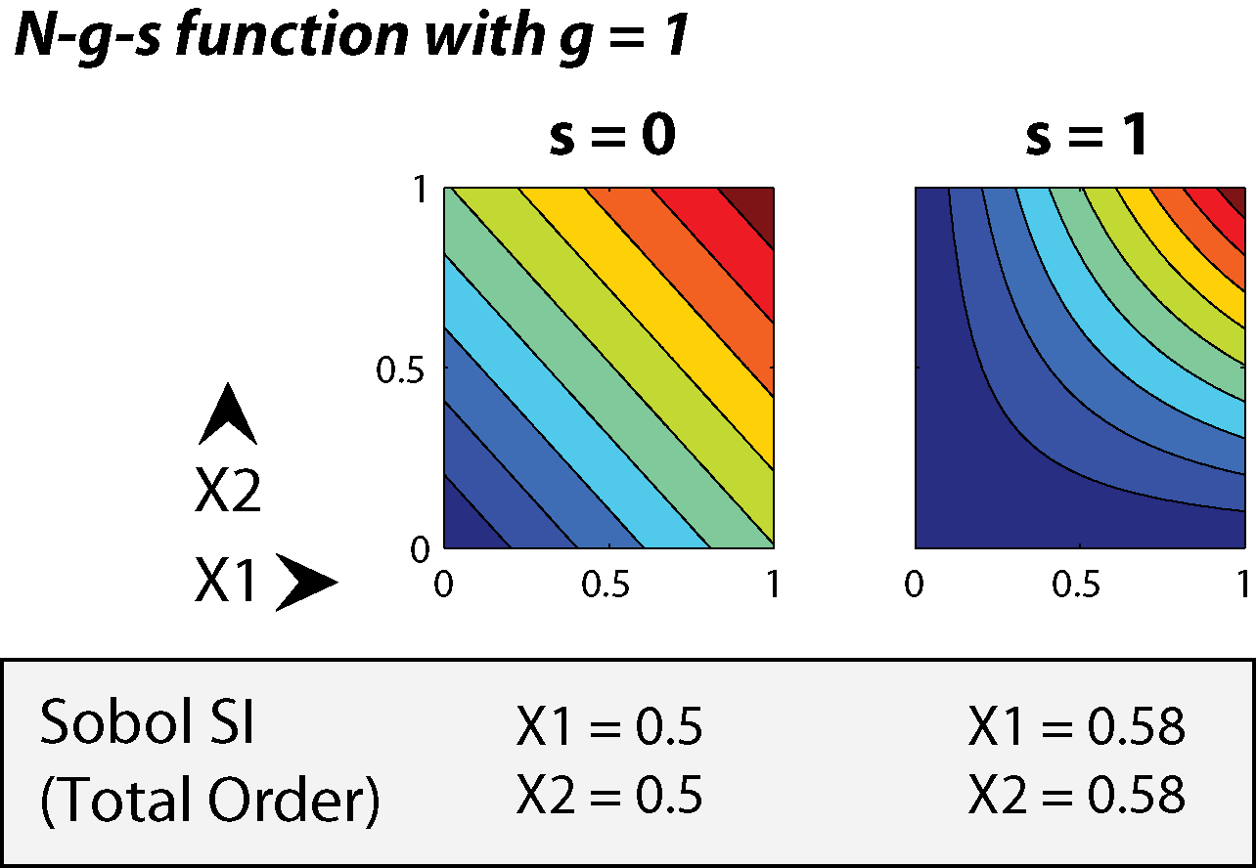
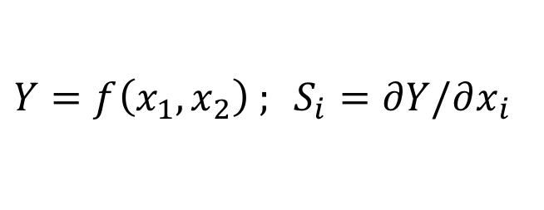
Local SA: Derivatives at a point
$Y=f\left(x_{1},x_{2}\right) ; S_{i}=∂Y/∂x_{i}$
Problem: Which point to use? Misses interactions.

Slide 5
Global SA: Sample throughout the space

Slide 6
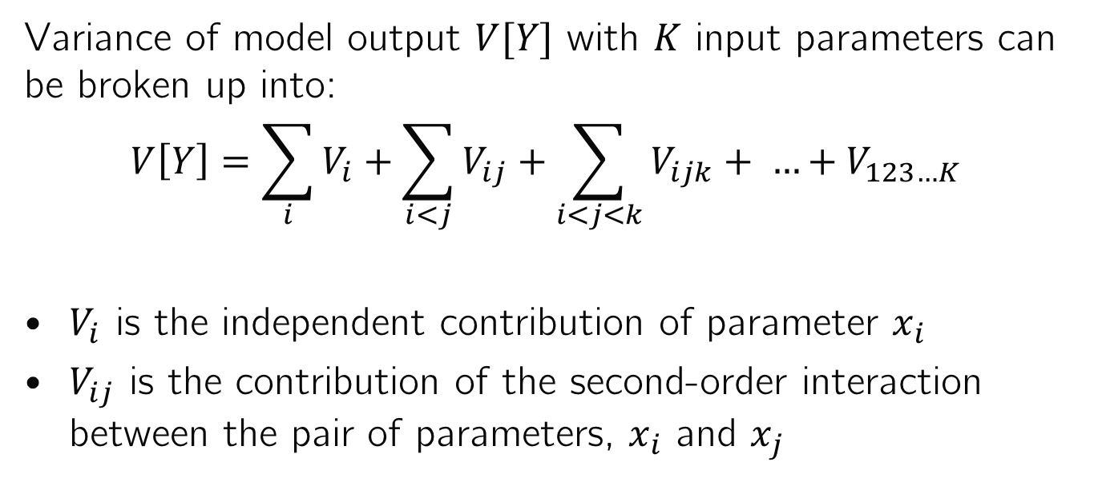
Sobol Variance Decomposition
Variance of model output $V[Y]$ with $K$ input parameters can be broken up into:
$$V\left[Y\right]=\sum_{i}{V_{i}}+\sum_{i<j}{V_{ij}}+\sum_{i<j<k}{V_{ijk}+ …+V_{123…K}}$$
$V_{i}$ is the independent contribution of parameter $x_{i}$
$V_{ij}$ is the contribution of the second-order interaction between the pair of parameters, $x_{i}$ and $x_{j}$
These can be estimated with numerical integration of the global sample
→ Saltelli et al. 2008 “Global SA: The Primer”

Slide 7
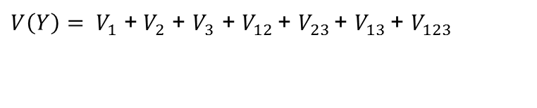
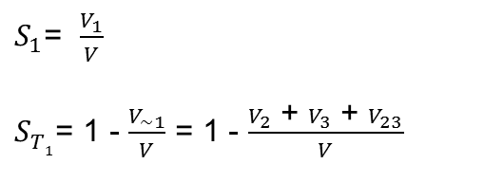
First-order index: the fraction of total variance that a parameter is responsible for by itself
Total-order index: the fraction of total variance that a parameter is responsible for, including interactions with other parameters
For a simple example, with three uncertain parameters:
Total variance:
First order sensitivity index for Parameter 1:
Total order sensitivity index for Parameter 1:

Slide 8
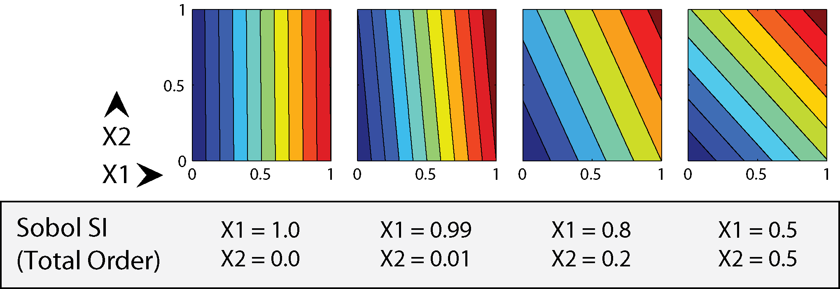
Example Sobol sensitivity indices for linear (separable) functions
No interactions: total-order indices sum to 1

Slide 9
Example Sobol sensitivity indices for separable and non-separable functions
With interactions, sum > 1 because interactions are double-counted

Slide 10
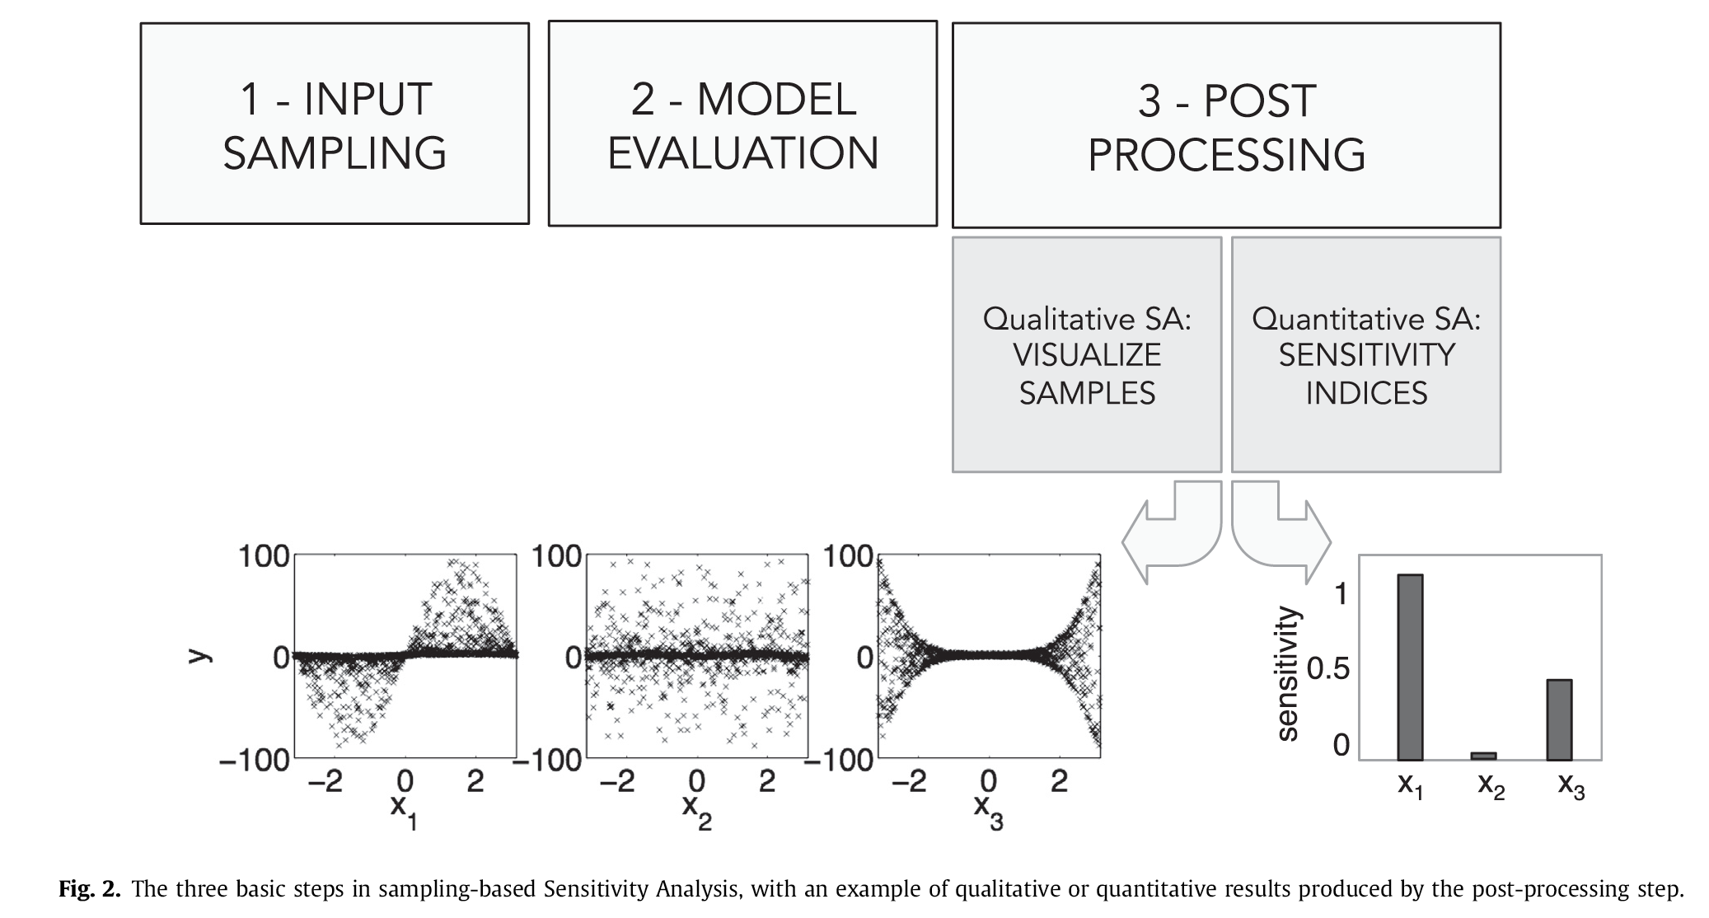
SA: three main steps (Pianosi et al. 2016)

Slide 11
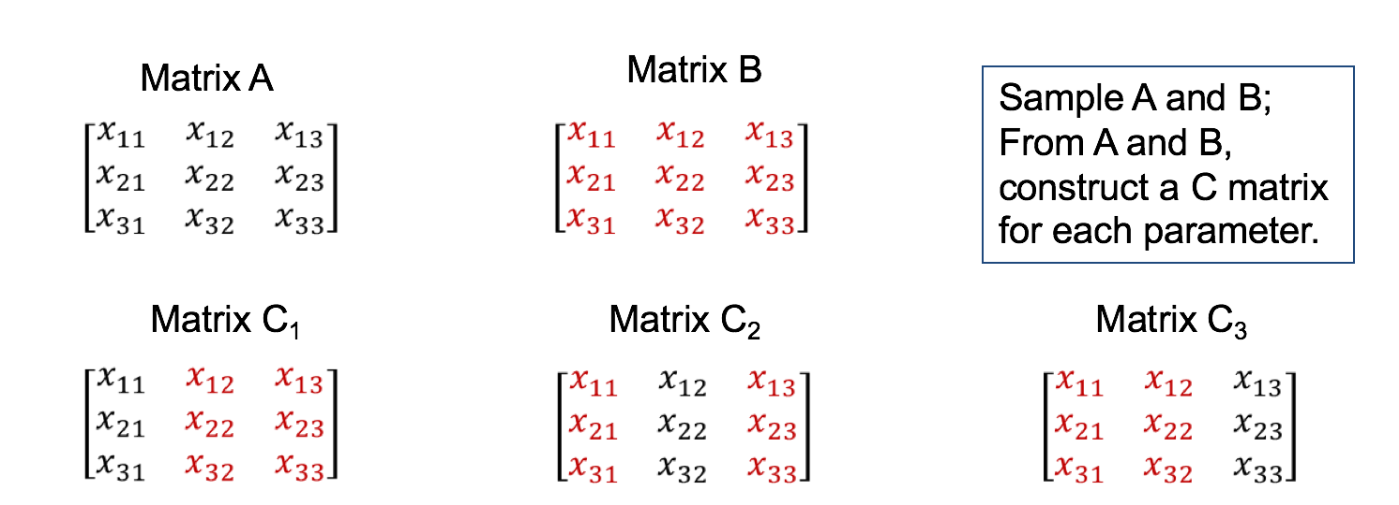
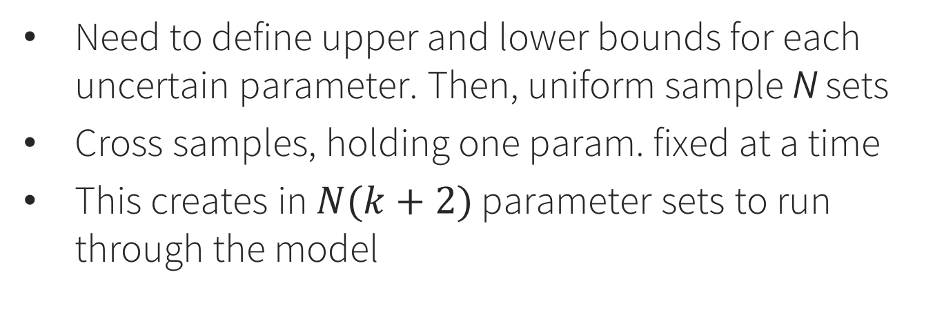
Step 1: Sample parameters (Sobol method)
Need to define upper and lower bounds for each uncertain parameter. Then, uniform sample N sets
Cross samples, holding one param. fixed at a time
This creates in $N(k+2)$ parameter sets to run through the model

Slide 12
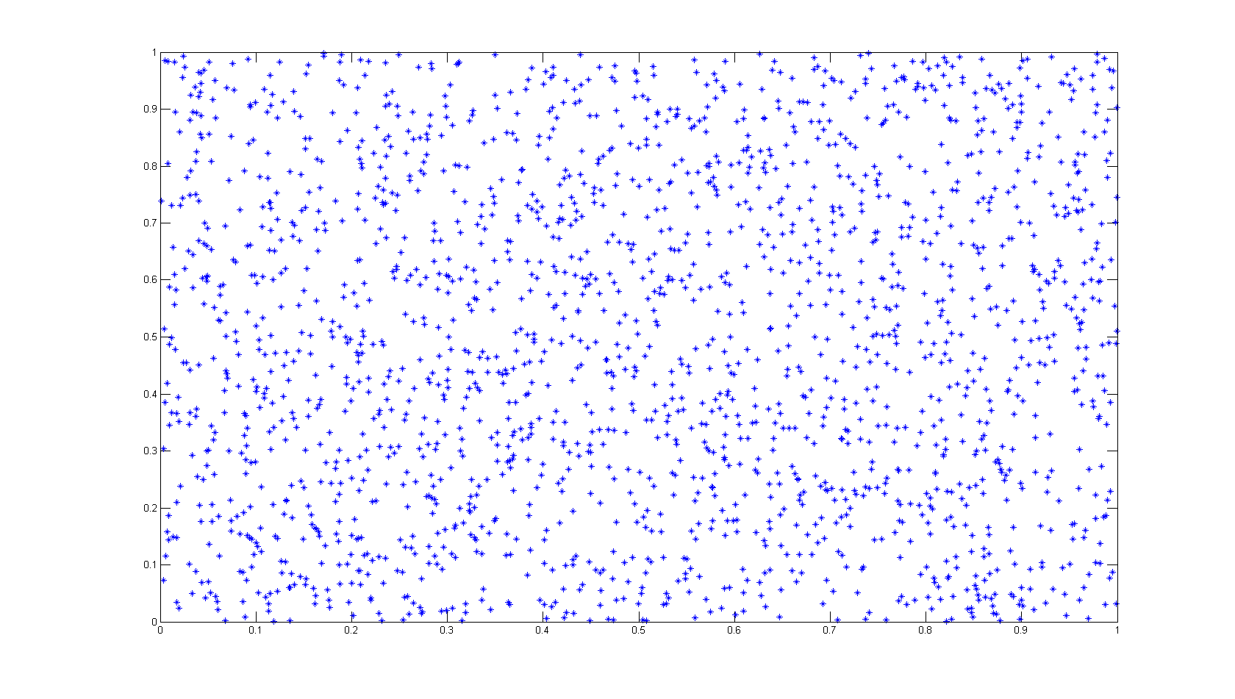
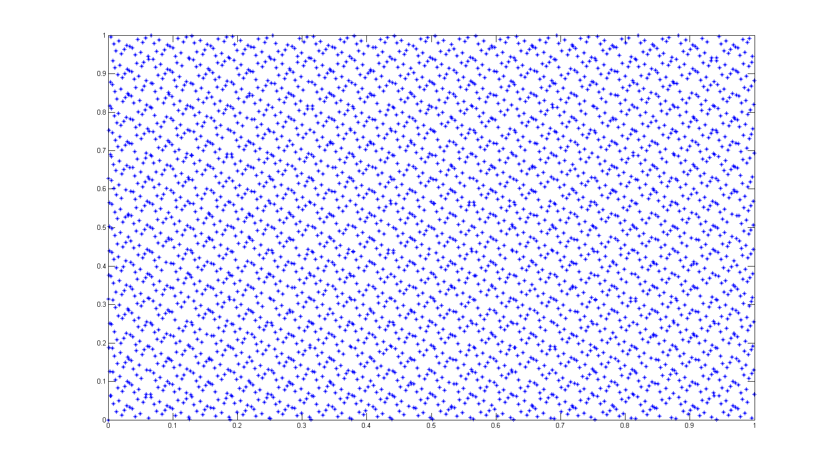
Uniform Random Monte Carlo Sampling vs. Sobol Sequence Sampling (“quasi-random”)
Error Growth Rate
for estimating variance

Slide 13
Step 2: Run model for all samples in the matrices A, B, and C. Save the output Y.
This step is user-specific and decoupled from everything else. Could even be in a different language, or using a GUI. Just save the output.

Slide 14
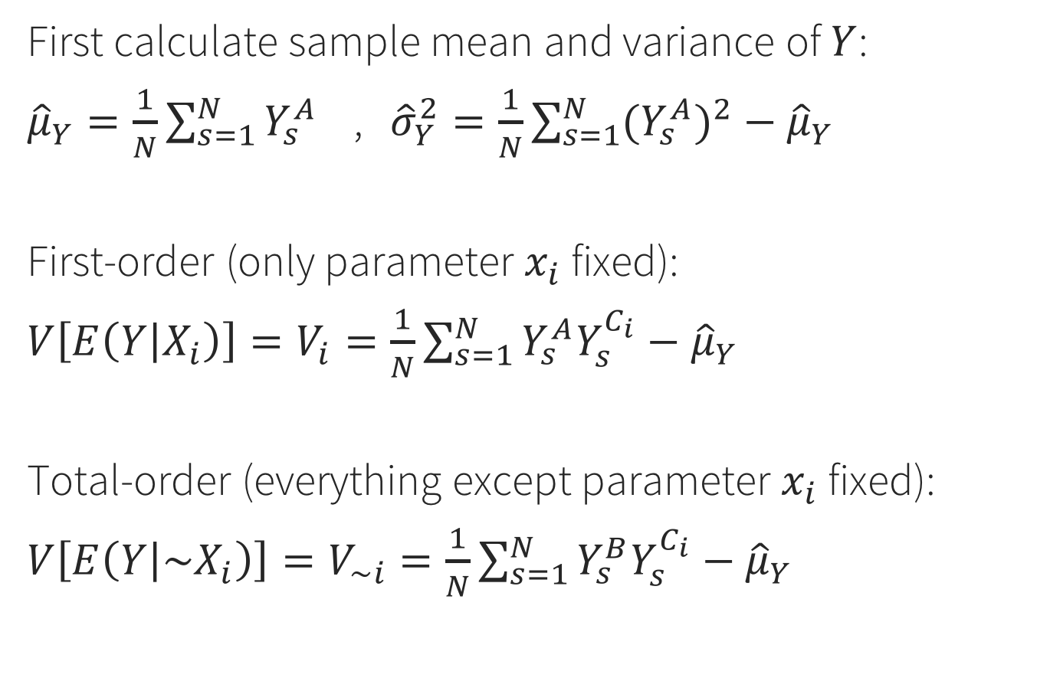
Step 3: Use the model output Y to estimate conditional variances
First calculate sample mean and variance of $Y$:
${\hat{μ}}_{Y}=\frac{1}{N}\sum_{s=1}^{N}{Y_{s}^{A}}$ , ${\hat{σ}}_{Y}^{2}=\frac{1}{N}\sum_{s=1}^{N}{{{(Y}_{s}^{A})}^{2}}−{\hat{μ}}_{Y}$
First-order (only parameter $x_{i}$ fixed):
$V\left[E\left(Y | X_{i}\right)\right]=V_{i}=\frac{1}{N}\sum_{s=1}^{N}{Y_{s}^{A}Y_{s}^{C_{i}}}−{\hat{μ}}_{Y}$
Total-order (everything except parameter $x_{i}$ fixed):
$V\left[E\left(Y | {\sim X}_{i}\right)\right]=V_{\sim i}=\frac{1}{N}\sum_{s=1}^{N}{Y_{s}^{B}Y_{s}^{C_{i}}}−{\hat{μ}}_{Y}$

Slide 15
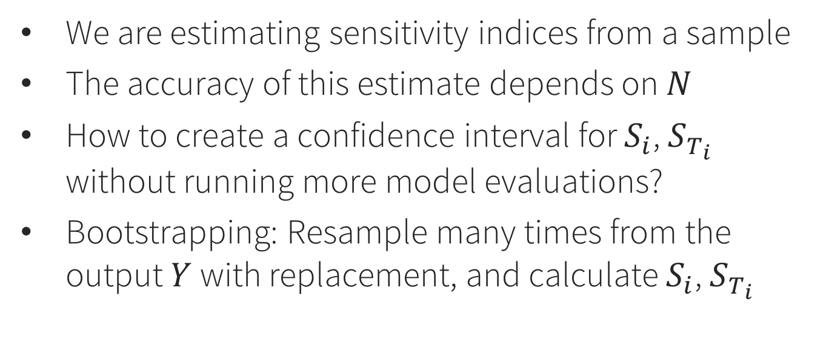
Bootstrapping
We are estimating sensitivity indices from a sample
The accuracy of this estimate depends on $N$
How to create a confidence interval for $S_{i}$, $S_{T_{i}}$ without running more model evaluations?
Bootstrapping: Resample many times from the output $Y$with replacement, and calculate $S_{i}$, $S_{T_{i}}$
http://www.statisticshowto.com/bootstrap-sample/

Slide 16

Sensitivity Analysis Library (SALib)
Library: https://github.com/SALib/SALib
Installation: pip install SALib
Requirements: Python, NumPy, SciPy
https://www.continuum.io/downloads

Slide 17
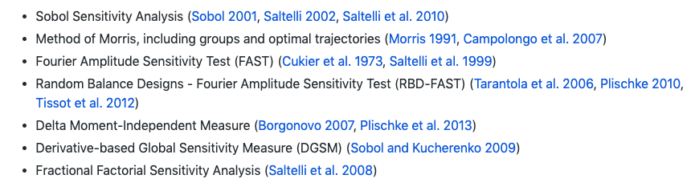
Methods included in SALib
We’ll focus on Sobol, but the examples/ folder on Github contains all of these

Slide 18
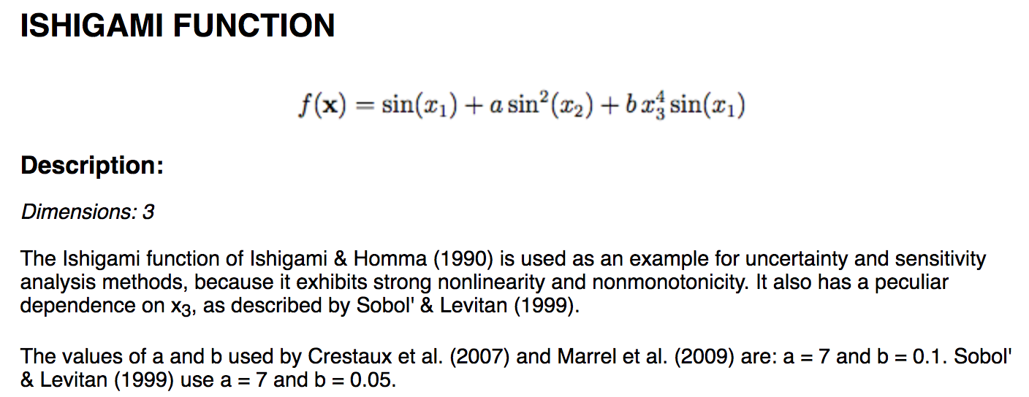
Example: Ishigami function
This is a test function used for SA method benchmarking, because we know what the answer should be.

Slide 19
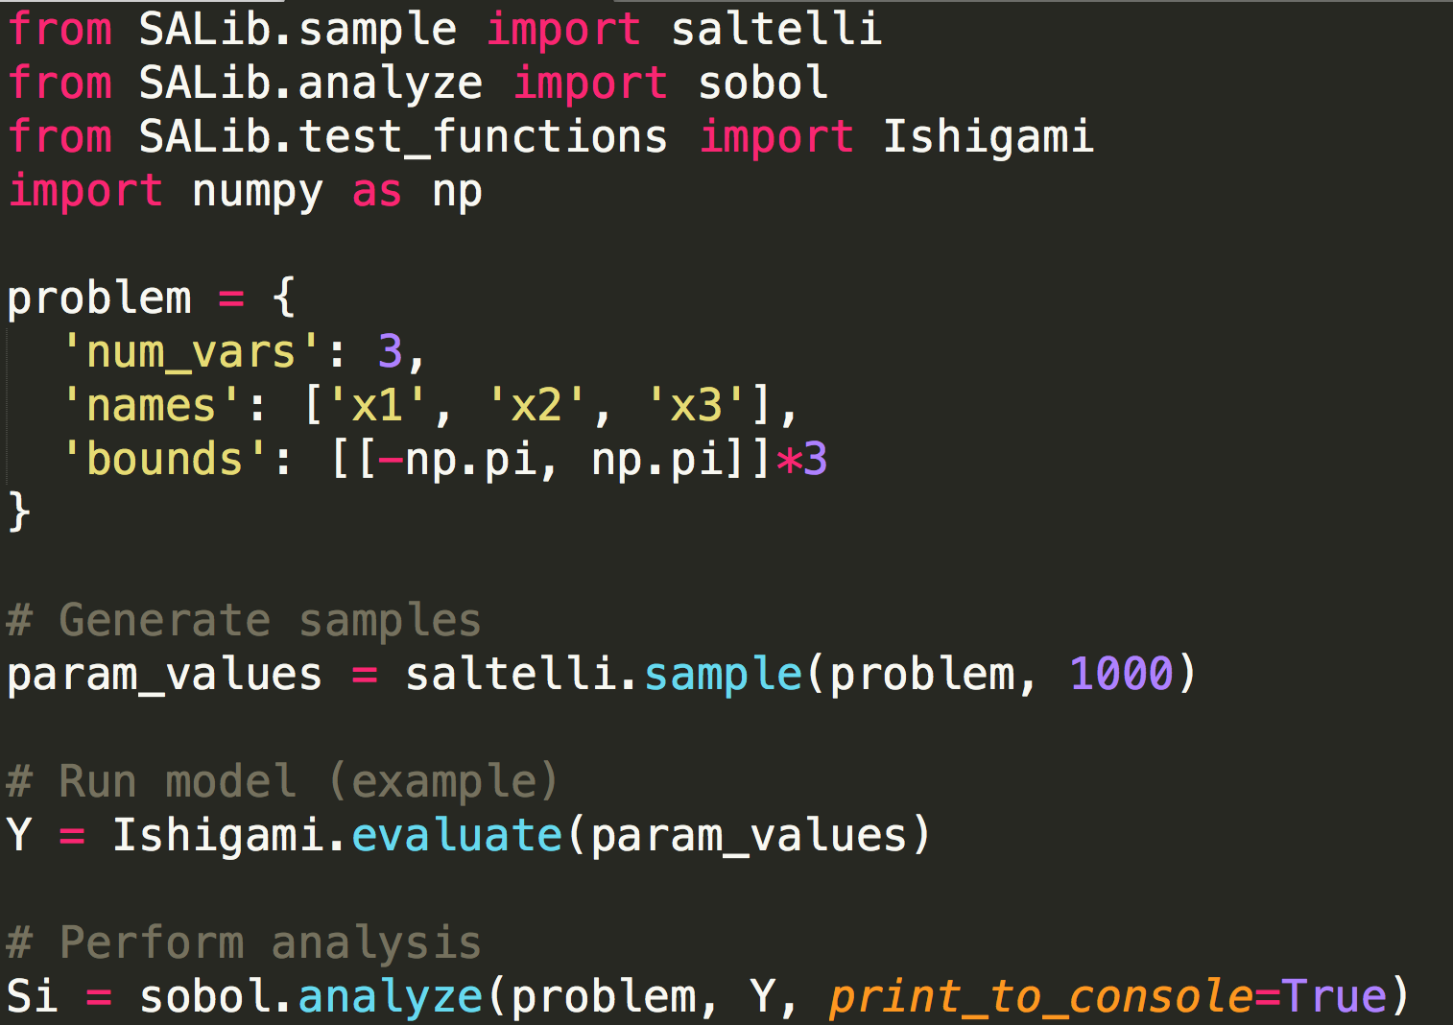
Example
First “pip install SALib” on the command line. Then:

Slide 20
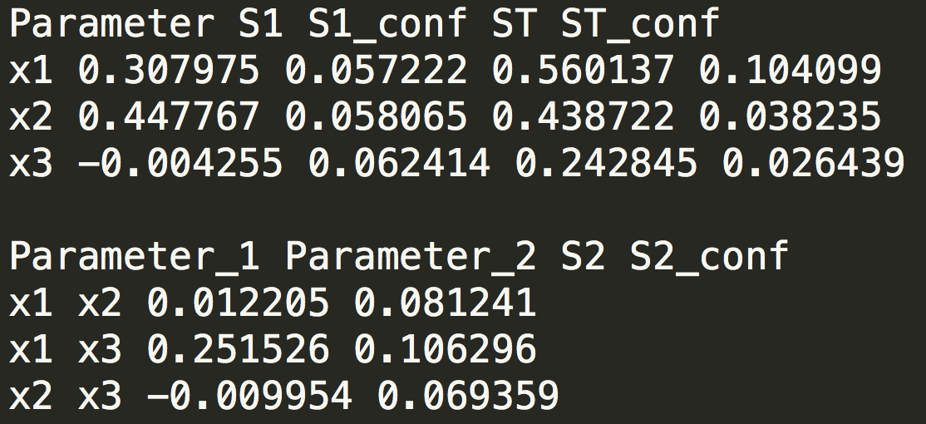
Interpreting results
X1 and X3 interact (second-order)
This is reflected in the difference between their respective first- and total-order indices
Confidence intervals should shrink as N increases
Negative values are not possible – they are zero.

Slide 21
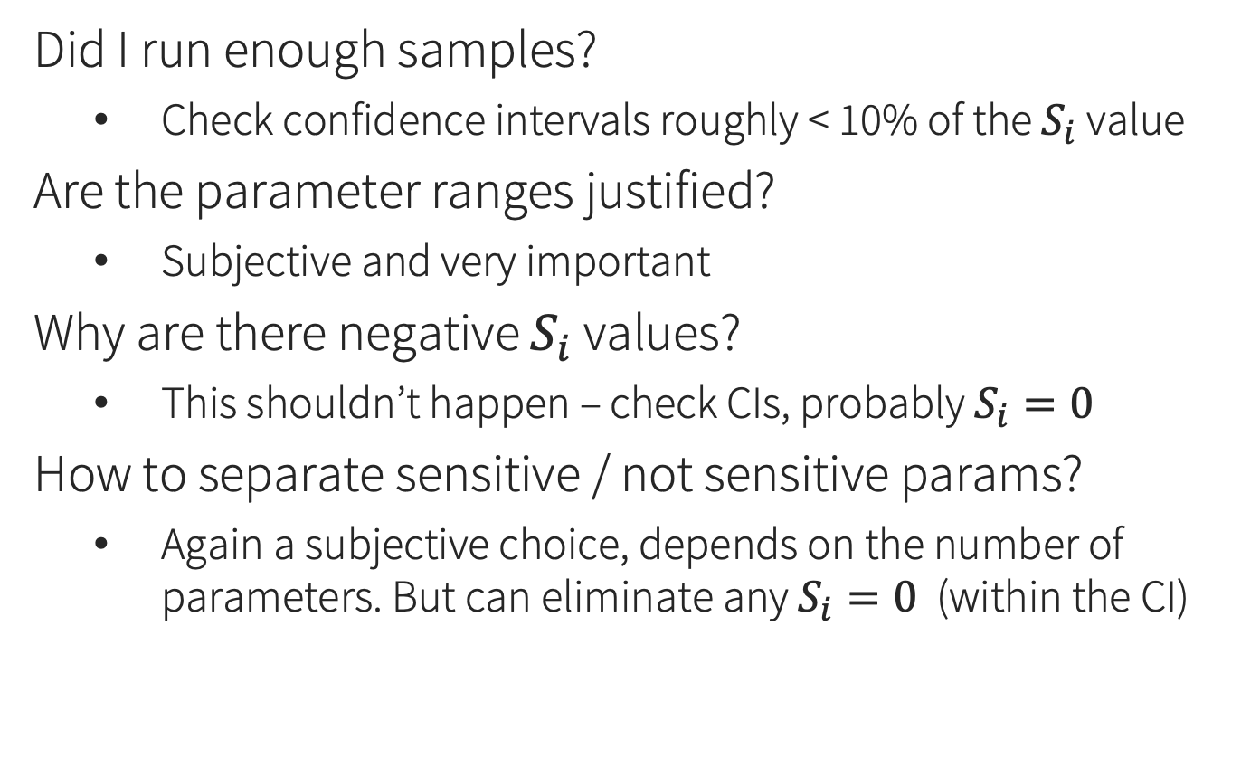
Frequently asked questions
Did I run enough samples?
Check confidence intervals roughly < 10% of the $S_{i}$ value
Are the parameter ranges justified?
Subjective and very important
Why are there negative $S_{i}$ values?
This shouldn’t happen – check CIs, probably $S_{i}=0$
How to separate sensitive / not sensitive params?
Again a subjective choice, depends on the number of parameters. But can eliminate any $S_{i}=0$ (within the CI)

Slide 22
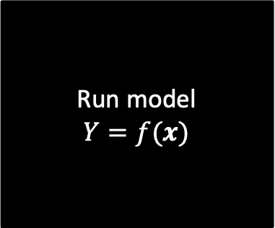
Example: rainfall-runoff model
Which model output should we use?
What are the input parameter ranges?
Do any of them vary over orders of magnitude? - if so, consider sampling in log space
Run model
$$Y=f(x)$$
Uncertain parameters (6)
Model output, $Y$

Slide 23
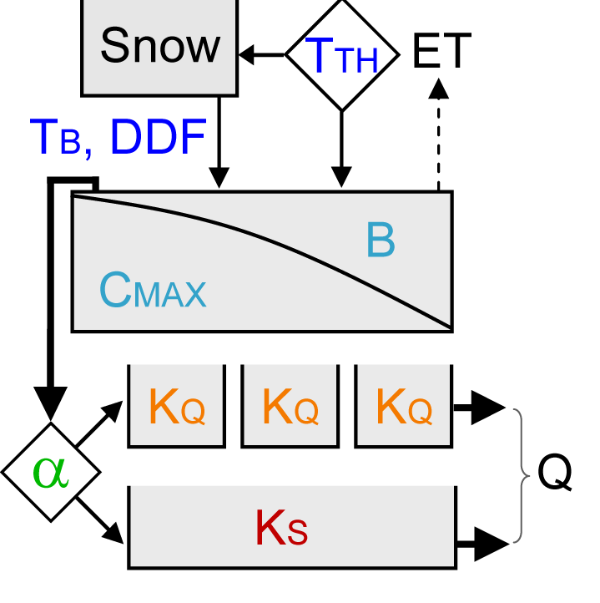
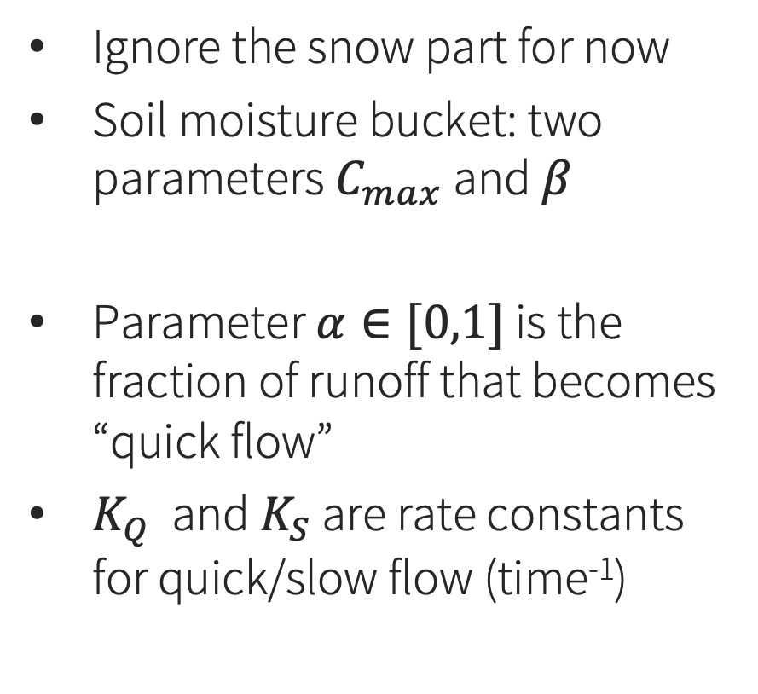
HyMod rainfall-runoff model (Moore 1985)
Ignore the snow part for now
Soil moisture bucket: two parameters $C_{max}$ and $β$
Parameter $α∈[0,1]$ is the fraction of runoff that becomes “quick flow”
$K_{Q}$ and $K_{S}$ are rate constants for quick/slow flow (time⁻¹)

Slide 24
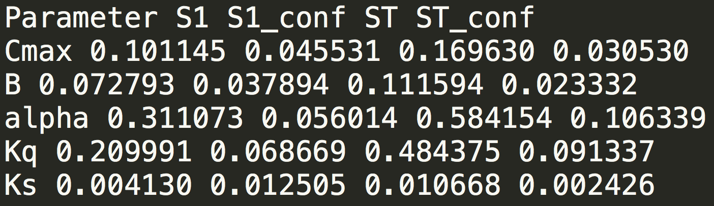
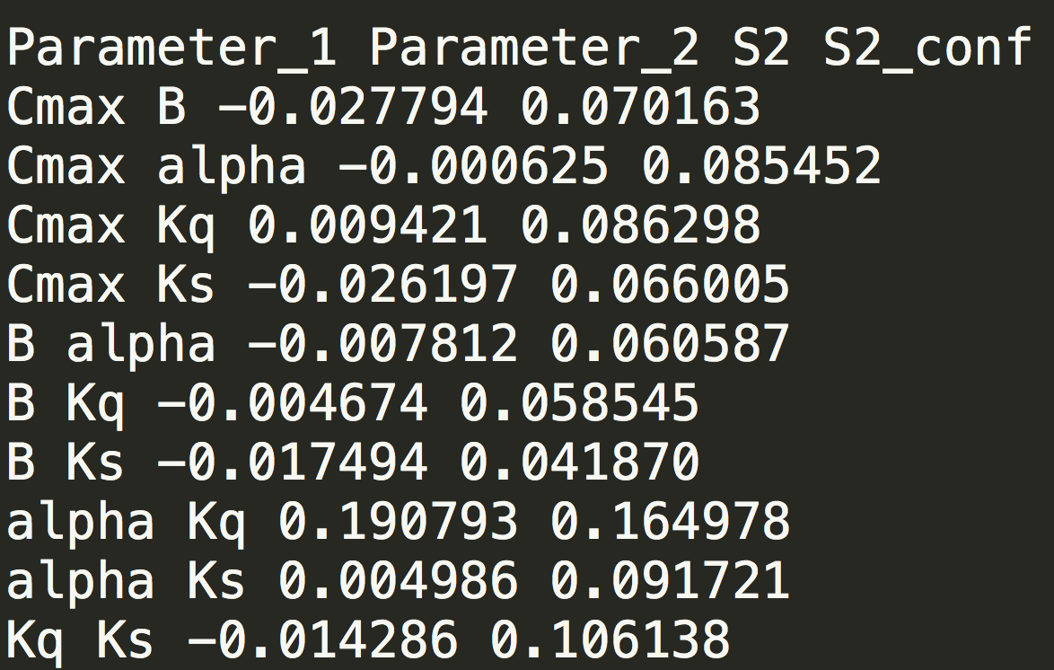

Slide 25
Limitations
These results are specific to the error metric (RMSE vs. some other metric)
Also specific to the time period (precip/temp)
… and, specific to the parameter ranges that were chosen - important for nonlinear models

Slide 26
Considerations for groundwater models
Parameter sensitivity varies across space and time
Model runtime generally long
Screening methods in SALib (Morris, FAST): effective parameter ranking with fewer samples
Surrogate models
Mix of uncertain environmental and human parameters
Implications for interpreting SA results

Slide 27
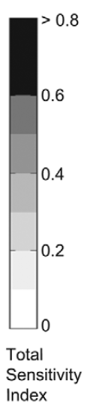
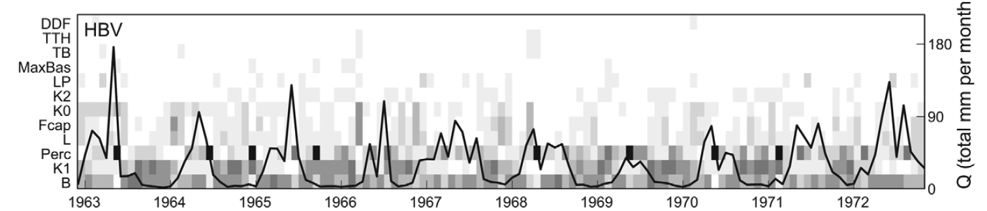
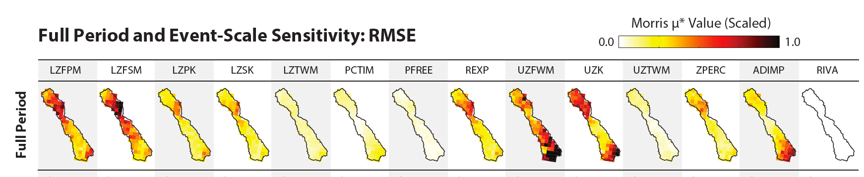
Example results: parameter sensitivity across space/time

Slide 28
Sensitivity analysis: Summary
Analyzing simulation models through input sampling
Which parameters matter most?
Which should we invest in measuring better?
Which ones can we ignore?
Local vs. global SA
3 decoupled steps: sample parameters, run model, analyze results
Sobol method and many others in SALib package

