Slide 1
Sensitivity Analysis with SALib (Python)
GRA Short Course - Jan. 13, 2020
Jon Herman
Assistant Professor, Civil & Environmental Engineering
UC Davis
Materials: https://github.com/jdherman/GRA-2020-SALib

Slide 2
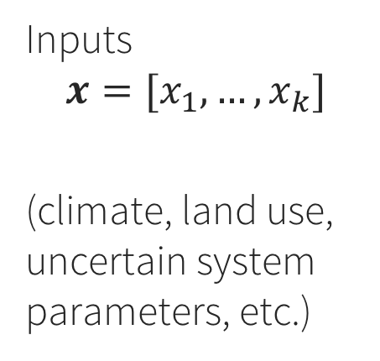
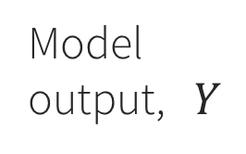
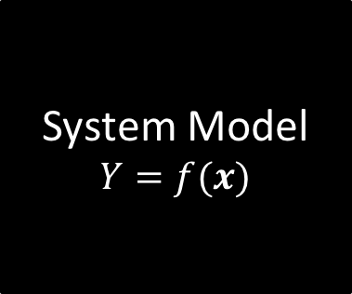
Which uncertain inputs have the most influence on model outputs?
System Model
$$Y=f(x)$$
Model output, $Y$
Inputs
$$x=[x_{1},…,x_{k}]$$
(climate, land use, uncertain system parameters, etc.)

Slide 3
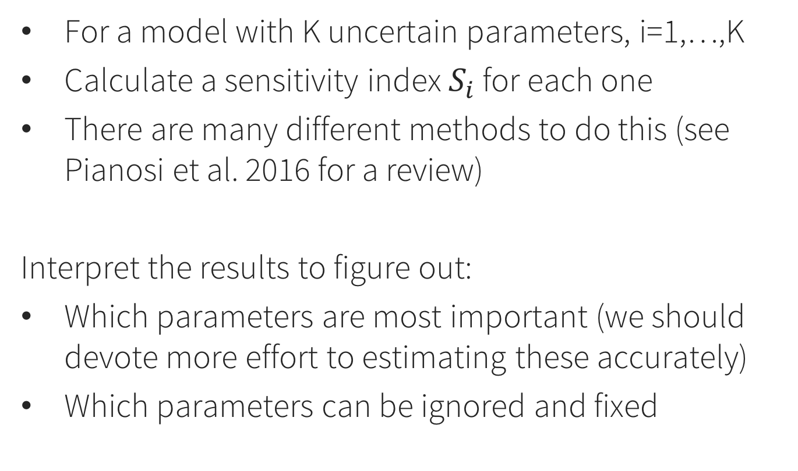
Sensitivity analysis in general
For a model with K uncertain parameters, i=1,…,K
Calculate a sensitivity index $S_{i}$ for each one
There are many different methods to do this (see Pianosi et al. 2016 for a review)
Interpret the results to figure out:
Which parameters are most important (we should devote more effort to estimating these accurately)
Which parameters can be ignored and fixed

Slide 4
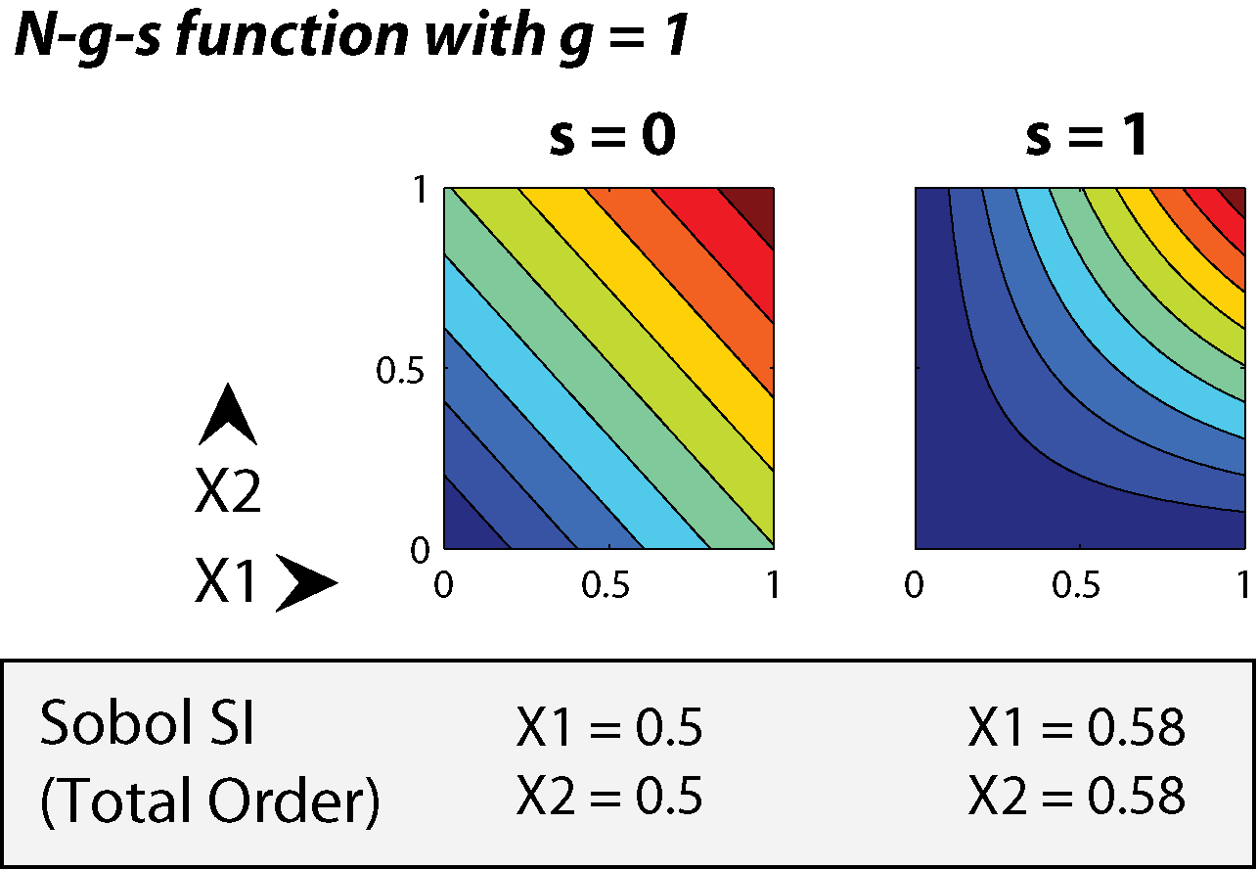
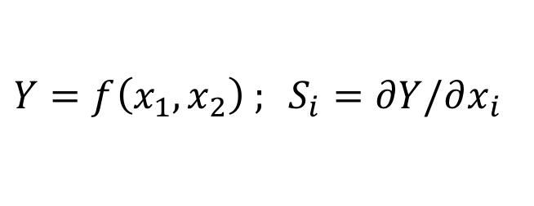
Local SA: Derivatives at a point
$Y=f\left(x_{1},x_{2}\right) ; S_{i}=∂Y/∂x_{i}$
Problem: Which point to use? Misses interactions.

Slide 5
Global SA: Sample throughout the space

Slide 6
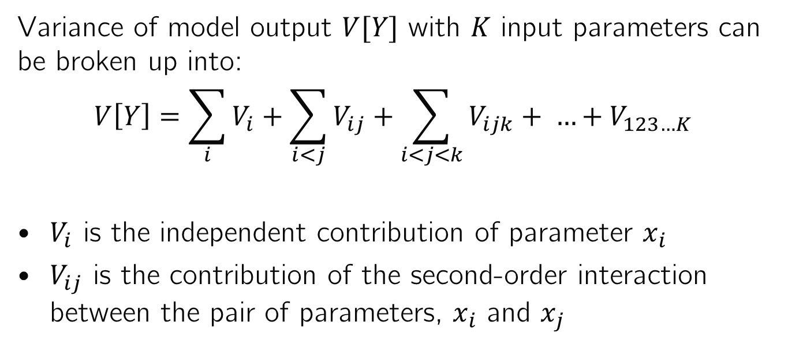
Sobol Variance Decomposition
Variance of model output $V[Y]$ with $K$ input parameters can be broken up into:
$$V\left[Y\right]=\sum_{i}{V_{i}}+\sum_{i<j}{V_{ij}}+\sum_{i<j<k}{V_{ijk}+ …+V_{123…K}}$$
$V_{i}$ is the independent contribution of parameter $x_{i}$
$V_{ij}$ is the contribution of the second-order interaction between the pair of parameters, $x_{i}$ and $x_{j}$
These can be estimated with numerical integration of the global sample
→ Saltelli et al. 2008 “Global SA: The Primer”

Slide 7
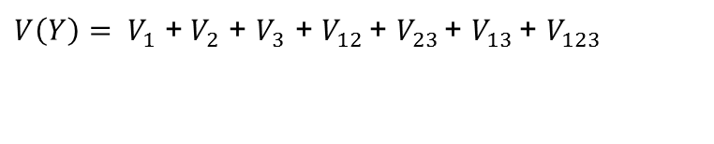
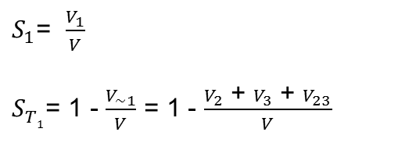
First-order index: the fraction of total variance that a parameter is responsible for by itself
Total-order index: the fraction of total variance that a parameter is responsible for, including interactions with other parameters
For a simple example, with three uncertain parameters:
Total variance:
First order sensitivity index for Parameter 1:
Total order sensitivity index for Parameter 1:

Slide 8
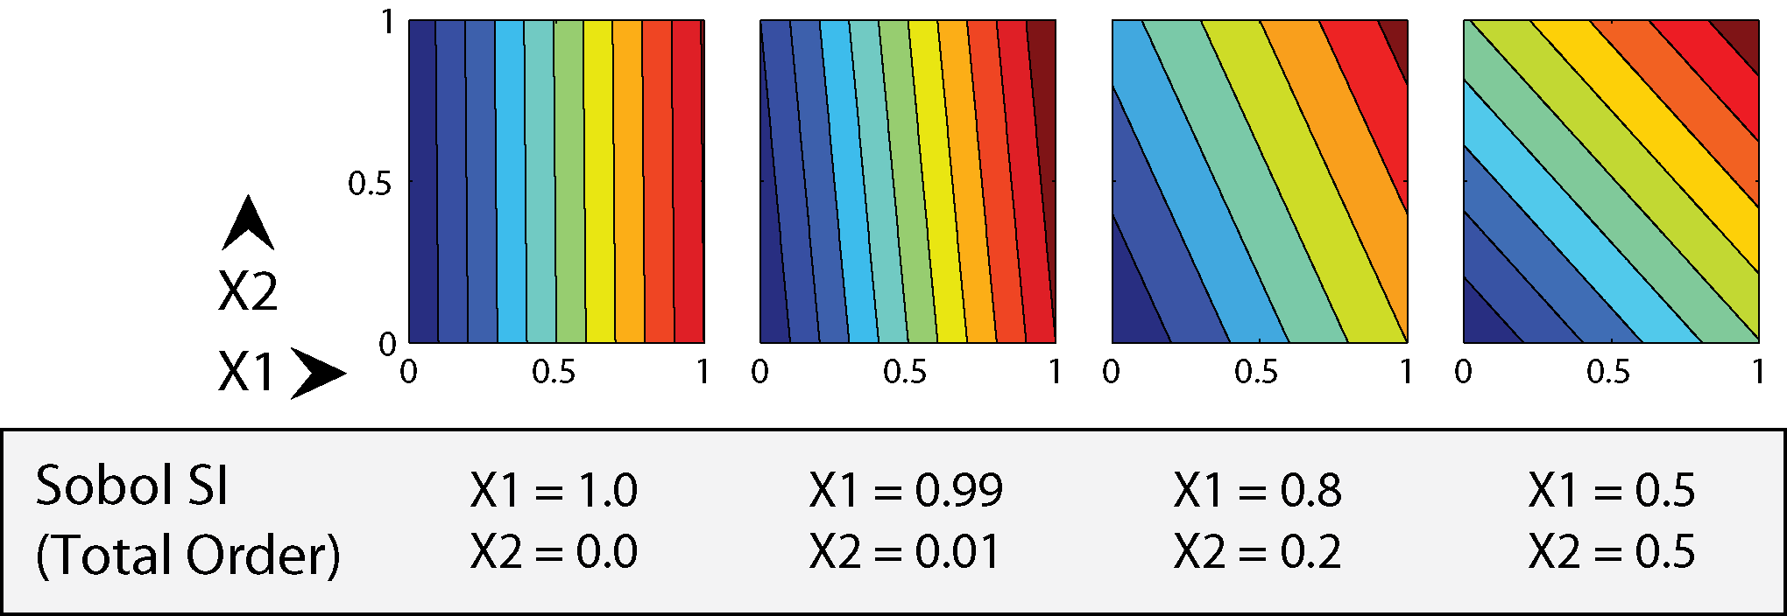
Example Sobol sensitivity indices for linear (separable) functions
No interactions: total-order indices sum to 1

Slide 9
Example Sobol sensitivity indices for separable and non-separable functions
With interactions, sum > 1 because interactions are double-counted

Slide 10
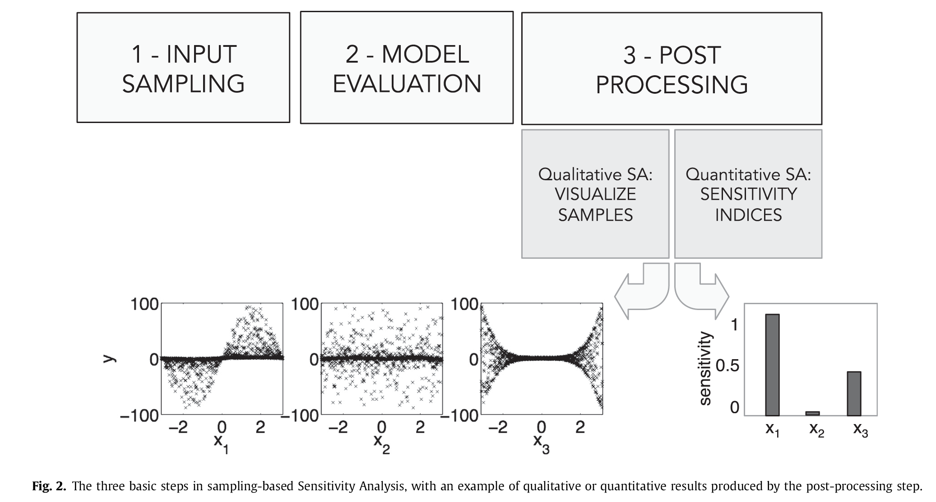
SA: three main steps (Pianosi et al. 2016)

Slide 11
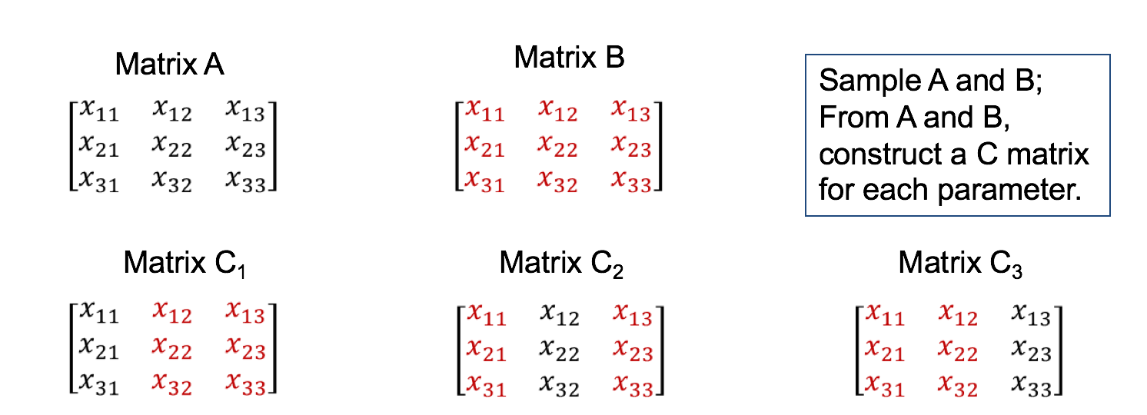
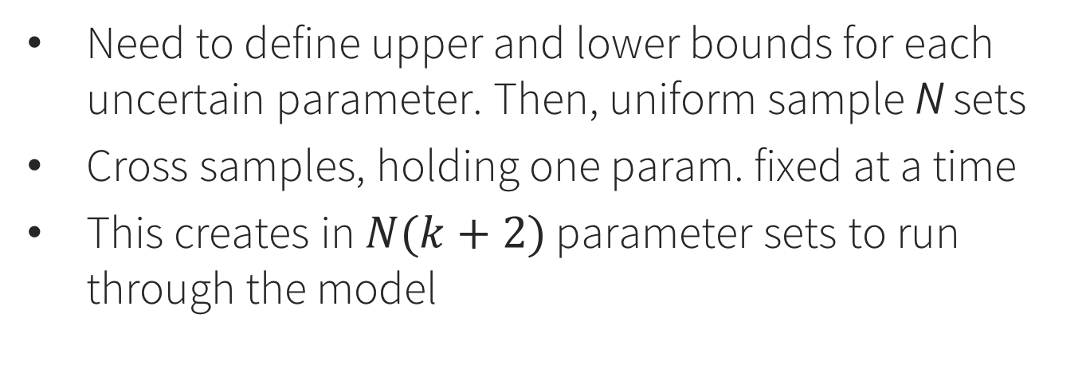
Step 1: Sample parameters (Sobol method)
Need to define upper and lower bounds for each uncertain parameter. Then, uniform sample N sets
Cross samples, holding one param. fixed at a time
This creates in $N(k+2)$ parameter sets to run through the model

Slide 12
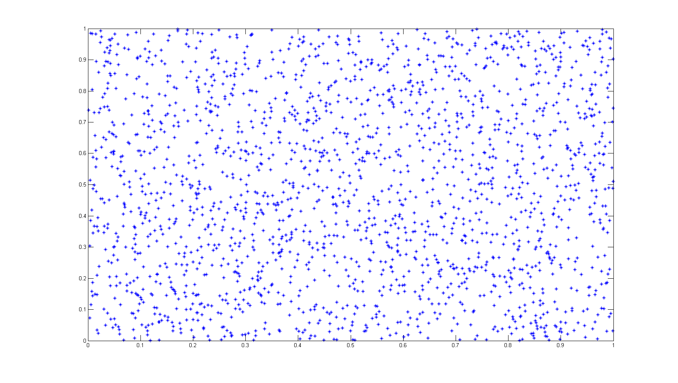
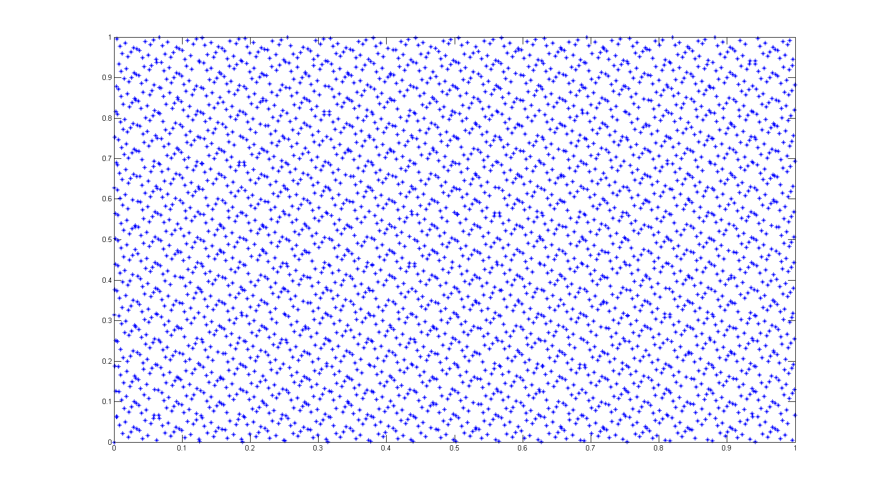
Uniform Random Monte Carlo Sampling vs. Sobol Sequence Sampling (“quasi-random”)
Error Growth Rate
for estimating variance

Slide 13
Step 2: Run model for all samples in the matrices A, B, and C. Save the output Y.
This step is user-specific and decoupled from everything else. Could even be in a different language, or using a GUI. Just save the output.

Slide 14
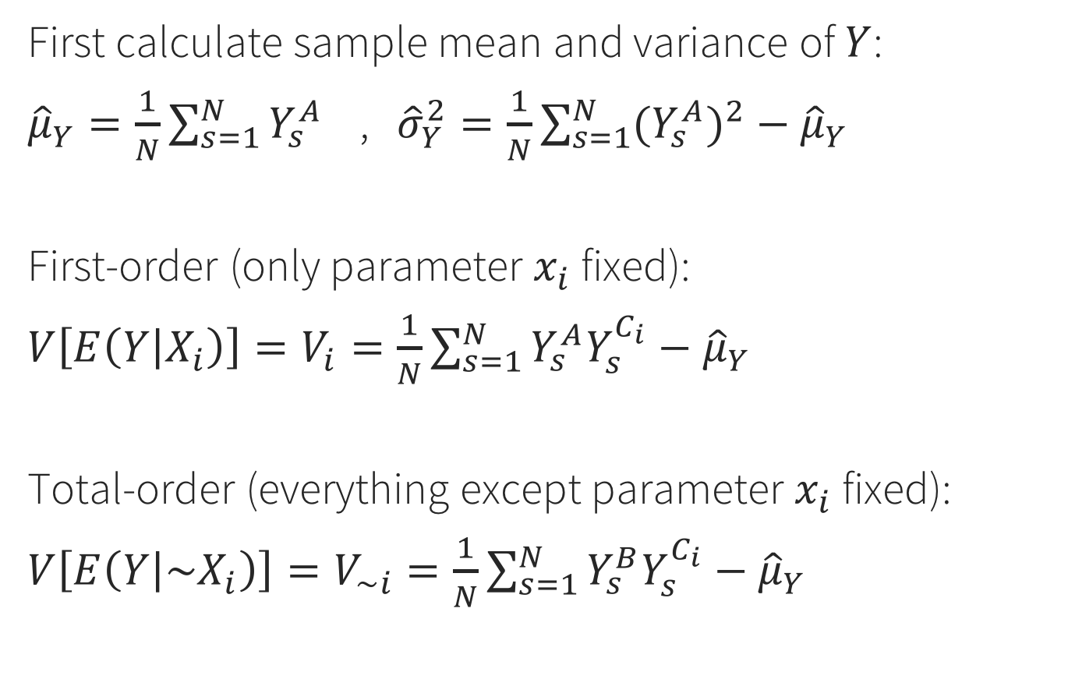
Step 3: Use the model output Y to estimate conditional variances
First calculate sample mean and variance of $Y$:
${\hat{μ}}_{Y}=\frac{1}{N}\sum_{s=1}^{N}{Y_{s}^{A}}$ , ${\hat{σ}}_{Y}^{2}=\frac{1}{N}\sum_{s=1}^{N}{{{(Y}_{s}^{A})}^{2}}−{\hat{μ}}_{Y}$
First-order (only parameter $x_{i}$ fixed):
$V\left[E\left(Y | X_{i}\right)\right]=V_{i}=\frac{1}{N}\sum_{s=1}^{N}{Y_{s}^{A}Y_{s}^{C_{i}}}−{\hat{μ}}_{Y}$
Total-order (everything except parameter $x_{i}$ fixed):
$V\left[E\left(Y | {\sim X}_{i}\right)\right]=V_{\sim i}=\frac{1}{N}\sum_{s=1}^{N}{Y_{s}^{B}Y_{s}^{C_{i}}}−{\hat{μ}}_{Y}$

Slide 15
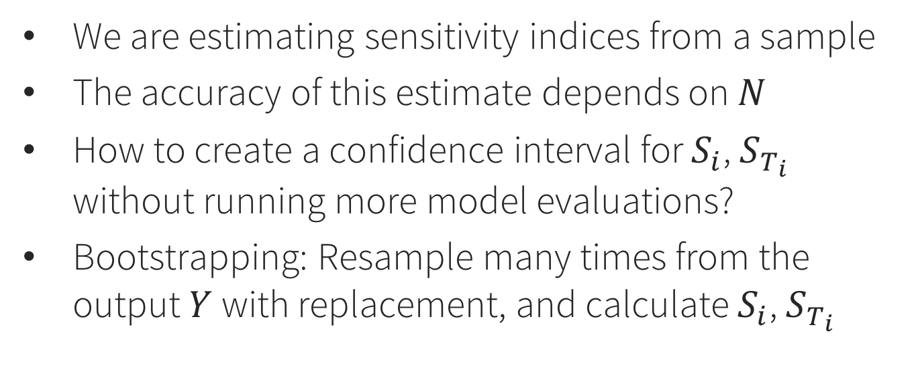
Bootstrapping
We are estimating sensitivity indices from a sample
The accuracy of this estimate depends on $N$
How to create a confidence interval for $S_{i}$, $S_{T_{i}}$ without running more model evaluations?
Bootstrapping: Resample many times from the output $Y$with replacement, and calculate $S_{i}$, $S_{T_{i}}$
http://www.statisticshowto.com/bootstrap-sample/

Slide 16

Sensitivity Analysis Library (SALib)
Library: https://github.com/SALib/SALib
Installation: pip install SALib
Requirements: Python, NumPy, SciPy
https://www.continuum.io/downloads

Slide 17
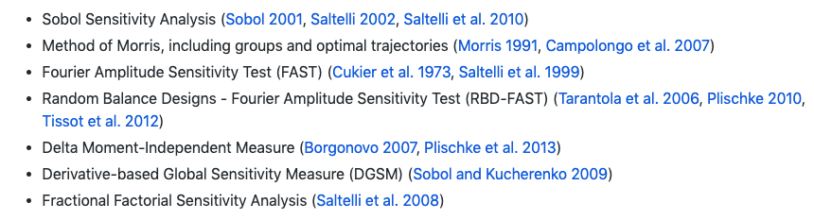
Methods included in SALib
We’ll focus on Sobol, but the examples/ folder on Github contains all of these

Slide 18
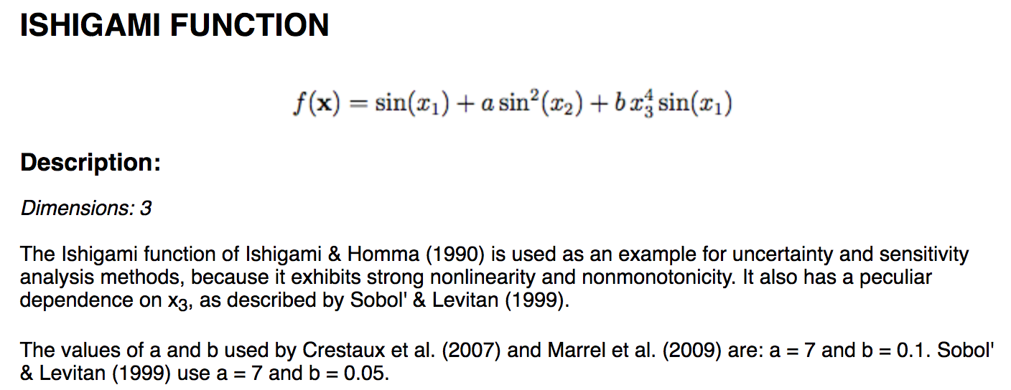
Example: Ishigami function
This is a test function used for SA method benchmarking, because we know what the answer should be.

Slide 19
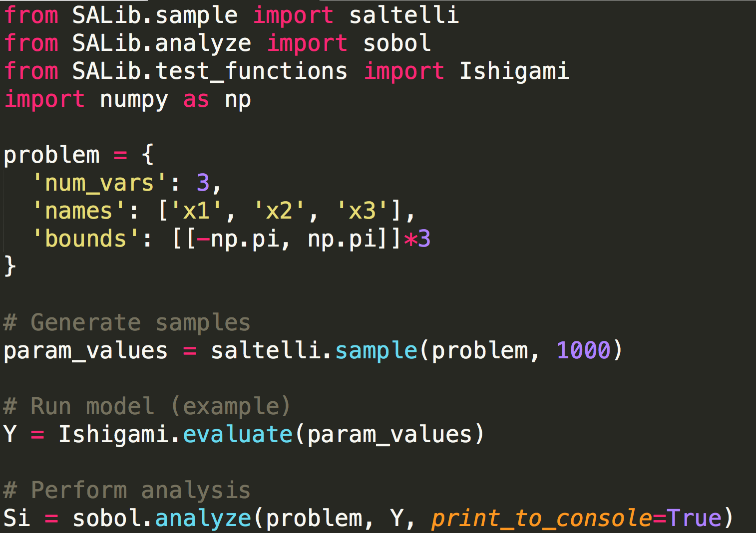
Example
First “pip install SALib” on the command line. Then:

Slide 20
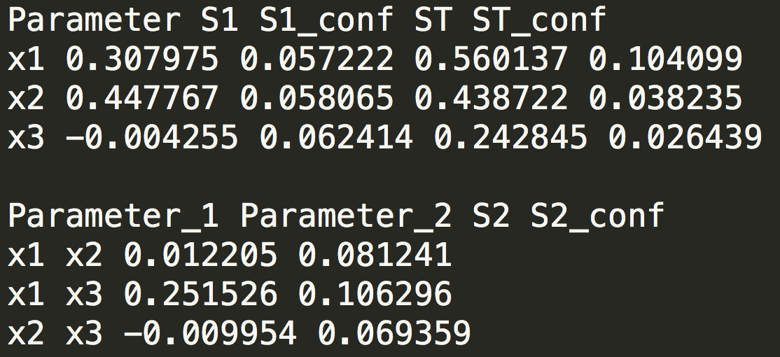
Results: reading the tea leaves
X1 and X3 interact (second-order)
This is reflected in the difference between their respective first- and total-order indices
Confidence intervals should shrink as N increases
Negative values are not possible – they are zero.

Slide 21
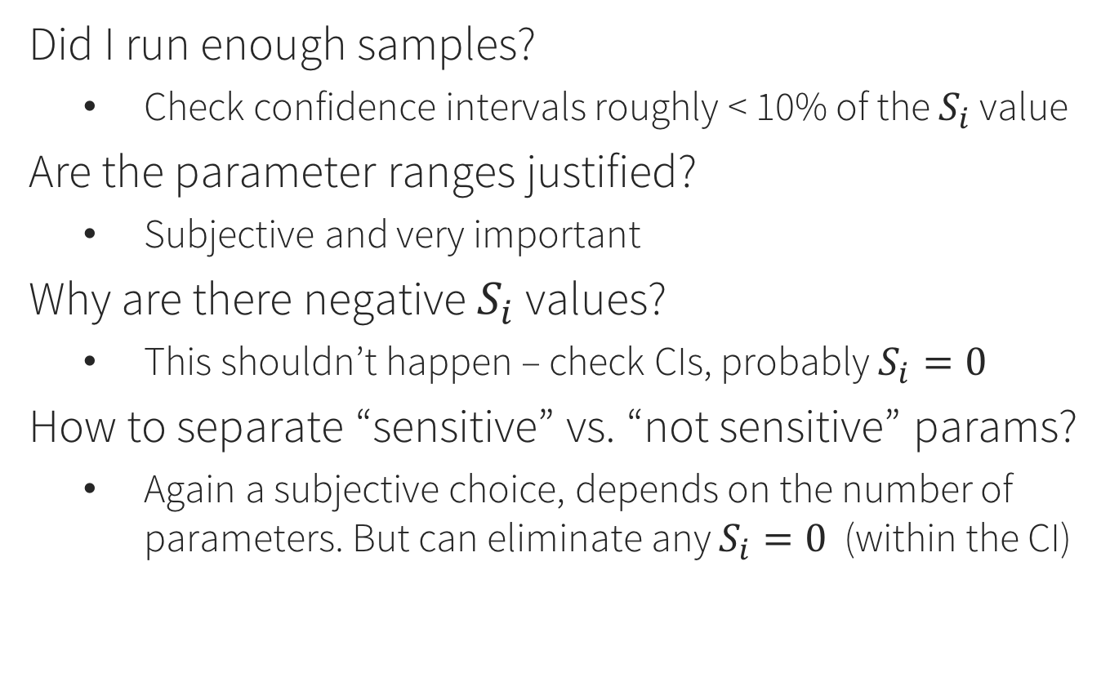
Frequently asked questions
Did I run enough samples?
Check confidence intervals roughly < 10% of the $S_{i}$ value
Are the parameter ranges justified?
Subjective and very important
Why are there negative $S_{i}$ values?
This shouldn’t happen – check CIs, probably $S_{i}=0$
How to separate “sensitive” vs. “not sensitive” params?
Again a subjective choice, depends on the number of parameters. But can eliminate any $S_{i}=0$ (within the CI)

Slide 22
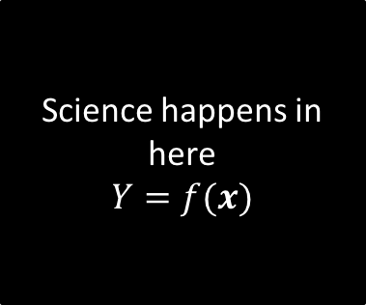
Example: rainfall-runoff model
Important questions:
Which model output should we use?
What are the input parameter ranges?
Do any of them vary over orders of magnitude? (if so, consider sampling in log space)
Science happens in here
$$Y=f(x)$$
Uncertain parameters (6 of them, see code)
Model output, $Y$

Slide 23
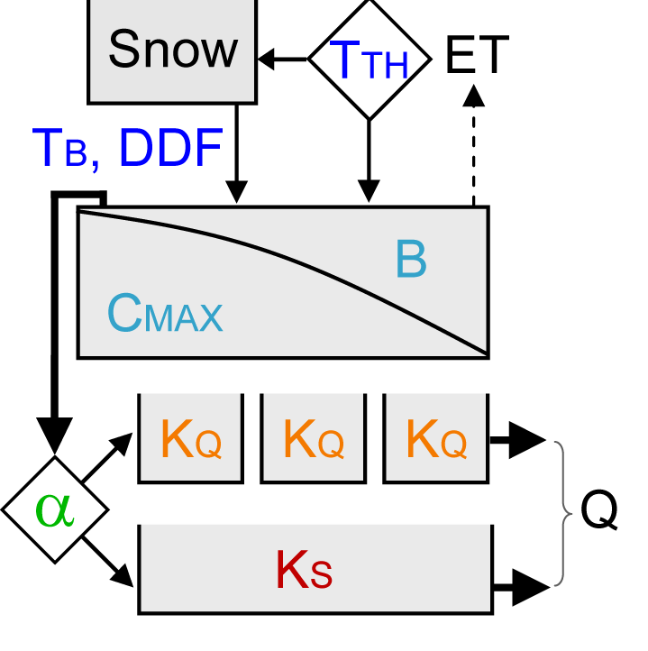
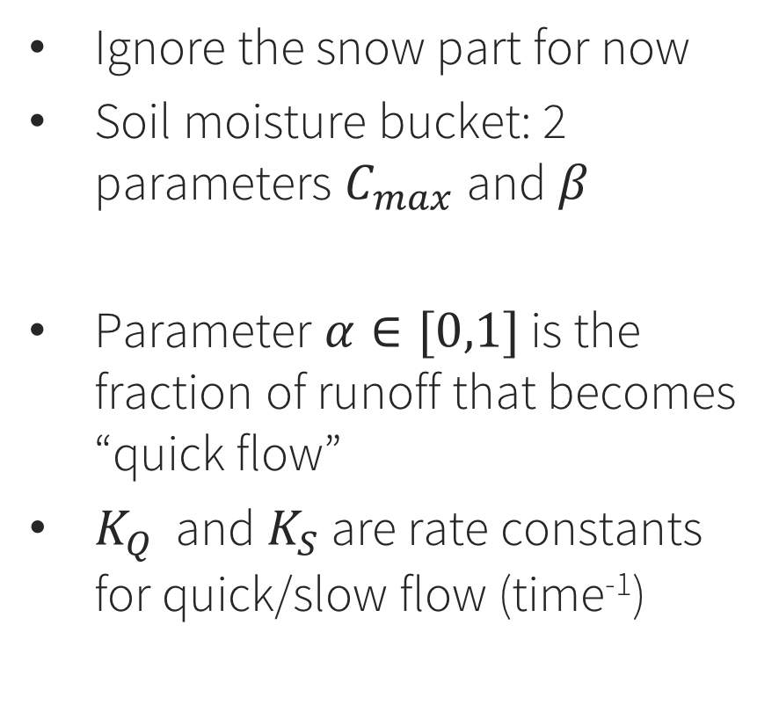
HyMod rainfall-runoff model (Moore 1985)
Ignore the snow part for now
Soil moisture bucket: 2 parameters $C_{max}$ and $β$
Parameter $α∈[0,1]$ is the fraction of runoff that becomes “quick flow”
$K_{Q}$ and $K_{S}$ are rate constants for quick/slow flow (time⁻¹)

Slide 24
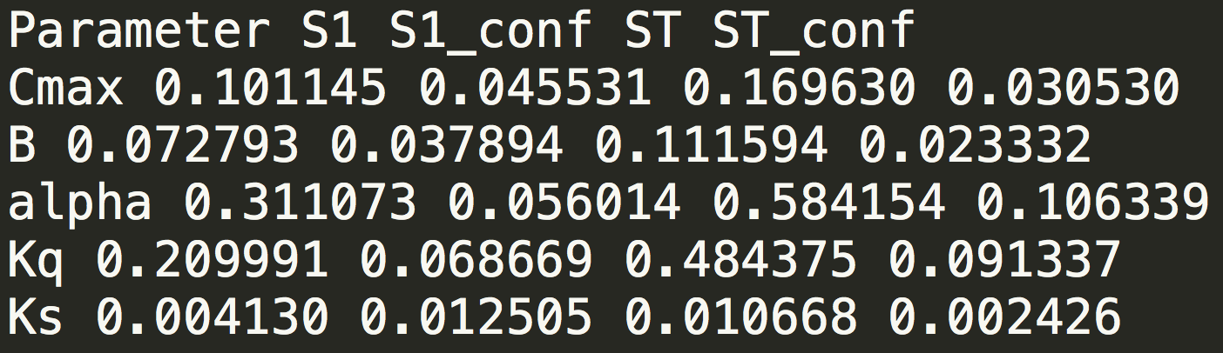
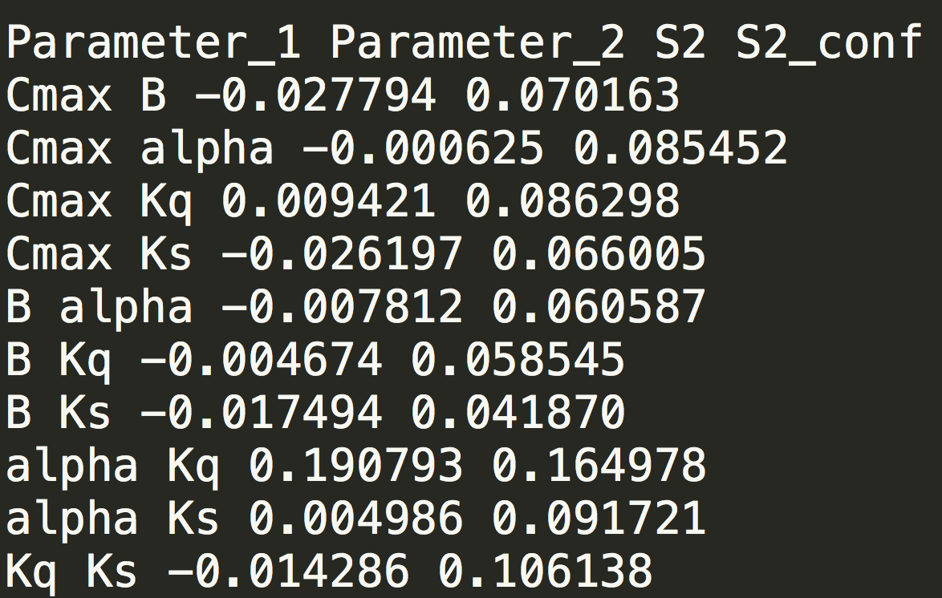

Slide 25
Limitations
These results are specific to the error metric (RMSE vs. some other metric)
Also specific to the time period (precip/temp)
… and, specific to the parameter ranges that were chosen - very important for nonlinear models

Slide 26
Considerations for groundwater models
Parameter sensitivity varies across space and time
Model runtime generally long
Screening methods in SALib (Morris, FAST): effective parameter ranking with fewer samples
Surrogate models
Mix of uncertain environmental and human parameters
Implications for interpreting SA results

Slide 27
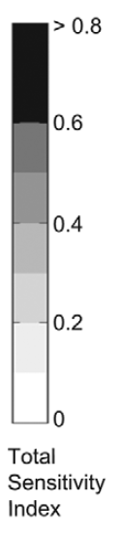
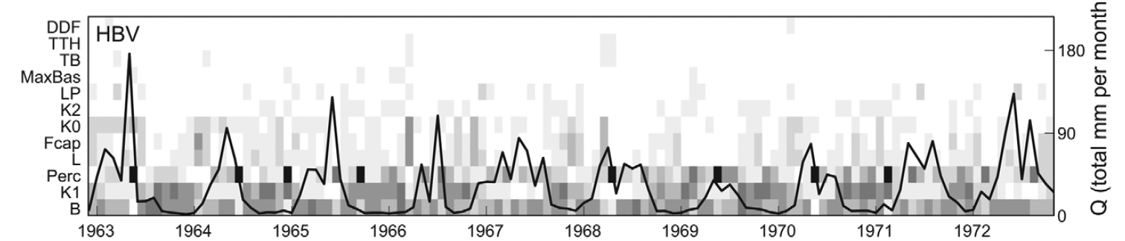
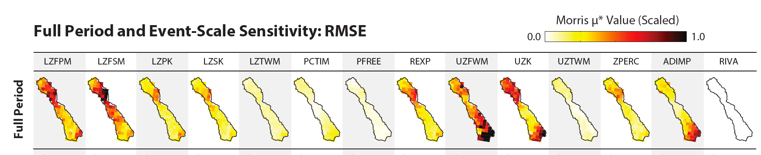
Example results: parameter sensitivity across space/time

Slide 28
Sensitivity analysis: Summary
A way of analyzing simulation models as a black box
Which parameters matter most?
Which should we invest in measuring better?
Which ones can we ignore?
Local vs. global SA
3 decoupled steps: sample parameters, run model, analyze results

