Slide 1
Reservoir model
Jan. 2018

Slide 2
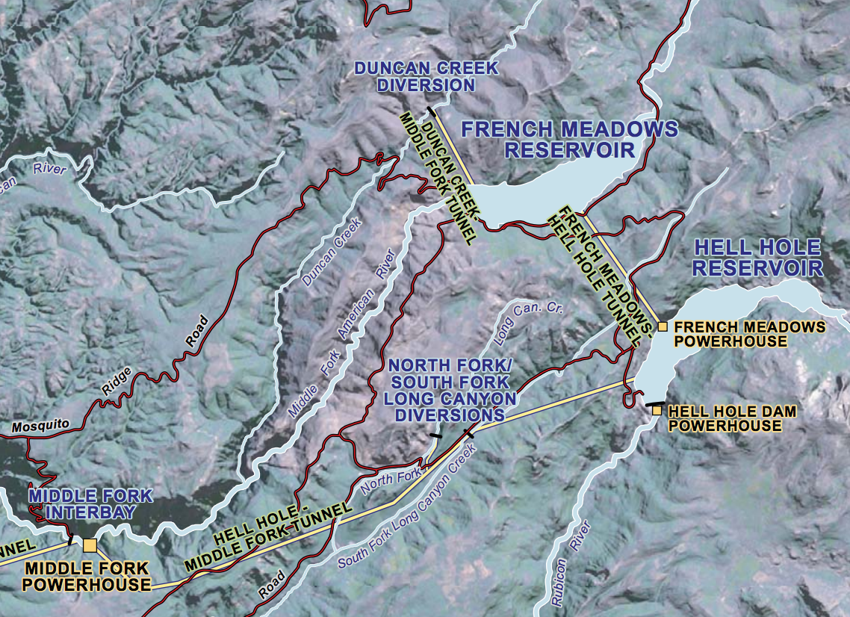
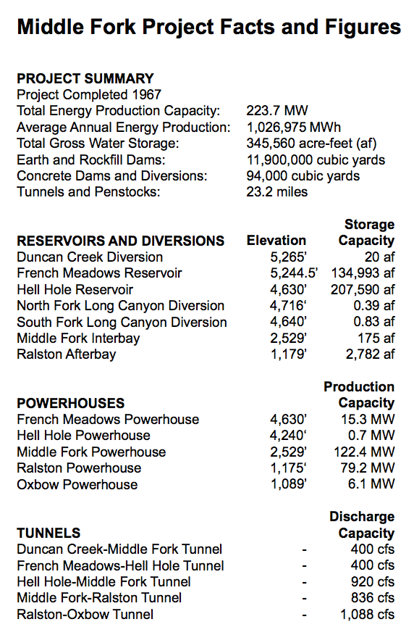
Simplified 2-reservoir model (image/data from PCWA)

Slide 3
Duncan Creek Diversion
French Meadows Reservoir
136.4 TAF
Middle Fork American River
Environmental flow requirements
French Meadows Powerhouse
15.3 MW
Hell Hole Reservoir
207.6 TAF
Rubicon River
Middle Fork Powerhouse
122.4 MW
Environmental flow requirements

Slide 4
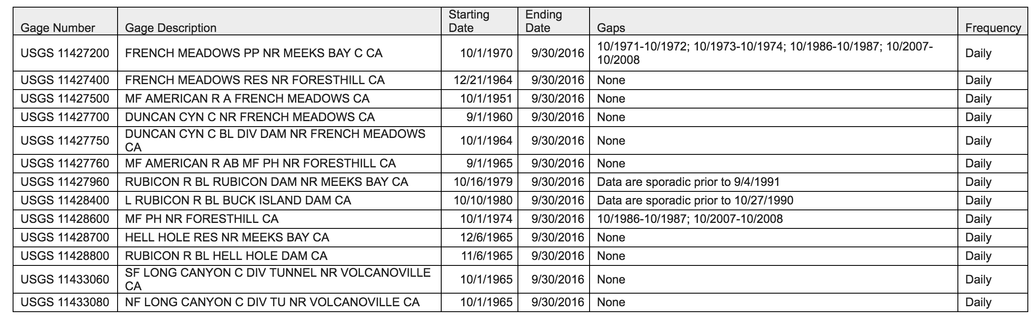
Daily flow data from USGS
Only French Meadows inflow is changed by the hydrologic modeling
Model period 10/1/1980 – 9/30/2015
Model assumes env. flows met first
Then, hydropower production is calculated using a linear storage-elevation curve

Slide 5
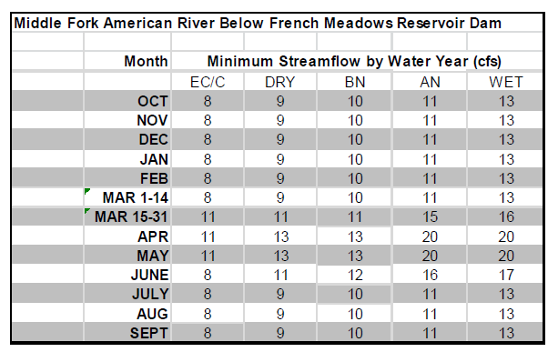
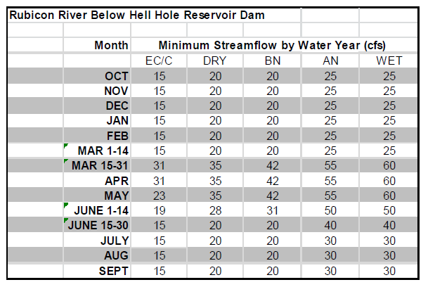
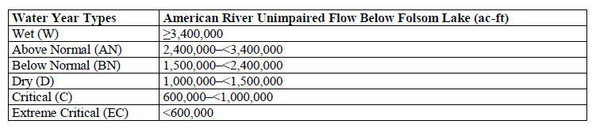
Year-round instream flow requirements

Slide 6
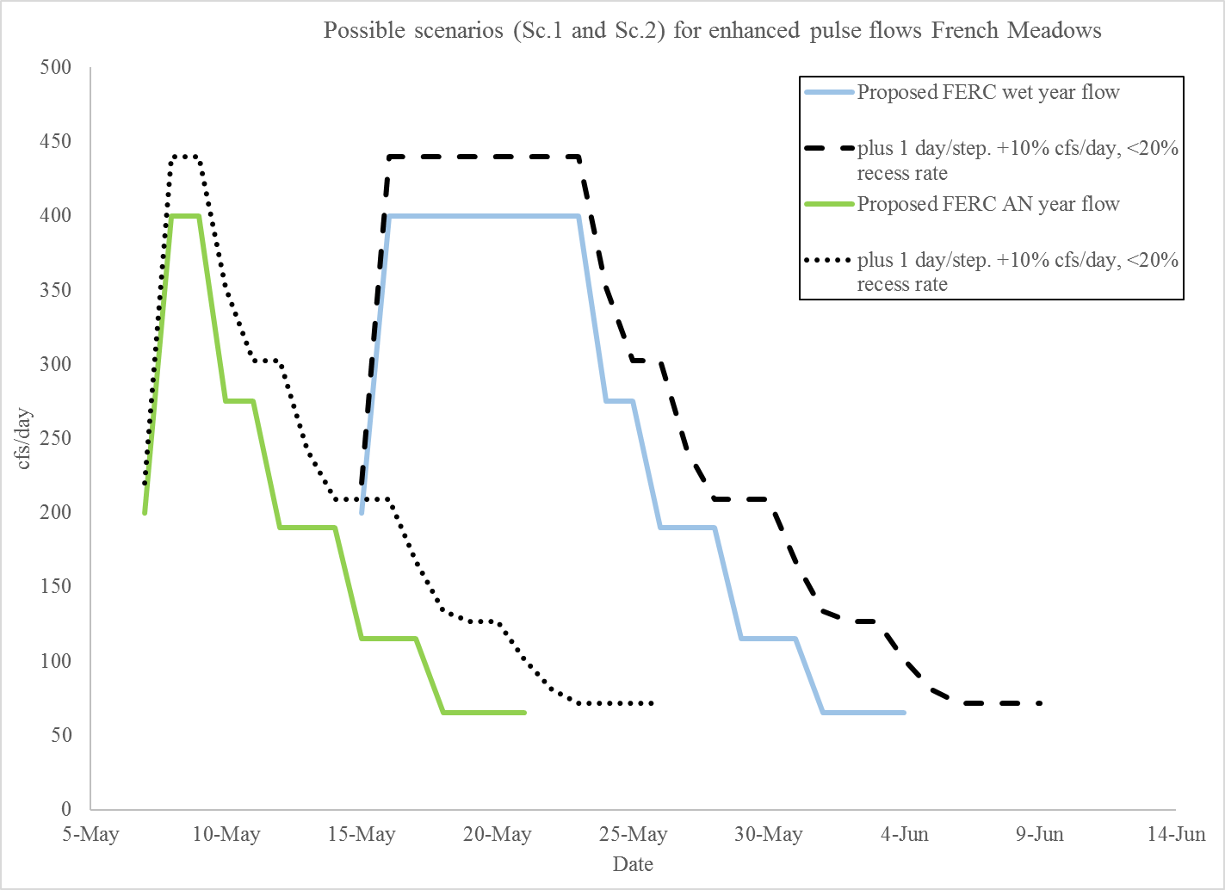
Pulse flow requirements
Second, add pulse flows. 4 scenarios:
No pulse (only instream flows)
FERC proposed (“FERC”)
+1 day/step, +10% cfs/day (“increase”)
Same, plus a <20% restriction on rampdown (“increase_rampdown”)
Only apply to W/AN year types

Slide 7
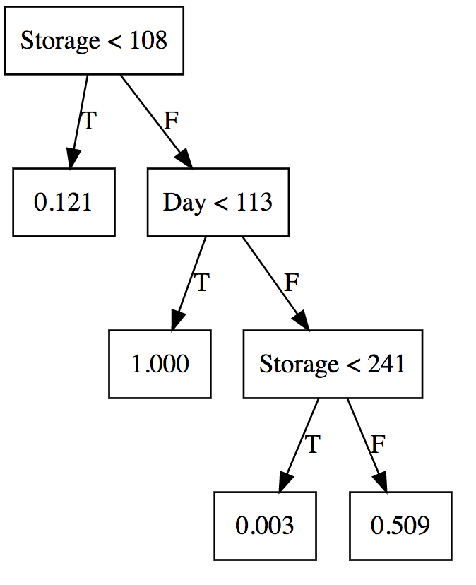
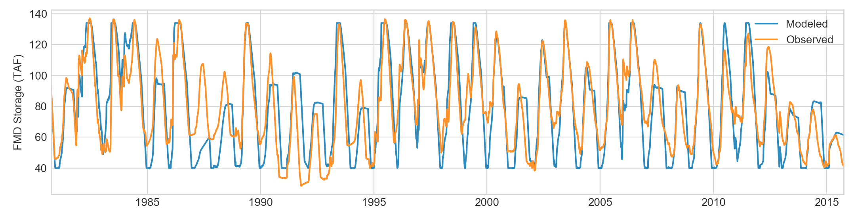
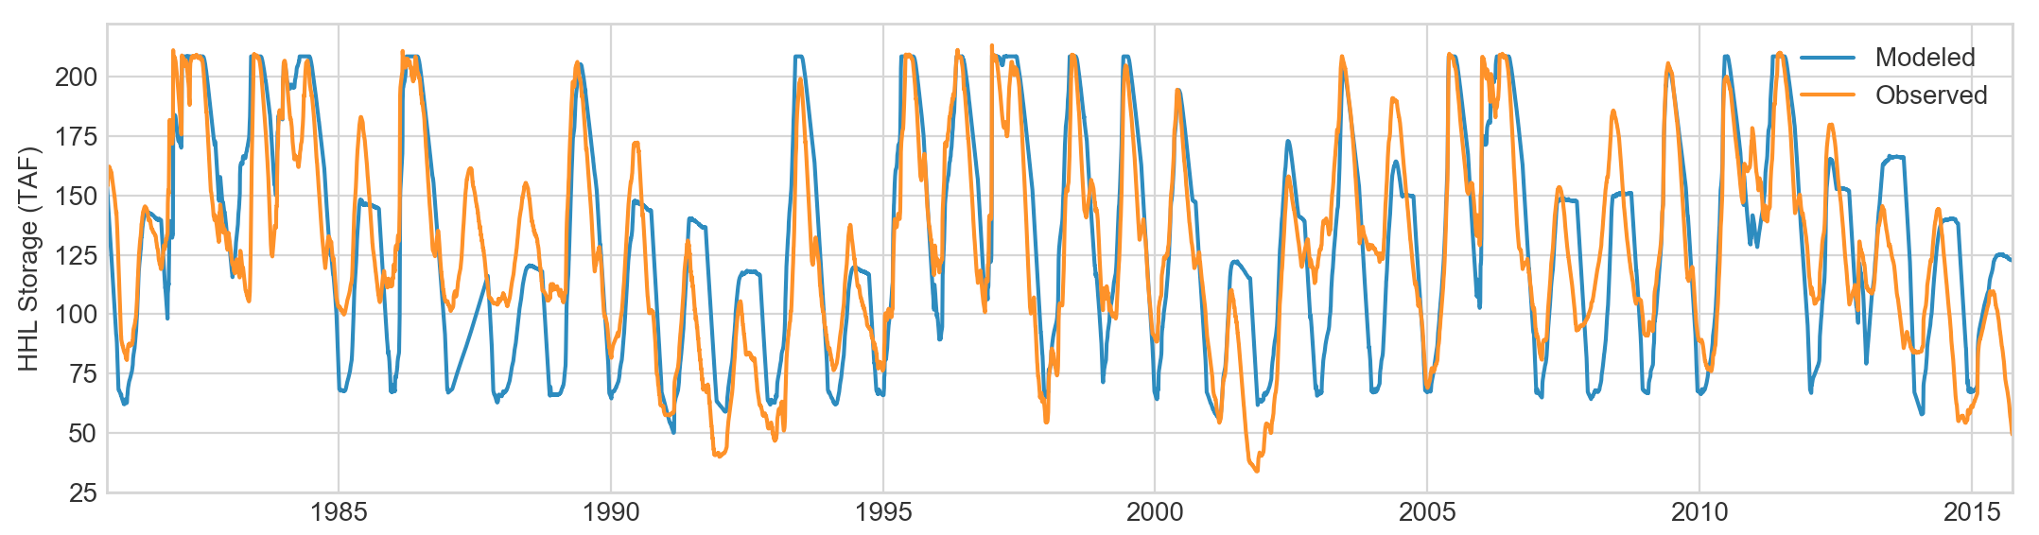
Fitting the historical release policy
To run other scenarios, we first have to represent the hydropower release policy
Approximated from observed historical data, assuming a set of “if-then” rules based on storage and day of the year

Slide 8
Two experiments:
How much hydropower is generated under different hydrologic scenarios, if the release policy stays the same?
What if the release policies are re-optimized to each hydrologic scenario?

Slide 9
