Slide 1
10.6%
churn rate
Reducing New-Customer Churn
A Data-Driven Retention Strategy
CAPSTONE BUSINESS ANALYSIS · 500-CUSTOMER RELATIONSHIP DATASET

Slide 2
The Business Problem
Every churned customer is lost recurring revenue plus a wasted acquisition cost.
The business needs to know: who is at risk, why, and what to do about it.
This analysis was built around four objectives:
  Identify statistically-validated churn drivers
  Build a model that flags at-risk customers early
  Segment customers to target retention spend
  Deliver a concrete implementation plan
10.6%
of customers
churn
53 of 500 customers lost
2

Slide 3
Our Approach: A 5-Phase Methodology
1
→
2
→
3
→
4
→
5
Plan
Prepare
Explore
Analyze
Recommend
Define problem
& success metrics
Collect, clean,
validate data
Comprehensive
EDA & visuals
Hypothesis tests,
model, segments
Insights & action
plan
3

Slide 4
Dataset Selection & Data Quality
Dataset | Rows | Selected?
sales_data.csv | 100 | No — below 500-row minimum
house_prices.csv | 300 | No — below 500-row minimum
customer_churn.csv | 500 | Yes
Data Quality Checks Passed
0 missing values across all 500 rows
0 duplicate rows, 0 duplicate customer IDs
No implausible numeric ranges (Tenure, charges)
Consistent categorical labels (Contract, Payment)
customer_churn.csv is the only dataset meeting the assignment's 500-row minimum, and it's the strongest fit for a retention-focused business problem.
4

Slide 5
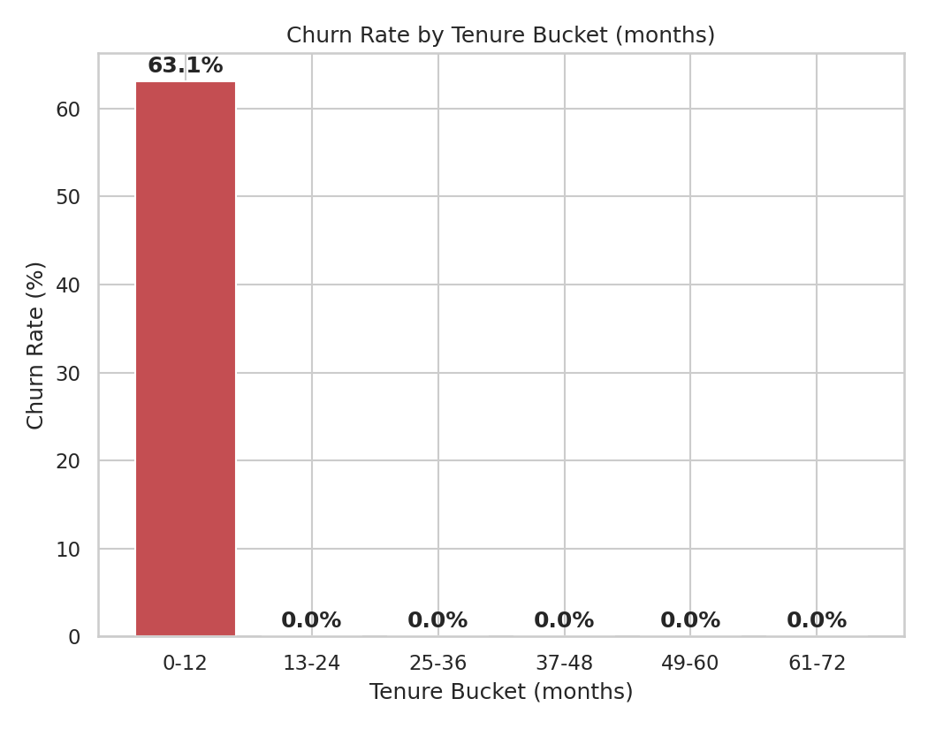
THE HEADLINE FINDING
100% of churn happens
in the first 11 months.
Churn rate for customers under 12 months of tenure: 63%.
Churn rate for everyone else: 0%.
This reframes the whole problem: it isn't general churn prediction — it's first-year retention.
5

Slide 6
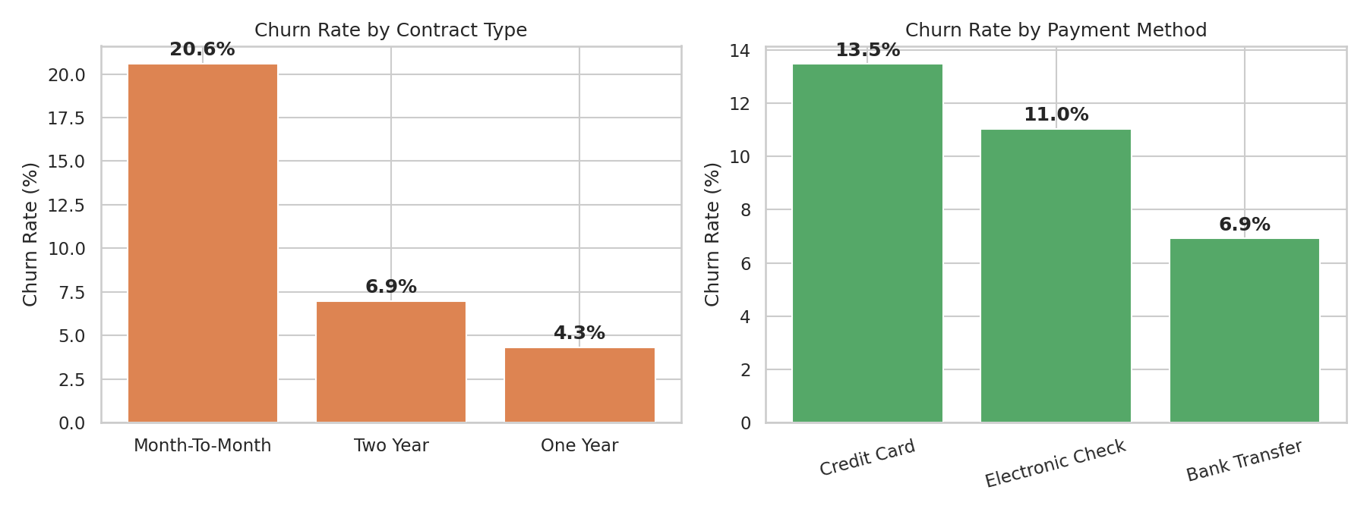
What Drives Churn: Contract & Payment
Month-to-month customers churn far more than annual-contract customers. Payment method shows some raw variation but is not statistically significant (Slide 7).
6

Slide 7
Statistical Validation: 5 Hypothesis Tests
Test | p-value | Result
Contract type vs Churn (Chi-square) | < 0.001 | Significant
Tenure: Churned vs Retained (t-test) | < 0.001 | Significant
MonthlyCharges: Churned vs Retained (t-test) | 0.010 | Significant
Payment method vs Churn (Chi-square) | 0.145 | Not significant
Senior citizen status vs Churn (Chi-square) | 0.795 | Not significant
Reporting non-significant results matters too: honest science means not overstating what the data supports.
7

Slide 8
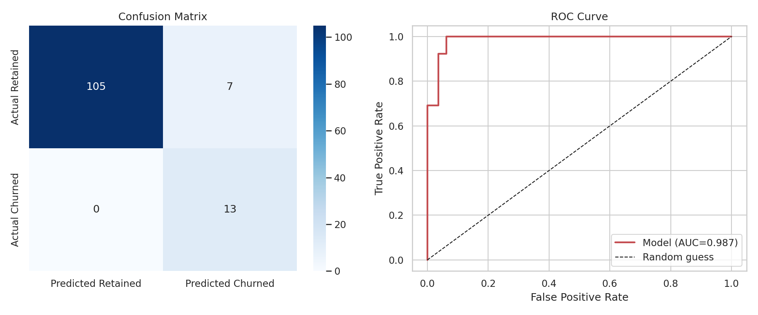
Predictive Model: Flagging At-Risk Customers
100%
Recall
65%
Precision
0.987
ROC AUC
8

Slide 9
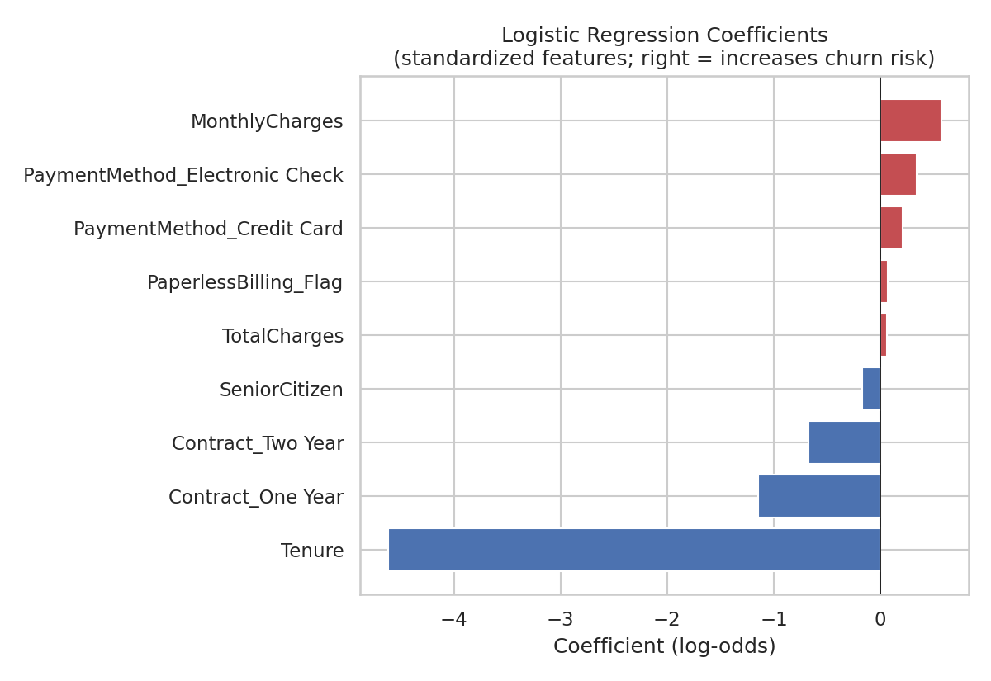
What the Model Learned
Tenure has by far the largest effect — more tenure strongly reduces churn odds.
One- and two-year contracts reduce churn odds vs. month-to-month.
Higher monthly charges and Electronic Check payment slightly raise churn odds.
9

Slide 10
A Critical Check: Do We Need the Full Model?
100% of churners have Tenure ≤ 11 months. Before trusting a 9-feature model, we tested the simplest possible alternative.
Logistic Regression (9 features)
Simple Rule: “Tenure < 12 months”
Recall: 100%
Precision: 65%
ROC AUC: 0.987
Needs training, scaling, monitoring
Recall: 100%
Precision: 64%
Accuracy: 94%
Ships today — zero infrastructure
Recommendation: ship the simple rule immediately; keep the fuller model as a secondary risk-ranking layer.
10

Slide 11
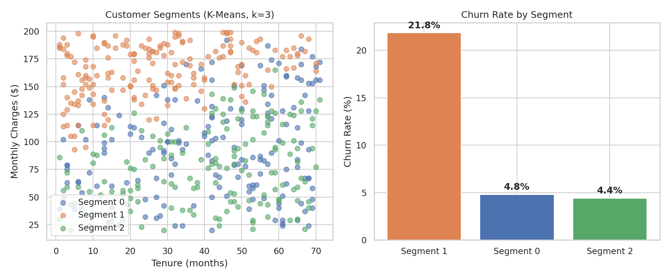
Customer Segmentation: Where to Focus
21.8%
churn in the
high-risk segment
vs. ~4.5% in the other two segments
11

Slide 12
Implementation Plan
Phase | Action | Owner | Success Metric
1 (Wks 1-2) | Deploy “Tenure<12mo” flag in CRM | Retention Ops | 100% flagged in week 1
2 (Wks 3-6) | Incentivize annual-contract switch | Marketing | Conversion rate
3 (Wks 5-10) | Dedicated onboarding for high-risk segment | Customer Success | New cohort churn vs. 22%
4 (Ongoing) | Retrain model quarterly | Data/Analytics | Recall ≥ 0.90 each refresh
Overall success metric: reduce the 0-12-month cohort's churn rate from 63% toward parity with the rest of the base within two quarters.
12

Slide 13
From Insight to Action
A one-line rule ships this week. A validated model and a targeted segmentation strategy are ready to scale retention efforts beyond it.
Full methodology: capstone_analysis.ipynb · Technical Report: reports/technical_report.pdf

