Slide 1
Your session title / Your name
Notes:
Slide 0: this slide will not automatically turned over. Show this BEFORE the acutal presentation starts.

Slide 2







Finding App Permissions in the Entra Maze
Senior Cloud Architect at Isolutions
25 Years of Experience in IT
Microsoft Cloud / Messaging / Communication / Identity / Security / PowerShell
MVP: Microsoft 365 / PowerShell
Meetup: Swiss PowerShell User Group / M365 Community Switzerland
https://blog.icewolf.ch
Andres Bohren
https://twitter.com/andresbohren / @andresbohren
https://www.linkedin.com/in/andres-bohren/
https://github.com/BohrenAn
https://isolutions.ch
1 / 20
Notes:
Finding App Permissions in the Entra Maze

Slide 3





EXO Application Access Policy
In 2020 the Exchange Team came up with Application Access Policies
Entra Application
Mail.ReadWrite
Mail.Send
Exchange Online
Mailboxes
ServicePrincipal in EXO
Filter:
Distribution Group Member
2 / 20
Notes:
SMTP.SendAsApp
Mail.Read
Mail.ReadBasic
Mail.ReadWrite
Mail.Send
MailboxSettings.Read
MailboxSettings.ReadWrite
MailboxFolder.Read
MailboxFolder.ReadWrite
MailboxItem.Read
MailboxItem.ImportExport
Calendars.Read
Calendars.ReadWrite
Contacts.Read
Contacts.ReadWrite
Mail Full Access
Exchange Full Access
EWS.AccessAsApp

Slide 4
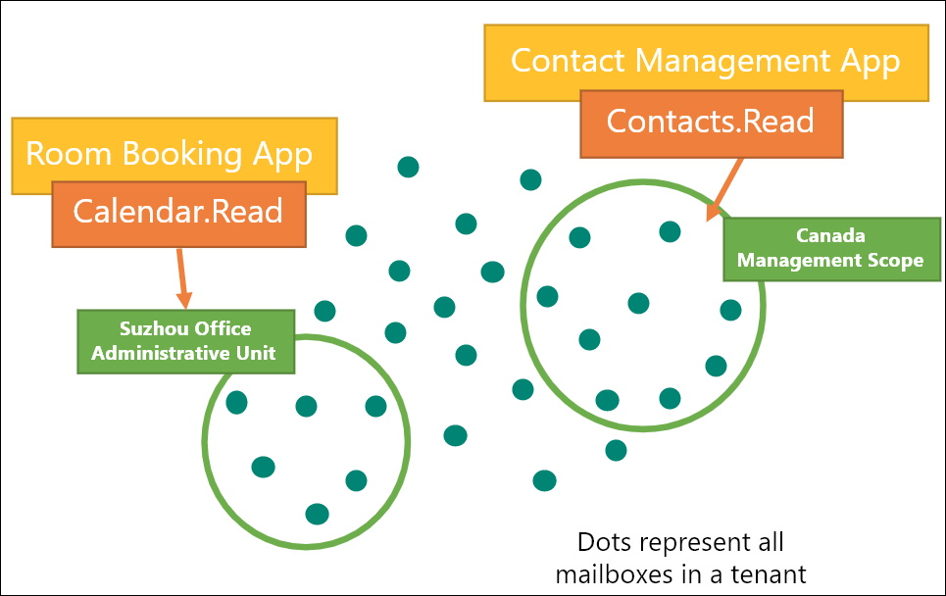
EXO RBAC for Applications
In 2023 the Exchange Team announced RBAC for Applications
The Entra Application has no Permissions – Everything is handled in EXO RBAC
3 / 20

Slide 5
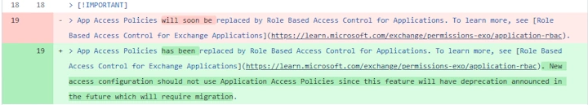
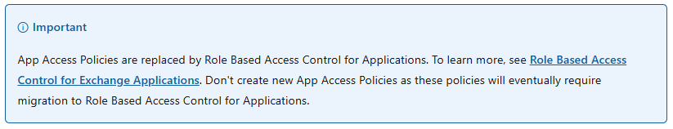
Move to RBAC for Applications
In August 2025 the Recommendation has changed, and you should move to RBAC for Applications in Exchange Online
4 / 20

Slide 6
Export Application Access Policies
On paper, it’s simple:
Get the ApplicationAccessPolicies, get the Apps, get the permissions of an app, get the Distribution Group and export it
Here starts the Journey to
Finding App Permissions in the Entra Maze
5 / 20

Slide 7
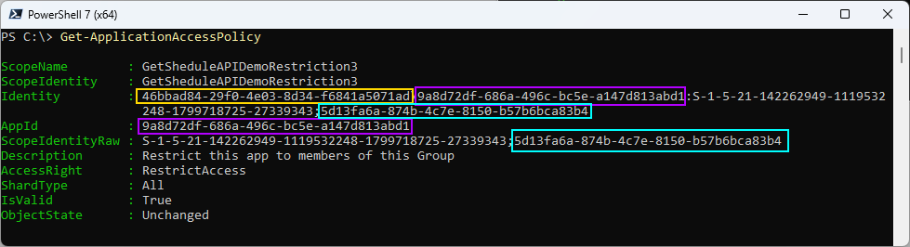
Get-ApplicationAccessPolicy
TenantID (yellow)
AppId (purple)
GroupObjectID (cyan)
6 / 20

Slide 8
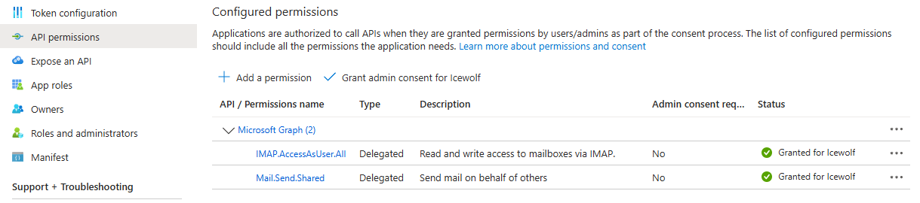
Application Permissions
Entra Portal shows us the API Permissions
ProTip: You should not mix Application and Delegated Permissions
7 / 20

Slide 9
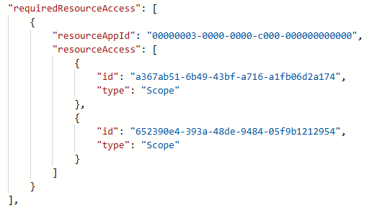
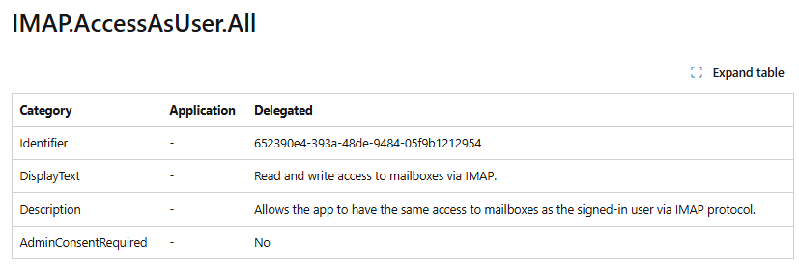
Application Manifest
Graph
Permissions-reference
8 / 20

Slide 10
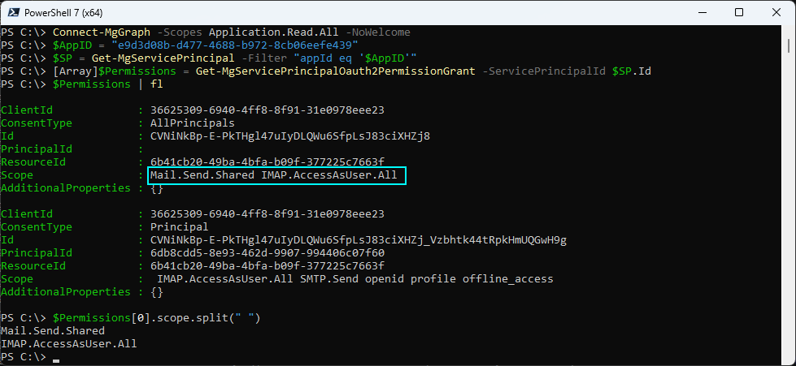
Delegated Permissions
9 / 20

Slide 11
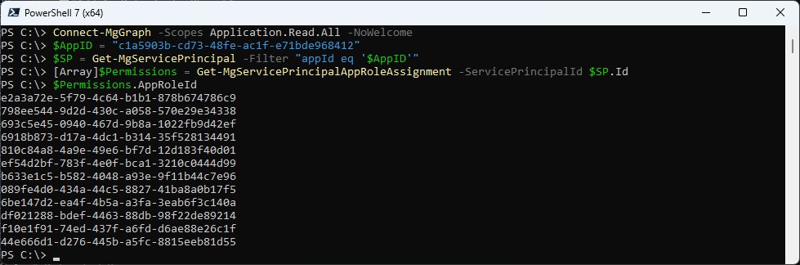
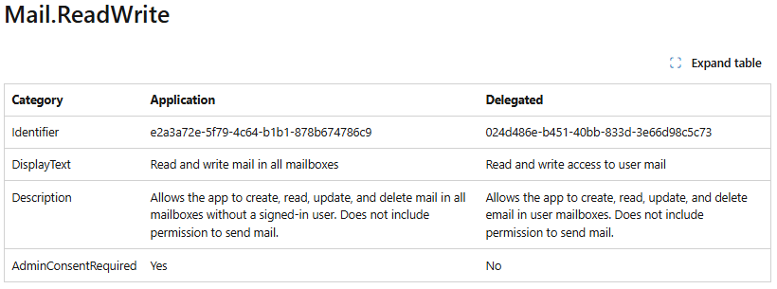
Application Permissions
10 / 20

Slide 12
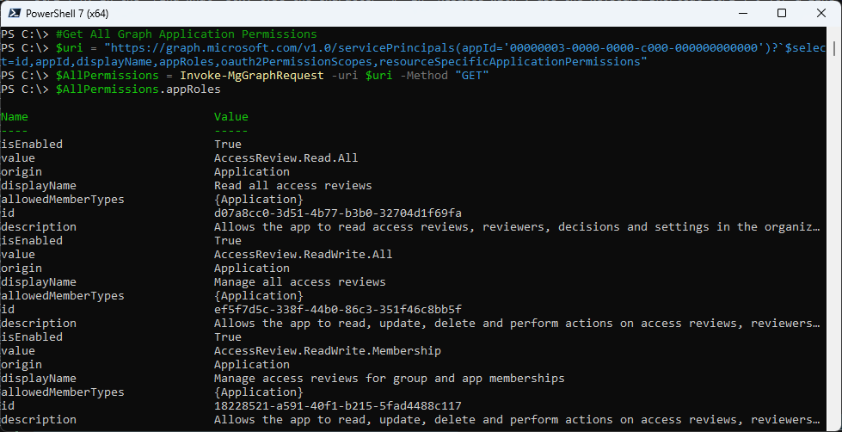
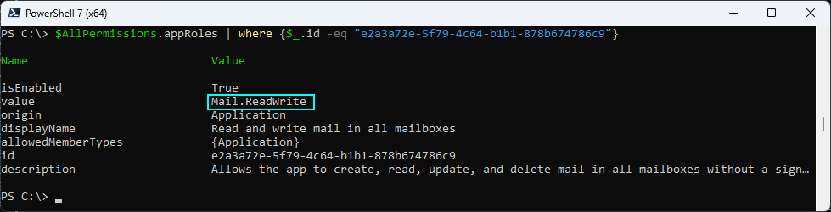
Get that App Permission List
11 / 20

Slide 13
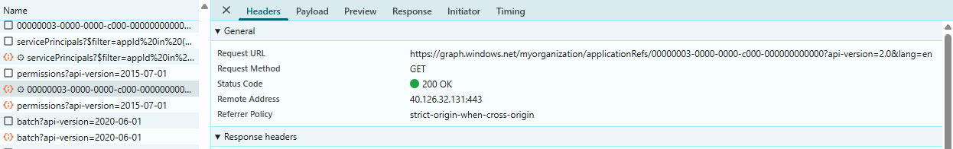
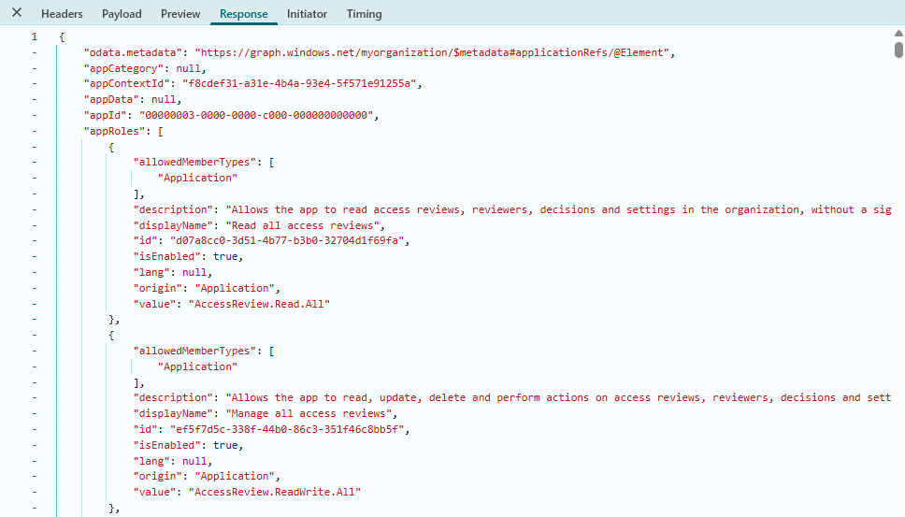
Reverse Engineering with DevTools
12 / 20

Slide 14
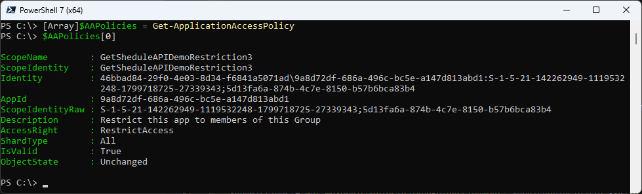
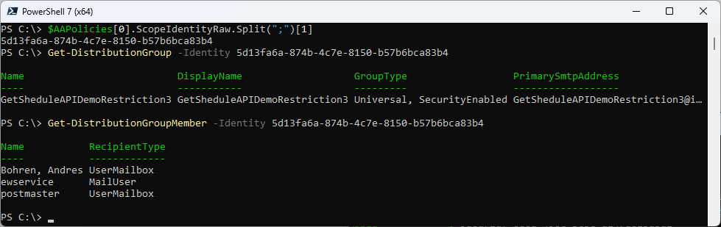
Distribution Group
13 / 20

Slide 15
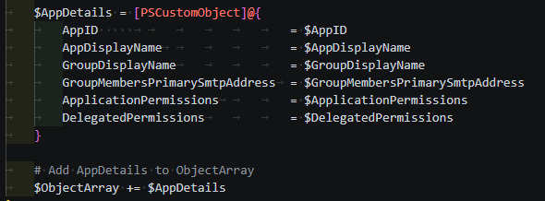
Make it pretty
We’re PowerShell people – so let’s make it pretty
14 / 20

Slide 16

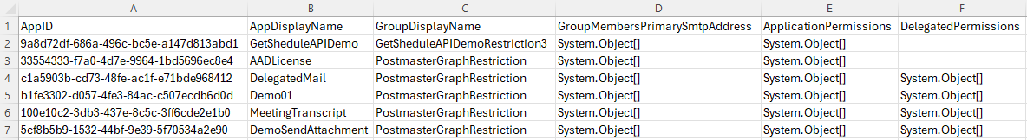
Save it and whe’re done
Exporting Arrays into csv
15 / 20

Slide 17
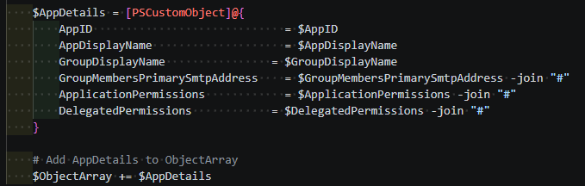
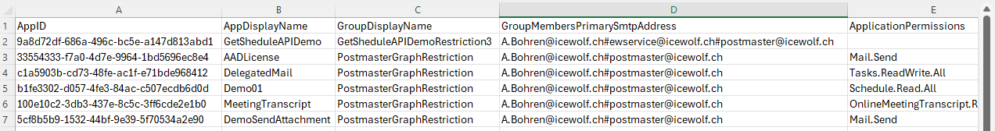
Join with a separator character
Join Array into String
16 / 20

Slide 18
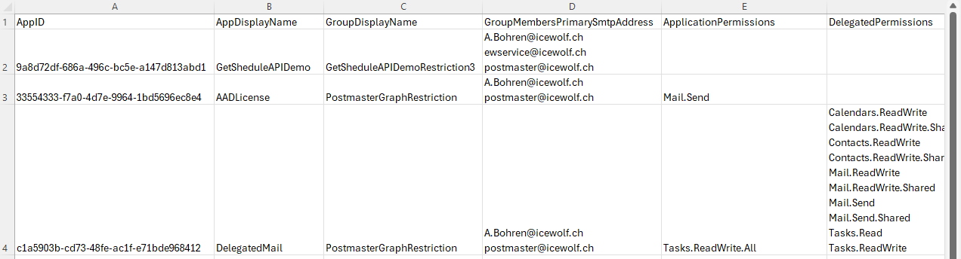
Excel Trick
Ctrl + H. In the "Find what" box, type the character "#" in "Replace with", use the keyboard shortcut Ctrl + J for a line break
17 / 20

Slide 19
Mission Accomplished
Get ApplicationAccessPolicy
Get Entra Application Details
Get Distribution Group Name and Members
Get Delegated and Application Permissions
Export Result to CSV
18 / 20

Slide 20
Summary
Showed you Exchange Online ApplicationAccessPolicy
Get delegated and application permissions
Generic approach to get the Permissions
Extras
Export Objects or Arrays to CSV
Showed you some Excel Tips
Added Owner and Tags this Morning
19 / 20

Slide 21
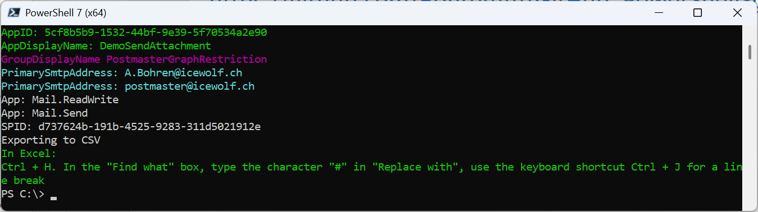
The final slide
Script has been published at GitHub
https://github.com/BohrenAn/GitHub_PowerShellScripts/blob/main/ExchangeOnline/ExportEXOApplicationAccessPolicy.ps1
Blog Article on https://blog.icewolf.ch will come soon…
20 / 20

Slide 22
A final comment
Leo Visser added a nice animation to his PoShaKucha in 2025: a growing horizontal red line. You can watch his presentation here:
https://youtu.be/ThPuQAvoHGM (Side deck here)
If you find that more appealing, feel free to use his idea. You find the animated red line here above. But be careful, only use one animation – otherwise it can confuse PowerPoint.
21 / 20
Notes:
https://youtu.be/ThPuQAvoHGM
https://github.com/psconfeu/2025/blob/main/%23PoShaKucha/Leo%20Visser/CacheDataInModulePoShaKucha.pptx

