Slide 1
How hard can it be to count a few XML nodes?
Notes:
Slide 0: this slide will not automatically turned over. Show this BEFORE the acutal presentation starts.

Slide 2
Performance Myth-Busting
“language X” is slow to do <something>
But actually
the library / implementation is key
1 / 20

Slide 3
Why I Care
Dev in Automotive Engineering
configuration and measurement-Data parsers
C++ / XSLT / C# / Rust / PowerShell
“xml-i” – personal pet-project to test assumptions and experiment
2 / 20

Slide 4
Same CLI, Many Implementations
xml-i (“xml eye”): count XML node names
./target/release/xml-i ./test/huge.xml boing blips
Node counts:
boing: 1342440
Blips: 1279
3 / 20

Slide 5
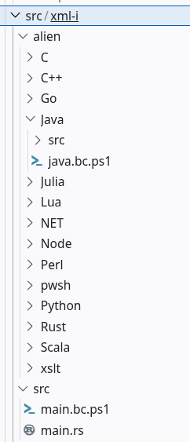
The “alien” Folder
./src/* → the baseline
./alien/* → different languages/implementations
4 / 20

Slide 6
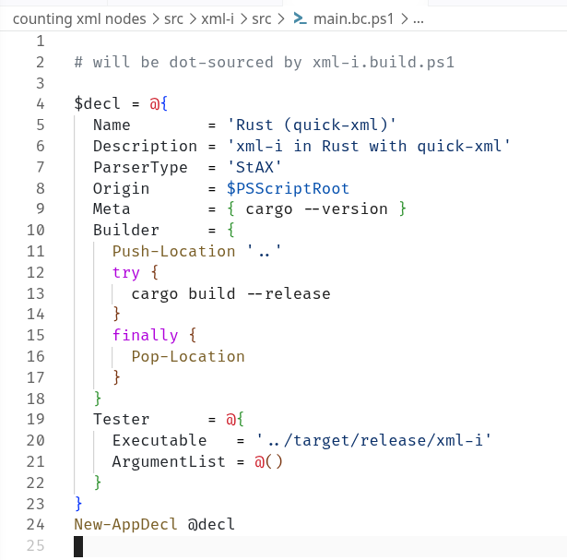

Benchmarking
reproducible setup
same test file
same language/stacks
I/O cold-start
/proc/sys/vm/drop_caches
comparable
5 / 20

Slide 7
Will It Scale?
500kB file → boring
1MB file → easy
100MB file → it gets interesting
1GB file → RAM becomes a liability
3GB file → "Behemoth"
(possible, but rarely seen)
6 / 20

Slide 8
Different Parsing Mindsets
DOM
Load whole structure into memory
SAX
Stream through content, callbacks to caller
StAX
Stream through content by pulling tokens
...
7 / 20

Slide 9
...
DOM
Load whole structure into memory
SAX
Stream through content, callbacks to caller
StAX
Stream through content by pulling tokens
...
8 / 20

Slide 10
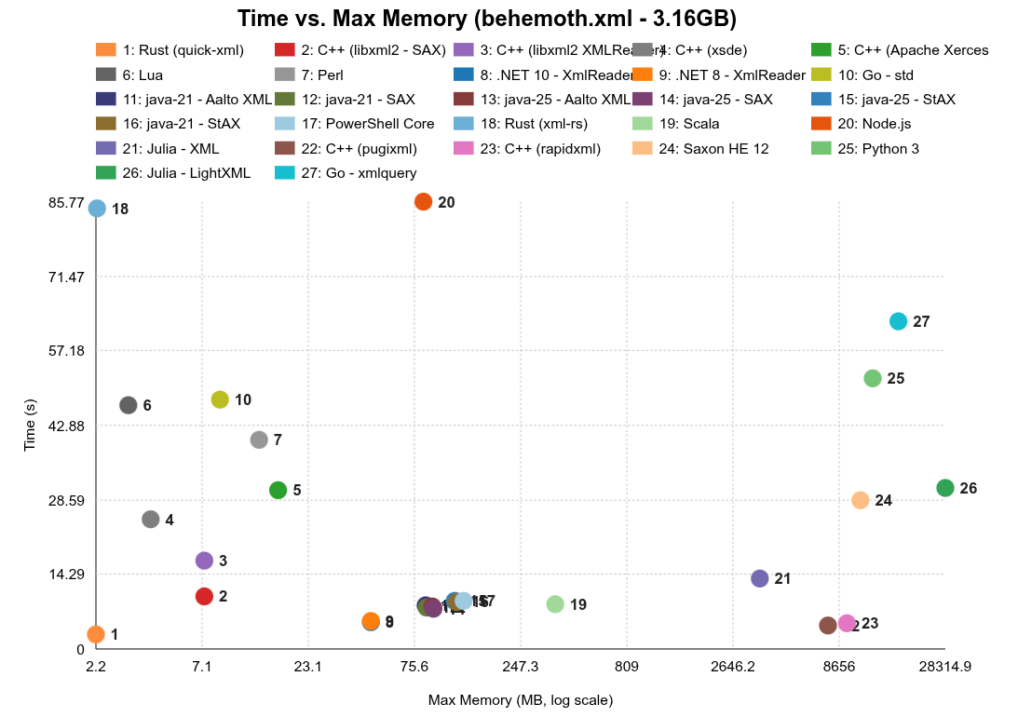
Memory Winners
9 / 20

Slide 11
10 / 20

Slide 12
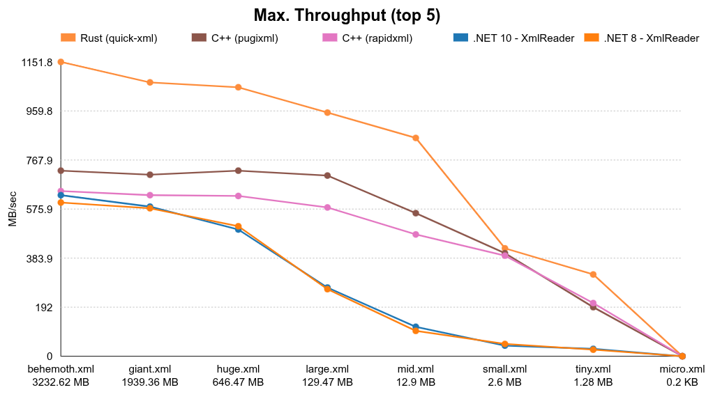
Throughput Leaders
11 / 20

Slide 13
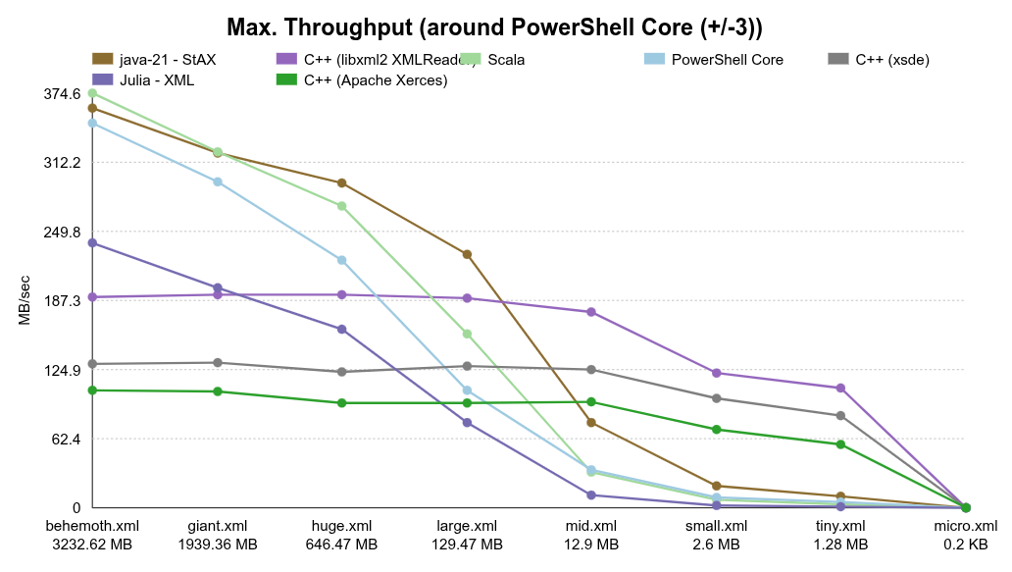
PowerShell Surprise
12 / 20

Slide 14
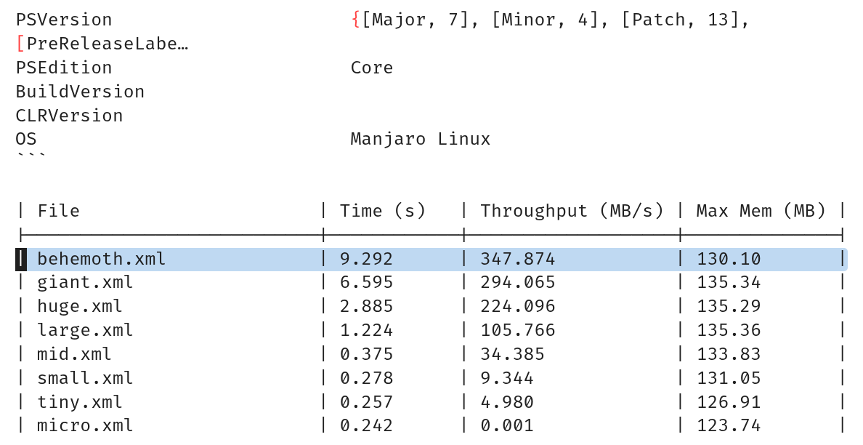
13 / 20

Slide 15
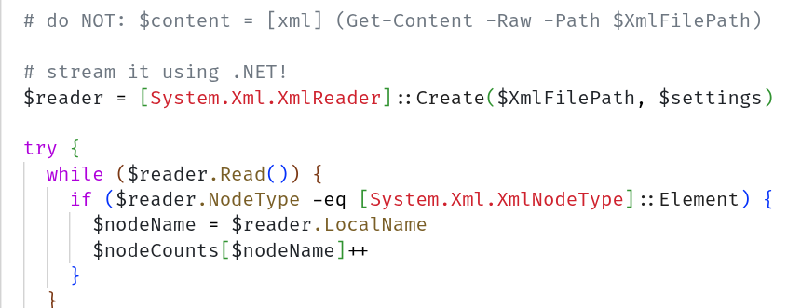
...
14 / 20

Slide 16
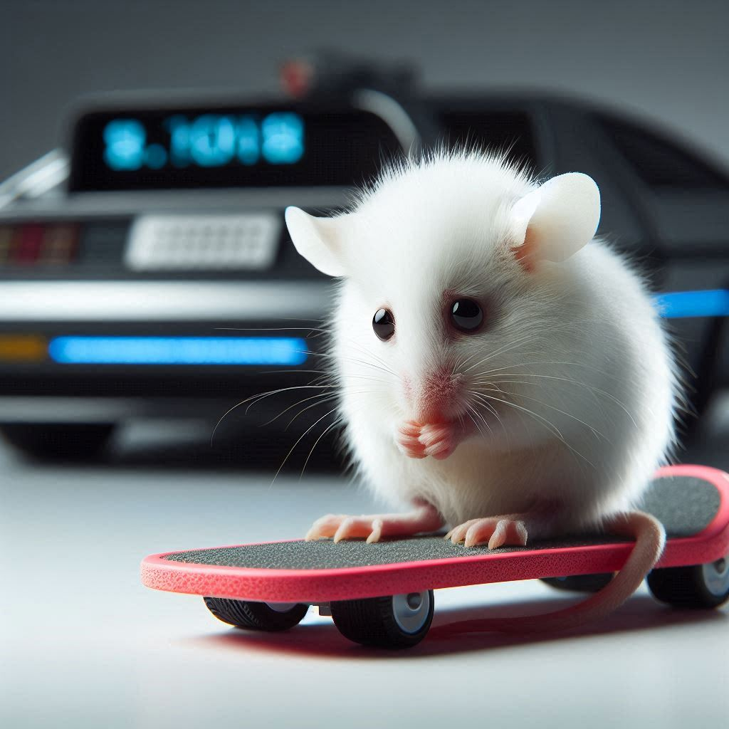
Convenience Wins
[xml] (Get-Content -Raw …)
one-shot
small files
startup > execution time
15 / 20

Slide 17
PowerShell
Myth: PowerShell performance bad :-(
Reality: Actually pretty competitive :-)
16 / 20

Slide 18

If it’s slow...
… it’s most likely on you :-)
17 / 20

Slide 19
Pick Your Bottleneck
Speed
Memory
Implementation overhead?
18 / 20

Slide 20
Call For Action
Benchmark one real XML processing task
Time + Size => Throughput
Memory consumption
Does it (need to) scale?
19 / 20

Slide 21

Thank You!
That’s it from my side,
all data + code
github.com/mwallner/xml-i
github.com/mwallner/PSQuickXml
20 / 20

