Slide 1
PowerShell Oddities & Curiosities: Language Quirks You Forgot… (or Never Knew)
Rob Pleau
https://www.bobbycodes.io/

Slide 2

Keep this here and replace it with the update sponsor image that will be sent out the week prior to summit

Slide 3
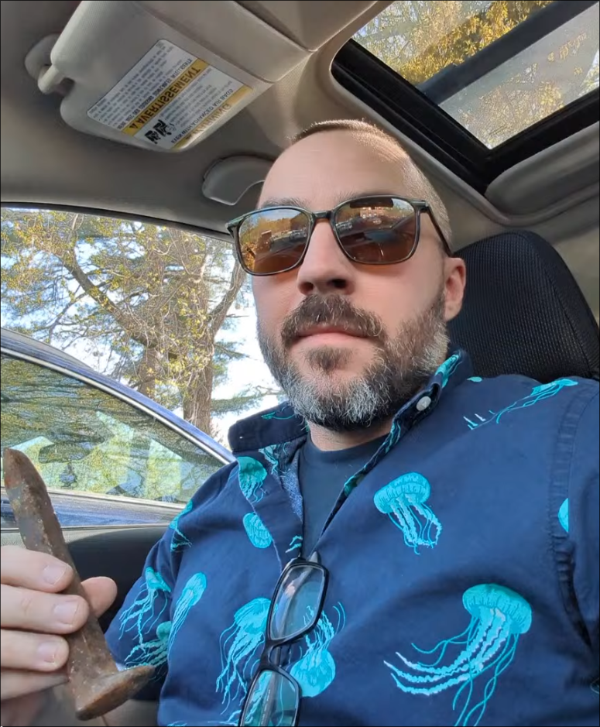



About Me
PowerShell user for over 14 years
Loves Linux (I use Arch btw)
Neovim is the only editor
Mechanical keyboards with Kaihl switches is the way.
Addicted to markdown
Disclaimer: Based on the above, buckle up for some terminals, markdown, and maybe a little Neovim today…
Pictured: Me holding a rusty railroad spike in my car (I found it in the parking lot of a hotel for some reason)

Slide 4

PS> Invoke-Demo -Force

Slide 5
THANK YOU
Feedback is a gift
Please review this session
via the mobile App

