Slide 1
Putting the “Pro” in PowerShell Profiles
Rob Pleau
https://www.bobbycodes.io/

Slide 2
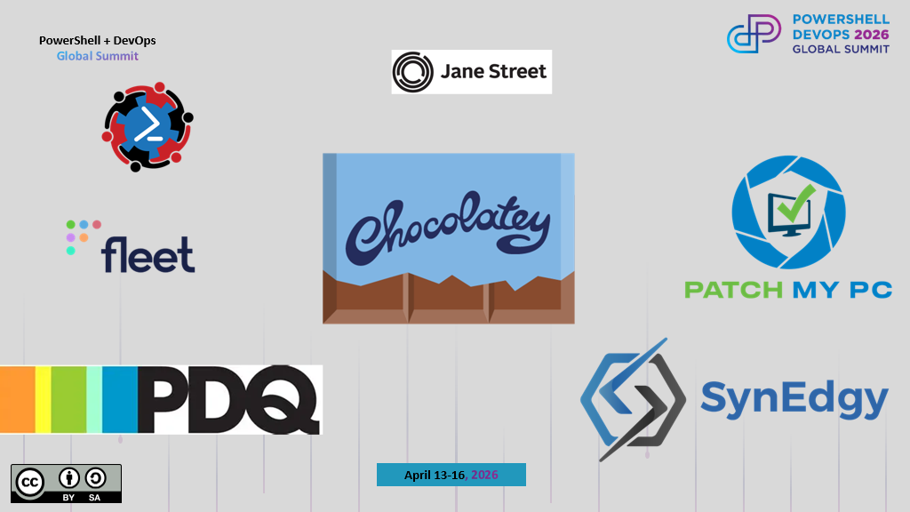
Keep this here and replace it with the update sponsor image that will be sent out the week prior to summit

Slide 3




About Me
PowerShell user for over 14 years
Loves Linux (I use Arch btw)
Neovim is the only editor
Mechanical keyboards with Kaihl switches is the way.
Addicted to markdown
Disclaimer: Based on the above, expect a lot of terminal, markdown and Neovim!
Pictured: Me behind the scenes of the movie ‘Con Air’

Slide 4
What We’ll Cover
What’s a profile?
What’s a prompt?
What’s a prompt engine?
How to access your profile anywhere

Slide 5
PowerShell Profiles and Prompts
What do you need to know?... (SPOILER ALERT)
The profile is a script.
The prompt is a function.

Slide 6

PS> Invoke-Demo -Force

Slide 7
PowerShell Profiles and Prompts
In review.
The profile is a script.
The prompt is a function.
Prompt engines help with heavy lifting
Access your profile from any machine Make it your own!

Slide 8
THANK YOU
Feedback is a gift
Please review this session
via the mobile App

