Slide 1

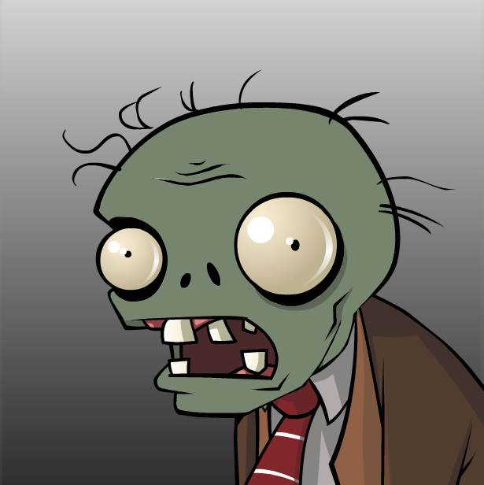
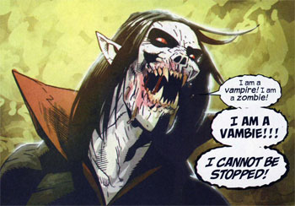
Vampiric Zombification

Slide 2
The Life Cycle of a Vampire Zombie
Humans
Natural
Death
0.0001
0.0050
0.0055
Vampires
Zombies
0.0005
0.0005
Vampire Zombies
0.0005
Natural Death
0.2500

Slide 3
