Slide 1
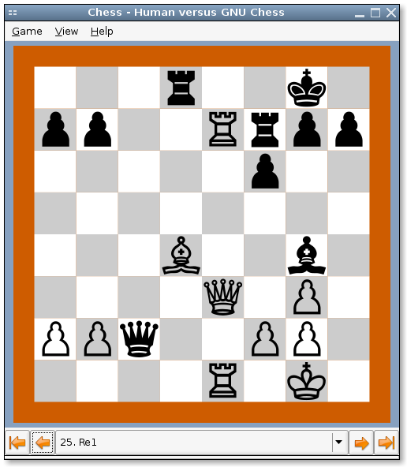
Algorithms for Computer Games
How computer plays board games ?
Notes:
You may wonder how computer plays games like chess, backgamon or tictactoe.
During this brief presentation, I'll give you an overview of how it works.

Slide 2
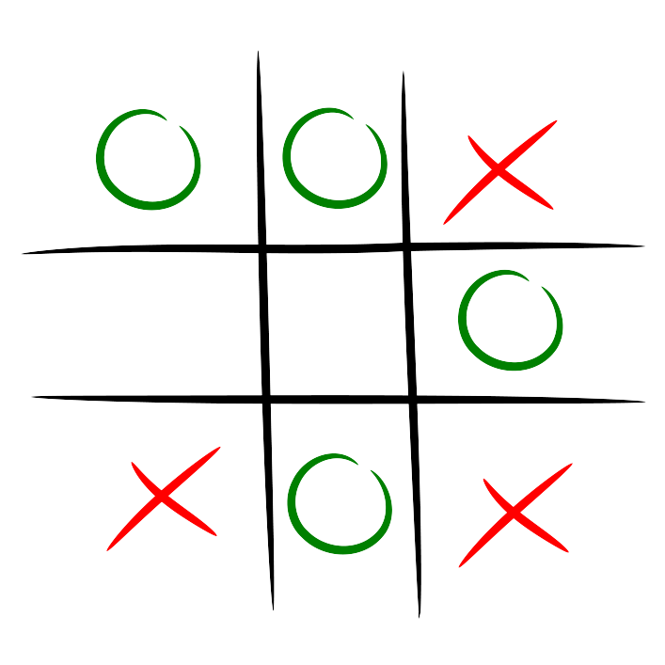
Let's focus on a simple game...
TicTacToe
  2 players (X and O)
  alternately put symbols in an empty squares of a 3×3 grid
  goal : placing three respective marks in a horizontal, vertical, or diagonal row
  the game is a draw if the grid has been filled without alignments
Notes:
I'll focus on the game of Tictactoe

Slide 3
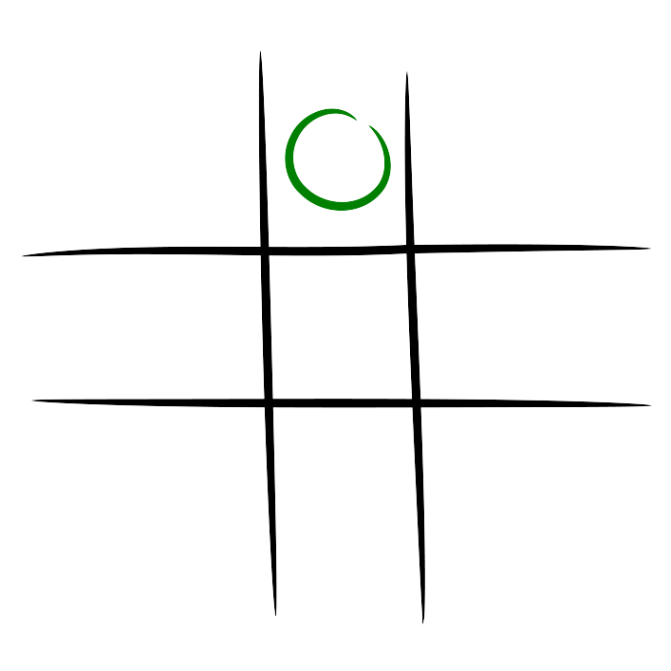
Let's focus on a simple game...
TicTacToe
  2 players (X and O)
  take turns marking the spaces in a 3×3 grid
  goal : placing three respective marks in a horizontal, vertical, or diagonal row
  draw game if there are no alignments

Slide 4
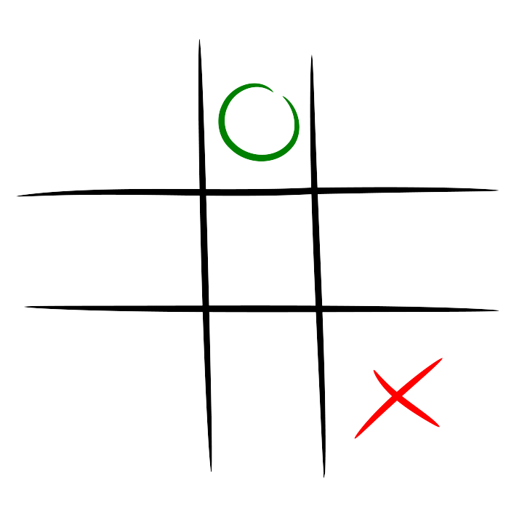
Let's focus on a simple game...
TicTacToe
  2 players (X and O)
  take turns marking the spaces in a 3×3 grid
  goal : placing three respective marks in a horizontal, vertical, or diagonal row
  draw game if there are no alignments

Slide 5
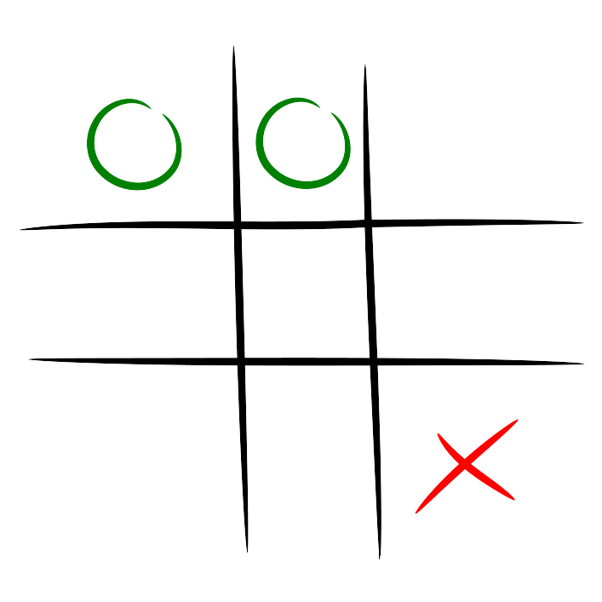
Let's focus on a simple game...
TicTacToe
  2 players (X and O)
  take turns marking the spaces in a 3×3 grid
  goal : placing three respective marks in a horizontal, vertical, or diagonal row
  draw game if there are no alignments

Slide 6
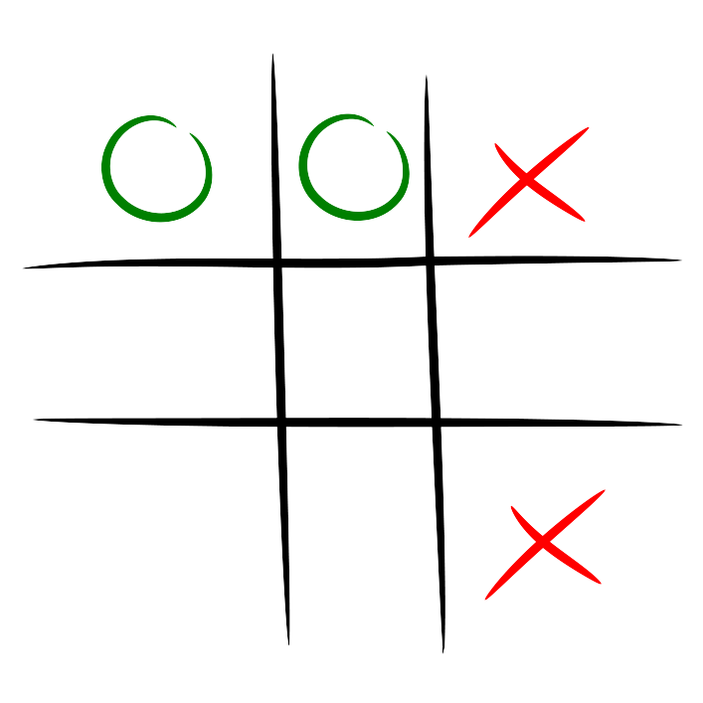
Let's focus on a simple game...
TicTacToe
  2 players (X and O)
  take turns marking the spaces in a 3×3 grid
  goal : placing three respective marks in a horizontal, vertical, or diagonal row
  draw game if there are no alignments

Slide 7
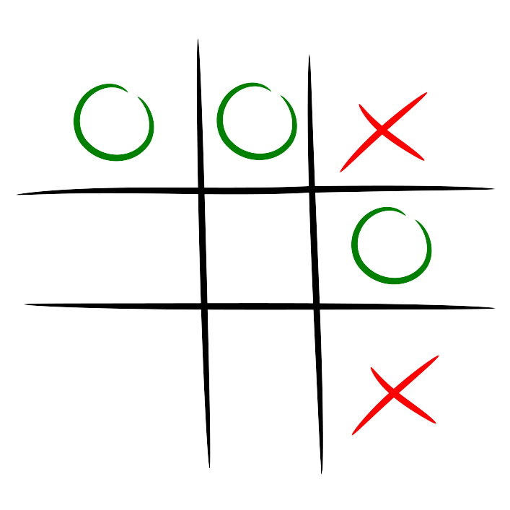
Let's focus on a simple game...
TicTacToe
  2 players (X and O)
  take turns marking the spaces in a 3×3 grid
  goal : placing three respective marks in a horizontal, vertical, or diagonal row
  draw game if there are no alignments

Slide 8
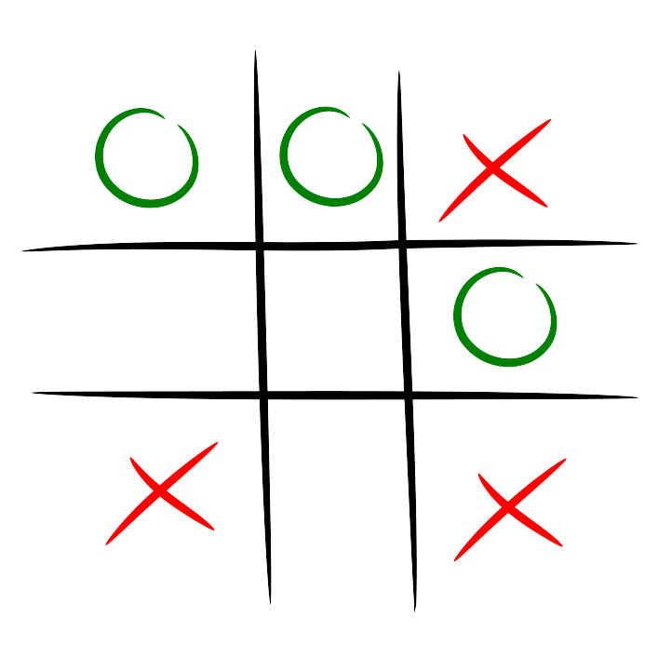
Let's focus on a simple game...
TicTacToe
  2 players (X and O)
  take turns marking the spaces in a 3×3 grid
  goal : placing three respective marks in a horizontal, vertical, or diagonal row
  draw game if there are no alignments

Slide 9
Let's focus on a simple game...
TicTacToe
  2 players (X and O)
  take turns marking the spaces in a 3×3 grid
  goal : placing three respective marks in a horizontal, vertical, or diagonal row
  draw game if there are no alignments

Slide 10
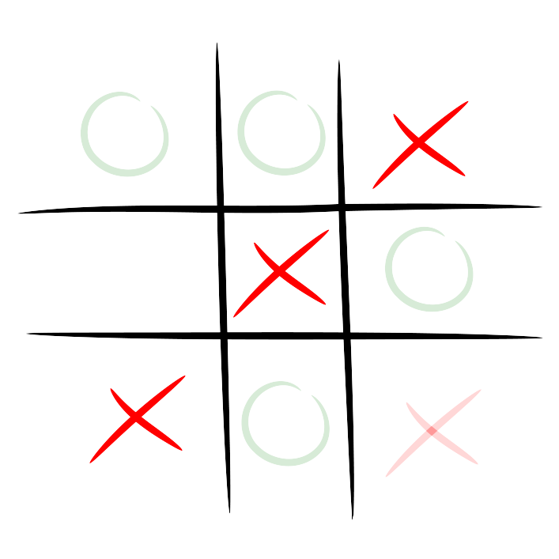
Let's focus on a simple game...
TicTacToe
  2 players (X and O)
  take turns marking the spaces in a 3×3 grid
  goal : placing three respective marks in a horizontal, vertical, or diagonal row
  draw game if there are no alignments

Slide 11

Let's choose an algorithm to let the computer plays this game...
« Minimax »
  easy to understand
  well suited for tictactoe
I'll explain how Minimax works

Slide 12
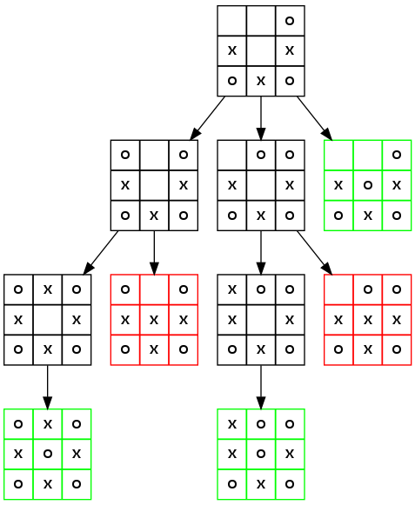
How the computer « see » the game ?
For the computer, tictactoe is :
  a set of states
  linked by possible actions
  making a tree structure
  which represents all possible games from a given state

Slide 13
Which action to choose
(given a particular state) ?
Let's say the game is in this state and it's computer's turns
How it would choose its next move (or action) ?
The computer will assess the 3 possible next states and choose the action which leads to the best one

Slide 14
How to assess states ?
An easy way to do it is to start the evaluation form the end of each possible games

Slide 15
How to assess terminal states ?
Let's say the game is in this state, it's computer's turns and it plays '0'
In this example, there are 5 terminal states (grey background)
Let's say terminal states have value
  +1 if the computer has won
  -1 if the opponent has won
  0 if the game is a draw
Notes:
For instance, here the computer has won so this terminal state value is +1

Slide 16
How to assess states ?
Let's say the computer plays '0'
Let's say terminal states have value
  +1 if the computer has won
  -1 if the opponent has won
  0 if the game is a draw
Notes:
For instance, here the opponent has won so this terminal state value is -1

Slide 17
How to assess states ?
Let's say the computer plays '0'
Let's say terminal states have value
  +1 if the computer has won
  -1 if the opponent has won
  0 if the game is a draw
Notes:
For instance, here the game is a draw so this terminal state value is 0

Slide 18
And for others states ?
If the opponent plays, we guess he will choose the action which leads to best state for him.
We considere he will try to :
  Go to a state « -1 »
  If not possible, go to a state « 0 »

Slide 19
And for others states ?
If the computer plays, it will choose the action which leads to best state for it :
  Go to a state « +1 »
  If not possible, go to a state « 0 »

Slide 20
To sum up
Each time the computer plays, it has to choose an action from the current state
To do so, it evaluates all following states from the end of each possible games going back to the current state
For each evaluation, it choose :
  the max of the next states if the computer plays
  the min of the next states if the opponent plays

Slide 21
?
?
?

Slide 25
Thank you for your attention
Questions ?

