Slide 1


Slide 2
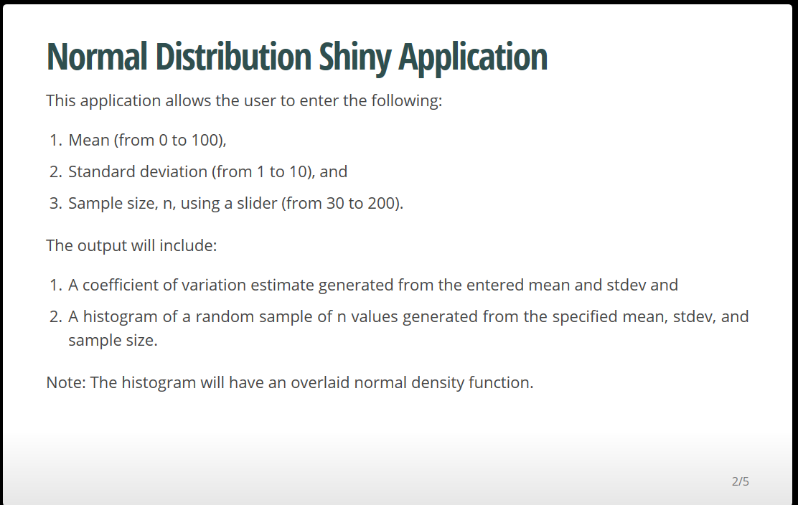

Slide 3
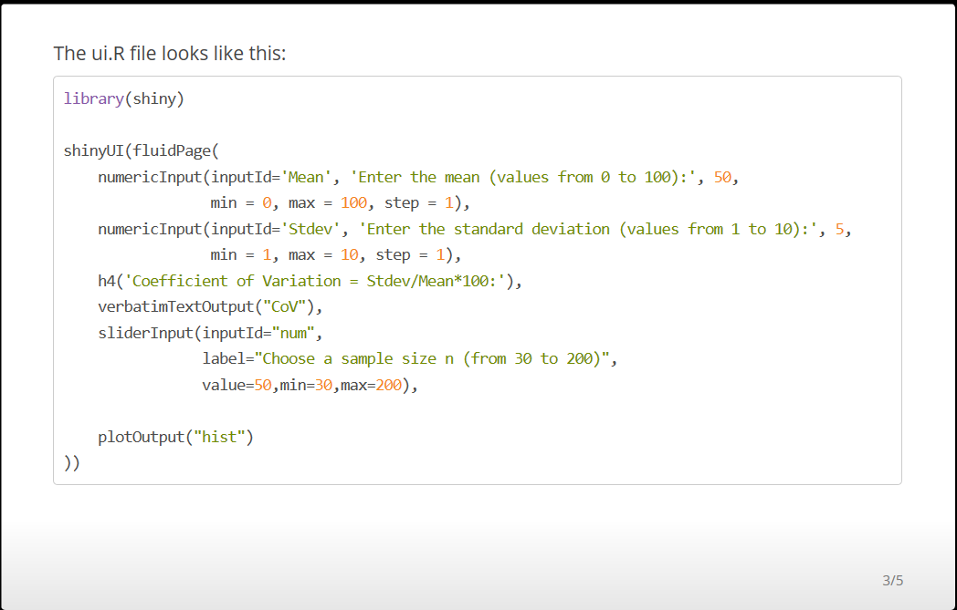

Slide 4
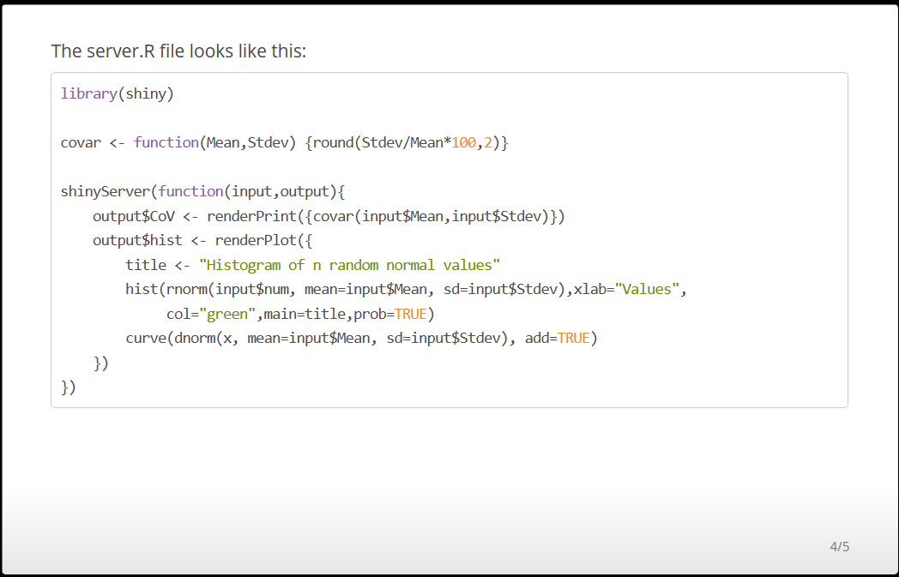

Slide 5
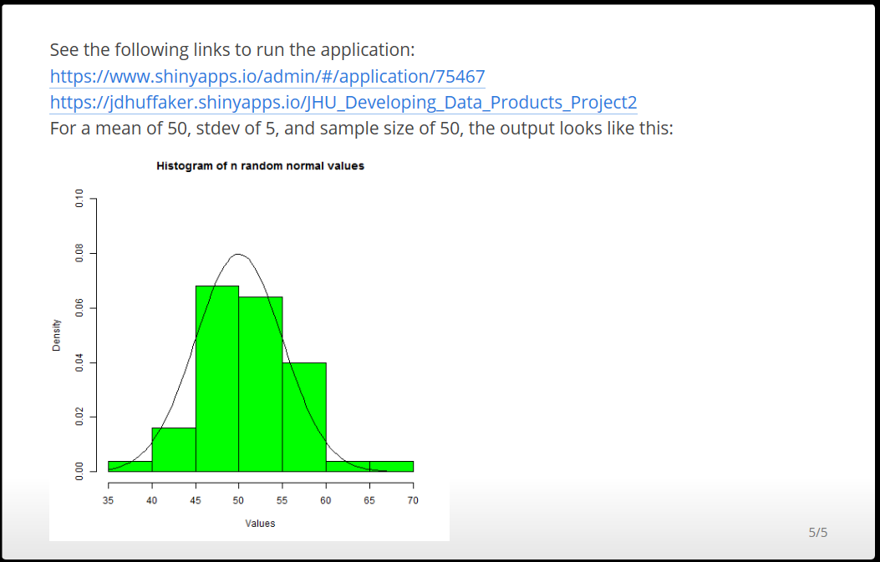
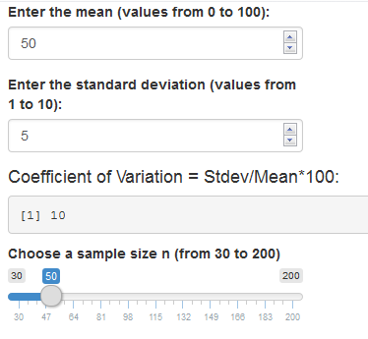
Note that the histogram on the left was generated in the slidify script. The UI below was copy and pasted to this presentation. I spent hours trying to publish the slidify presentation without success. This course was by far the worst one in the series..

