Slide 1
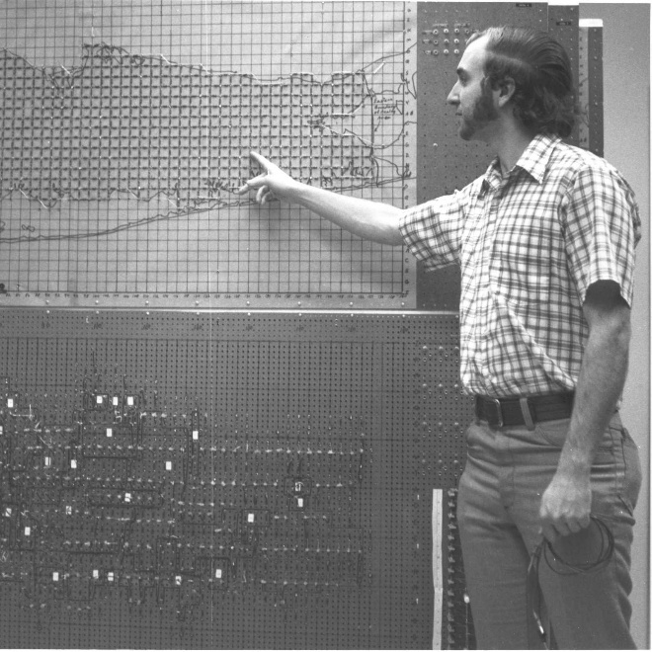
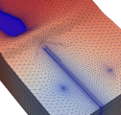
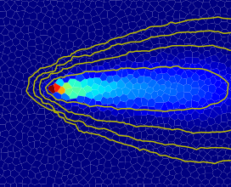
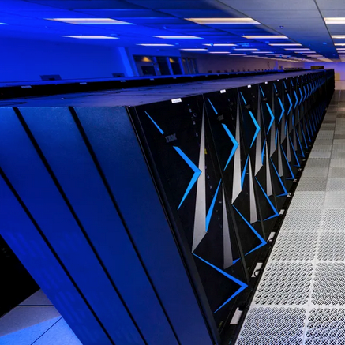






Welcome
Advanced MODFLOW Training Class,
Delft, November 21, 2025

Slide 2
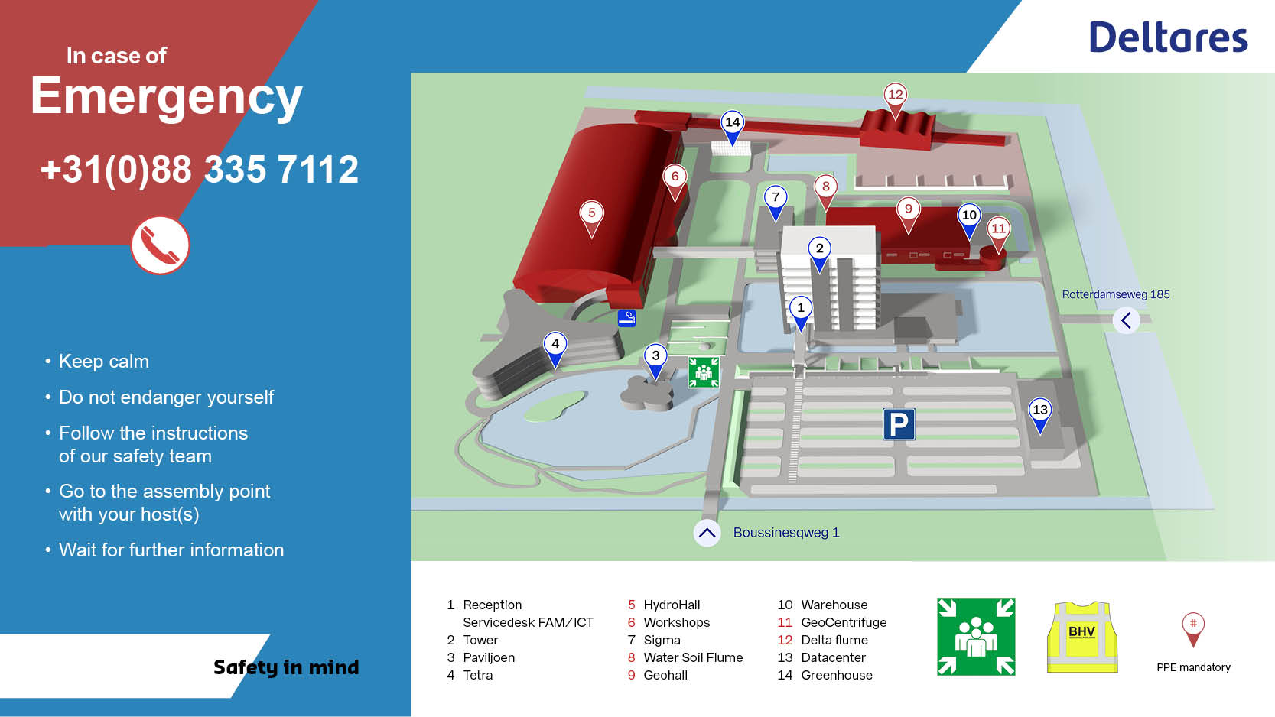

Slide 3
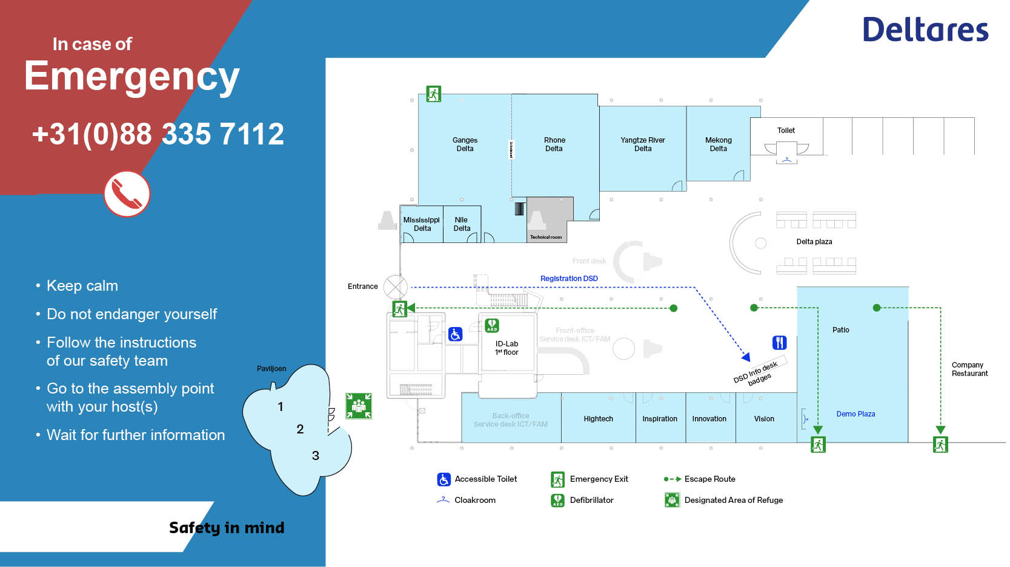

Slide 4
Introductions

Slide 5
WiFi
See email sent (Did everyone get it?)
Or, scan the QR code
Or, go to eduroam.deltares.nl
Pre-class Installations
E-mail about setup
pixi installation from class github:
  https://github.com/mjr-deltares/modflow-dsd25

Slide 6
Badge
Please pick up your badge in the coffee break, if you haven’t already

Slide 7
Agenda
08:30 to 09:00 — ARRIVAL
09:00 to 09:10 — Welcome and Introductions (MR)
09:10 to 09:40 — Overview of MODFLOW 6, newest capabilities, and ongoing developments (MR/CL)
09:40 to 10:40 — Brief introduction to FloPy and pixi, installation of the class environment (JH/MR)
10:40 to 11:00 — COFFEE BREAK
11:00 to 12:30 — In-depth density driven flow, adaptive timestepping, advection schemes, SWI (CL/ST)
12:30 to 12:55 — Highlights: new and advanced features such as PRT, NetCDF, gridded input, ... (MR/CL)
12.55 to 13.00 — GROUP PICTURE
13:00 to 14:00 — LUNCH BREAK
14:00 to 15:30 — Aquifer Thermal Energy Storage (ATES/WKO) example using GWE (MB)
15:30 to 15:50 — COFFEE BREAK
15:50 to 16:50 — In-depth Numerical Solution: solver settings, diagnostics, best practices (JH/MR)
16:50 to 17:00 — Closing (MR)
17:00 to 18:00 — DRINKS

