Slide 1
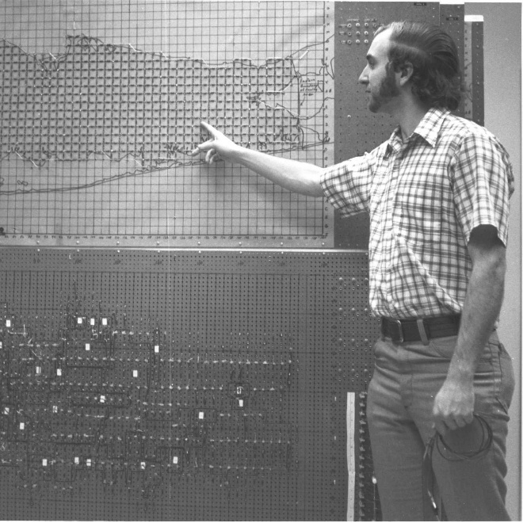
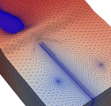
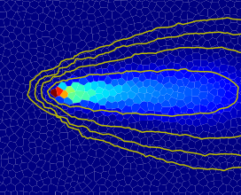
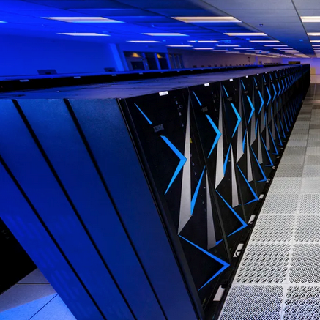






Numerical Solution
Configuration & Diagnostics

Slide 2
QGIS integration

Slide 3
Stream Flow

Slide 4
Particle Tracking

Slide 5
Richards

Slide 6
CONUS runs on Snellius

Slide 7
Parallel Variable Density

Slide 8
FloPy 4

