Slide 1
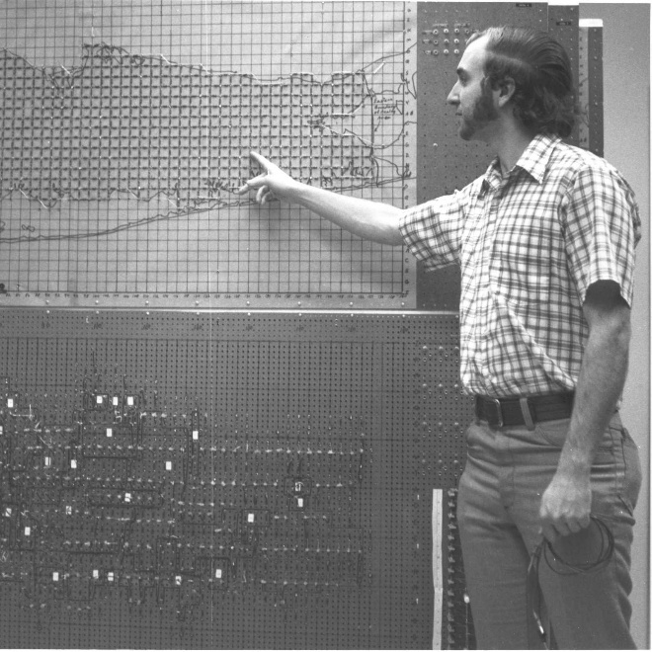
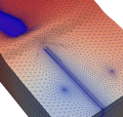
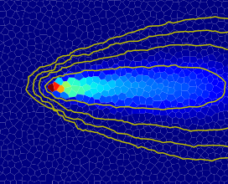


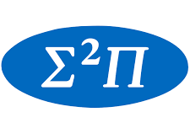




Numerical Solution
Configuration & Diagnostics

Slide 2
Recap: the discretized flow equation

Slide 3
Linear Solution

Slide 4
Preconditioning

Slide 5
…

Slide 6
Non-linear

Slide 7
Under-relaxation

Slide 8
…

