Slide 1


Python Overview
47TH IAH Congress
São Paulo, Brazil
August 22, 2021
Notes:
Describe some of the ongoing work we are doing with MODFLOW
MODFLOW and related software distributed by the USGS is developed and supported by a growing team of USGS scientists and external collaborators. Recent MODFLOW development efforts have focused on use of unstructured and locally refined grids for constant or variable-density groundwater flow and solute transport simulation, robust handling of three-dimensional anisotropy, generalization and tracking of water transfer between packages, distributed memory parallelization, and consolidation of these core capabilities into MODFLOW 6. These capabilities make it possible to construct new types of models, such as tightly coupled nested models, that have not been possible with previous MODFLOW versions. Underlying these efforts has been the adoption of an open-development philosophy that relies on testing-based development and continuous integration practices by the core development team and by the broader MODFLOW community. Ongoing development increasingly relies on the Flopy python package for automating model construction. Resulting from these development efforts is a suite of MODFLOW programs that can be applied at local, regional, and National scales for a wide variety of complex groundwater flow and transport problems.
OASIS MCT

Slide 2
Motivations for Using Python
Automate tedious, boring and repetitive tasks
Escape limits imposed by other people’s software
Improve quality and efficiency of work
Scientific reproducibility/repeatability

Slide 3
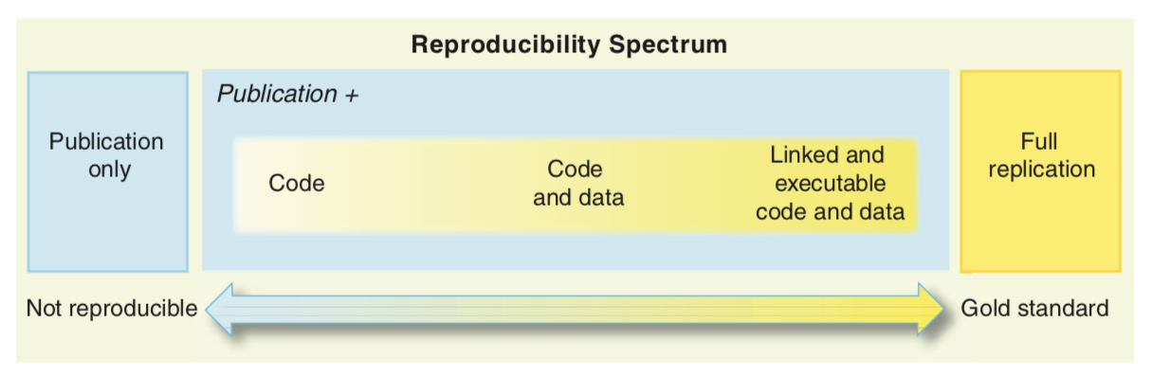
Python and Reproducibility/Repeatability
Peng, R.D. 2011. Reproducible Research in Computational Science, Science 334, p 1226-1227
Hutton, C., T. Wagener, J. Freer, D. Han, C. Duffy, and B. Arheimer (2016), Most computational hydrology is not reproducible, so is it really science?, Water R. Res., 52, 7548–7555, doi:10.1002/2016WR019285.
Ince, D.C., Hatton, L., Graham-Cumming, J., 2012, The case for open computer programs, Nature 482, p 485-488.

Slide 4
What is Python
Interpreted, high-level language for general-purpose programming
Based on C
Object-oriented
Highly extensible
Besides standard library, large ”ecosystem” of packages for diverse purposes
Emphasizes code readability, simplicity and flexibility
Guido van Rossum

Slide 5
What does it mean to be pythonic?
Some of the core principals:
Beautiful is better than ugly
Explicit is better than implicit
Simple is better than complex
Complex is better than complicated
Readability counts
https://en.wikipedia.org/wiki/Zen_of_Python

Slide 6
Advantages of Python
Ease of programming
Well designed language
Modular and object-oriented
Documentation is in the code
Large standard library
Larger collection of add-on packages
Platform-independent
Popular
Free!

Slide 7
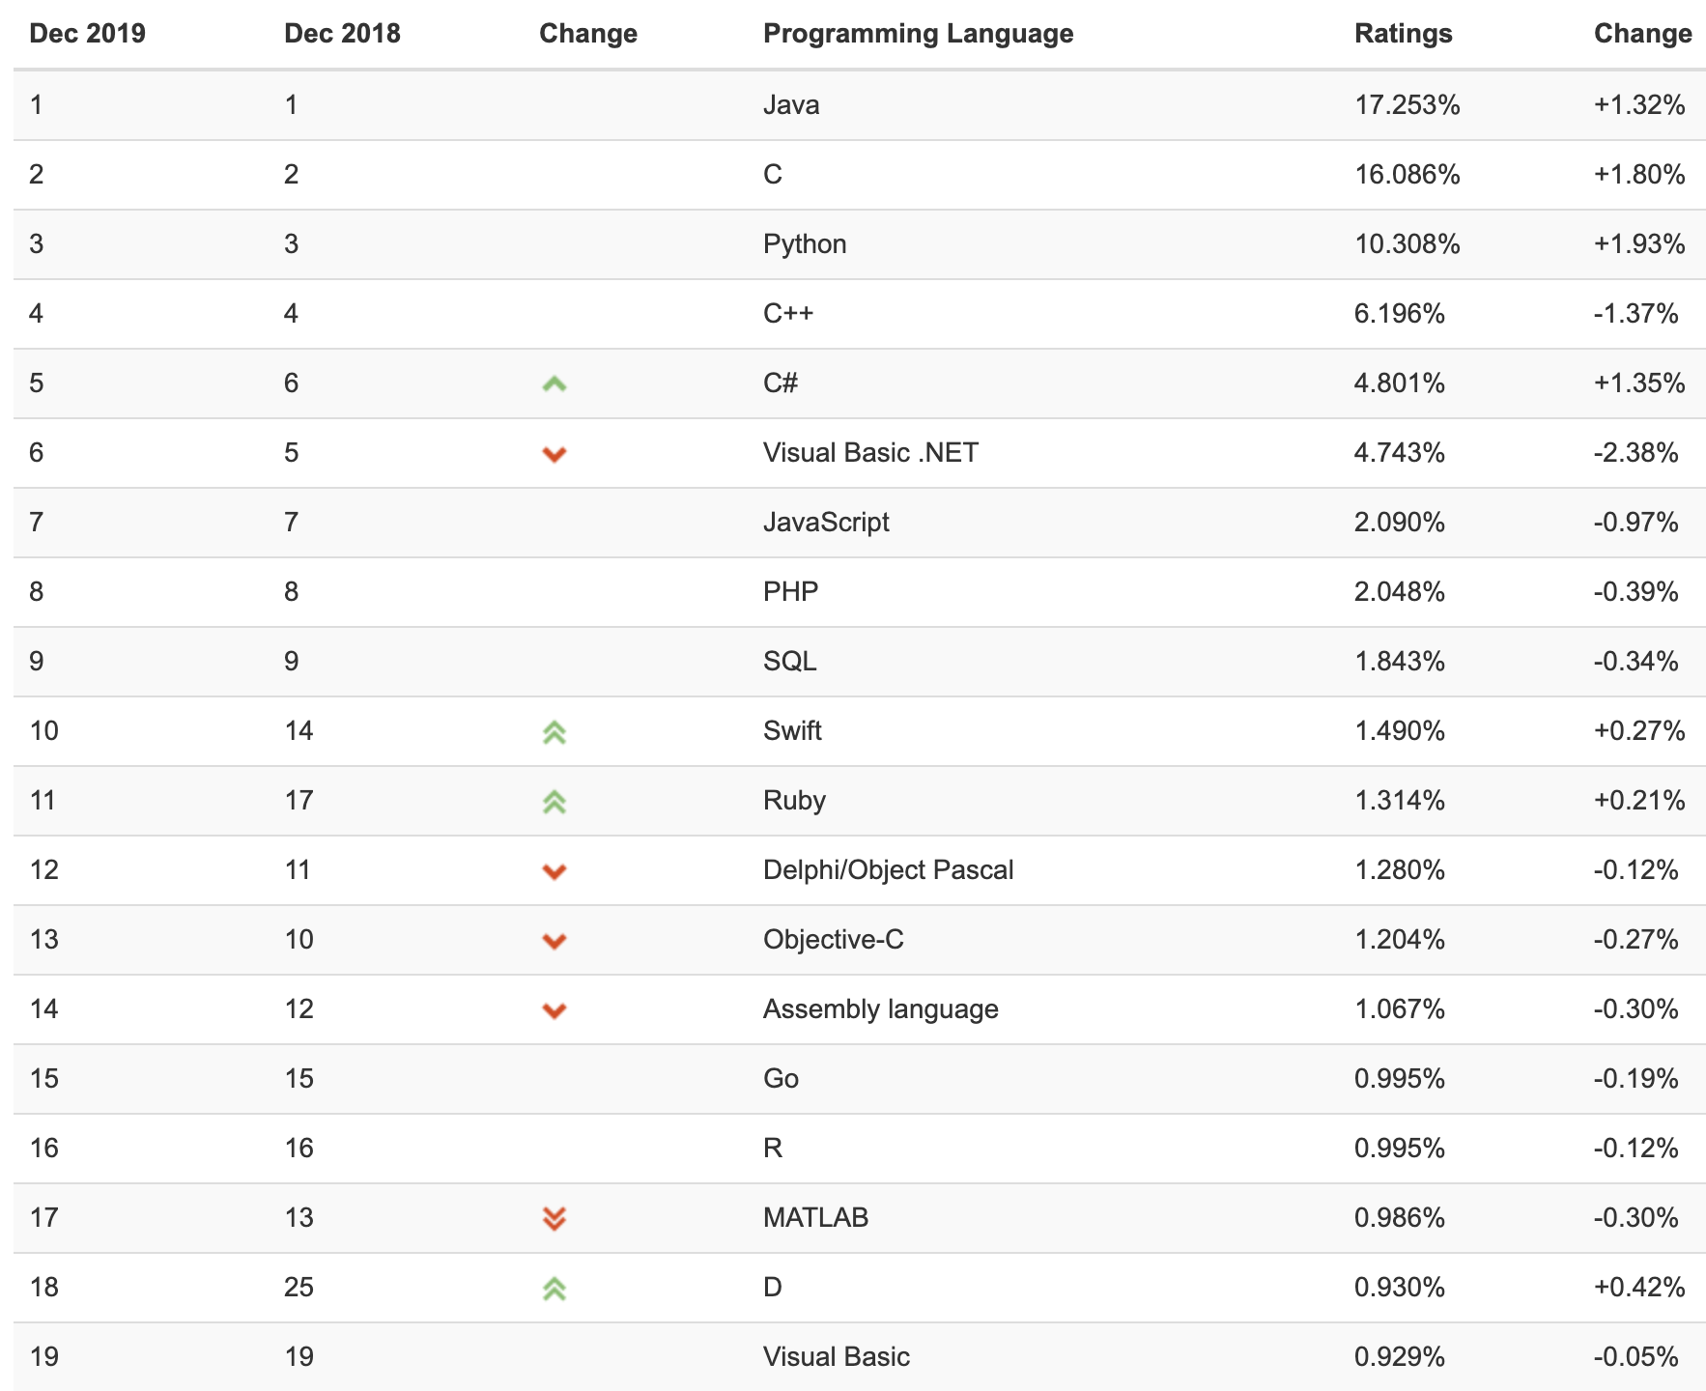
TIOBE Index (December 2019)
https://www.tiobe.com/tiobe-index/

Slide 8
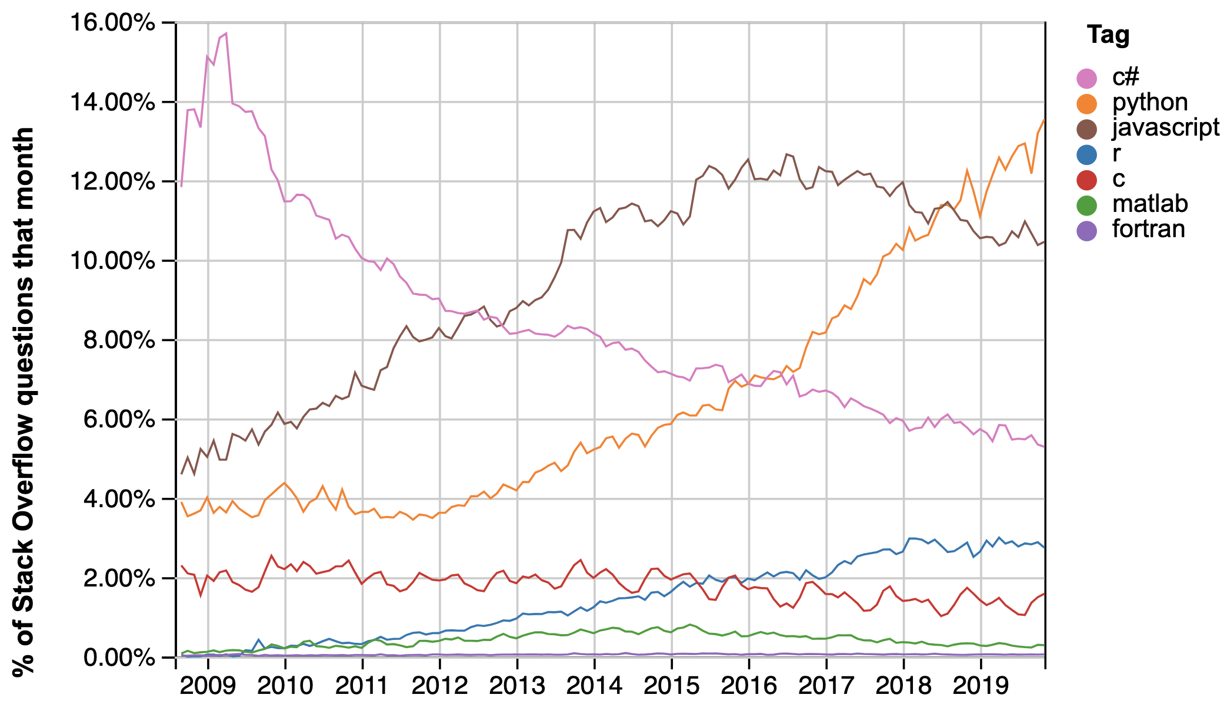
Growth of Python
https://insights.stackoverflow.com/trends

Slide 9
Disadvantages
Can be slower than other languages
Flexibility comes at a cost of overhead
Somewhat decentralized; changes frequently
Installation/Hard to get started
Easy to write bad code
https://towardsdatascience.com/5-reasons-why-jupyter-notebooks-suck-4dc201e27086

Slide 10
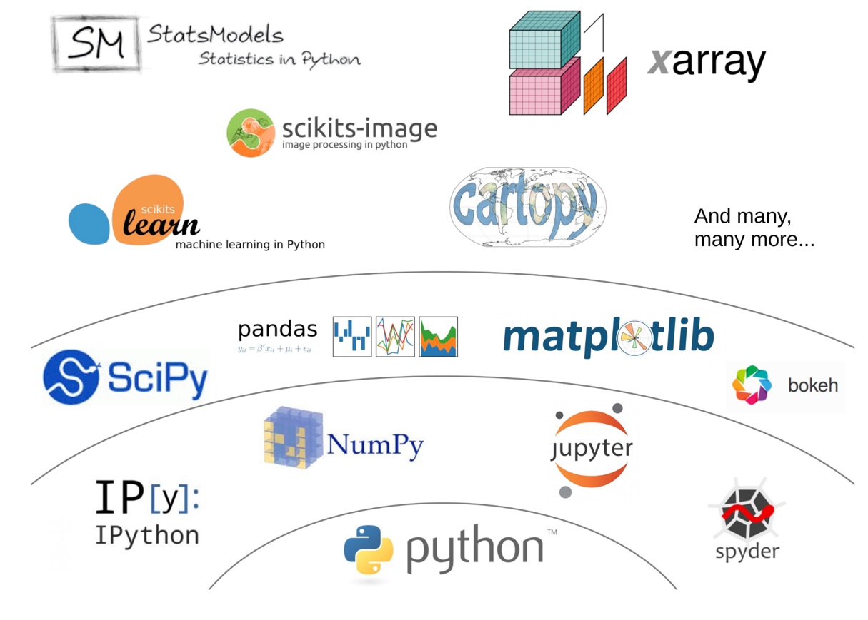
Python Scientific Ecosystem

Slide 11
Python Versions
Python 2.7 will not be maintained past 2019
https://pythonclock.org/
Python 3.5+ is now the standard
We are using Python 3.7 for the class

Slide 12
Some “best practices” resources
“Cookiecutter” template for packaging, testing, documenting, and publishing scientific Python code: https://nsls-ii.github.io/scientific-python-cookiecutter/index.html
PEP8 python style guide: https://www.python.org/dev/peps/pep-0008/
Numpy doc string format: https://numpydoc.readthedocs.io/en/latest/format.html
”Good enough” practices for scientific computing: https://swcarpentry.github.io/good-enough-practices-in-scientific-computing/

