Slide 1
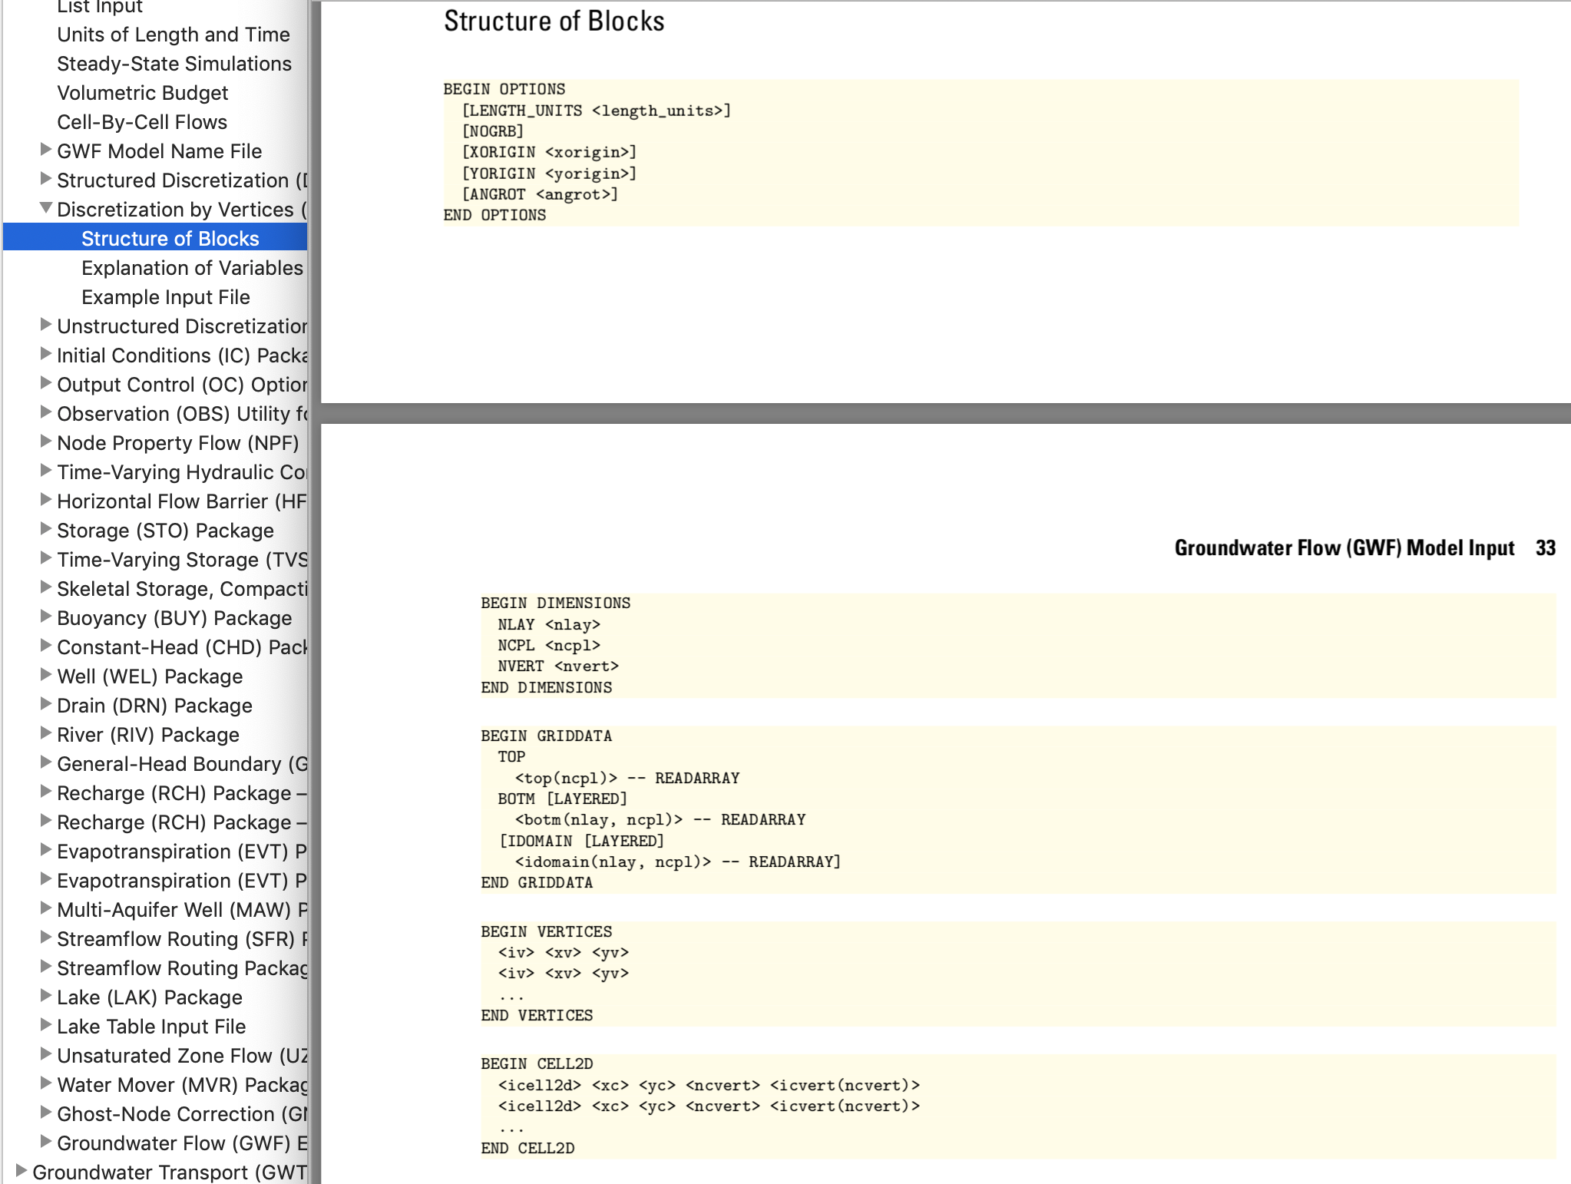
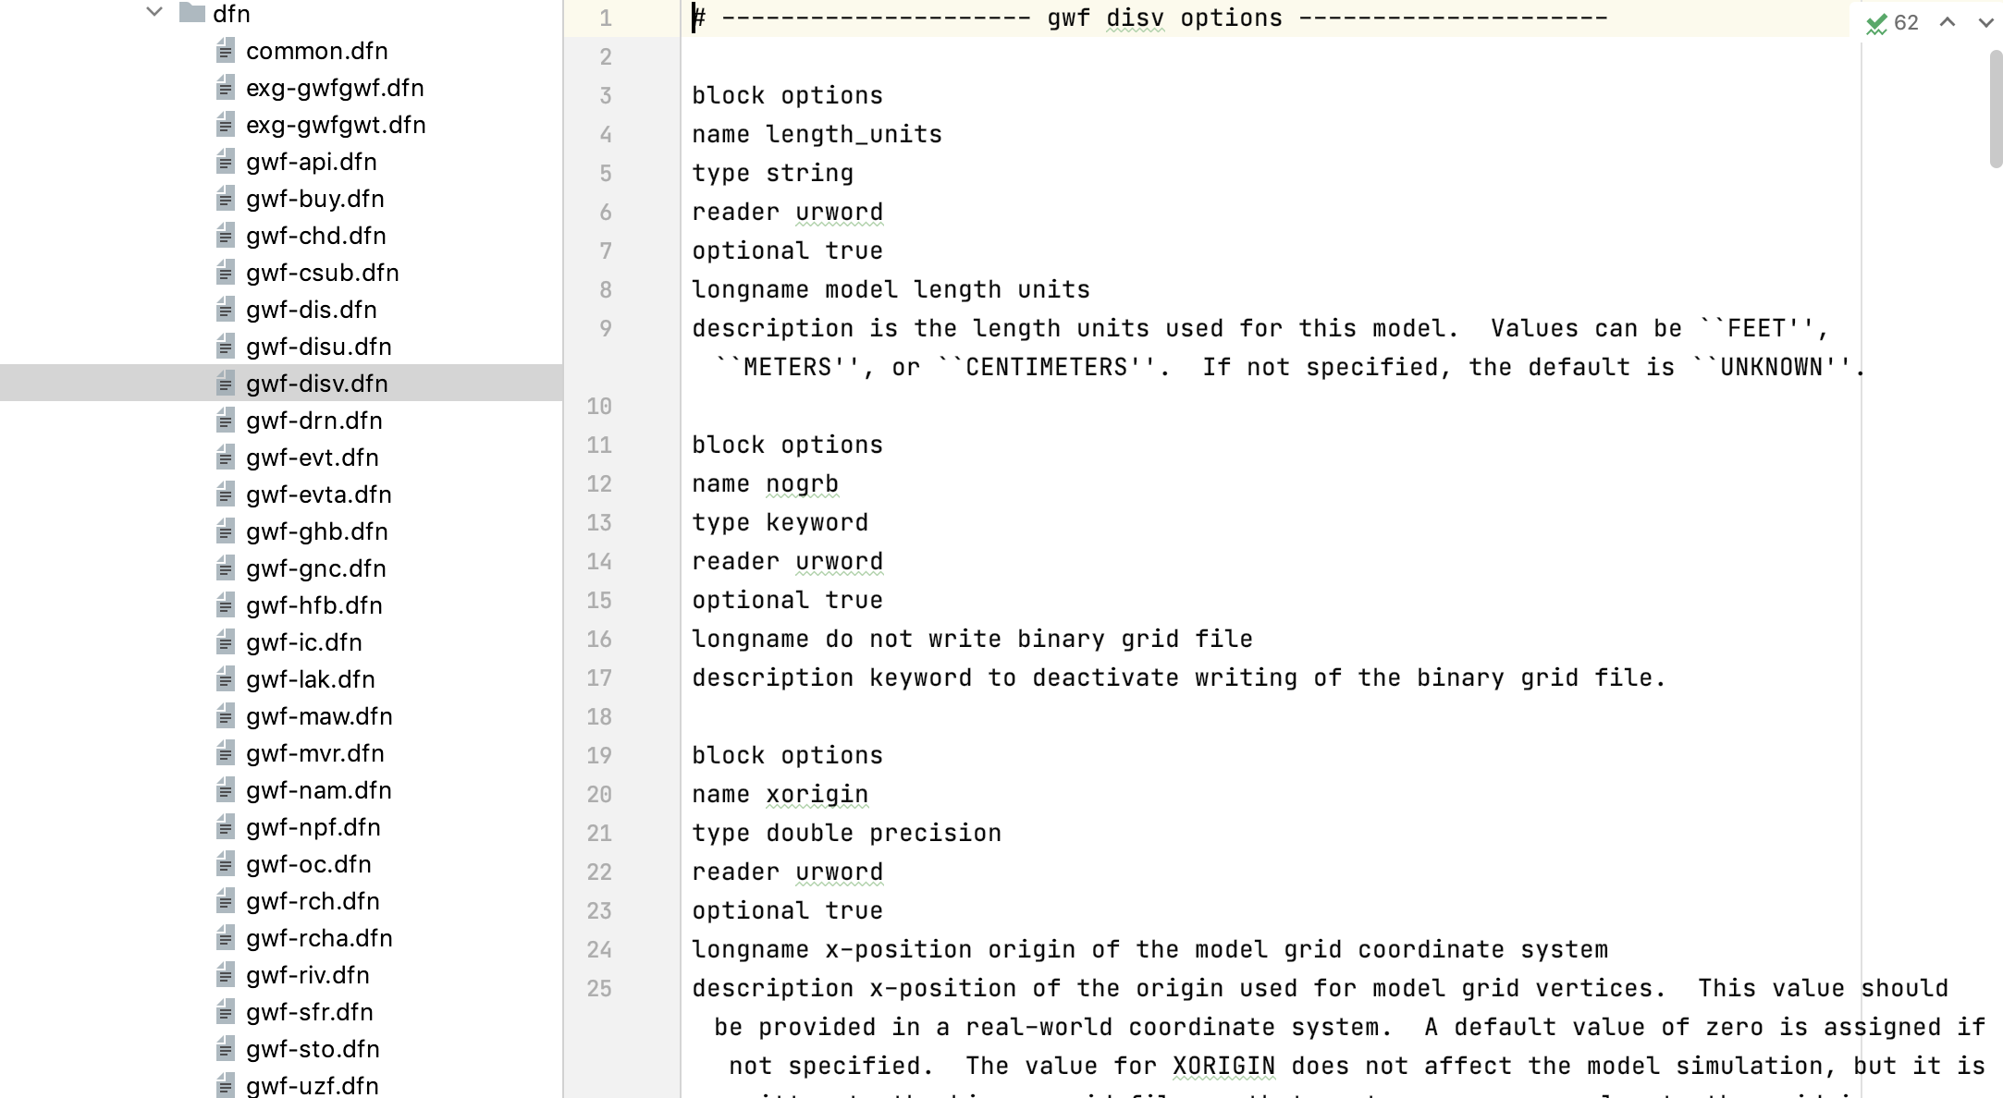
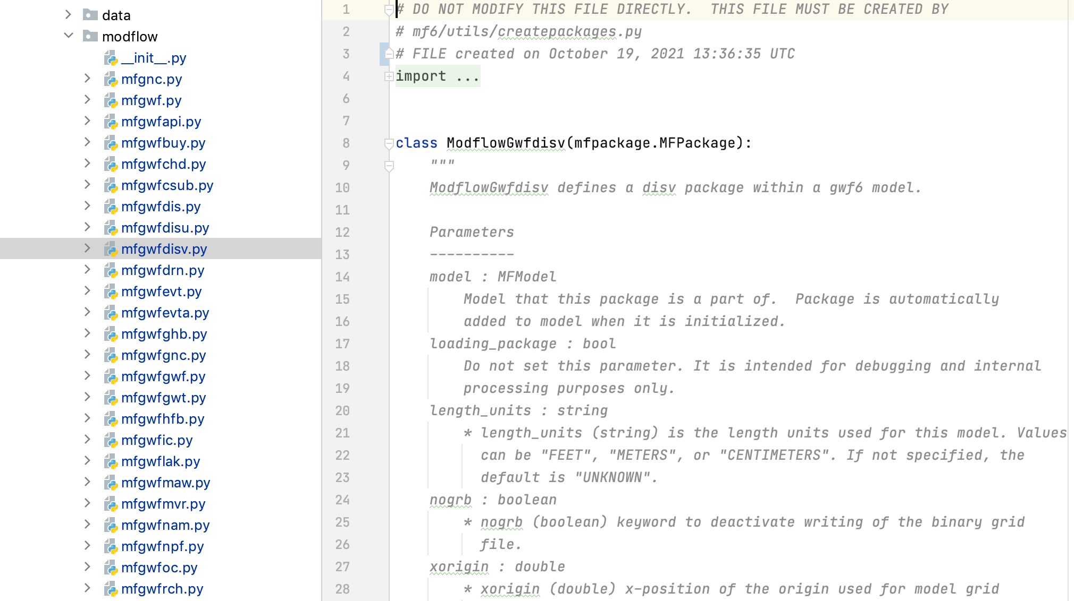
MODFLOW 6 Input and Output Guide
Input description
FloPy Python Classes for MODFLOW 6

