Slide 1
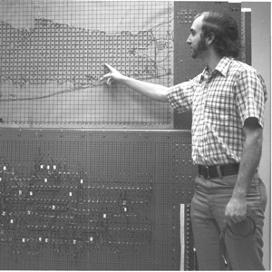
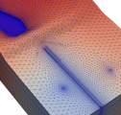
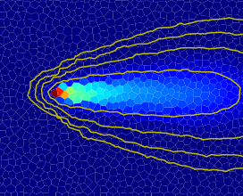



Variable Density Flow
Advanced MODFLOW Training Class, November 22, 2024, Deltares, NL

Slide 2
Approaches for Representing Variable-Density Flow
Ignore it!
Sharp interface approach
Fully coupled flow and dispersive transport approach

Slide 3
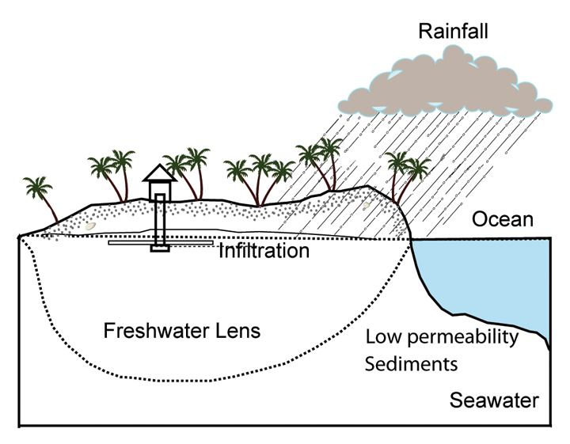
Today: fresh water lense

Slide 4
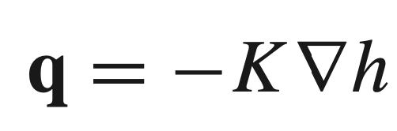
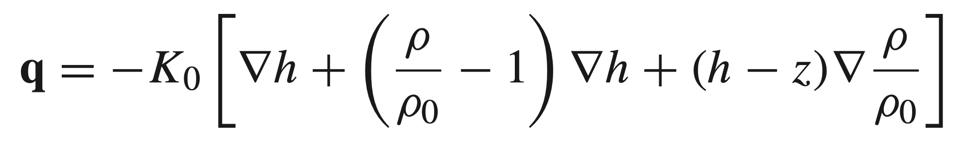
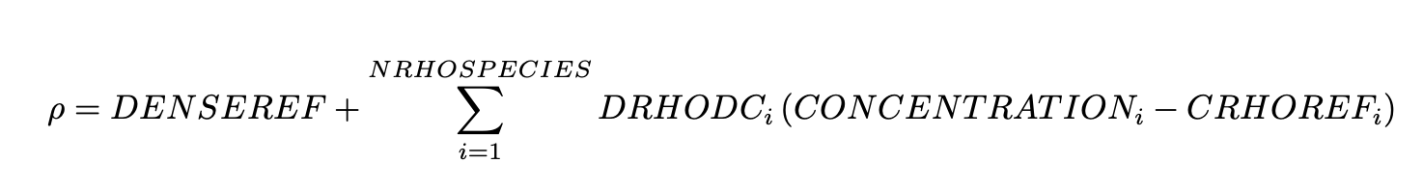
Buoyancy (BUY) Package
Constant Density Flux Expression
Variable Density Flux Expression
Density Equation of State
Density is calculated as a function of one or more concentrations in GWT models and temperature in a GWE model
Limitation: Buoyancy package cannot be used with XT3D

Slide 5
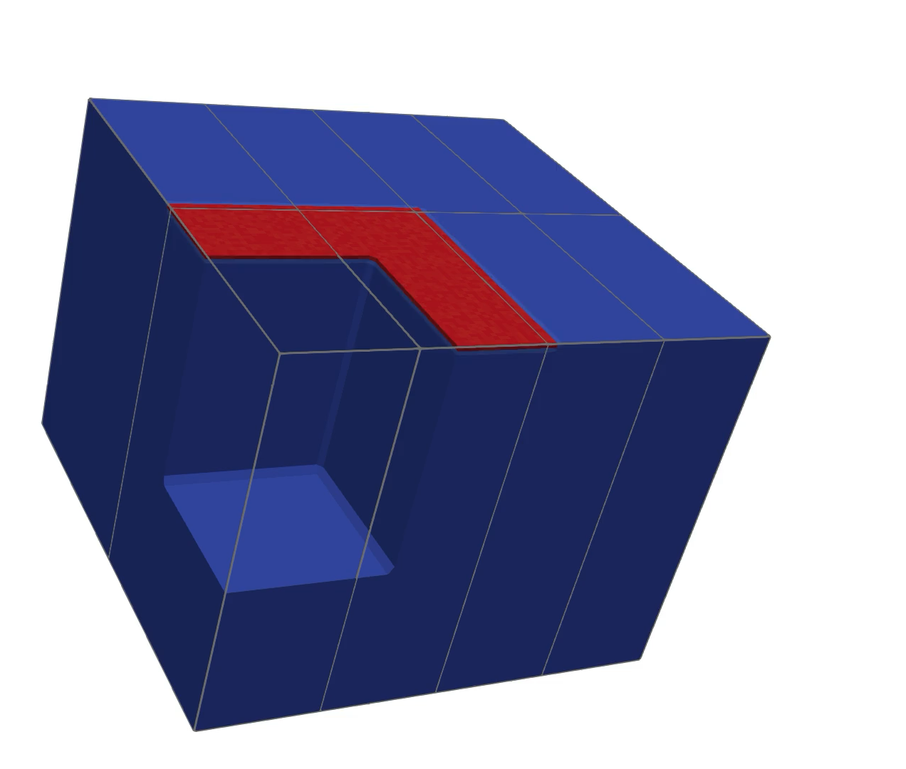
3D Salt Lake example
Coupled variable-density flow and transport simulation
Solved in parallel on a laptop using 8 cores

Slide 6
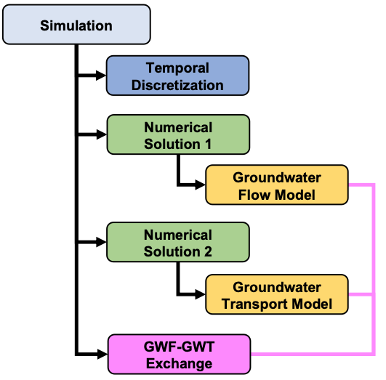
Today’s example: multi-model configuration
Activate Buoyancy (BUY) Package in the GWF Model
Run GWF and transport models (GWT) together in the same simulation (requires GWF-GWT Exchanges)

