Slide 1
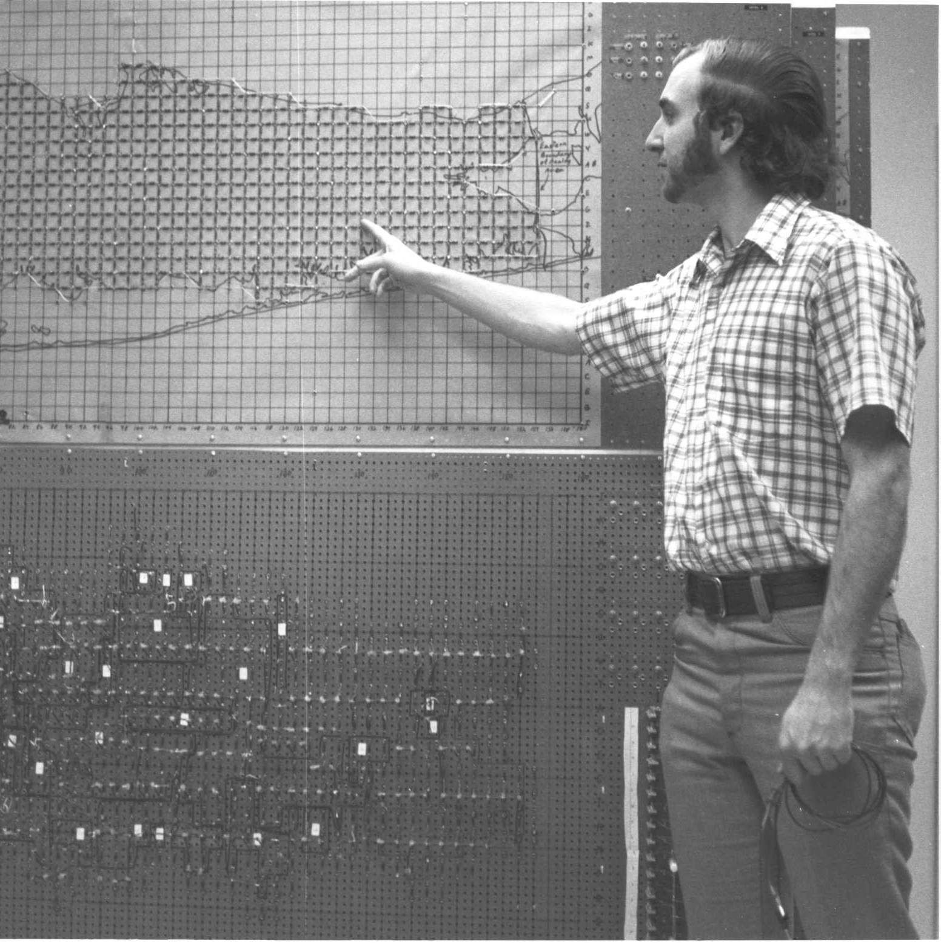
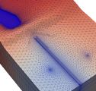
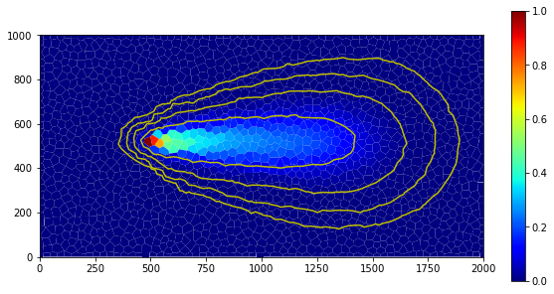
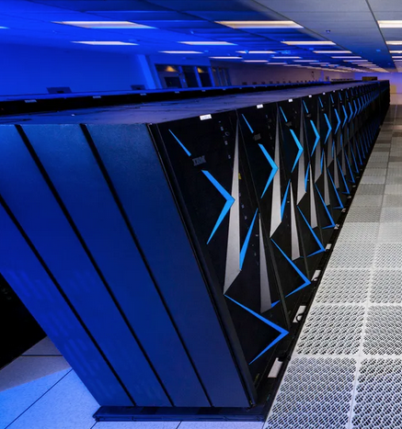


Welcome
Advanced MODFLOW Training Class, December 1st, 2024, Deltares, NL

Slide 2
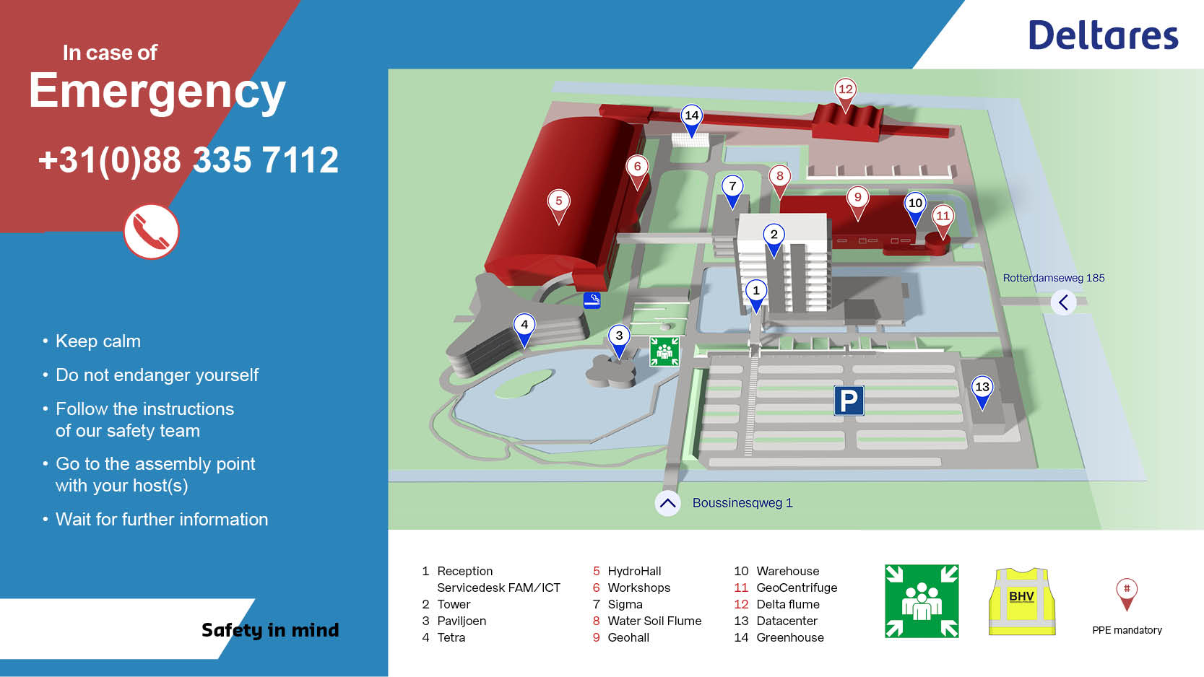

Slide 3
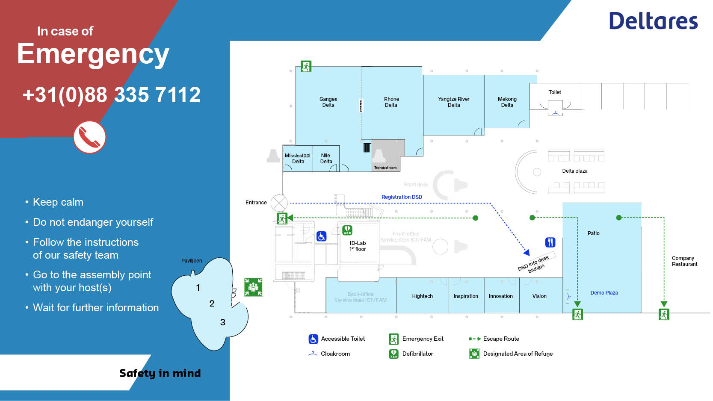

Slide 4
Introductions

Slide 5
WiFi
See email sent (Did everyone get it?)
Or, scan the QR code
Or, go to eduroam.deltares.nl
Pre-class Installations
E-mail about setup (including WSL)
pixi installation from class github:
https://github.com/jdhughes-usgs/modflow-dsd24

Slide 6
Badge
Please pick up your badge in the coffee break, if you haven’t already

Slide 7
Agenda
ARRIVAL — 08:30 to 09:00
Welcome and Introductions — 09:00 to 09:10
Overview of MODFLOW 6 — 09:10 to 09:30
Brief introduction to FloPy and pixi — 09:30 to 10:15
COFFEE BREAK — 10:15 to 10:35
Variable density groundwater flow and transport — 10:35 to 11:55
GROUP PICTURE — 11:55 to 12:00
LUNCH BREAK — 12:00 to 13:00
Aquifer storage and recovery — 13:00 to 14:30
COFFEE BREAK — 14:30 to 14:50
Extended MODFLOW 6 — parallel, netcdf/ugrid — 14:50 to 15:45
MODFLOW API demonstration — 15:45 to 16:45
Wrap up and evaluation — 16:45 to 17:00
DRINKS — 17:00 to 18:00

