Slide 1
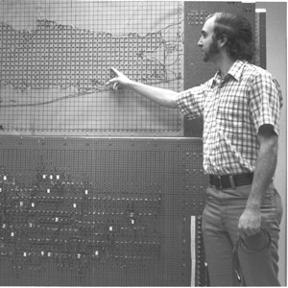
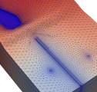
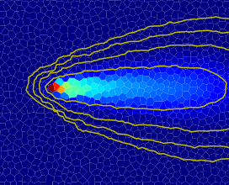
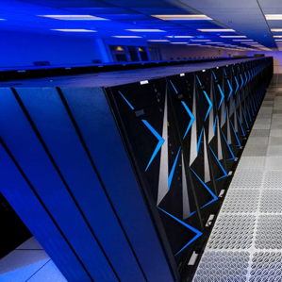


Variable Density Flow
Advanced MODFLOW Training Class, November 22, 2024, Deltares, NL

Slide 2
Title
points

Slide 3
Multi-model configuration
Simulation
Blabla
Temporal Discretization
Numerical Solution 1
Groundwater Flow Model 1
Numerical Solution 2
Groundwater Transport Model 1
Groundwater Transport Model 2
GWF-GWT
Exchange 1
GWF-GWT
Exchange 2

Slide 4
Buoyant Flow
Blabla

