Slide 1
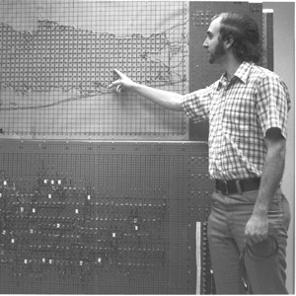
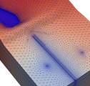
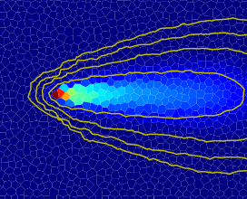



Extended MODFLOW Parallel Computing and NetCDF
Advanced MODFLOW Training Class, November 22, 2024, Deltares, NL

Slide 2
Title
points

