Slide 1
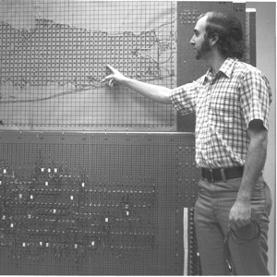
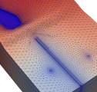
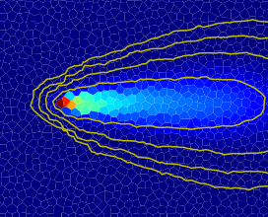



Introduction to FloPy
Advanced MODFLOW Training Class, November 22, 2024, Deltares, NL

Slide 2
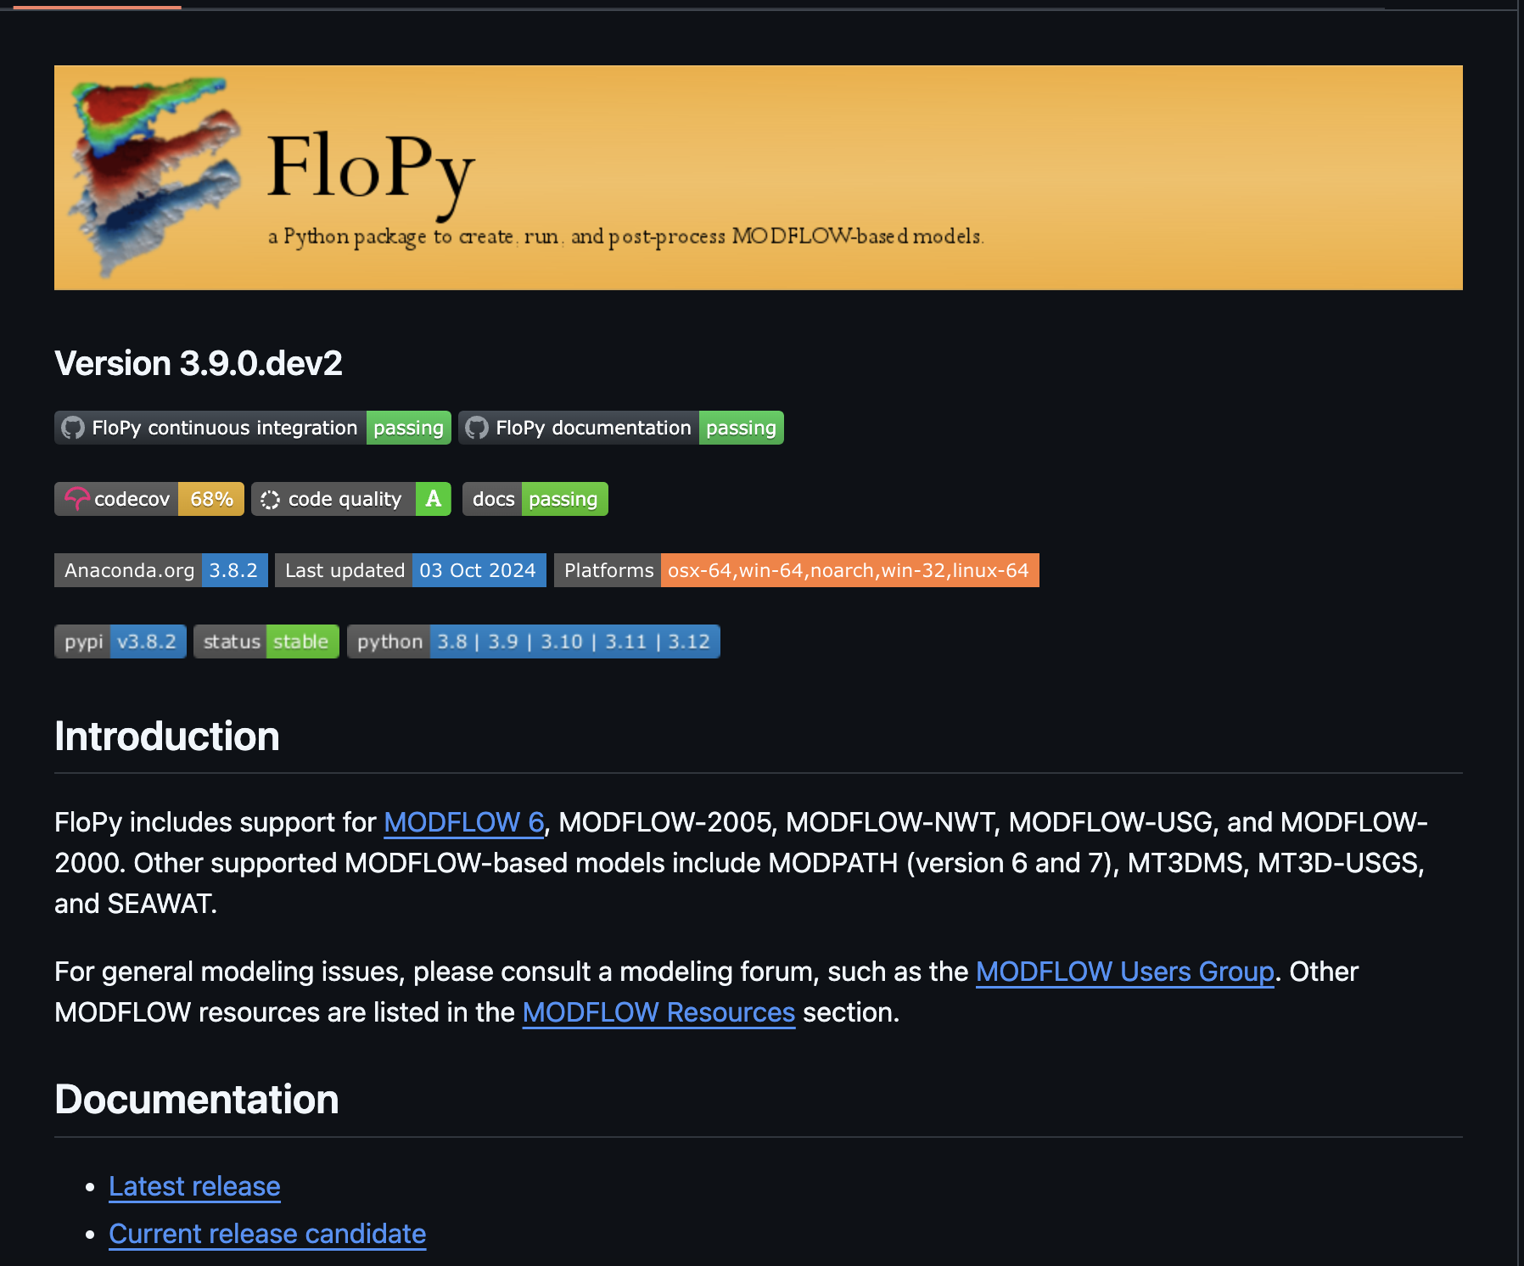
FloPy
Create structured and unstructured models
Geoprocessing of spatial features and raster data to develop model input for supported discretization types
Functionality to provide direct access to simulated output data
Plotting structured and unstructured discretization types
Export model data to shapefiles, NetCDF, and VTK formats
FloPy GitHub repository

Slide 3
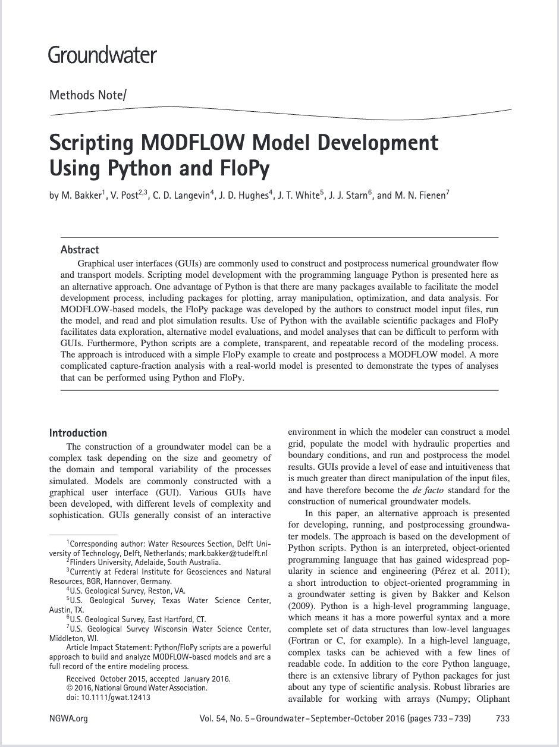
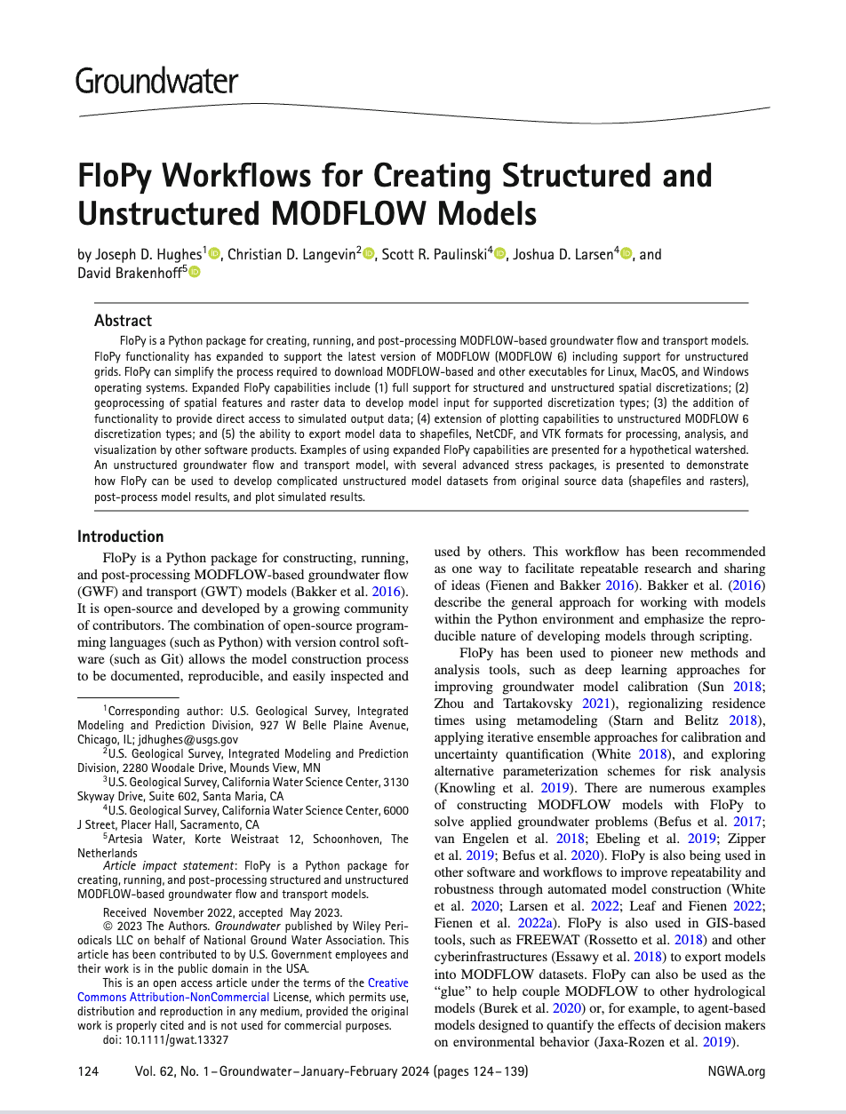
Baker et al. (2016)
Hughes et al. (2024)

Slide 4
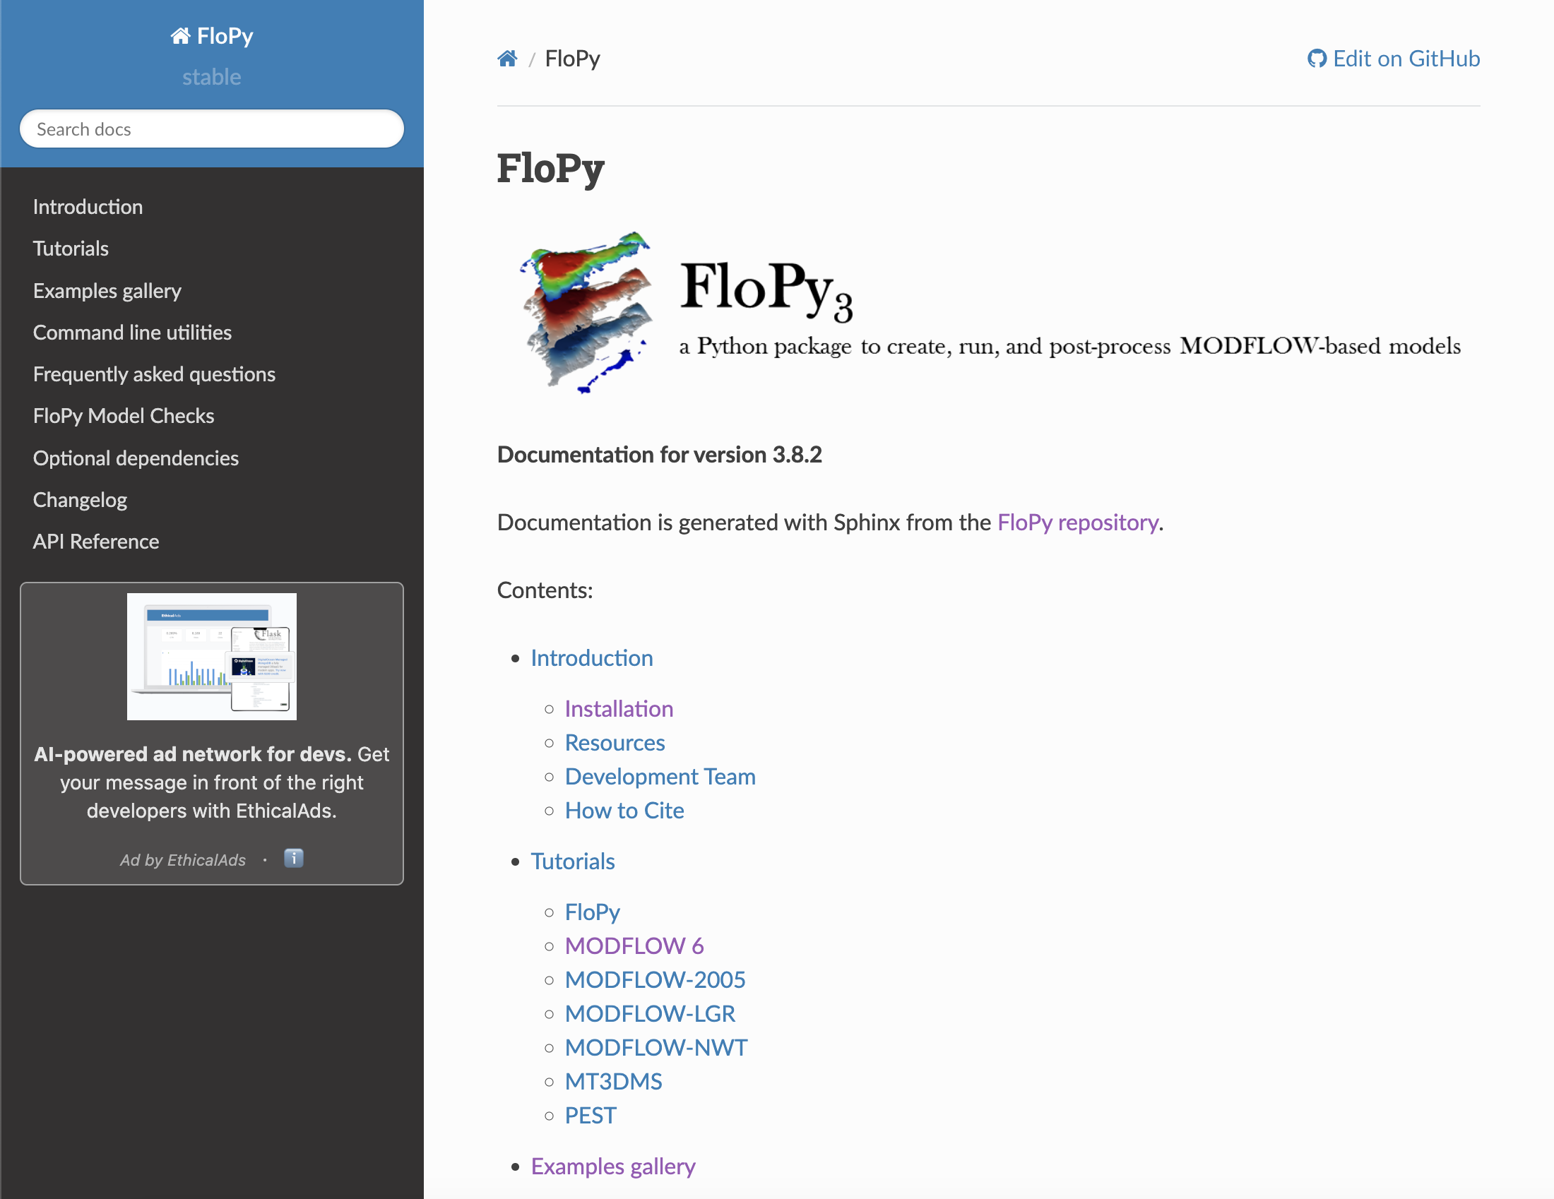
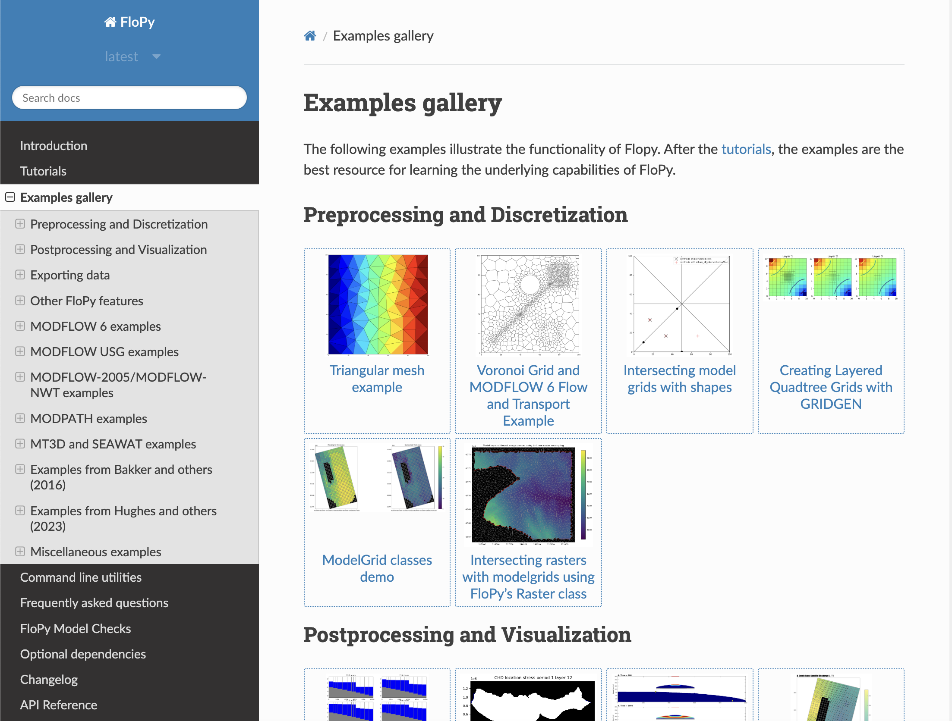
FloPy
FloPy readthedocs

Slide 5
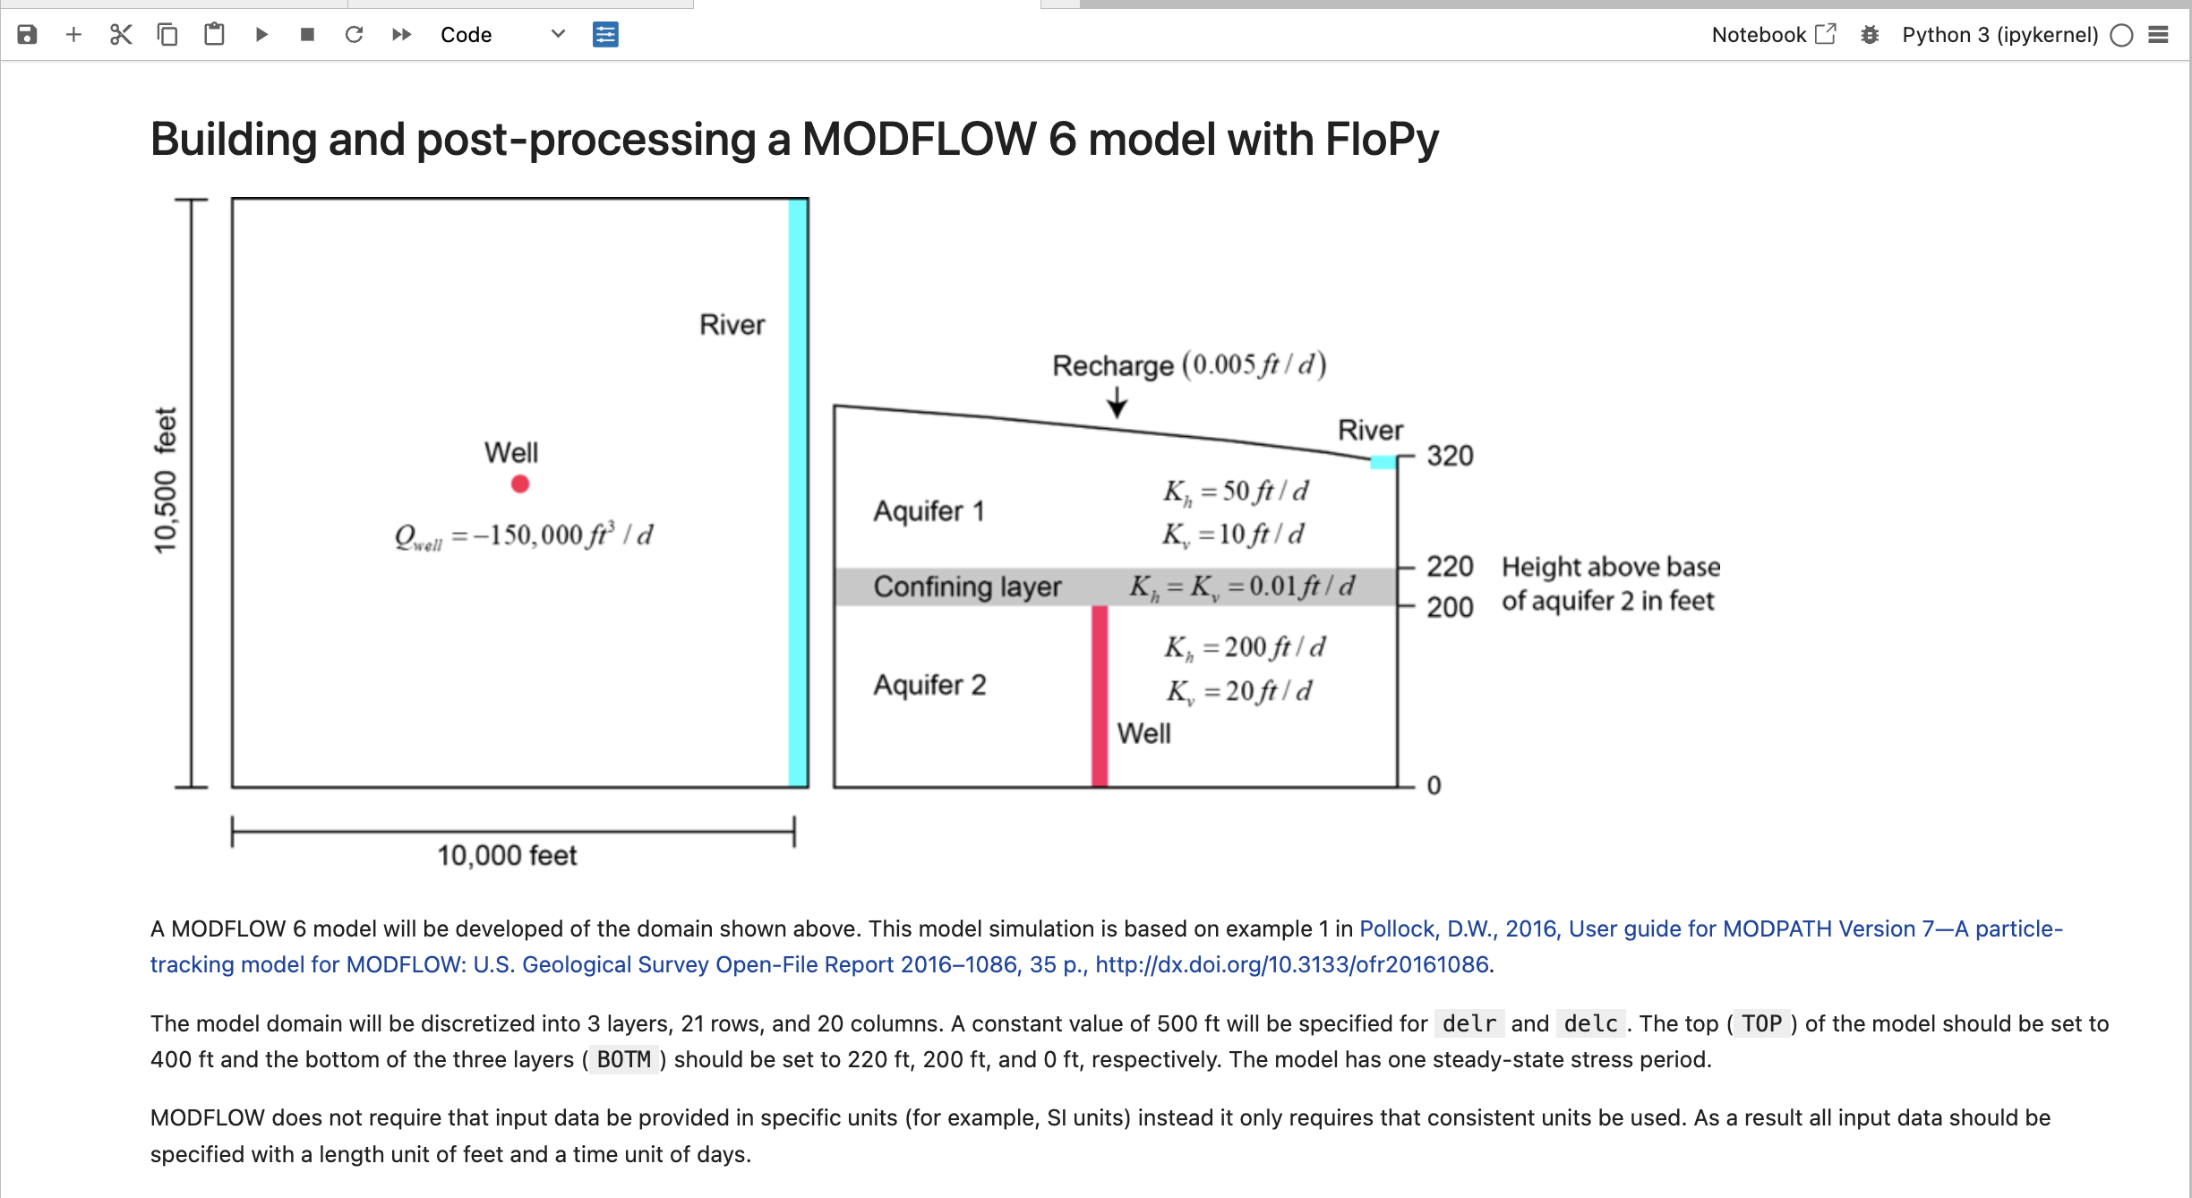
FloPy exercise
Create a simple MODFLOW 6 model
Steady-state simulation
Two aquifers separated by a confining unit
Areal recharge
River boundary
Groundwater pumpage from the confined aquifer
Run the model
Post-process the results

