Slide 1
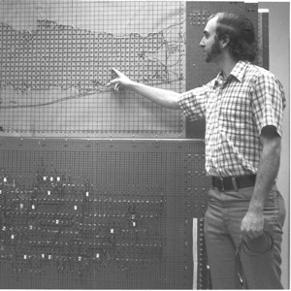
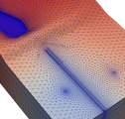
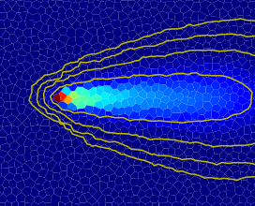



MODFLOW API
Advanced MODFLOW Training Class, November 22, 2024, Deltares, NL

Slide 2
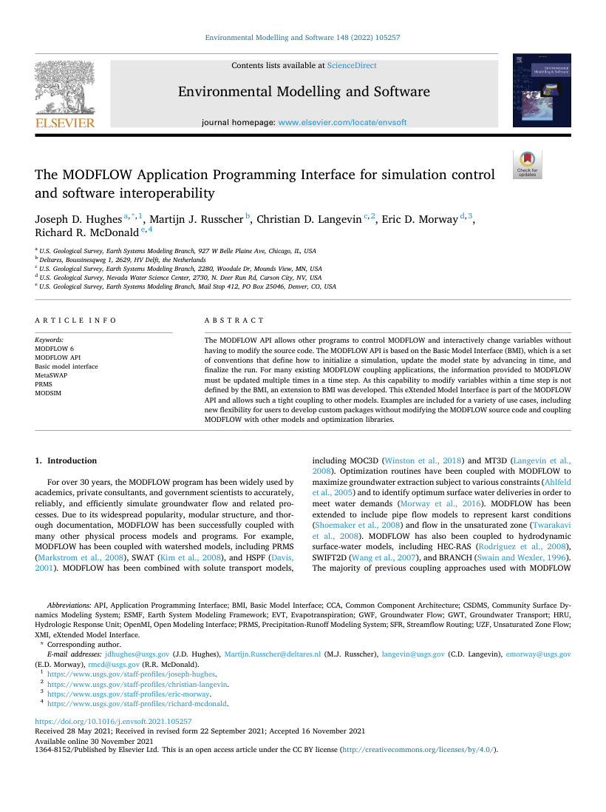
MODFLOW API
Full control of MODFLOW while it’s running
Well-defined interfaces based on Basic Model Interface (BMI) standard
Access to MODFLOW internal variables at runtime
Uses a shared library (DLL) version of MODFLOW 6 based on the same code as the executable version
API use cases
Couple MODFLOW with another model
Prototype or develop new MODFLOW packages
“Observe” MODFLOW behavior during a simulation
Hughes et al. (2022)

Slide 3
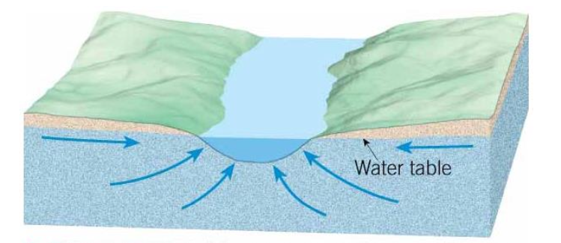
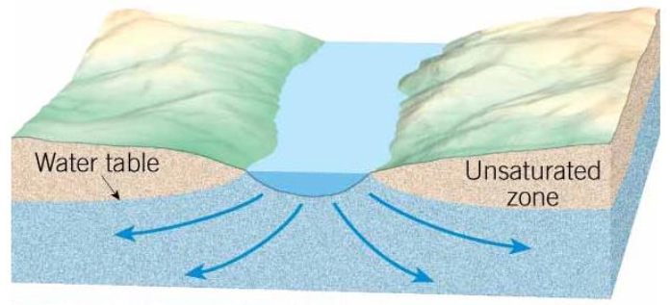
MODFLOW API exercise
Modify the behavior of the river package to alter the conductance in gaining reaches
Inspired by Zaadnoordijk (2009), which used a combination of a general head and drain boundaries to increase the conductance when the aquifer is discharging to the river
Observe simulated results at runtime
Use the modflowapi python package
Access internal variables
Control execution of MODFLOW
gaining
losing

