Slide 1
Headviewer
Training program to view output heads
/software/headviewer/HeadViewerMF6

Slide 2
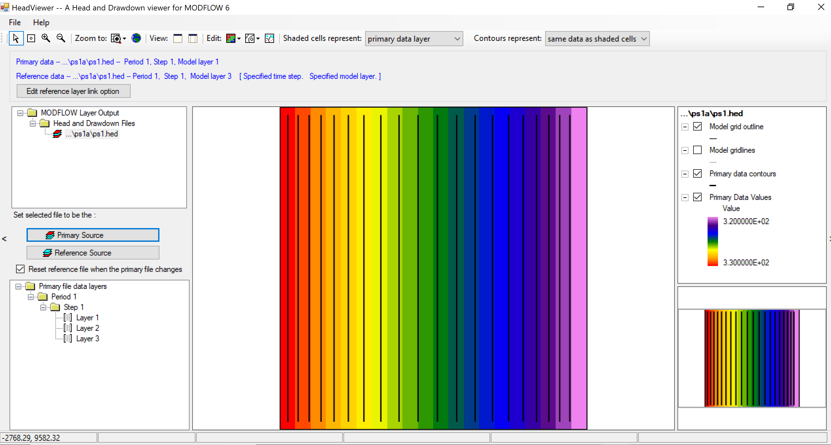

Slide 3
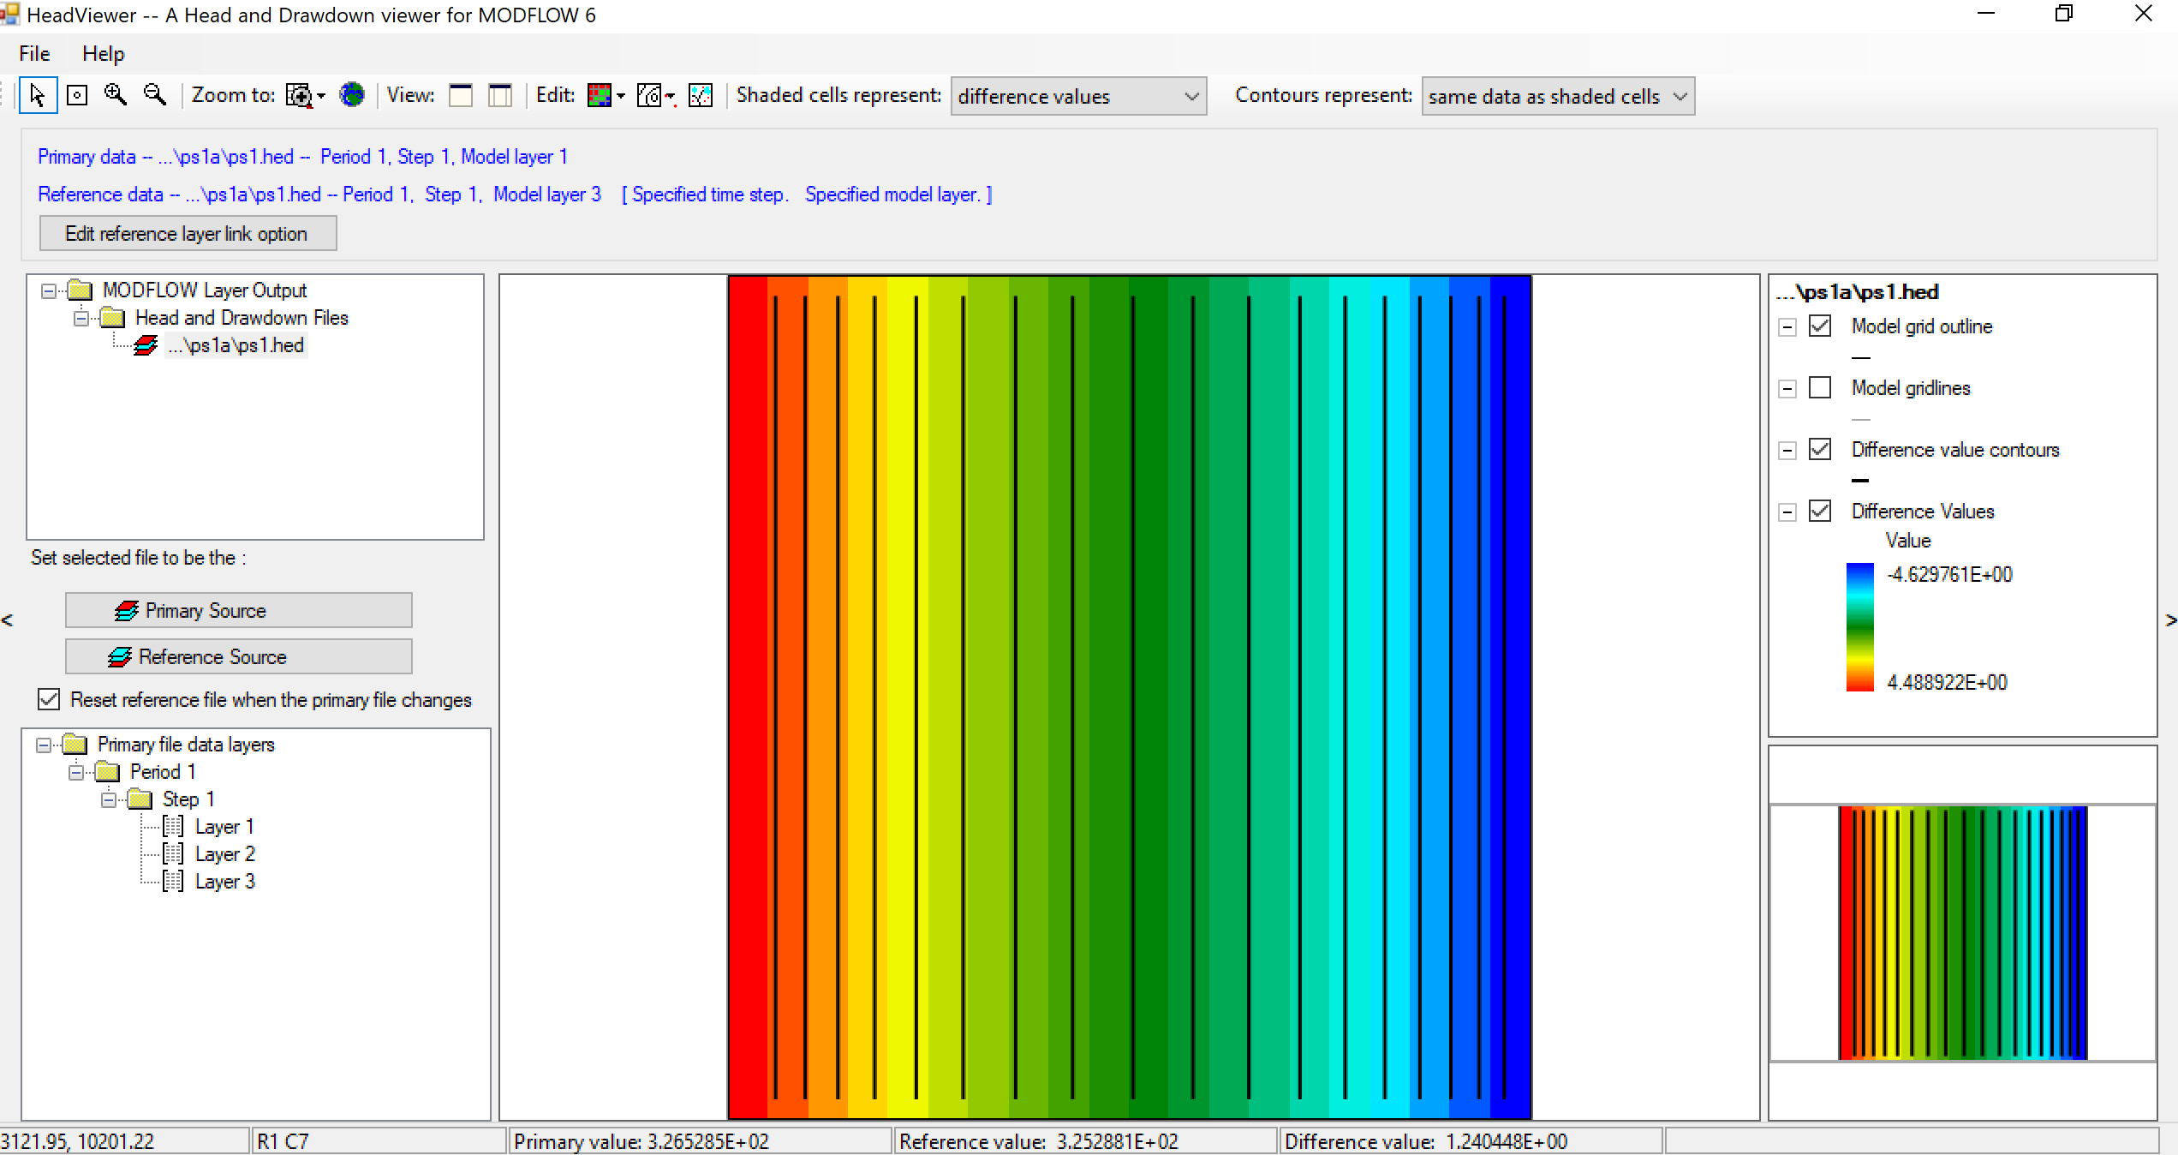

Slide 4
ModelViewer (for MF6)
Program to view output heads and vectors
/bin/ModelViewer_for_Modflow6/mvmf6

Slide 5
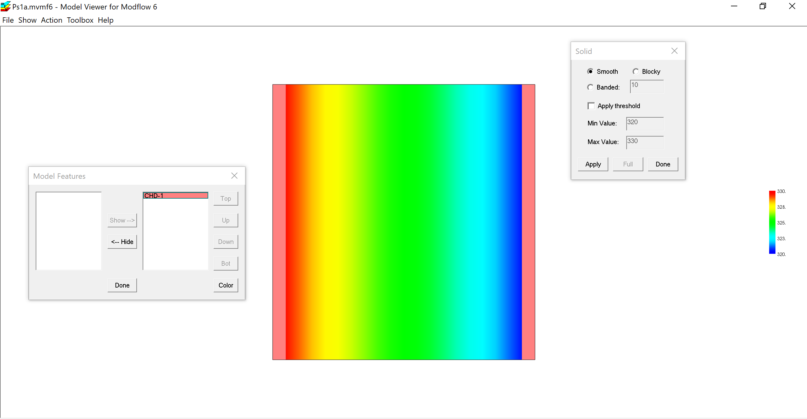

Slide 6
