Slide 1
Headviewer
Training program to view output heads
/software/headviewer/HeadViewerMF6

Slide 2
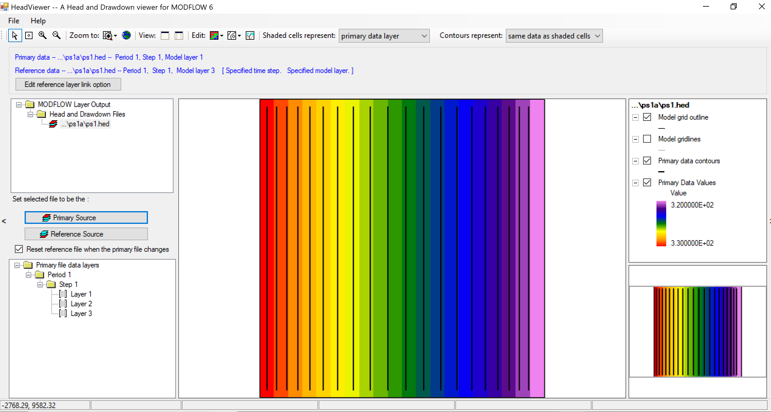

Slide 3
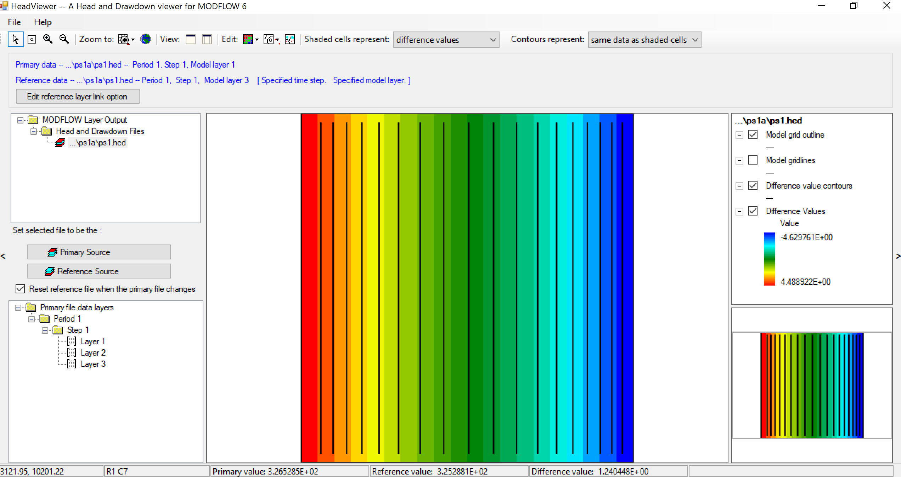

Slide 4
ModelViewer (for MF6)
Program to view output heads and vectors
Download program from:
https://www.usgs.gov/software/model-viewer-program-three-dimensional-visualization-ground-water-model-results

Slide 5
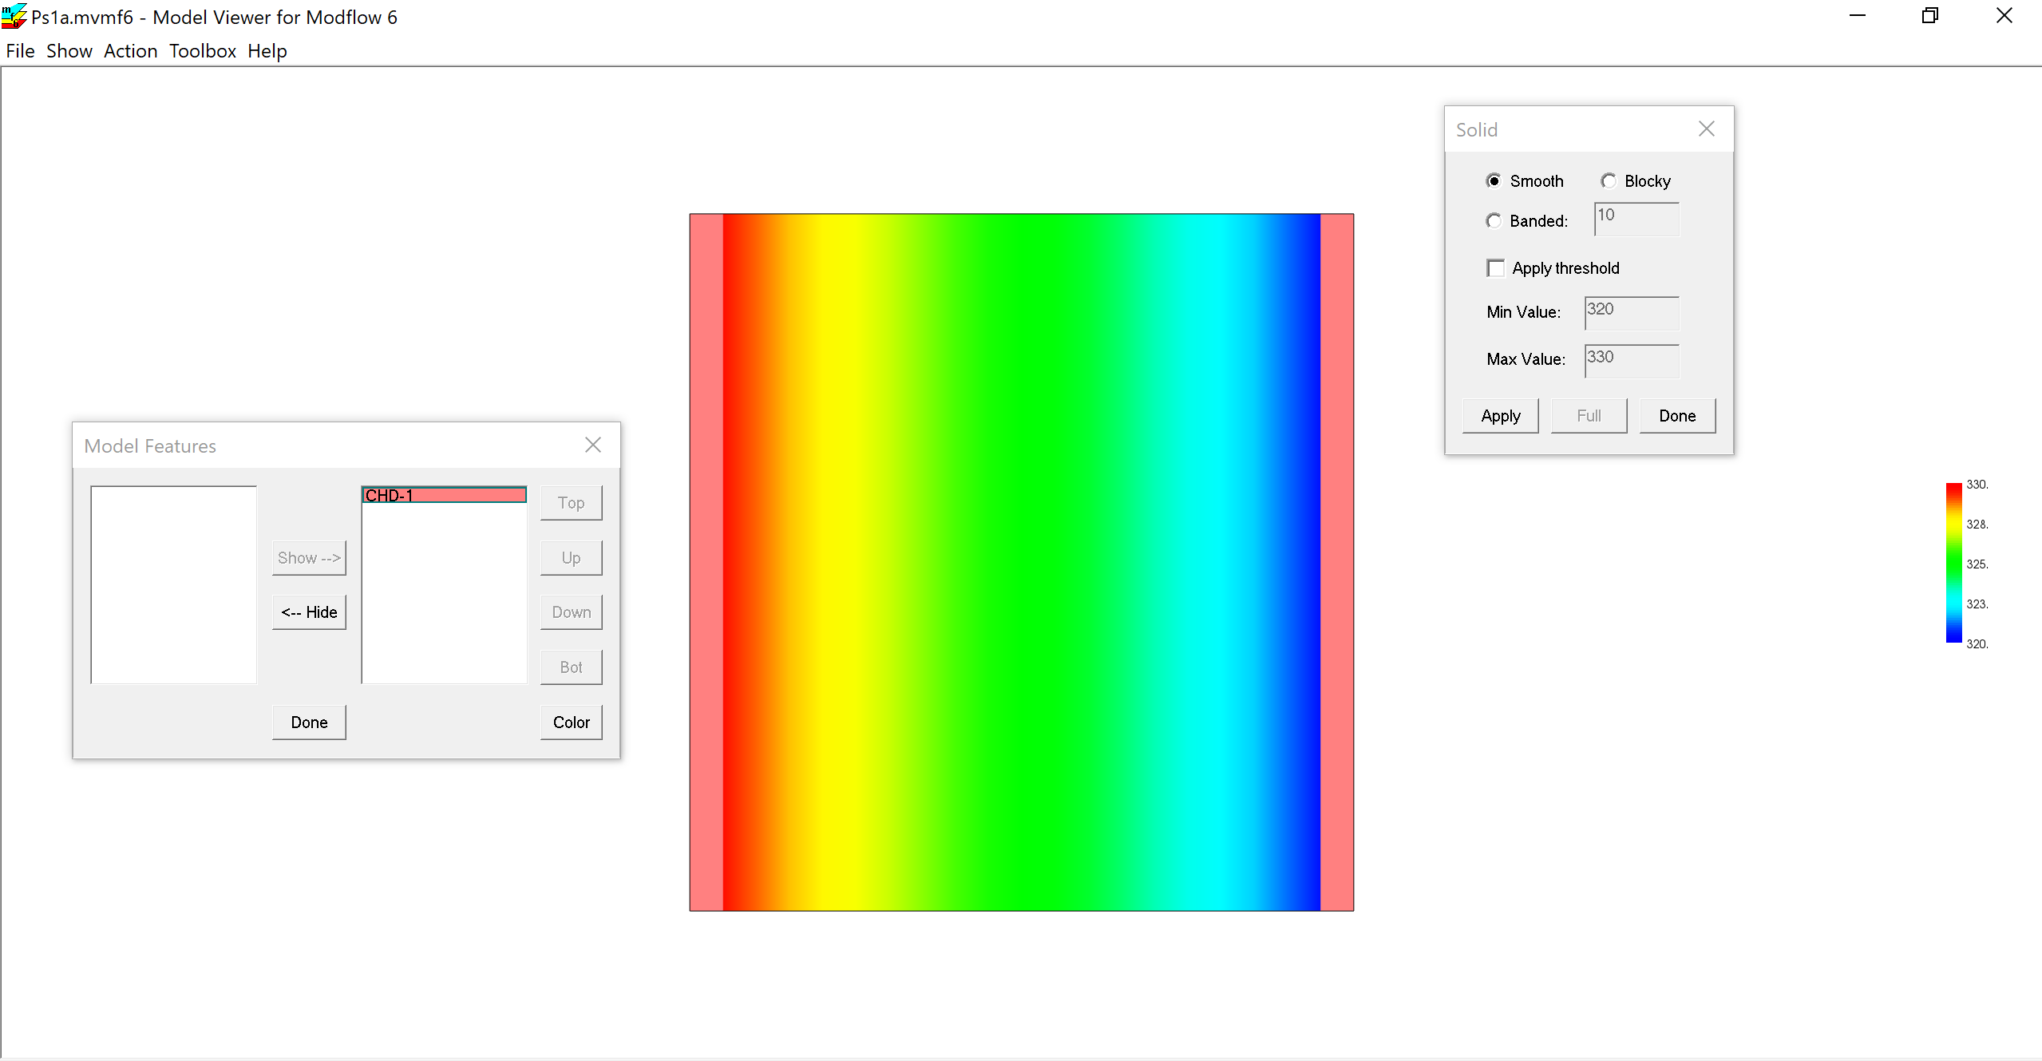

Slide 6
