Slide 1
Storage and Stress Packages

Slide 2
Packages
Internal Packages
Storage (STO) Package
Time-Varying Storage (TVS) Package¹
Skeletal Storage, Compaction and Subsidence (CSUB) Package ¹
Horizontal Flow Barrier (HFB) Package¹
Buoyancy (BUY) Package¹
Viscosity (VSC) Package¹
¹ Will not be covered
Standard Stress Packages
Constant Head (CHD)
Recharge (RCH)
Well (WEL)
River (RIV)
Drain (DRN)
General Head Boundary (GHB)
Evapotranspiration (EVT)
Advanced Stress Packages²
² Will be covered later

Slide 3


Storage (STO) Packages
Steady state if STO Package not specified for a simulation
Aquifer storage properties are specified
Individual stress periods are marked as steady state or transient

Slide 4
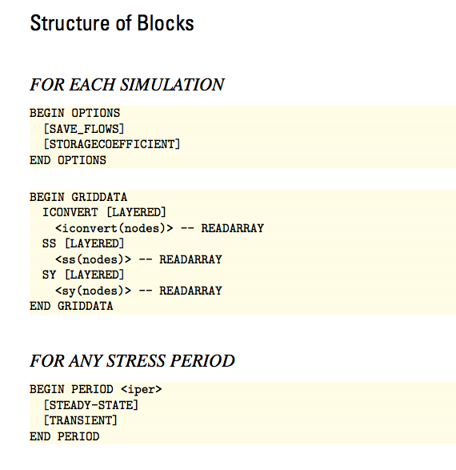
STO Input File

Slide 5
STO Input File
ICONVERT=0: cell is treated as confined for storage calculations
ICONVERT=1: cell converts between confined and unconfined depending on head

Slide 6
STO Input File

Slide 7
STO Input File
Stress periods can be marked as “STEADY-STATE” or “TRANSIENT”

Slide 8
Recharge package

Slide 9
Recharge Definition
Evapotranspiration
Precipitation
Runoff
Recharge
Recharge = Precipitation – Runoff – Evapotranspiration

Slide 10

Recharge Formulation
Q_{R} = I x A
I is recharge rate (L/T) entered by user
A is the cell area
Negative values indicate discharge
Applied directly to a cell – percolation time through the unsaturated zone is not represented
RHS = -Q_{R}
Only complication is deciding which cells receive recharge

Slide 11
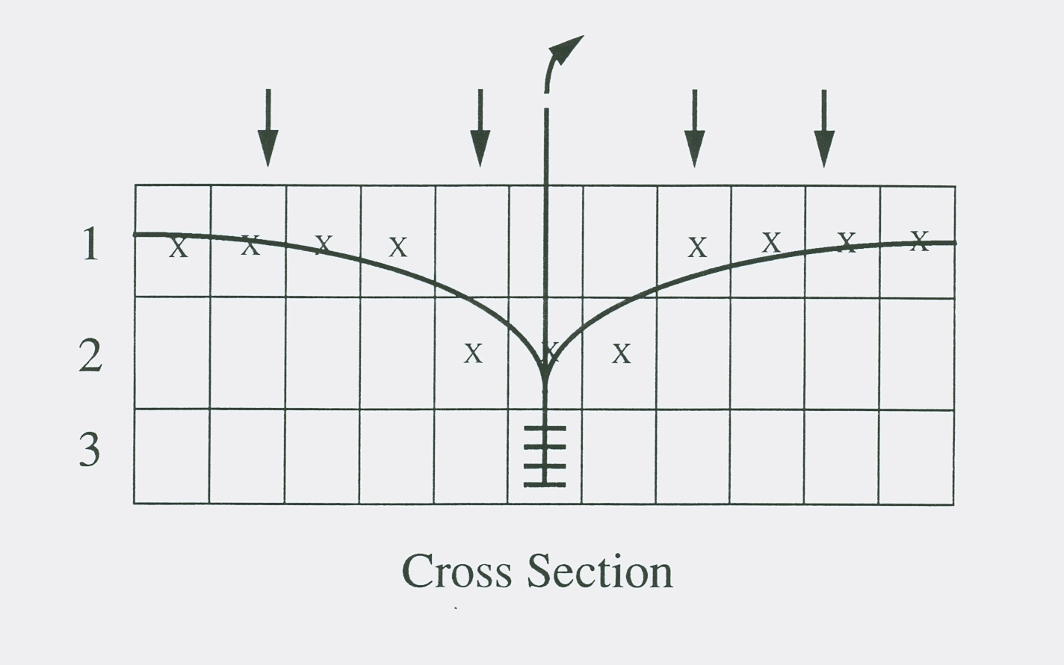
Apply Recharge to Highest Active Layers (default)
Recharge applied to cells with an X

Slide 12
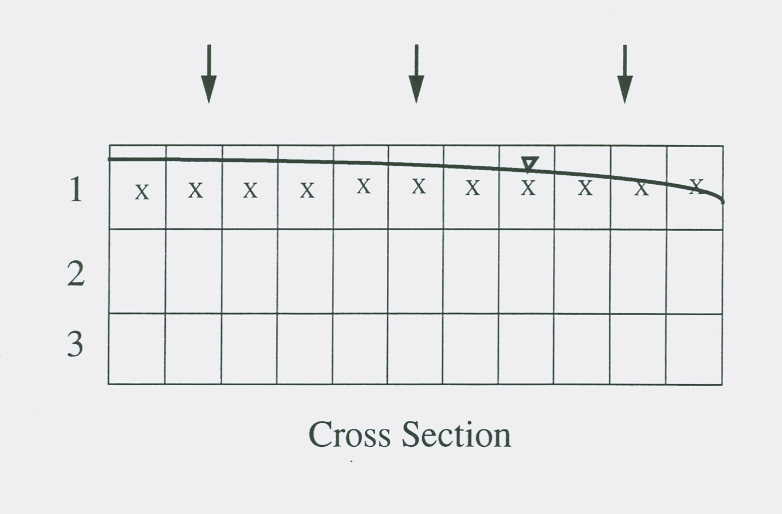
Apply Recharge to Top Layer
Recharge applied to cells with an X

Slide 13
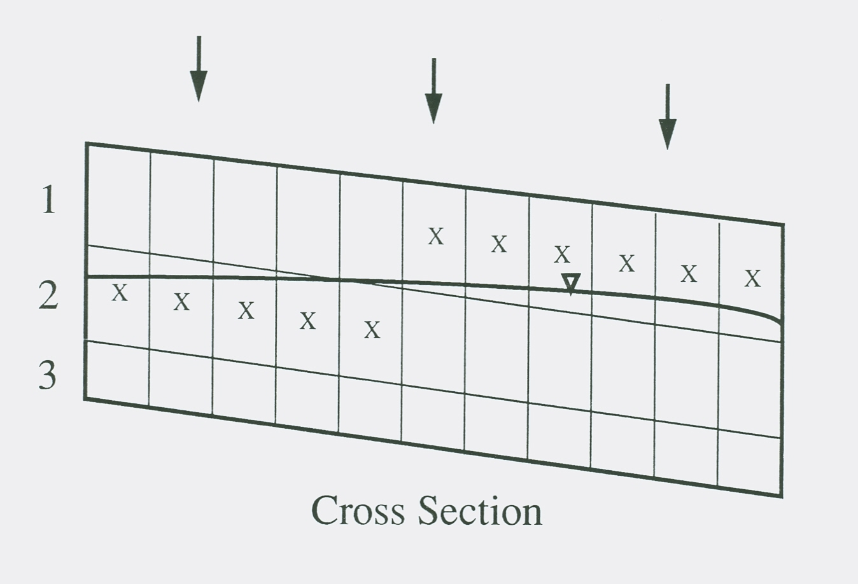
Apply Recharge to Specified Layers
Recharge applied to cells with an X

Slide 14
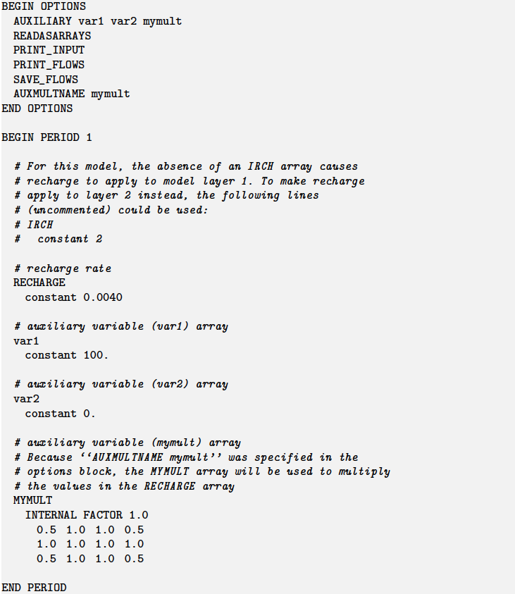
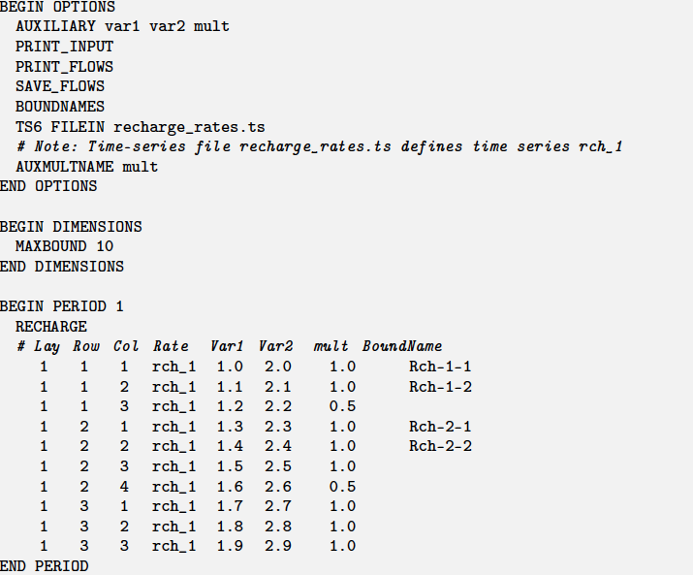
Recharge Package Example
Array-based input
List-based input

Slide 15
Well package

Slide 16
Well Package
Q = User-specified Q
Use consistent units (L3/T)
Negative values indicate discharge
Positive values indicate injection
RHS = -Q
AUTO_FLOW_REDUCE can be used to turn wells off as head in cell approaches cell bottom

Slide 17
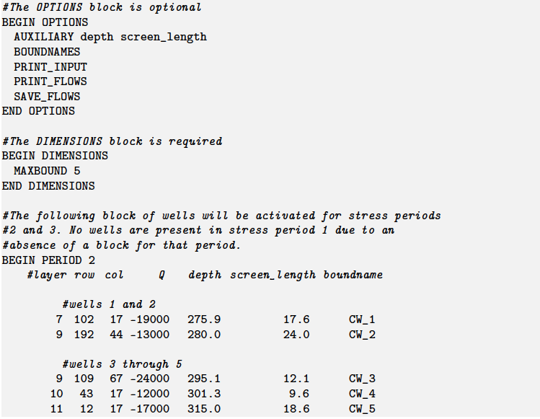
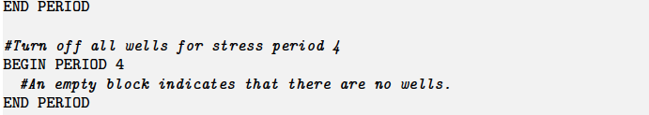
Well Package Input

Slide 18
River package

Slide 19
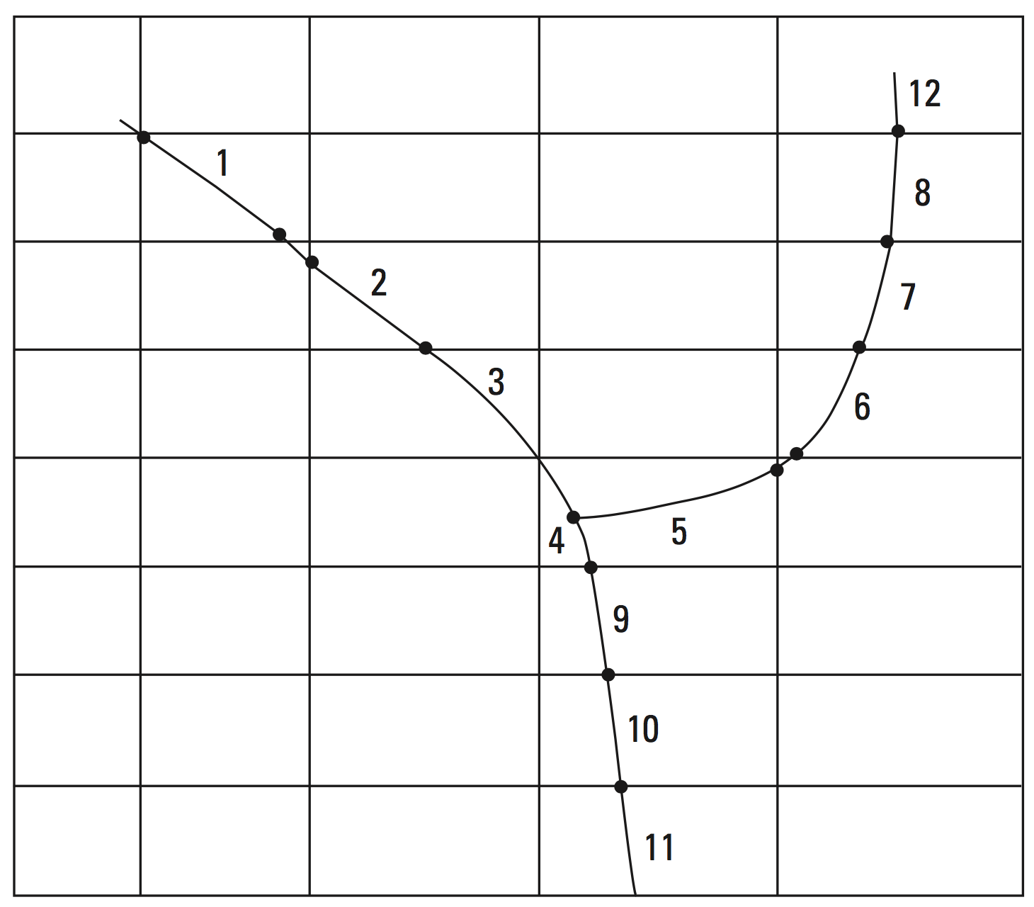
River Package
Simulates the impact of rivers on the aquifer – not the river itself

Slide 20
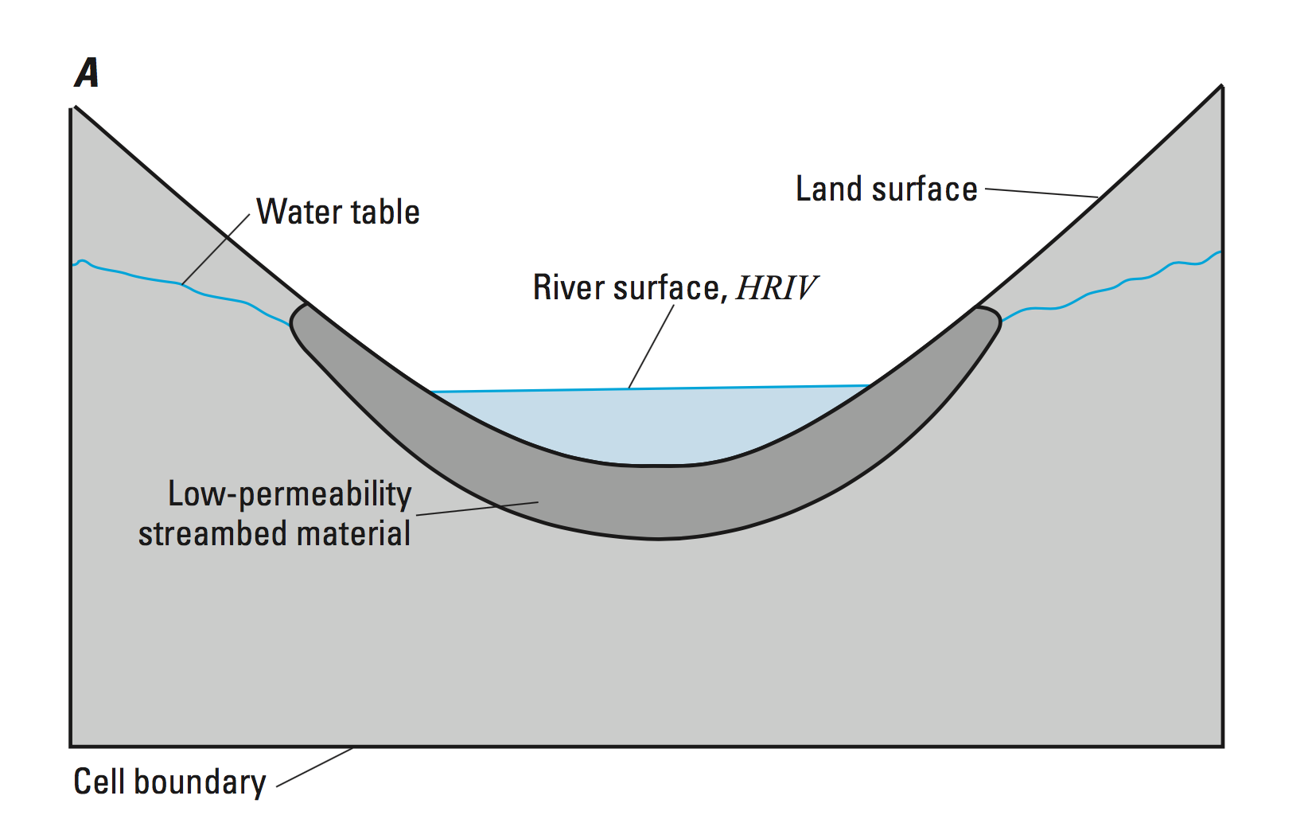
River Package – Conceptual Model

Slide 21
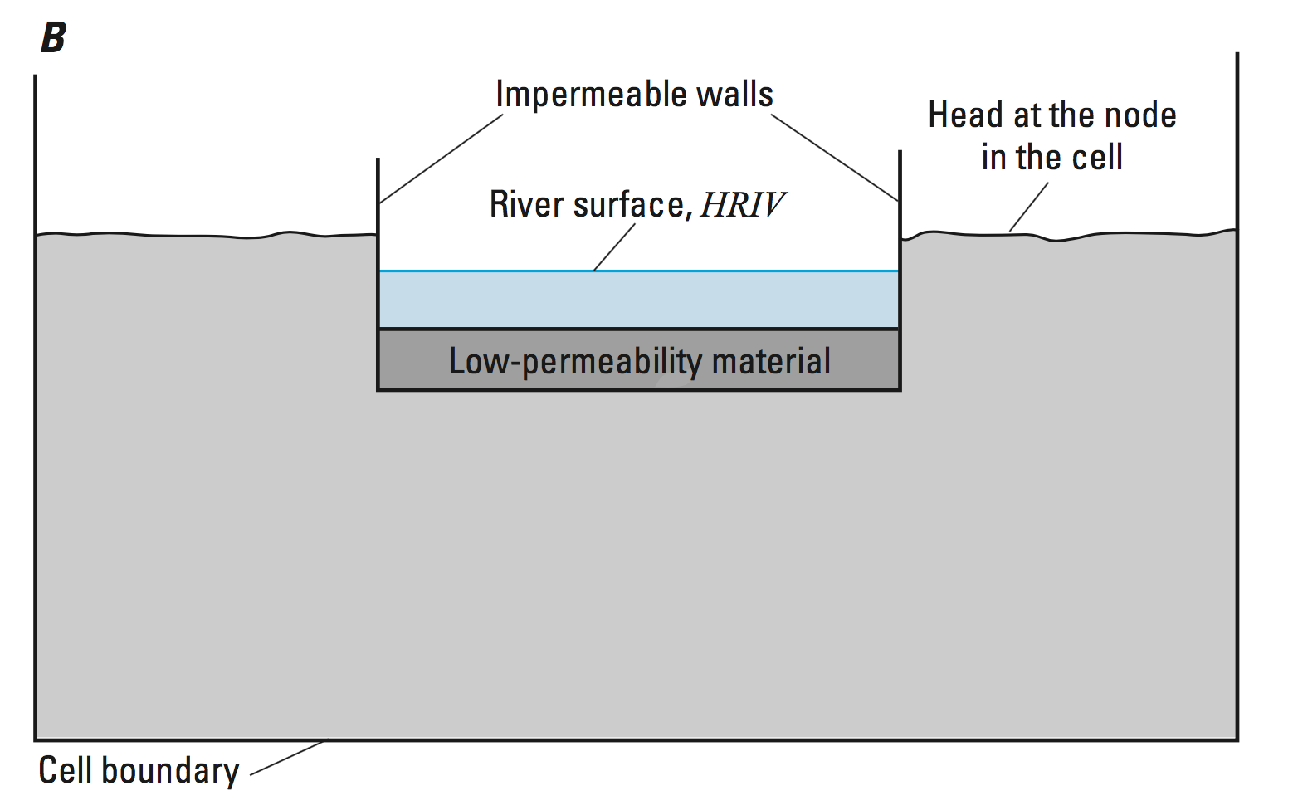
River Package – Conceptual Model

Slide 22
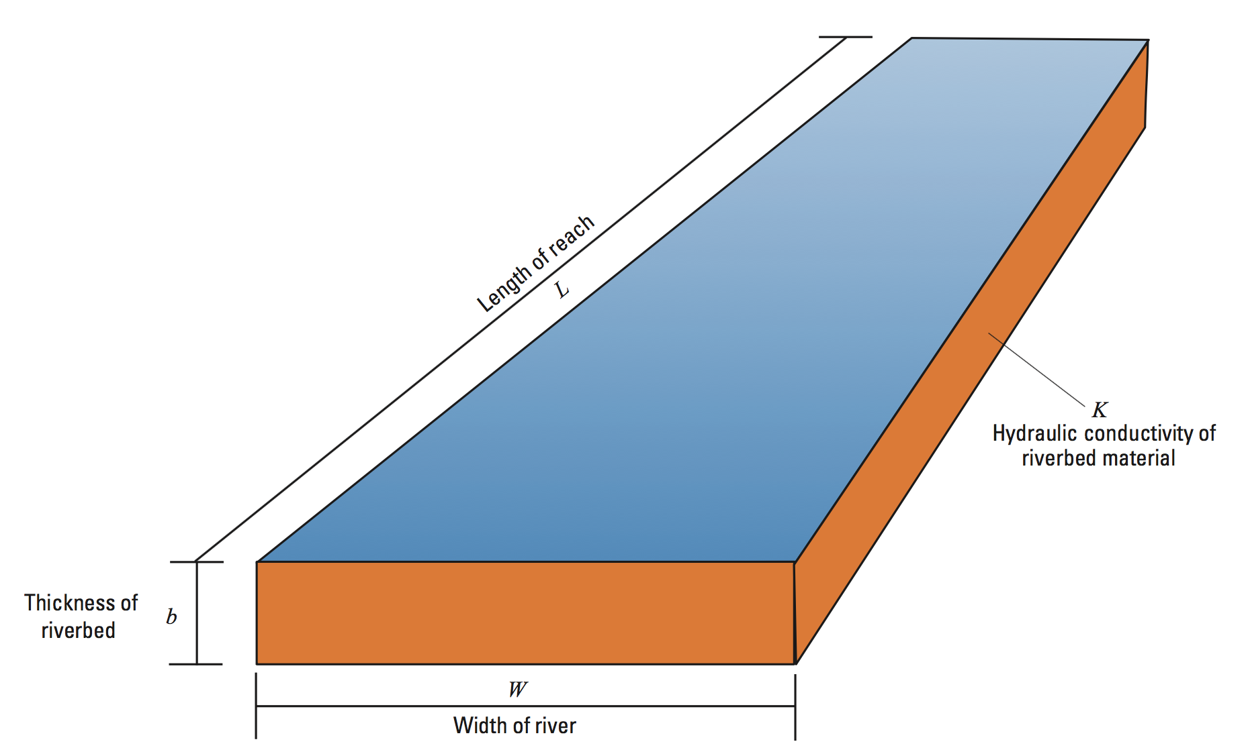
River Package – Conductance Conceptualization
Riverbed conductance = KLW/b

Slide 23
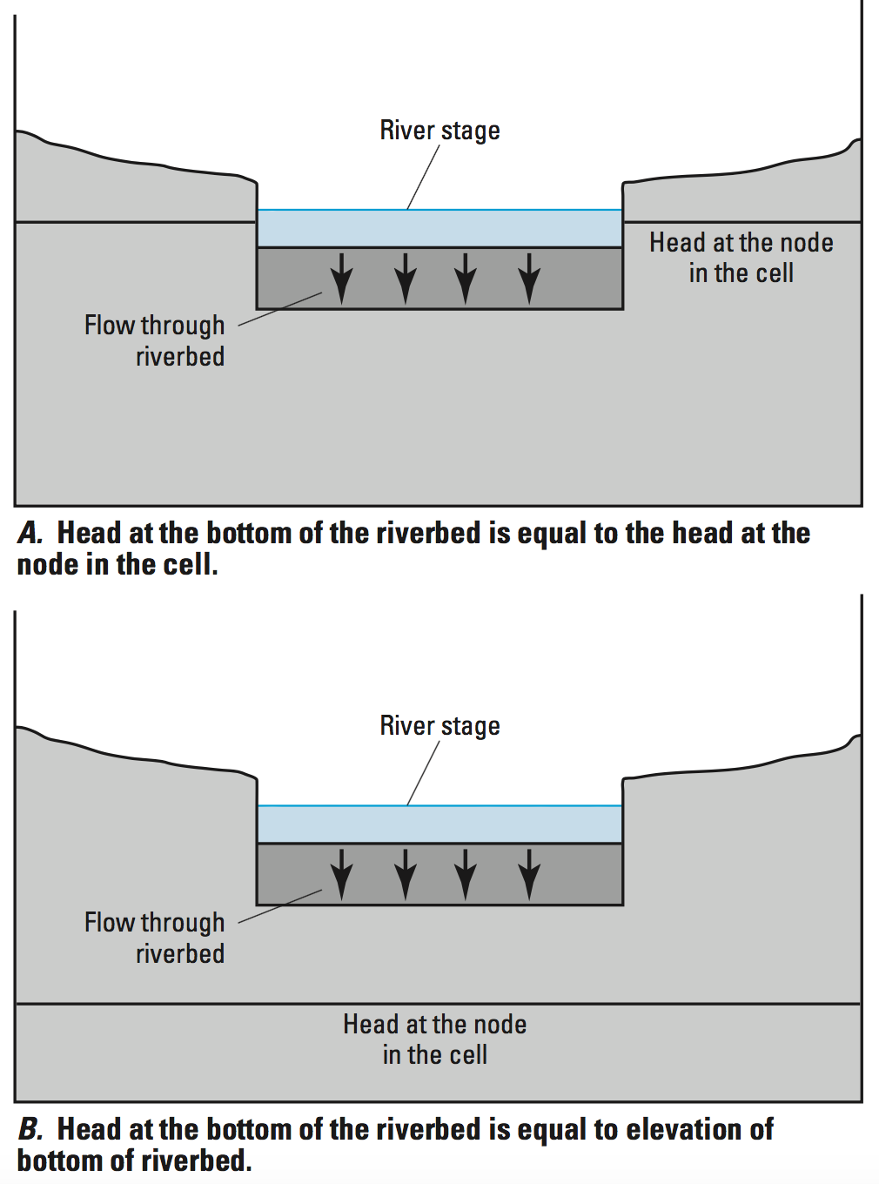
River Package – Aquifer/River Connection
Q_{RIV} = CRIV(HRIV – h_{cell})
If h_{cell} > RBOT
Q_{RIV} = CRIV(HRIV – RBOT)
If h_{cell} <= RBOT

Slide 24
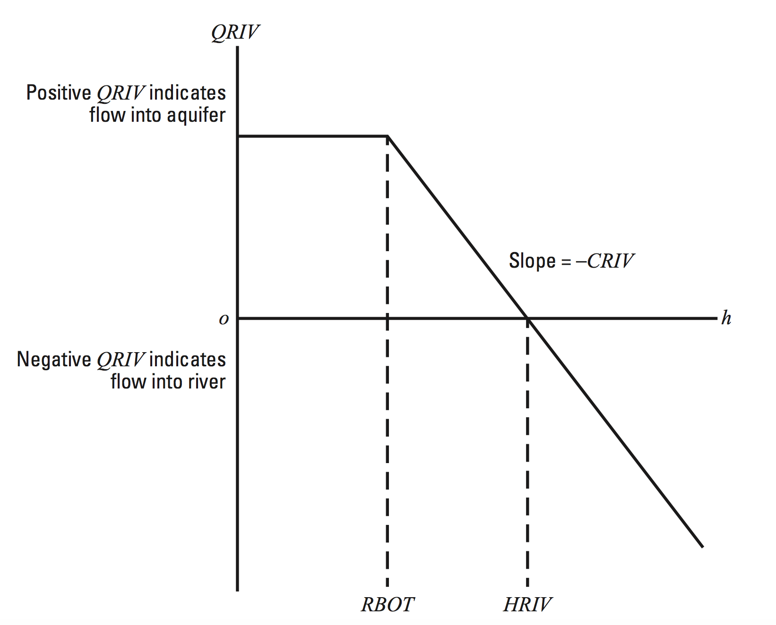
River Package – Head-Dependent Flow

Slide 25
River Package – Discretization Issues
The river equation is a simplification
Each reach is independent of the other reaches
Things to consider:
Are there multiple reaches in cell?
What is the length of a reach in cell?
What is the appropriate river head for a reach?
Are multiple reaches needed or can a composite/average river cell be used?
If a preprocessor is used, how does it define a river cell?

Slide 26
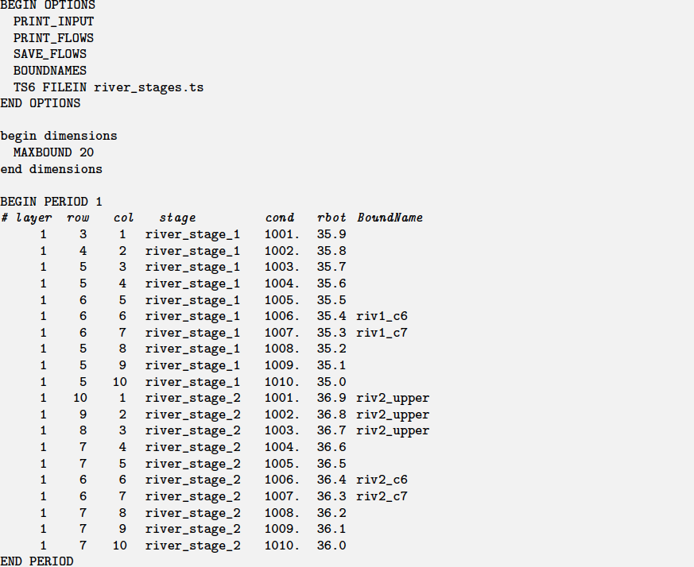
River Package Example

Slide 27
Drain package

Slide 28
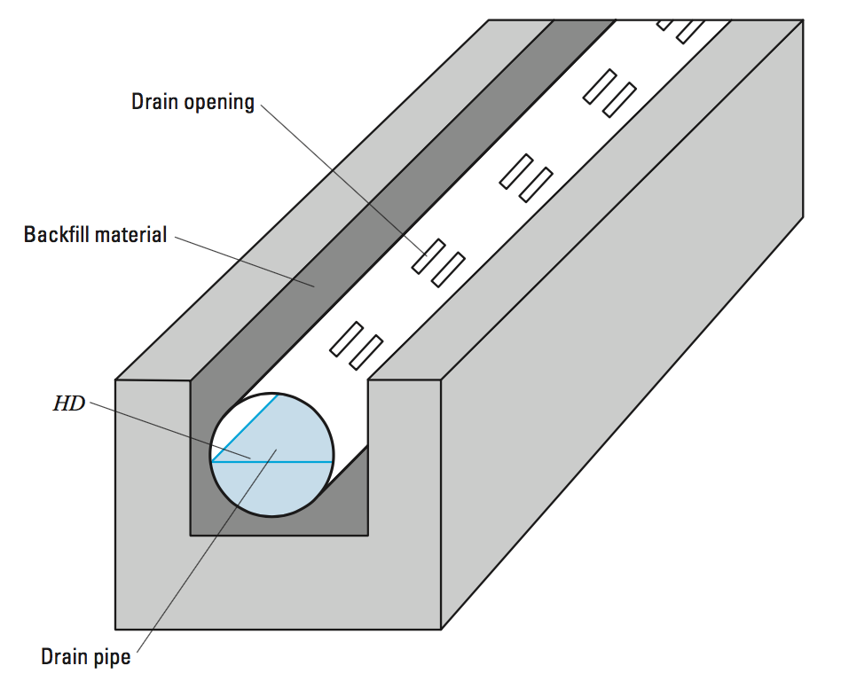
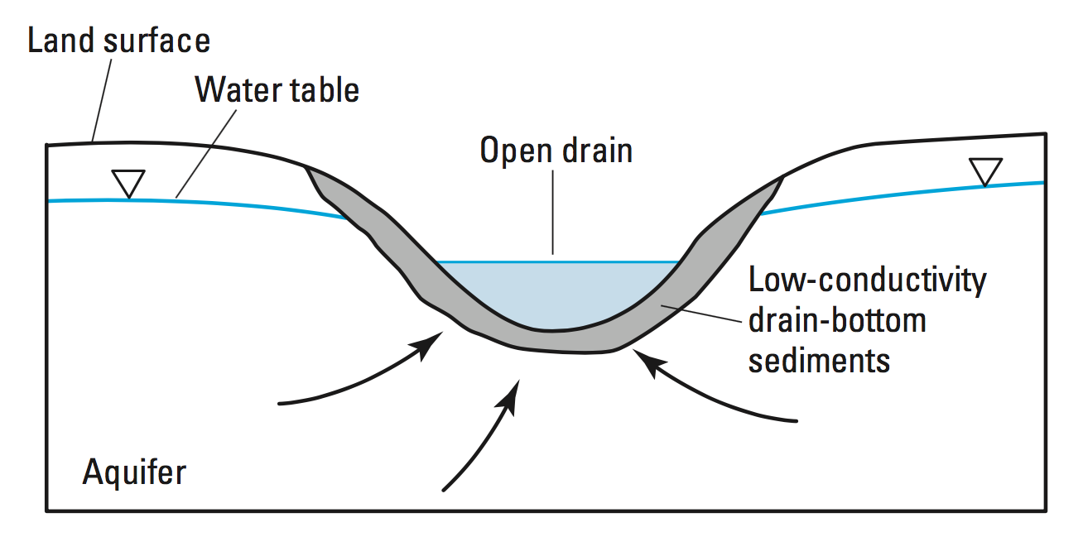
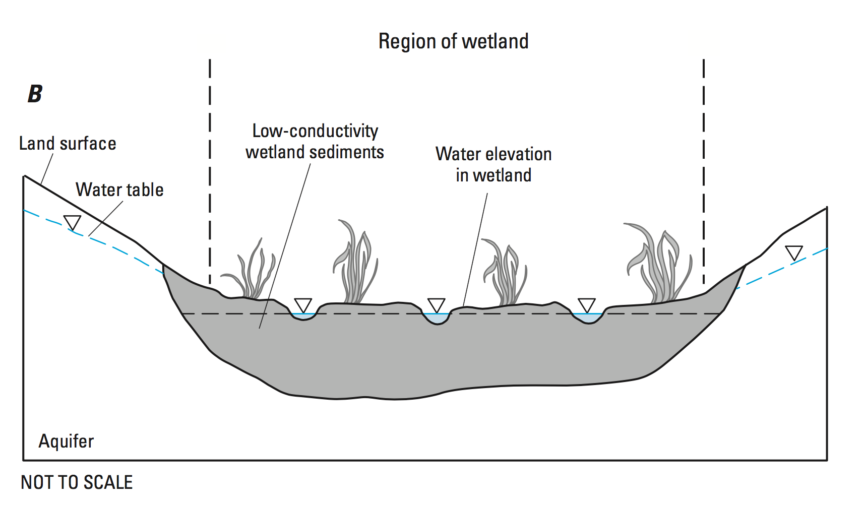
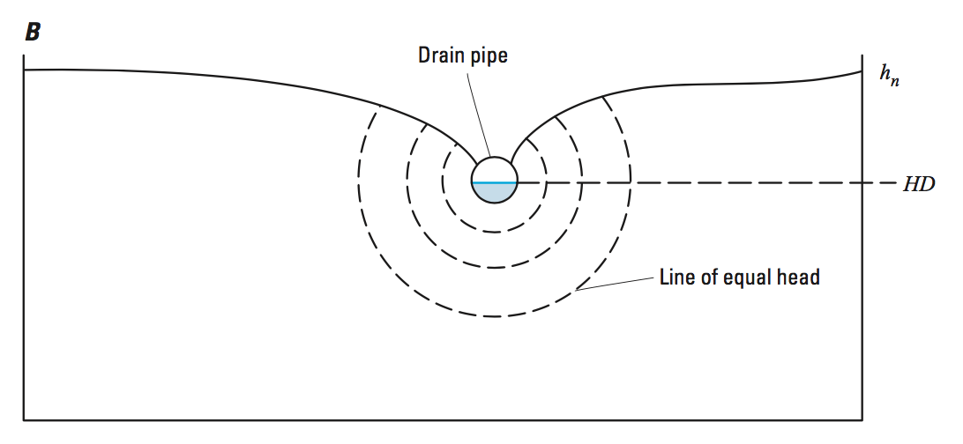
Drain Package

Slide 29
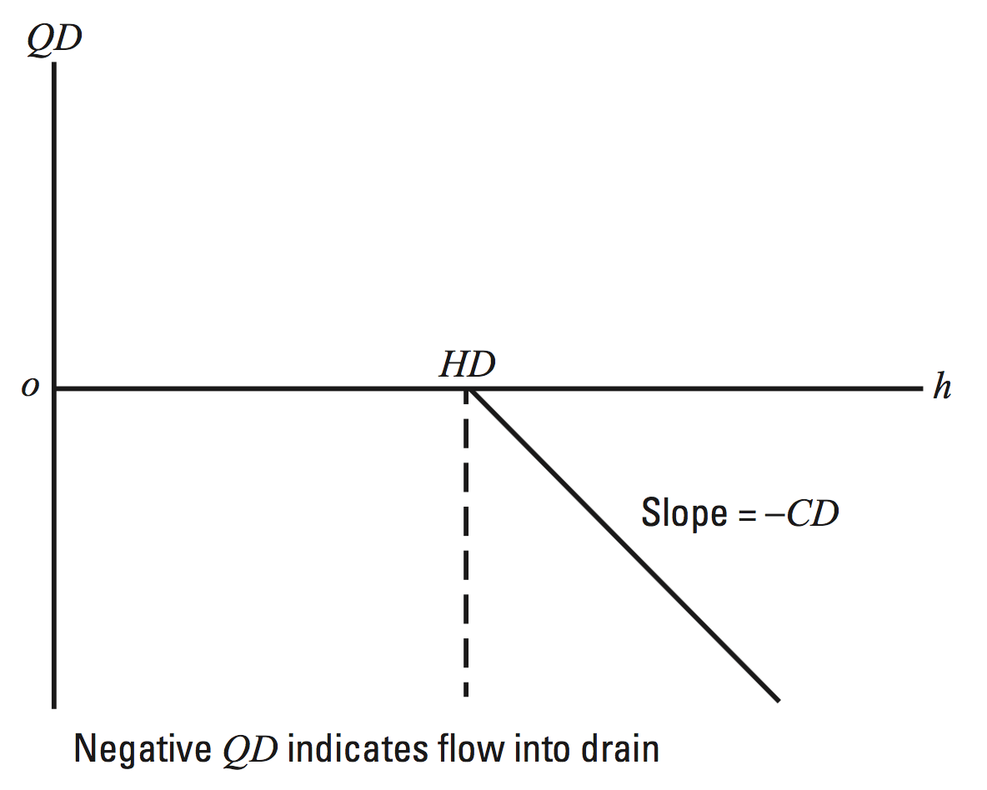
Drain Package – Head-Dependent Flow

Slide 30
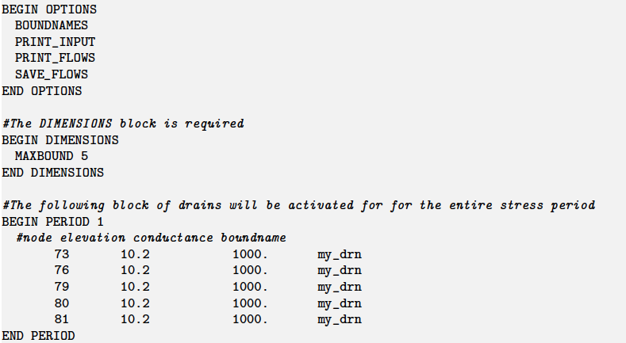
Drain Package Example

Slide 31
General-head boundary package

Slide 32
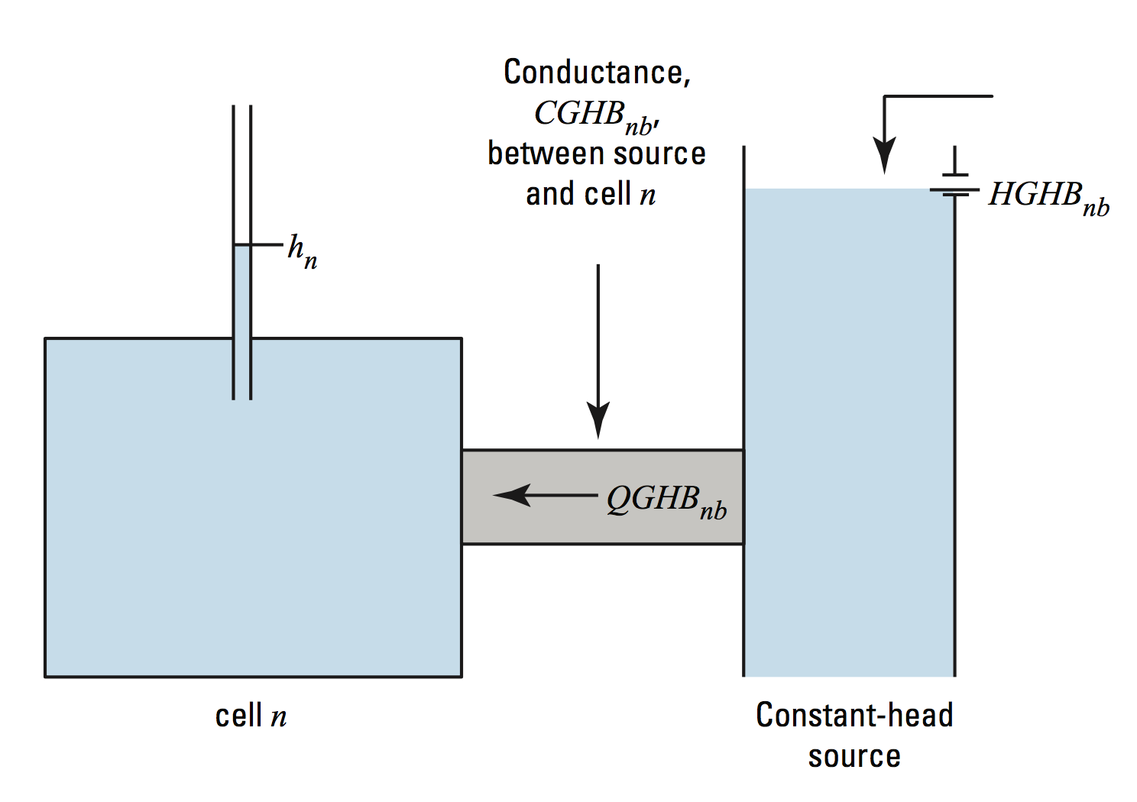
General-Head Boundary Package
QGHB = CGHB (HGHB – hcell)

Slide 33
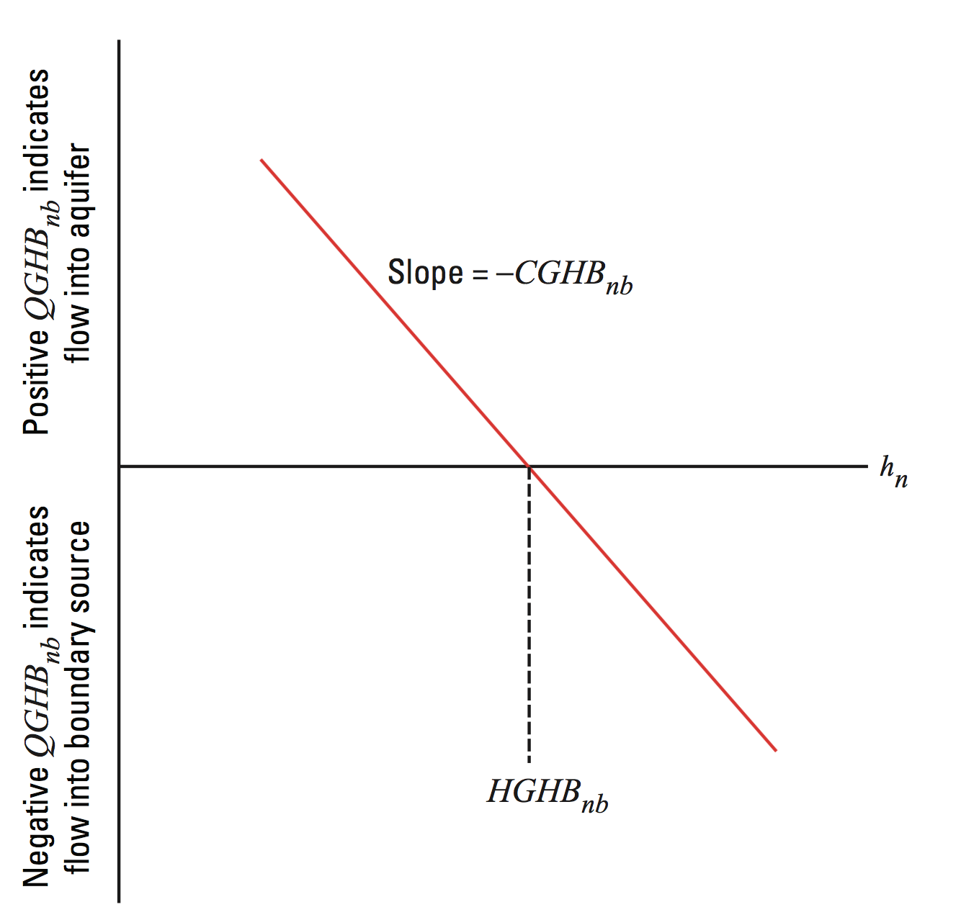
General Head Boundary – Head-Dependent Flow

Slide 34
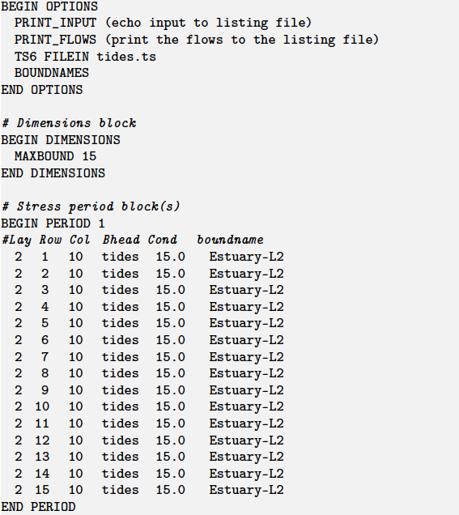
General Head Boundary Example

Slide 35
Evapotranspiration package

Slide 36
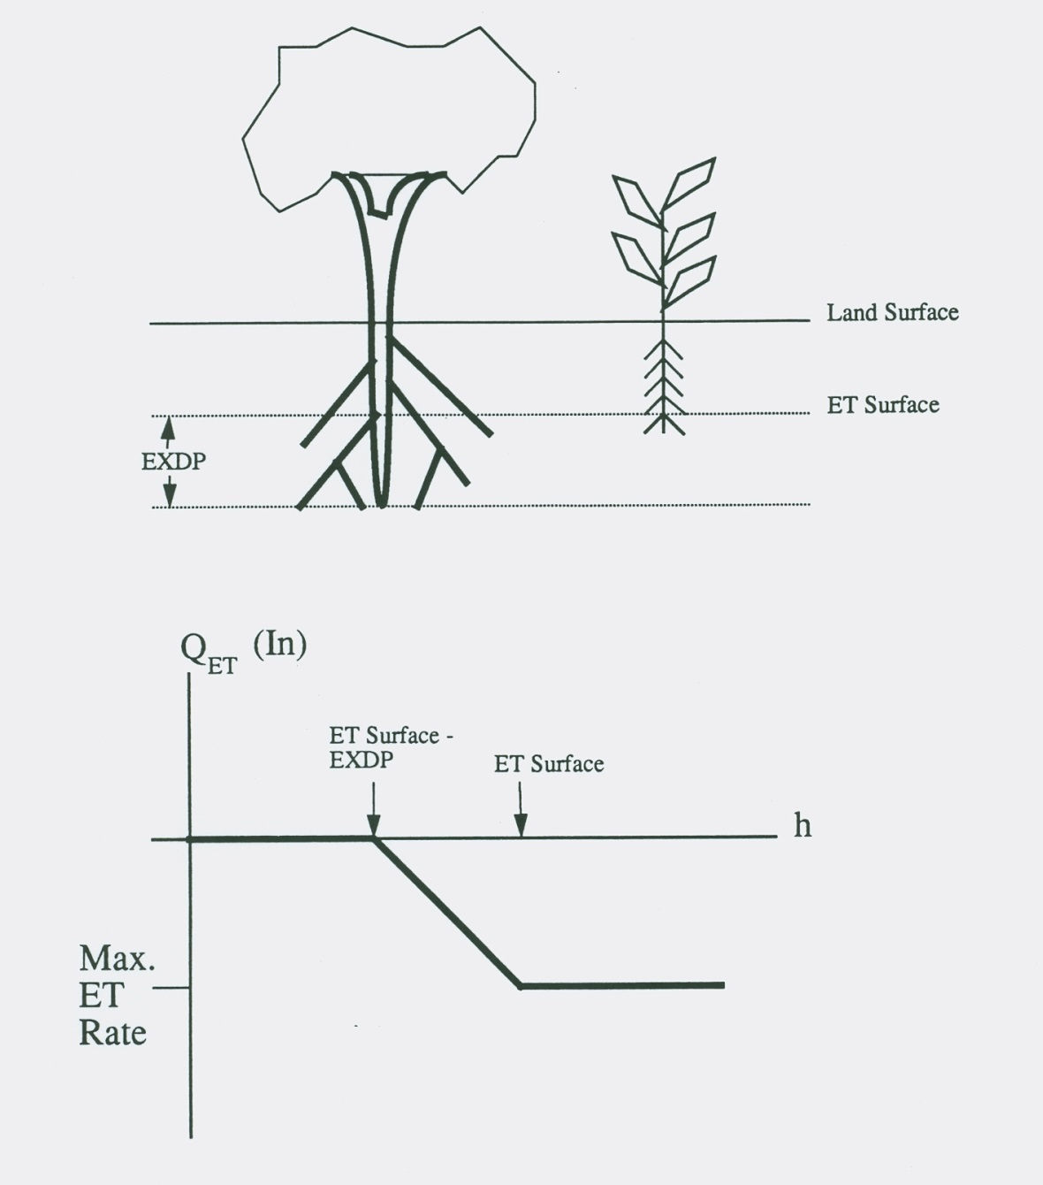
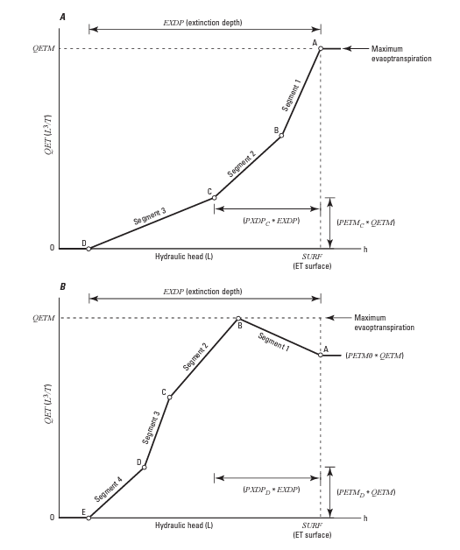
Evapotranspiration Package

Slide 37
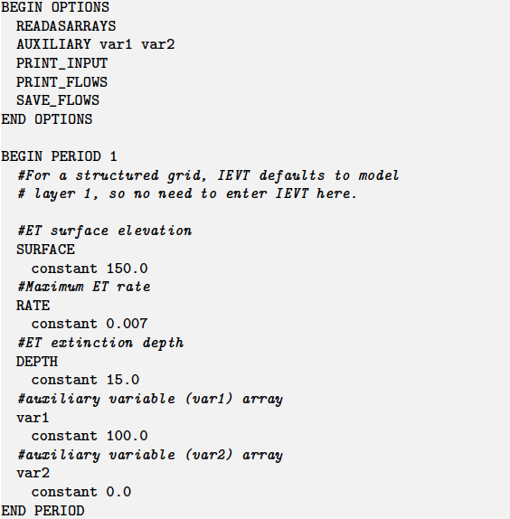
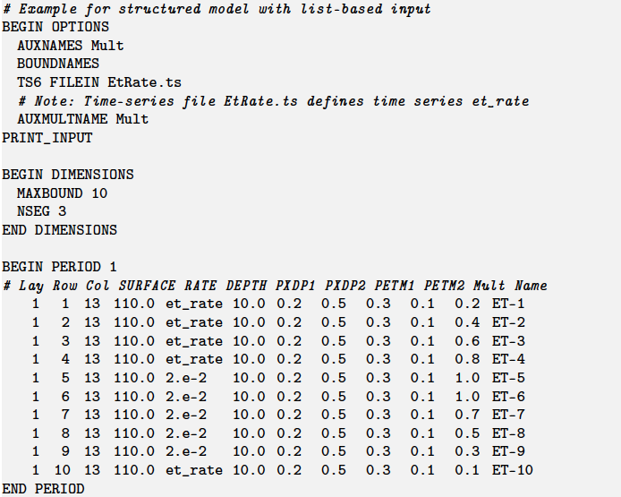
Evapotranspiration Package Example
Array-based input
List-based input

Slide 38
Comparison of stress packages

Slide 39
