Slide 1
Model Projections

Slide 2
What are model projections?
What a model can do
What it doesn’t do
Provide relative information about different scenarios
Pumping
Climate
Resource management
Land use changes
Data worth
Provide absolute answers!!!

Slide 3
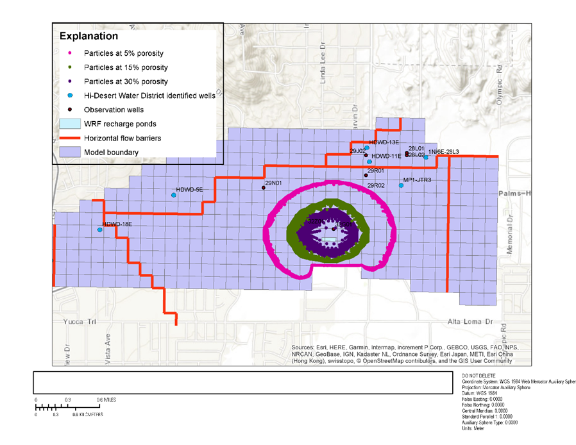
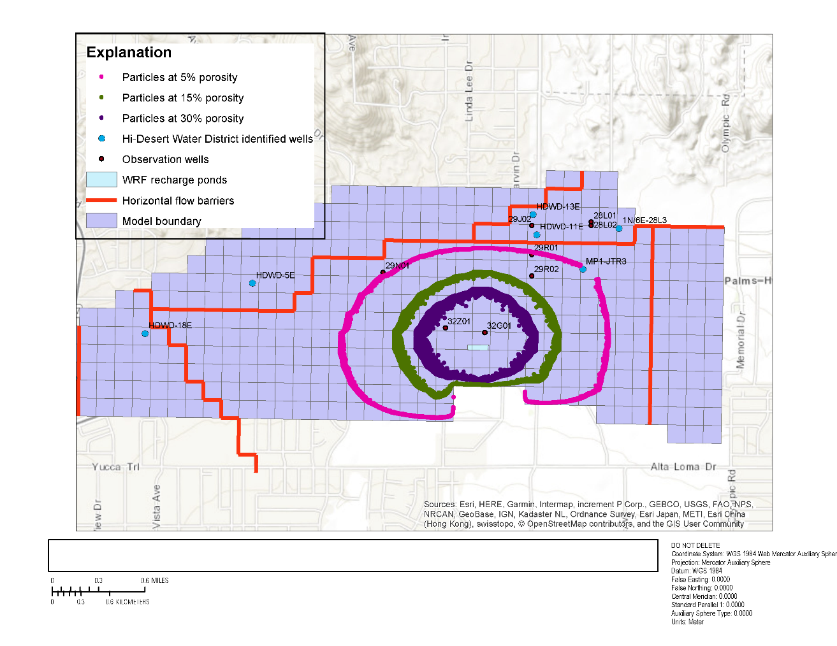
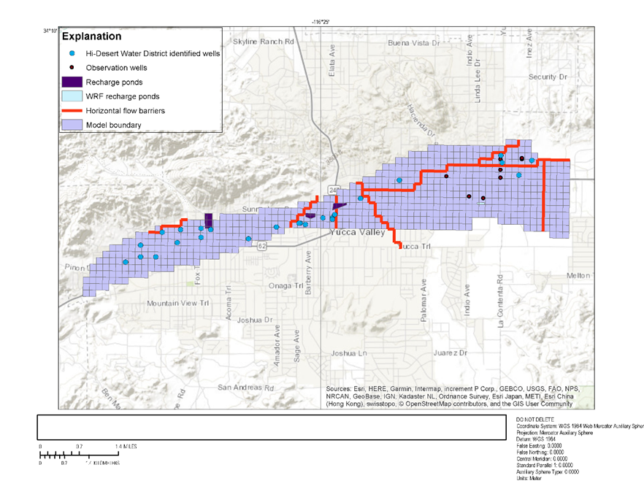

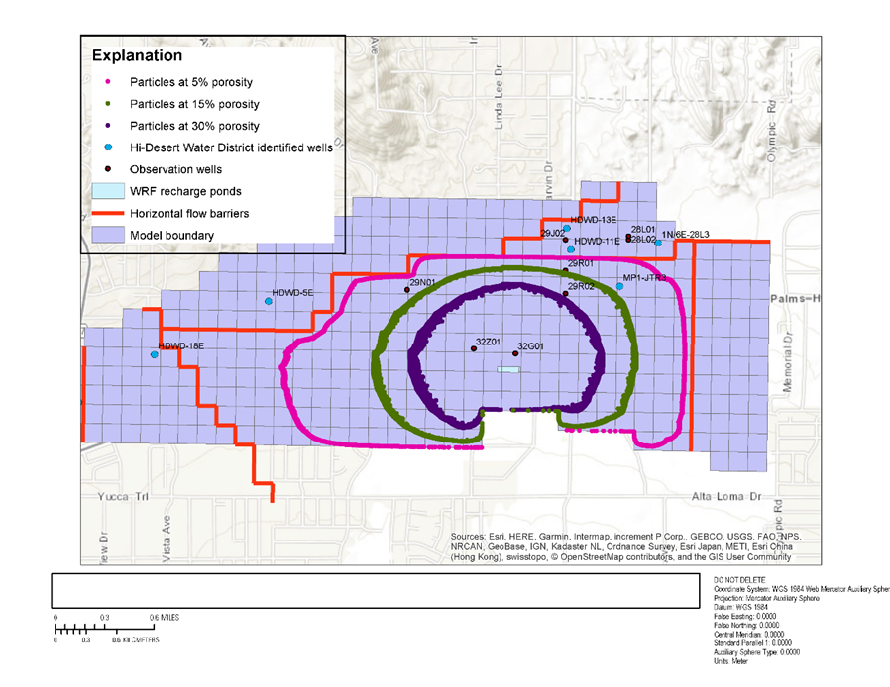
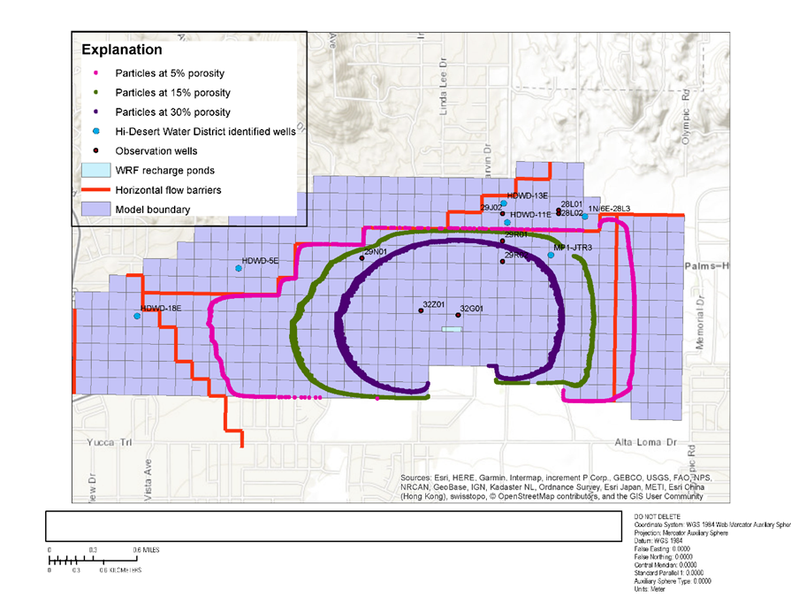
Example: Particle tracking managed aquifer recharge
5 years
10 years
Warren valley, near Joshua Tree
25 years
50 years

Slide 4
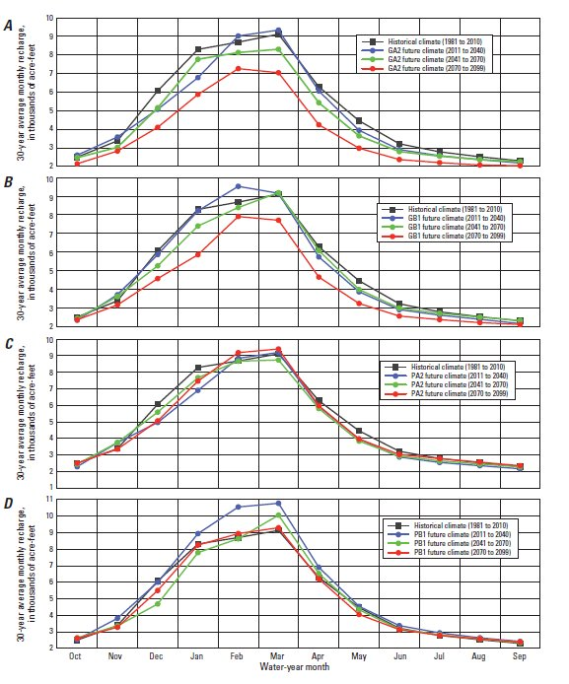
Example: future climate scenarios
Santa Rosa plain, Sonoma County, CA (Woolfenden and Nishikawa, 2014)

Slide 5
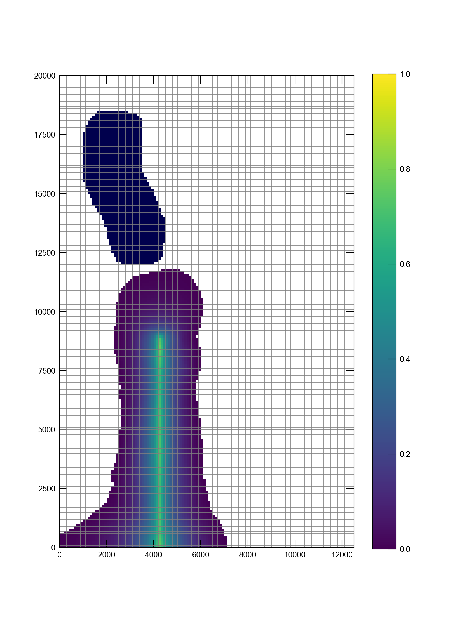
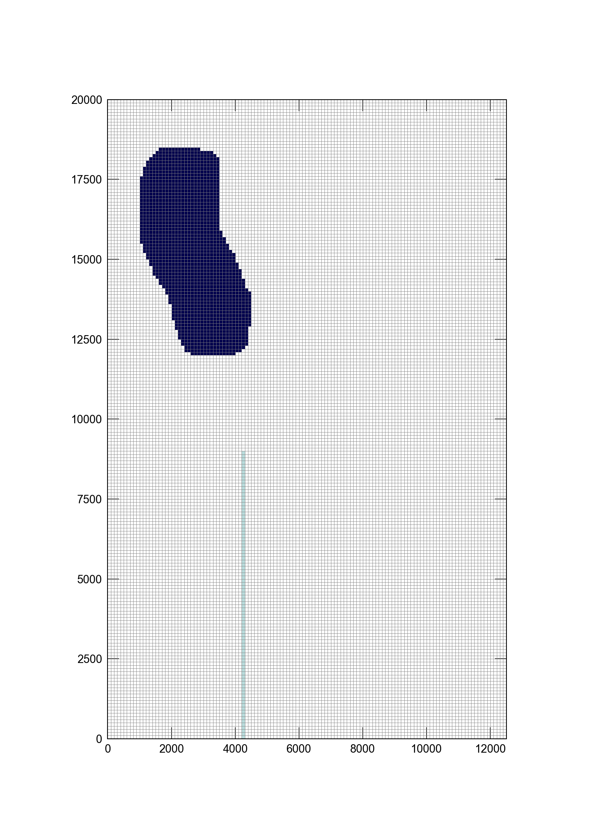
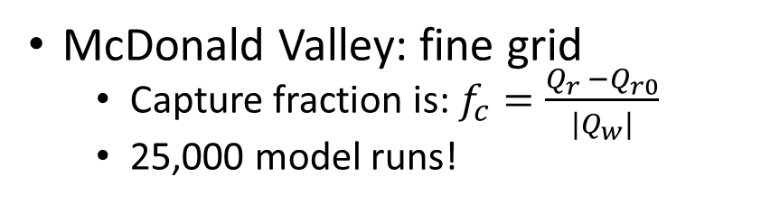
Stream capture fraction
McDonald Valley: fine grid
Capture fraction is: $f_{c}=\frac{Q_{r} −Q_{r0}}{{|Q}_{w}|}$
25,000 model runs!

Slide 6
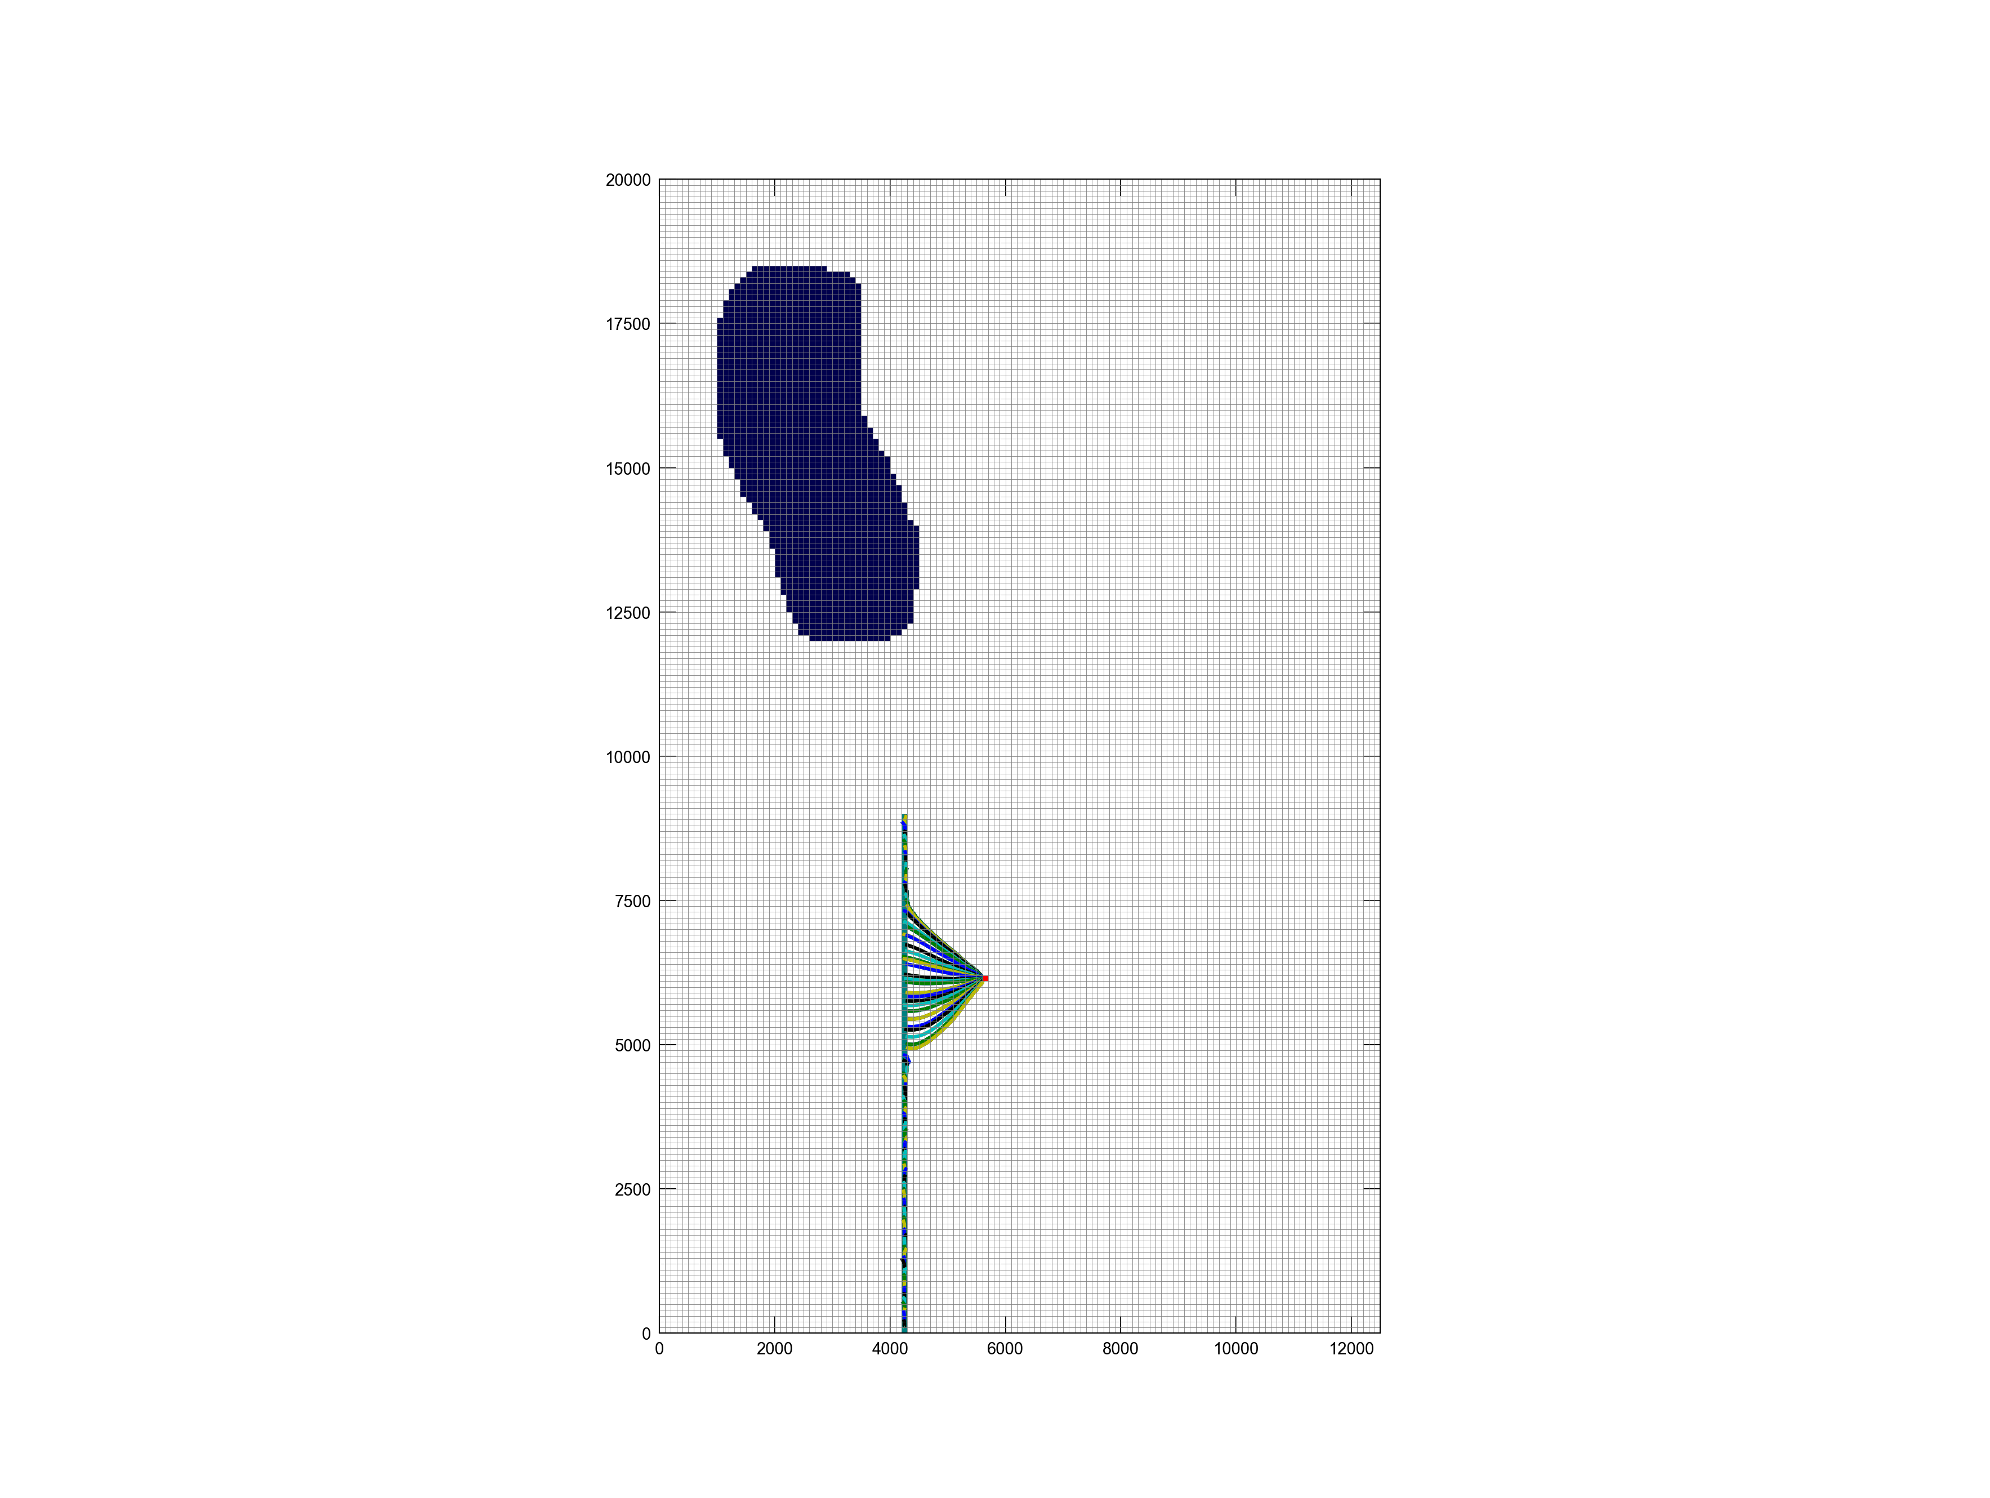
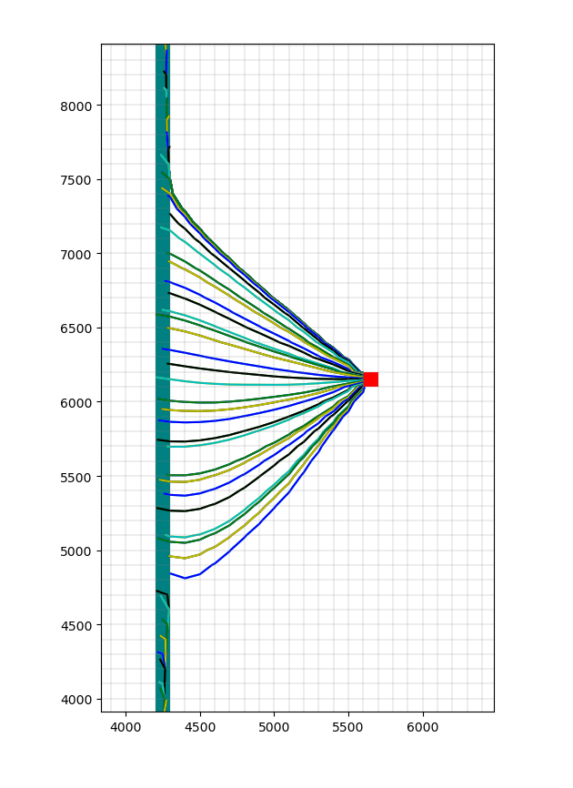
Particle tracking for new wells
Particle tracking discussed on Friday afternoon.

Slide 7
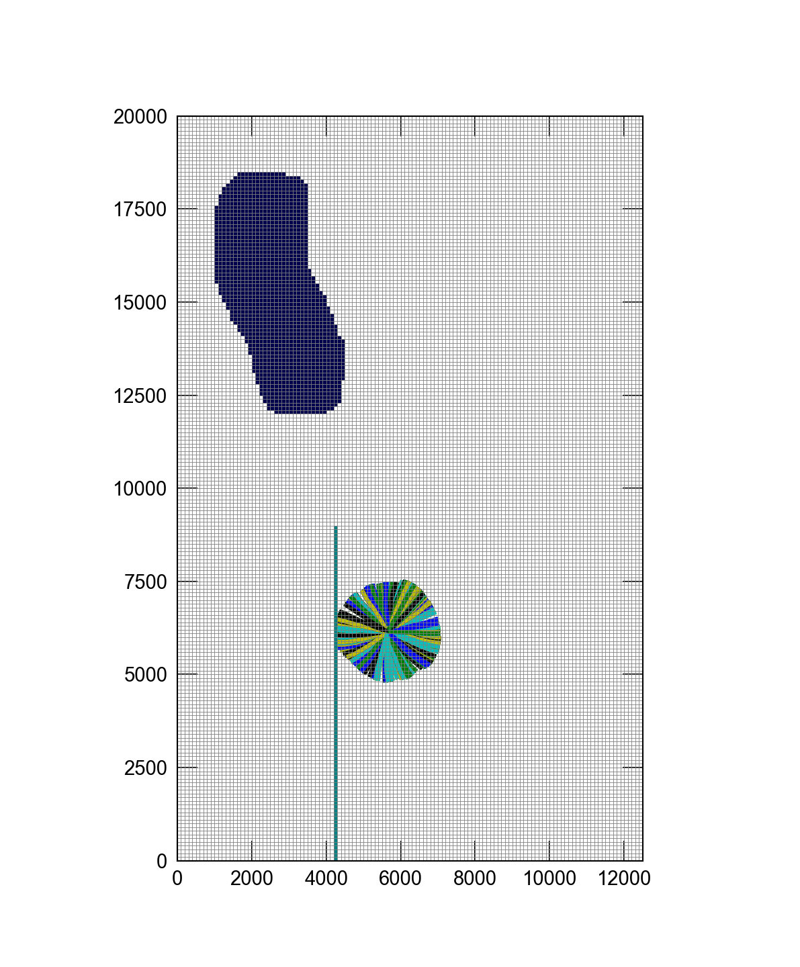
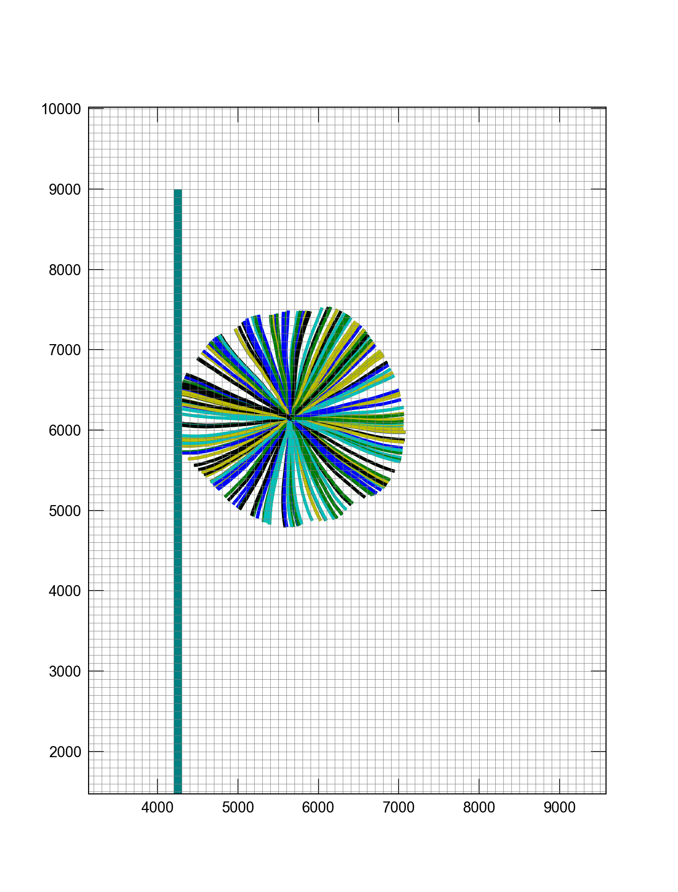
Particle tracking for new wells
Particle tracking discussed on Friday afternoon.

Slide 8
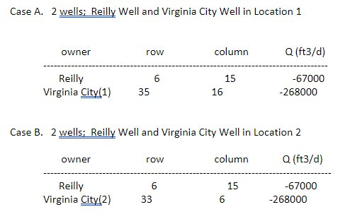
Workshop: Generate model projections
Use your calibrated model to simulate the impact of two different development scenarios
Keep in mind background information from the county
Requirement that no more than a 2ft decline in the water table (north)
Potential development shouldn’t reduce stream flow at pollocks ford by > 20%

