Slide 1
Overview of Groundwater Flow Modeling and the Groundwater Flow Equation

Slide 2
Groundwater Flow Modeling Process
Define Problem and Objectives
Conceptual Model
Mathematical Model
Model Calibration and Assessment
Apply Model
Revise Objectives ?

Slide 3
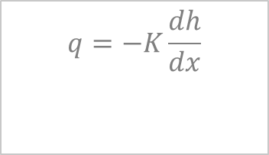
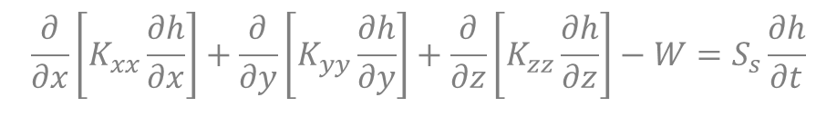
Groundwater Flow Equation Fundamental Concepts
Hydraulic Head
Darcy’s Law
Conservation of Mass
Groundwater Storage
$$q=−K\frac{dh}{dx}$$
$$\frac{∂}{∂x}\left[K_{xx}\frac{∂h}{∂x}\right]+\frac{∂}{∂y}\left[K_{yy}\frac{∂h}{∂y}\right]+\frac{∂}{∂z}\left[K_{zz}\frac{∂h}{∂z}\right]−W=S_{s}\frac{∂h}{∂t}$$

Slide 4
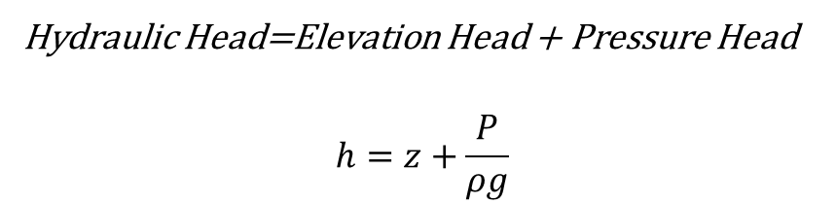
Hydraulic Head
Hydraulic Head=Elevation Head + Pressure Head
$$h=z+\frac{P}{ρg}$$
z = 0 (datum)

Slide 5
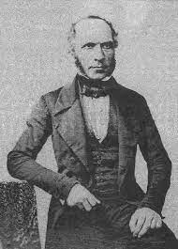
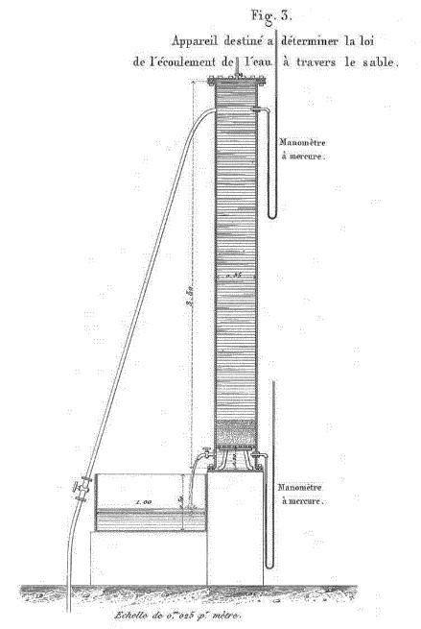
Henry Philibert Gaspard Darcy
Experiments on flow of water through sand beds, (1856).
Four major influences
Number of phases
Fluid compressibility
System geometry
Time
Notes:
Question: What do we need to know if we want to get a volumetric rate instead of a 1d flux? Cross-sectional area!
Maybe diagram it on the board with Q = -KA dh/L

Slide 6
Darcy’s Law One-Dimensional Flow
q = Specific discharge
K = Hydraulic conductivity
= Hydraulic gradient
Notes:
Question: What do we need to know if we want to get a volumetric rate instead of a 1d flux? Cross-sectional area!
Maybe diagram it on the board with Q = -KA dh/L

Slide 7
Groundwater Flow is a Vector described by a Rate and Direction

Slide 8
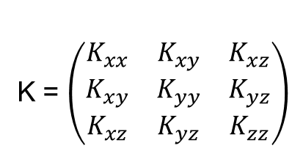
General 3-Dimensional Flow
K = $\left(\begin{matrix}K_{xx} & K_{xy} & K_{xz} \\ K_{xy} & K_{yy} & K_{yz} \\ K_{xz} & K_{yz} & K_{zz}\end{matrix}\right)$
Notes:
Kij (where i≠j) are cross terms of the K tensor, representing contributions to the flow rate in direction i from the gradient in direction j.
This is “in effect” a three-dimensional affine rotation and scaling matrix

Slide 9
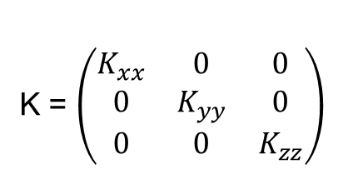
Simplified 3-Dimensional Flow
K = $\left(\begin{matrix}K_{xx} & 0 & 0 \\ 0 & K_{yy} & 0 \\ 0 & 0 & K_{zz}\end{matrix}\right)$
Notes:
This becomes an “affine” scaling matrix!

Slide 10
The Groundwater Flow Equation A Water Balance
z
y
x

Slide 11
Constructing the Water Balance
Mass In – Mass Out = Change in Mass Stored
z
y
x

Slide 12
Building the Flow Equation The First Steps
Step 1: Write the balance equation using the inflow and outflow terms:
Step 2: Divide by the volume of the cube and the time interval:
Step 3: Shrink the cube to an arbitrarily small size to arrive at the differential equation:
Notes:
Chalk talk the derivation from step 1 through 6

Slide 13
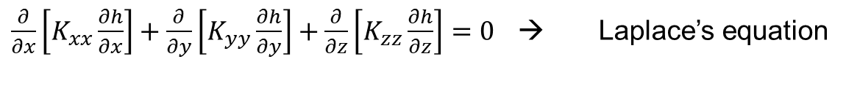
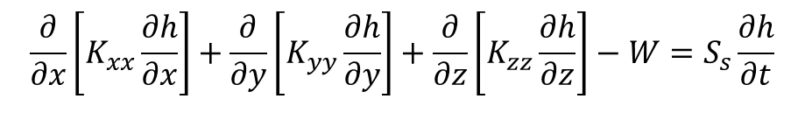
Building the Flow Equation The Final Steps
Step 4: Use Darcy’s Law to express the flow rates (q) as a function of head:
Step 5: Use the concept of specific storage to express storage change as a function of head:
Step 6: Put it all together:
$$\frac{∂}{∂x}\left[K_{xx}\frac{∂h}{∂x}\right]+\frac{∂}{∂y}\left[K_{yy}\frac{∂h}{∂y}\right]+\frac{∂}{∂z}\left[K_{zz}\frac{∂h}{∂z}\right]−W=S_{s}\frac{∂h}{∂t}$$
$\frac{∂}{∂x}\left[K_{xx}\frac{∂h}{∂x}\right]+\frac{∂}{∂y}\left[K_{yy}\frac{∂h}{∂y}\right]+\frac{∂}{∂z}\left[K_{zz}\frac{∂h}{∂z}\right]=0$ → Laplace’s equation
Notes:
Ss=pw*g(a + n*B)
a = aquifer compressibility
B = compressibility of water
n = porosity

Slide 14
Boundary and Initial Conditions
Differential equation → head and flow in the interior of the groundwater system.
A combination of head and flow rate must be specified along all the boundaries of the groundwater system.
Transient flow problems also require the starting head to be specified everywhere in the system.

Slide 15
Boundary Conditions
Specified-head boundary
h=constant
Constant-head boundary
Specified-flux boundary
dh/dn = constant
No-flow boundary
Notes:
Specified flux: wel package.

Slide 16
Boundary Conditions
Mixed boundary
dh/dn + ch = constant
Head-dependent flux boundary
Free surface boundary
h=f(z)
Notes:
Free surface: example: lake intersecting with groundwater system

Slide 17
Initial Conditions
Need to specify the head distribution in time
h = f(x,y,z; t=0)

Slide 18
2-Dimensional Flow in a Confined Aquifer

Slide 19
2-Dimensional Unconfined Flow
R
Aquifer
Low Conductivity Material
R = areal recharge rate; S_{y} = specific yield
Notes:
Sy is more or less the effective porosity. In uz terms: theta_s – theta_r

