Slide 1
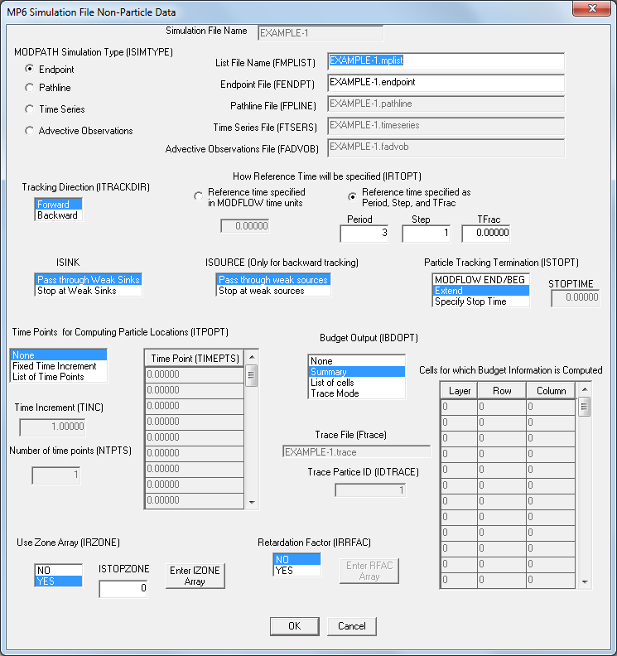
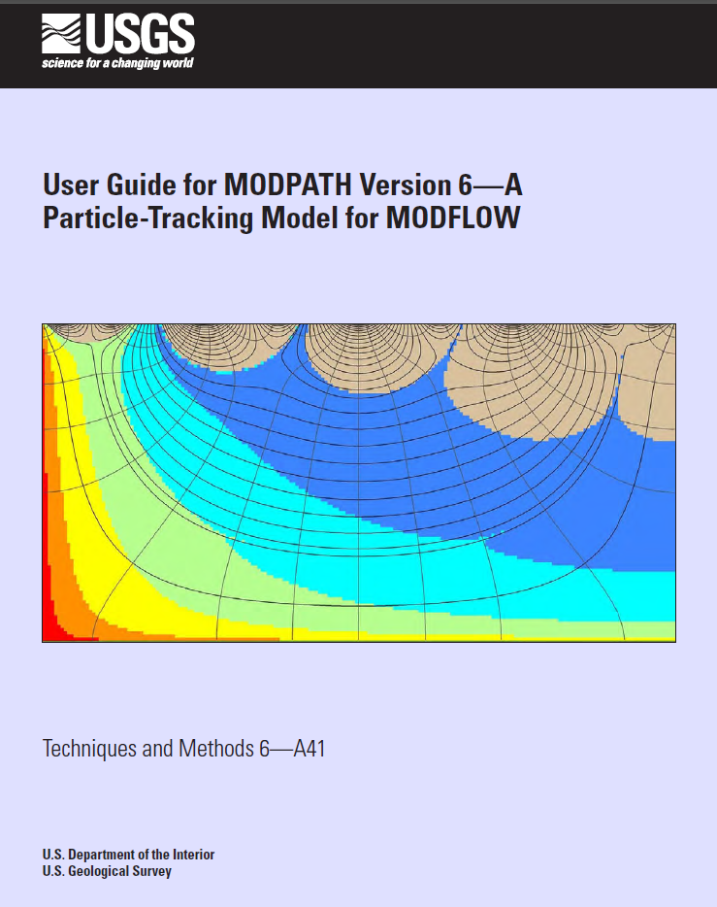
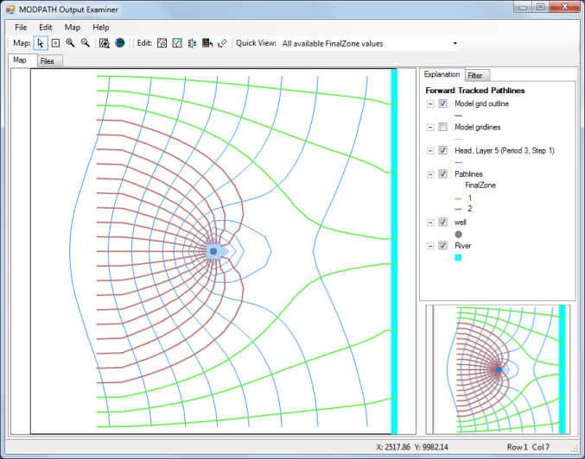
MODPATH
A Particle Tracking Model for MODFLOW

Slide 2
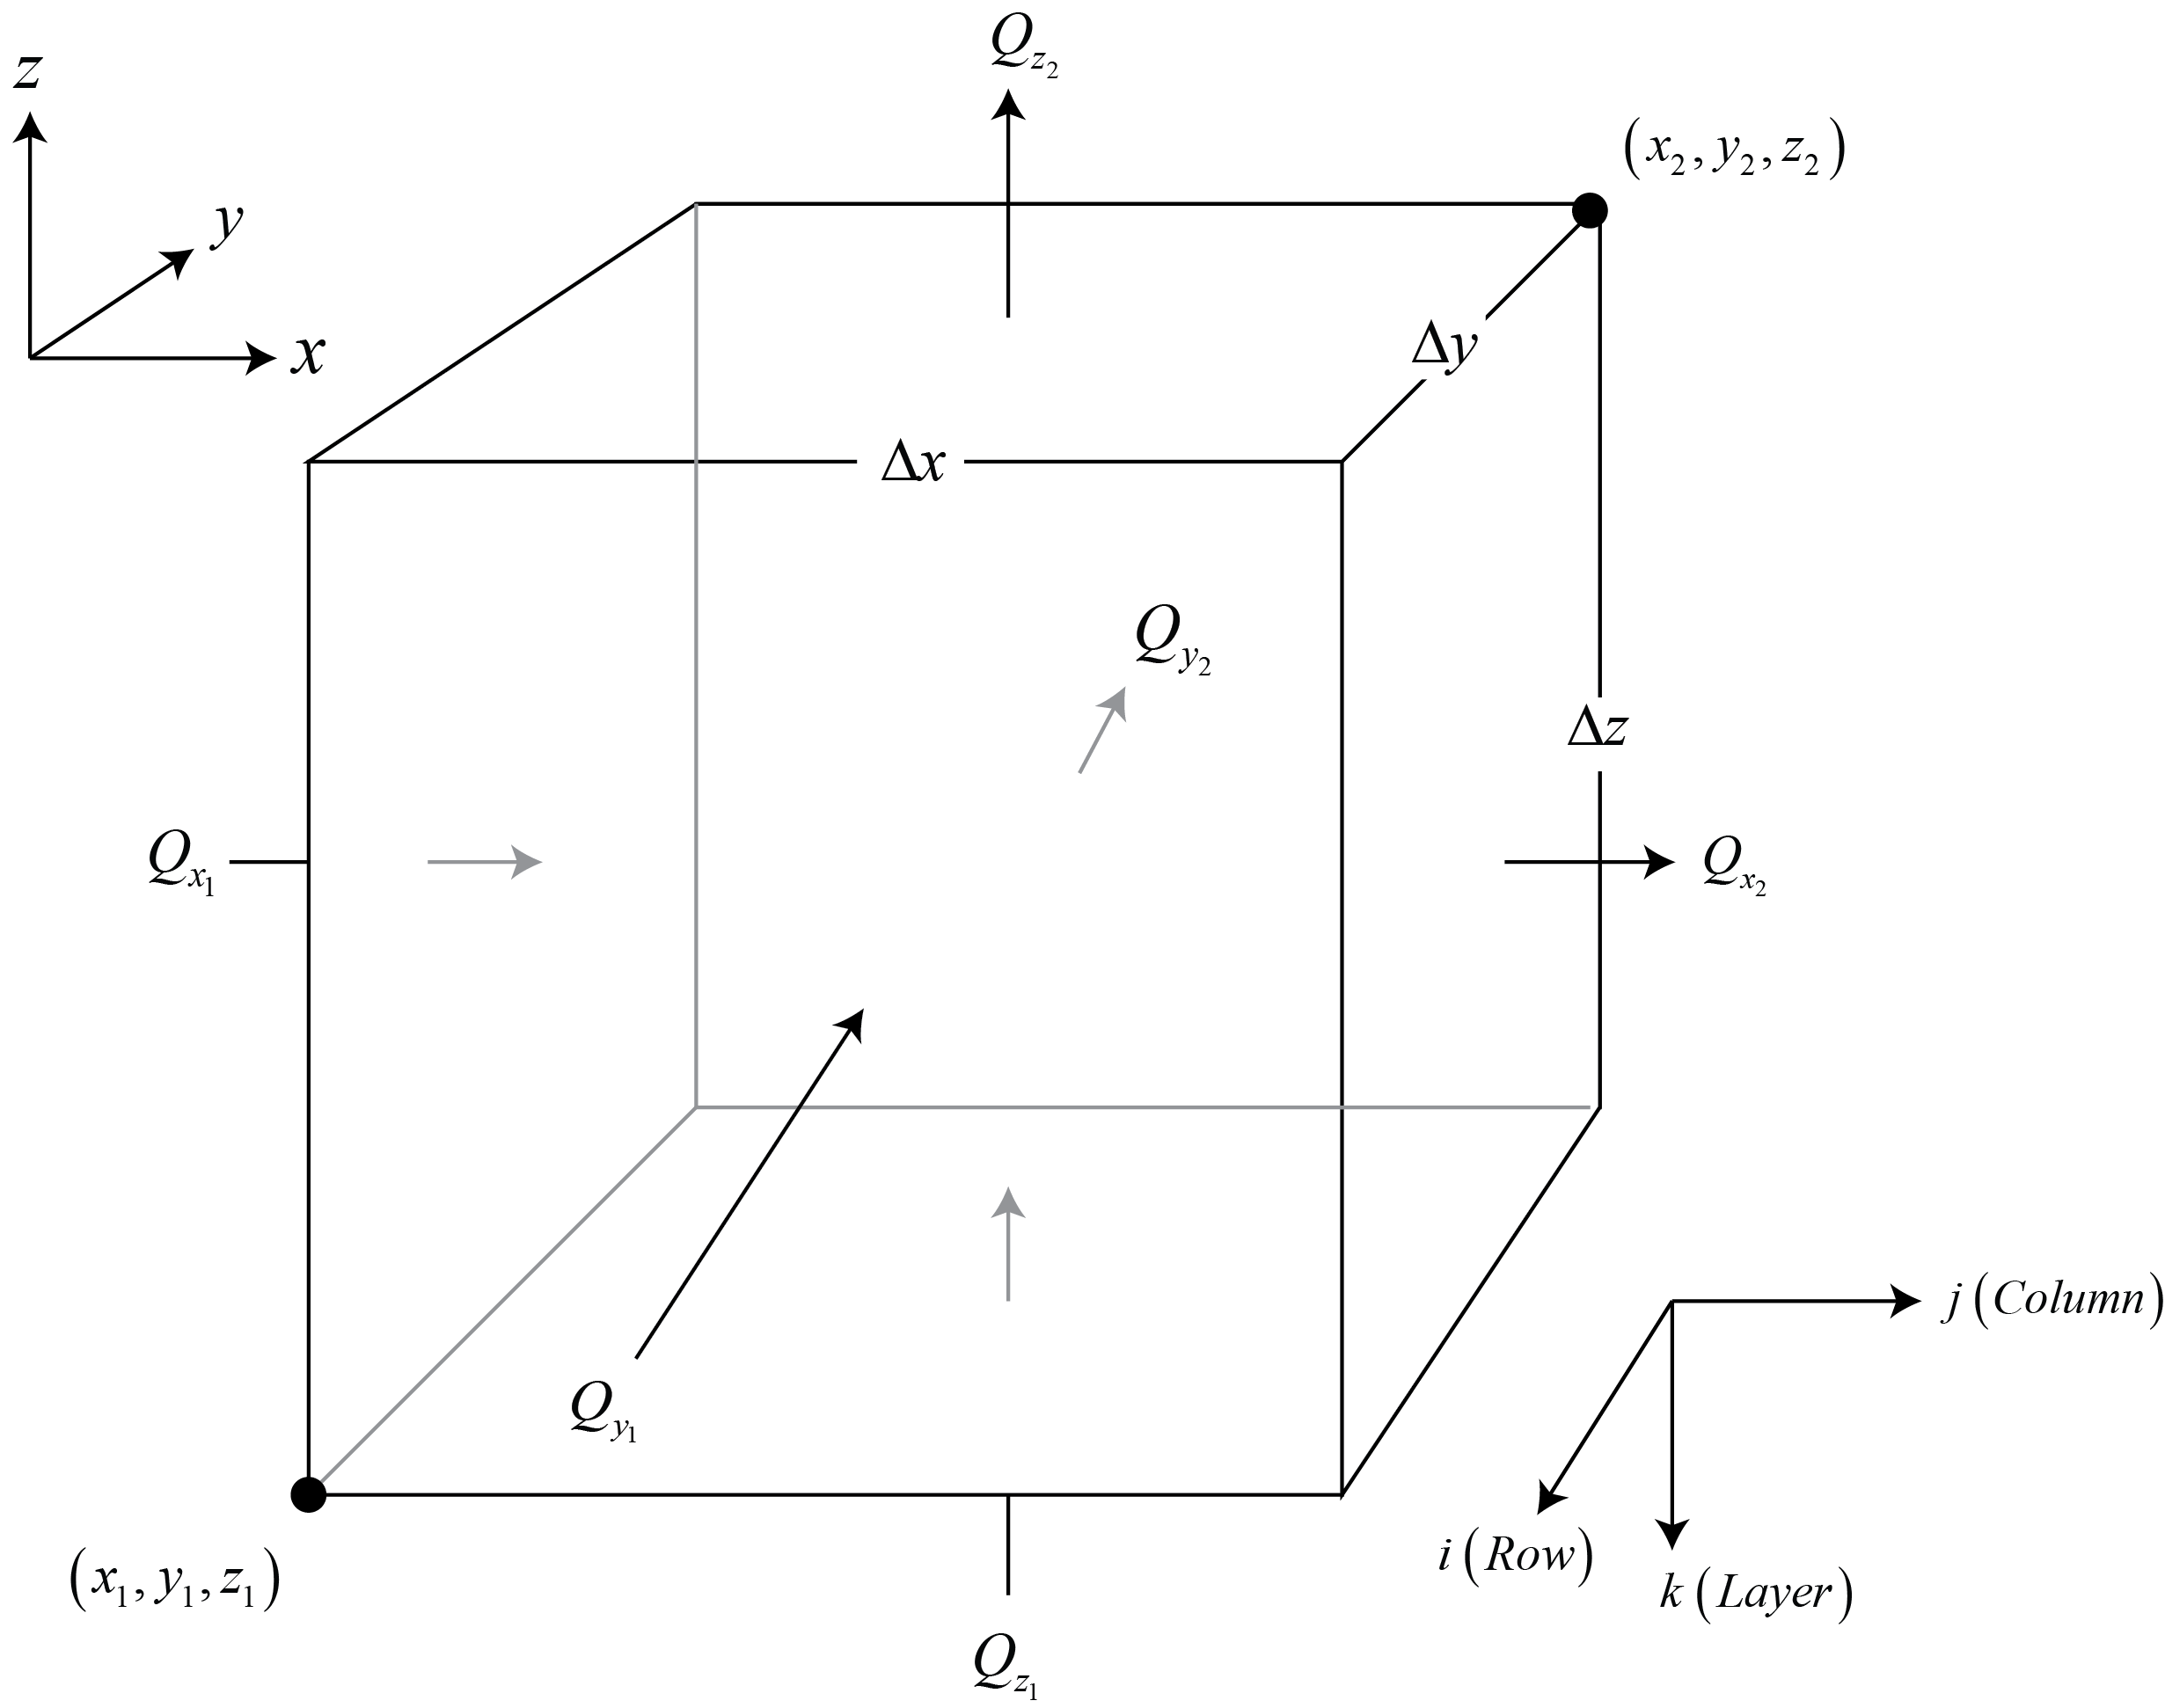
Cell-by-Cell Output from MODFLOW is used by MODPATH
The volumetric flow rates across the six cell faces are obtained from MODFLOW output saved in the cell-by-cell budget file.

Slide 3
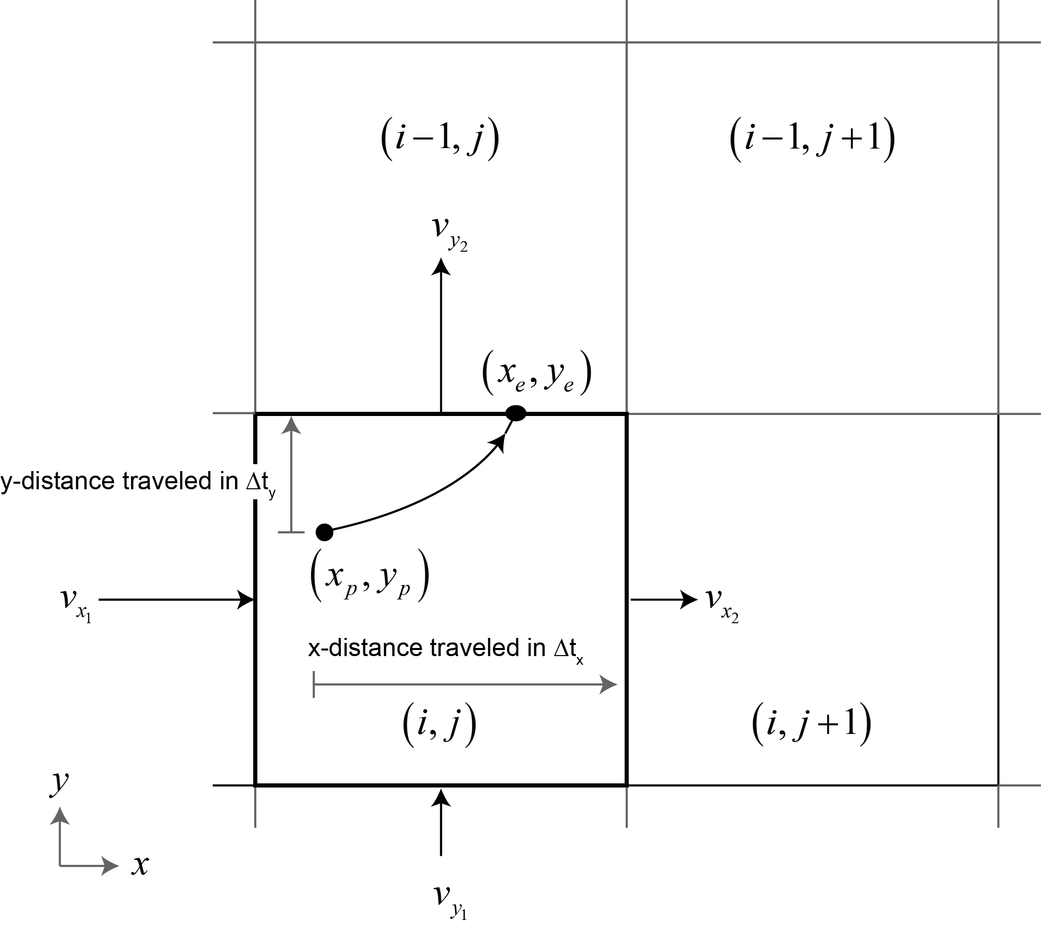
Particle Tracking Through a Grid Cell
Velocity components at each cell face are calculated from the MODFLOW budget rates by dividing them by the cell face area and the porosity
Velocity components are interpolated linearly within a cell
Particle paths are integrated analytically within each cell

Slide 4
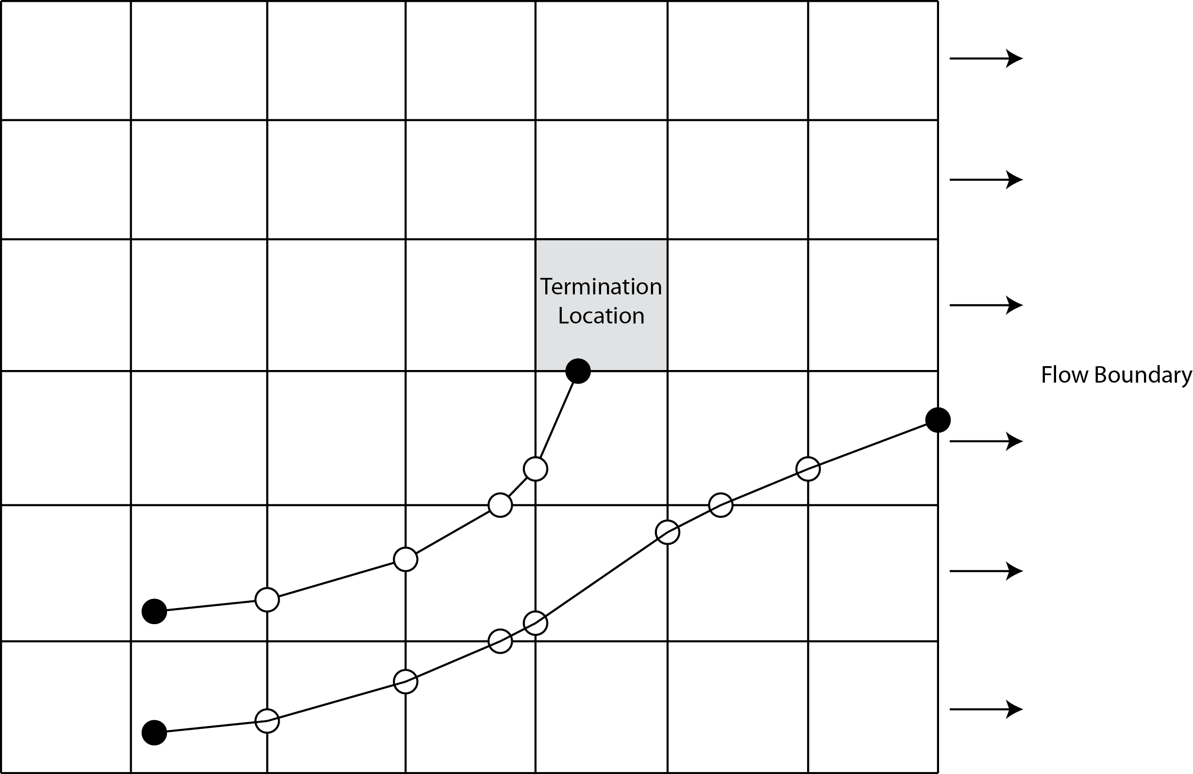
MODPATH Moves Particles Cell to Cell

Slide 5
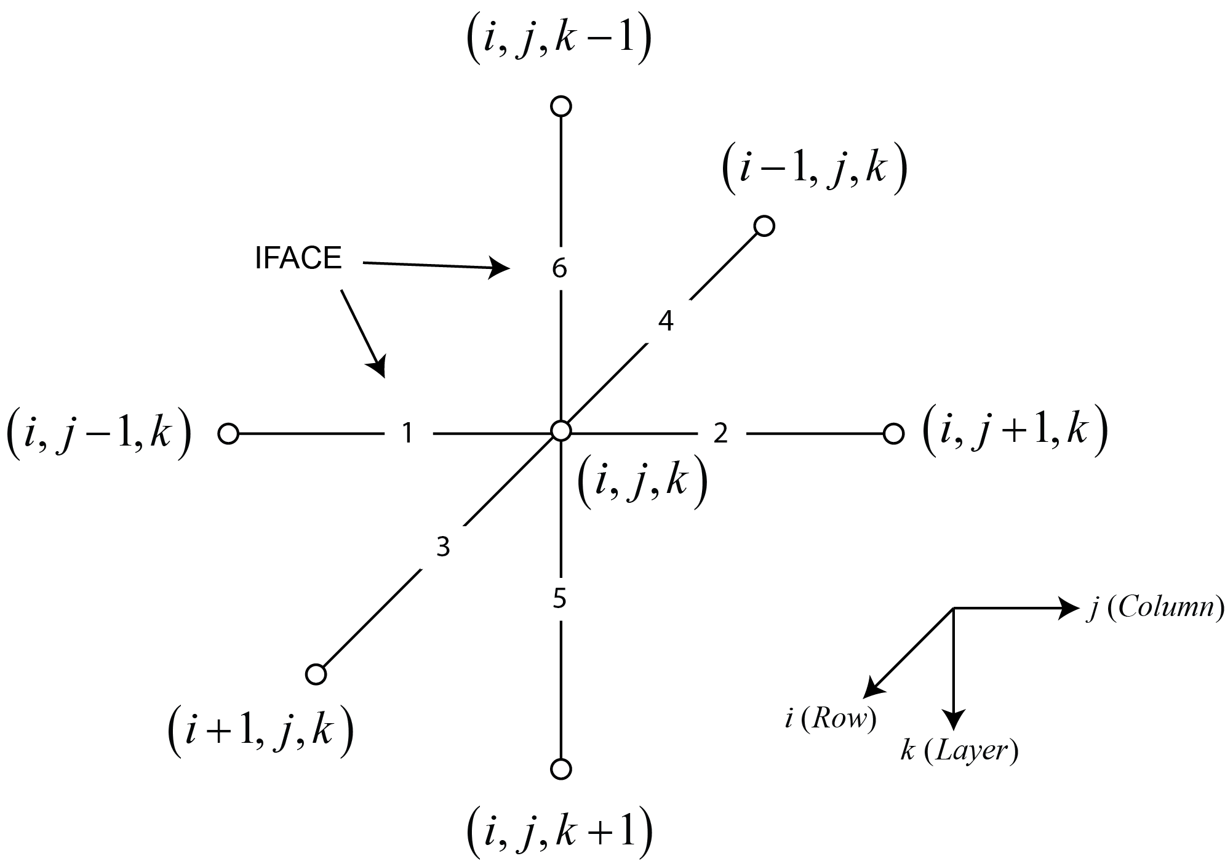
Specifying Boundary Face Flows
Flows from MODFLOW stress packages often represent boundary conditions at cell faces
To compute accurate velocities in MODPATH it is necessary to specify which faces have stress package boundary flows
The variable IFACE is an integer flag that indicates which face to associate with a stress package boundary flow

Slide 6
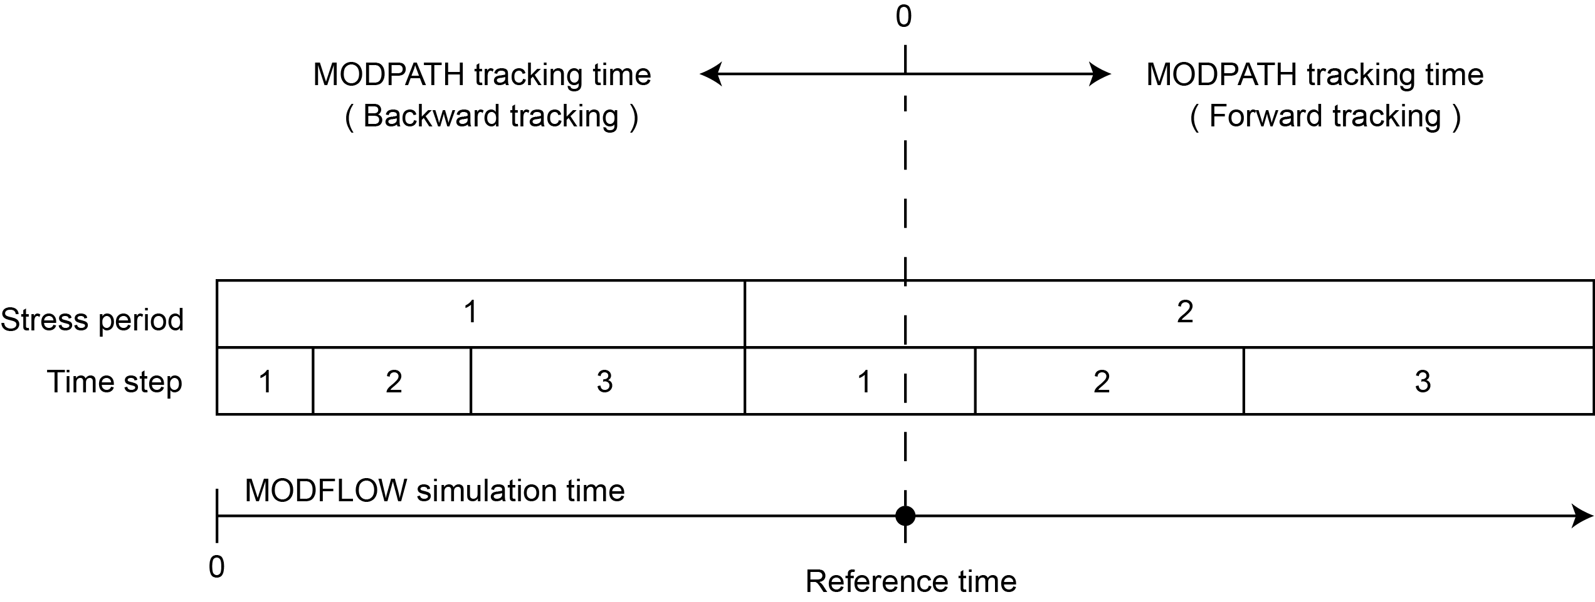
Time Concepts in MODPATH

Slide 7
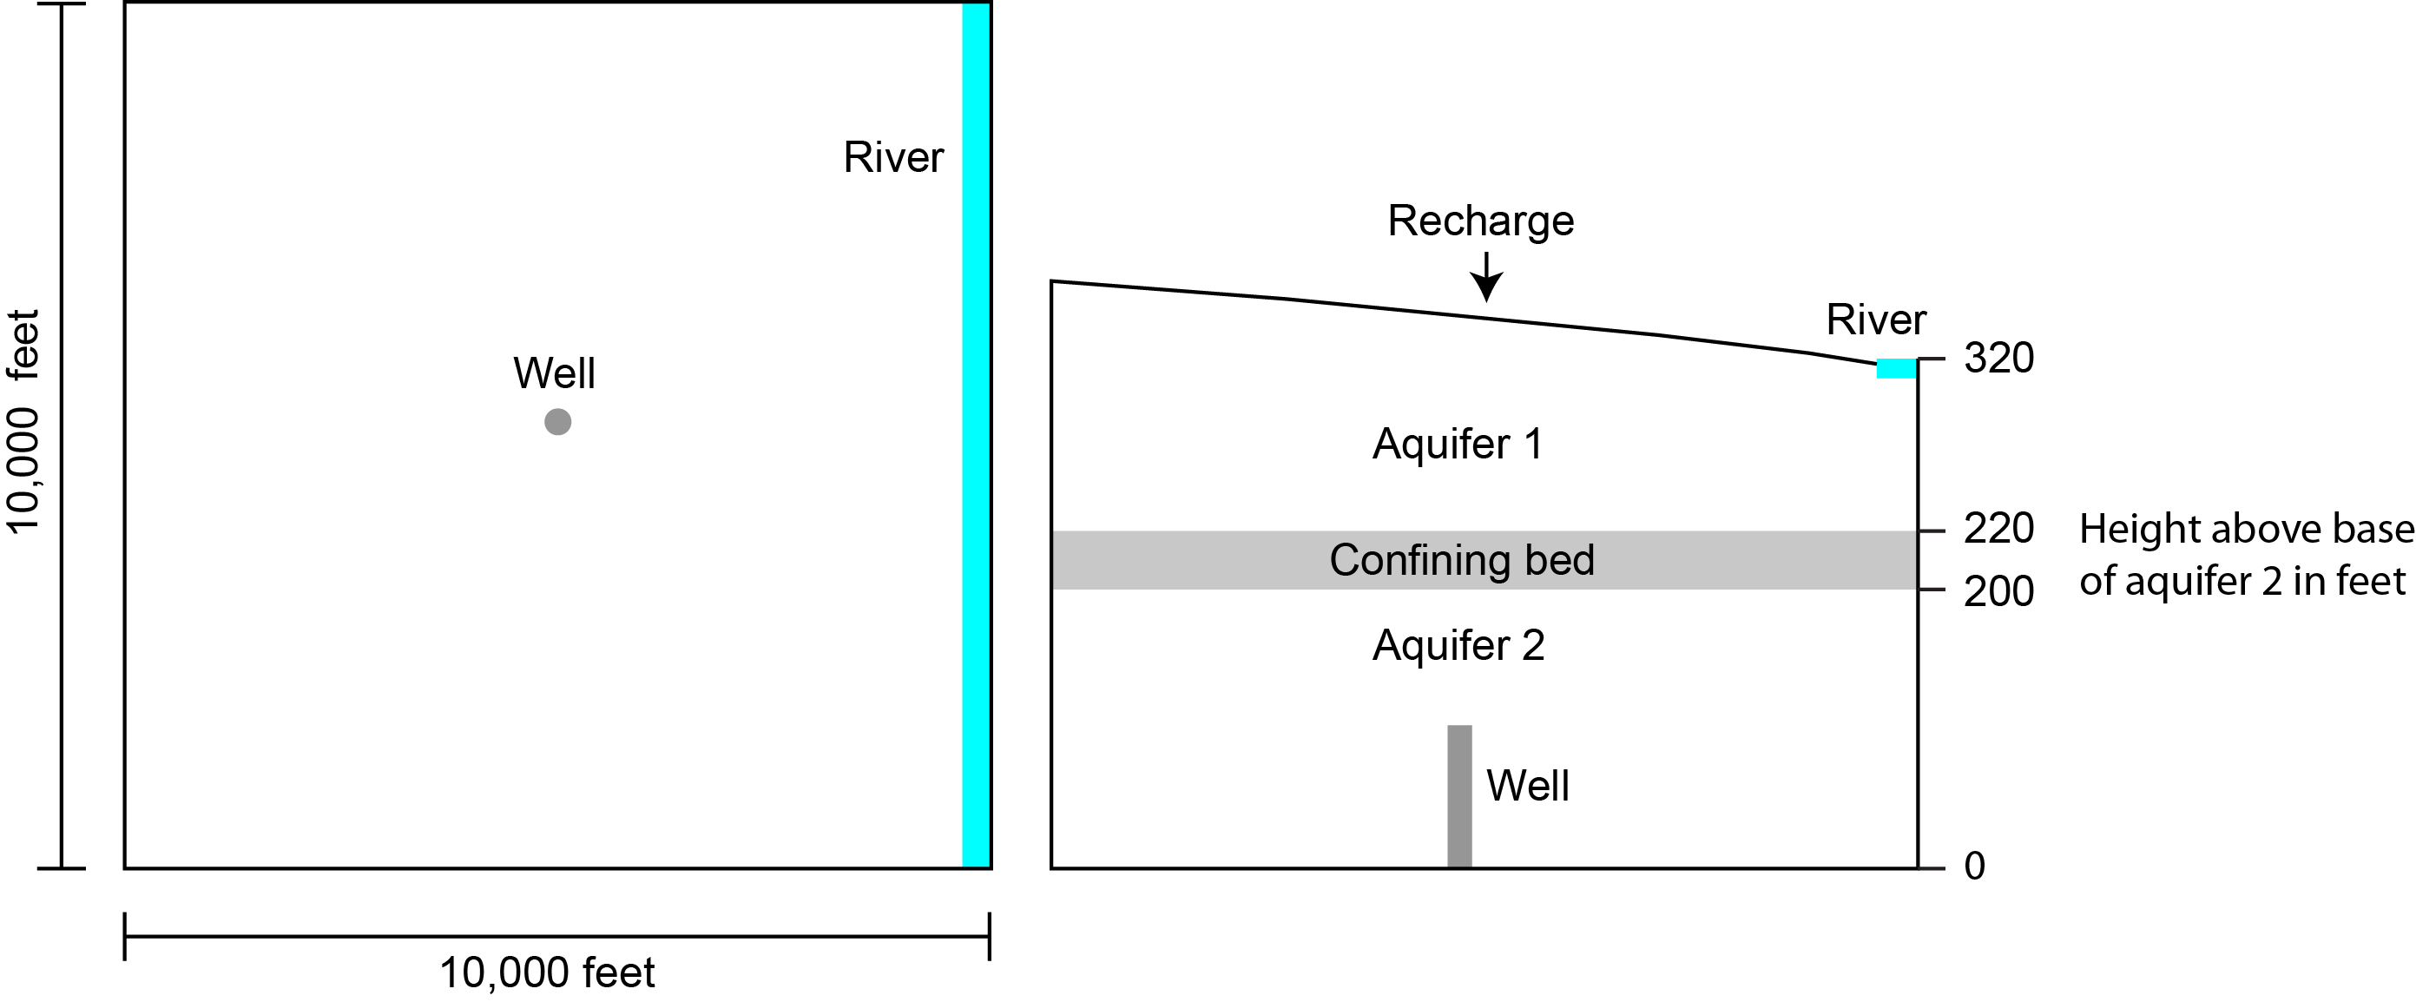
Example

Slide 8
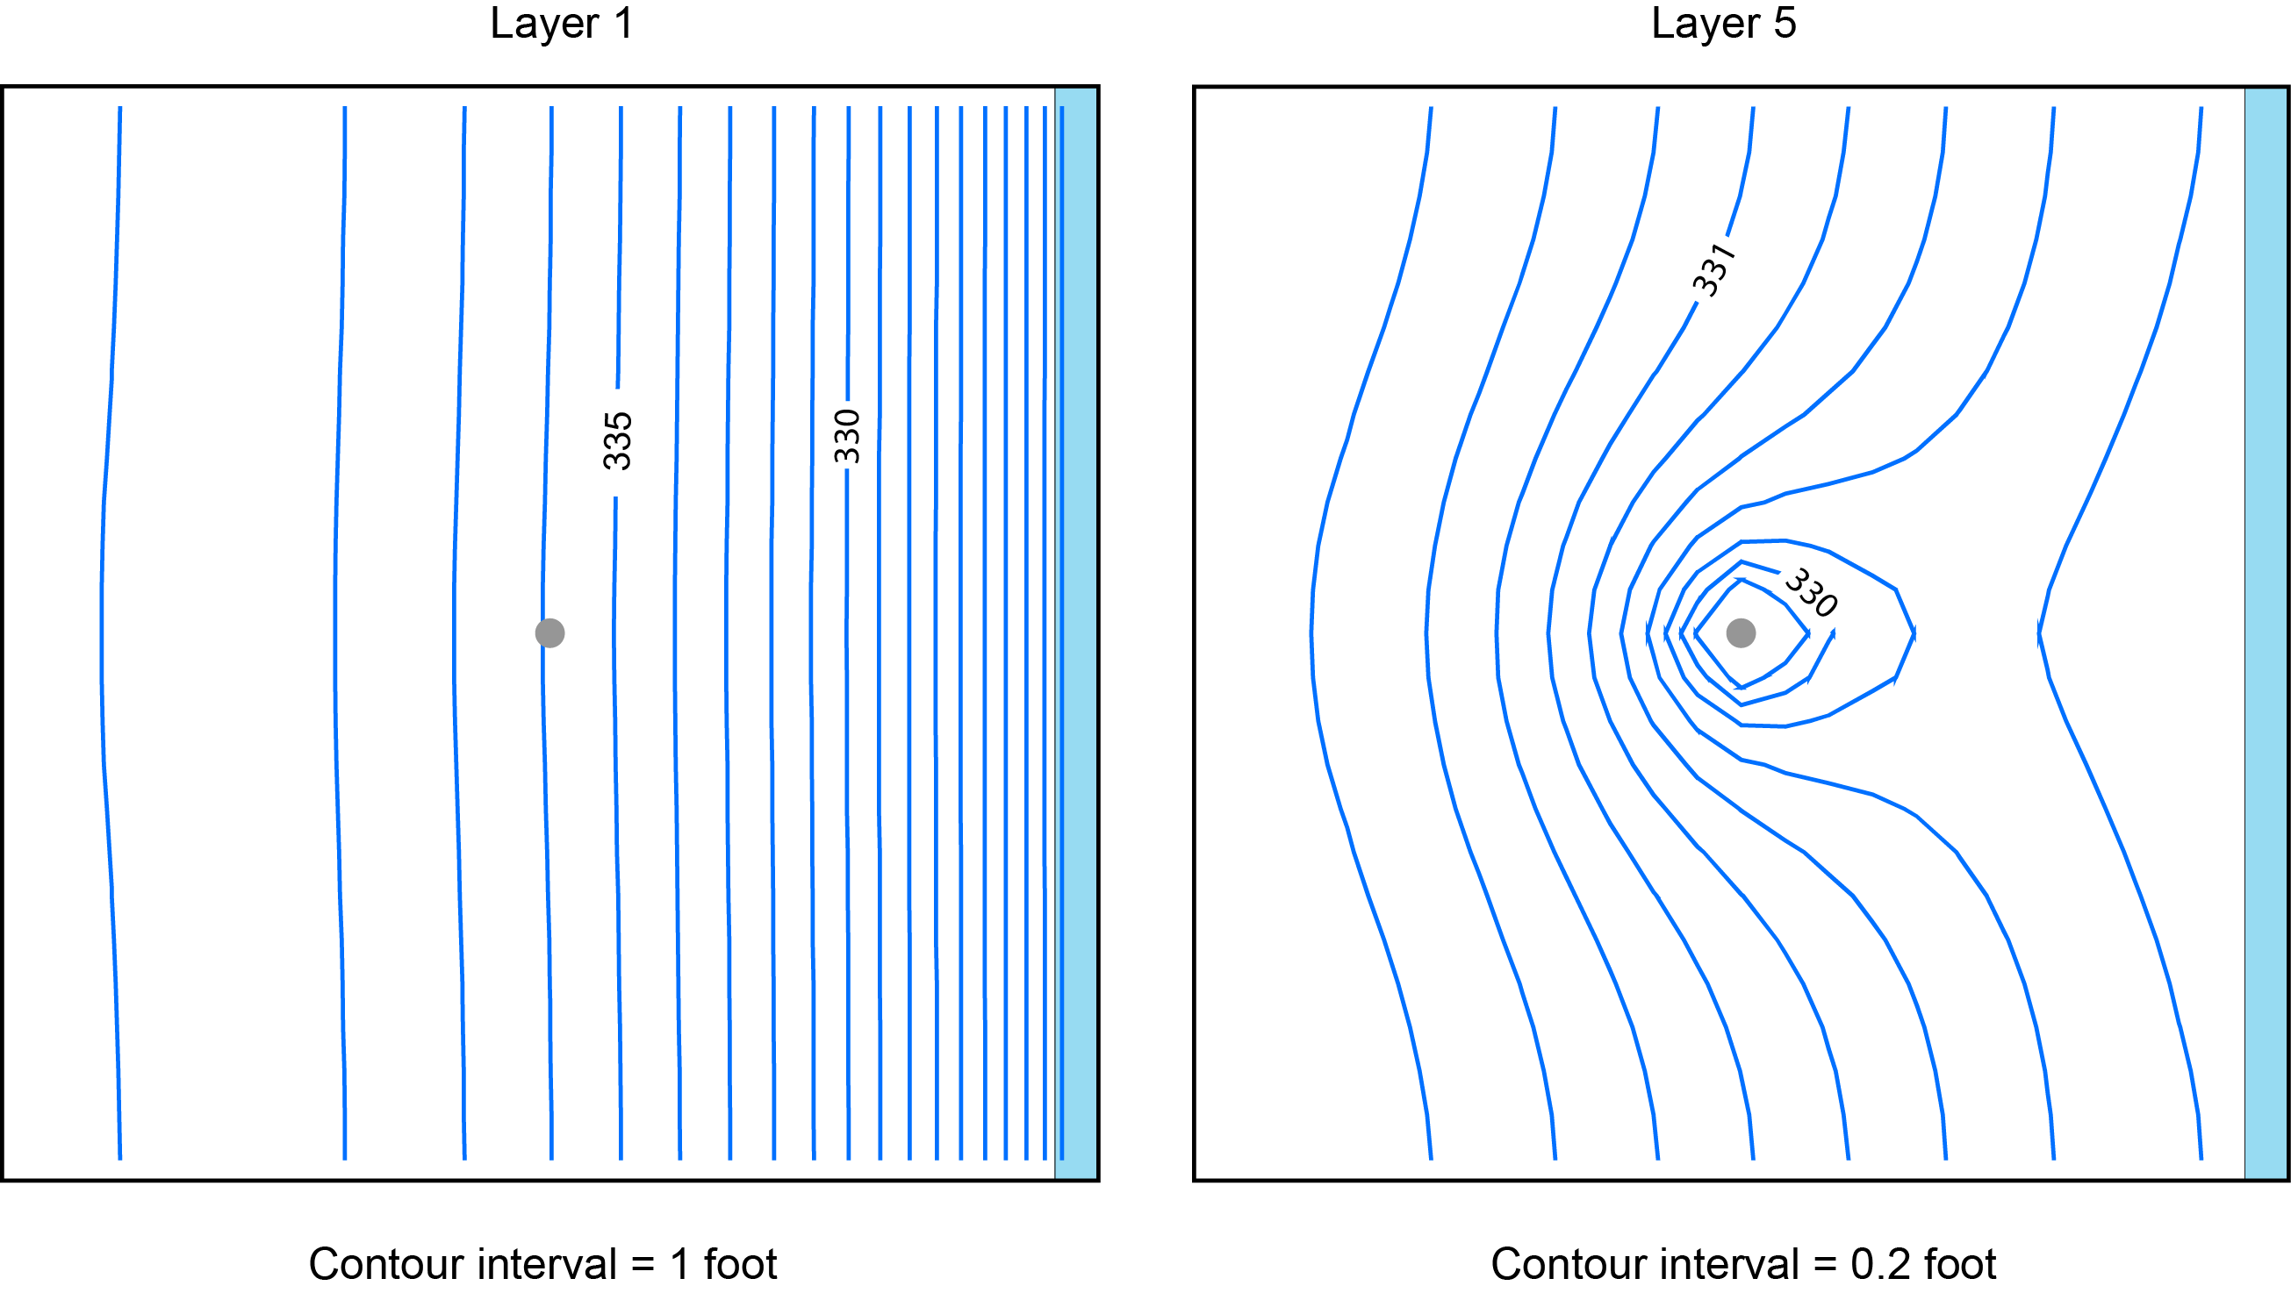
Head in Layers 1 and 5

Slide 9
Output Options
Endpoint simulation produces an endpoint file
Pathline simulation produces a pathline file in addition to an endpoint file
Timeseries simulation produces a timeseries file in addition to an endpoint file

Slide 10
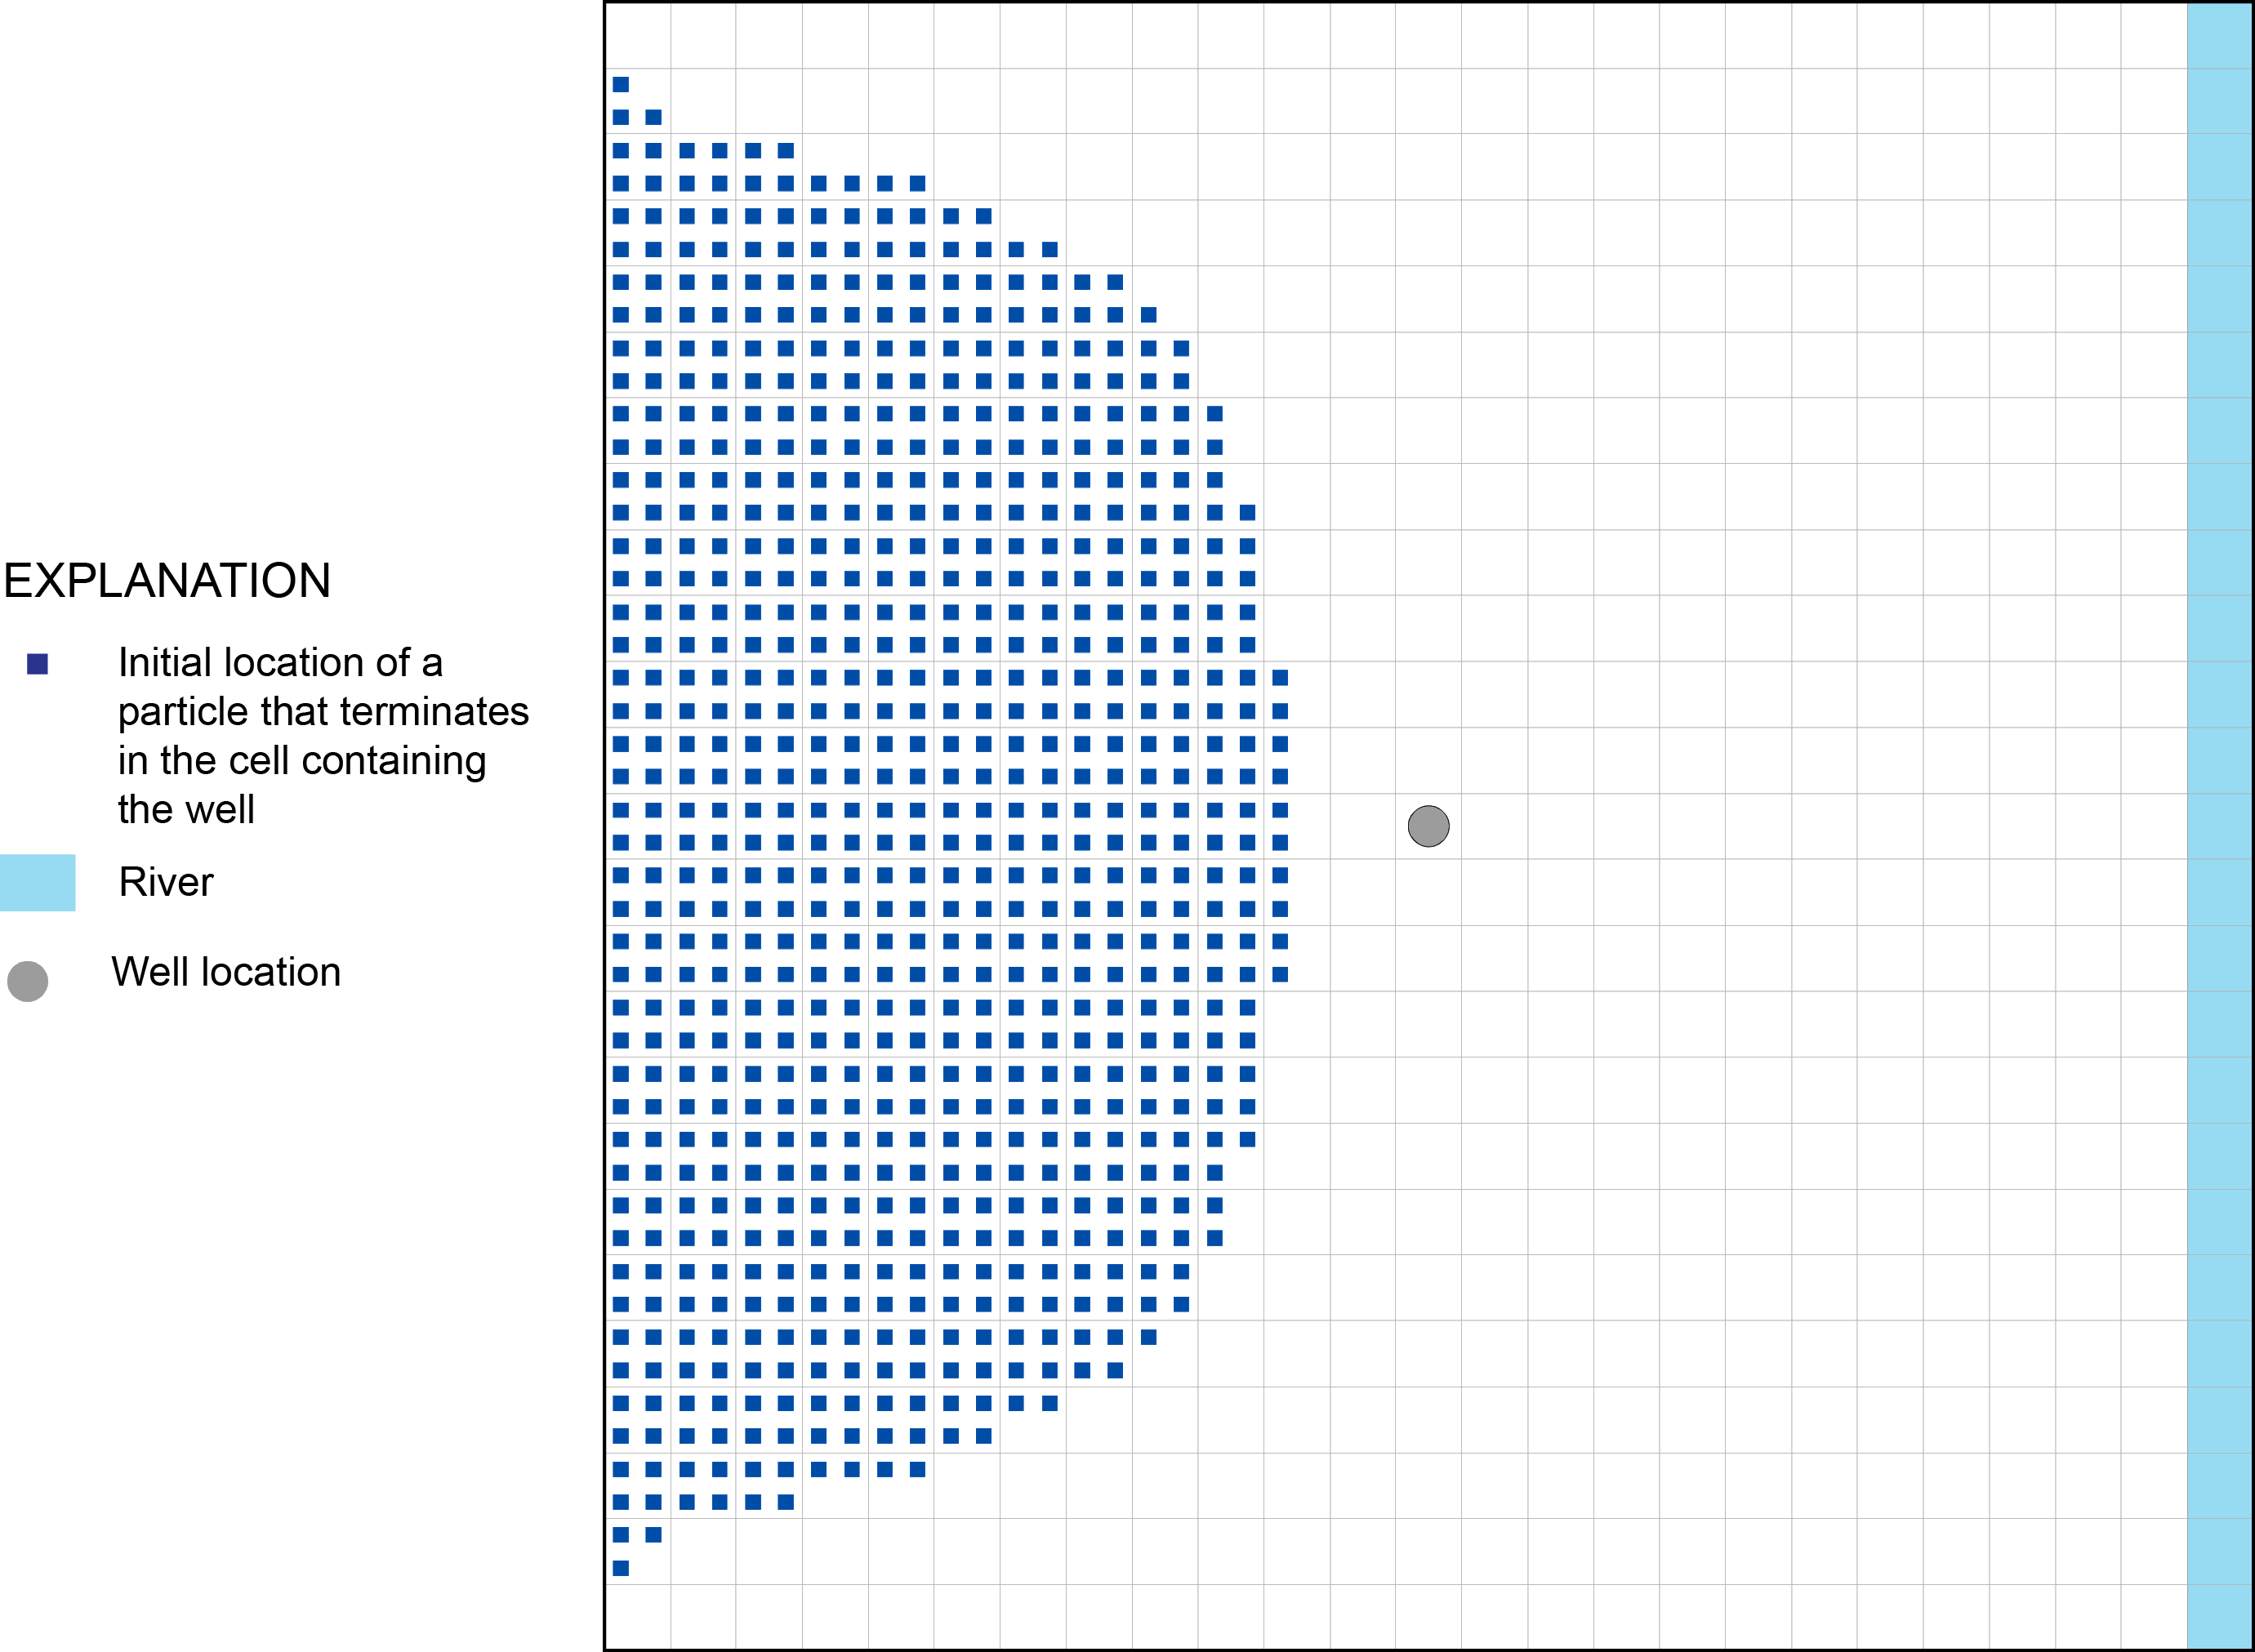
Endpoint Simulation
Information about the initial and final locations of particles are stored in the endpoint file

Slide 11
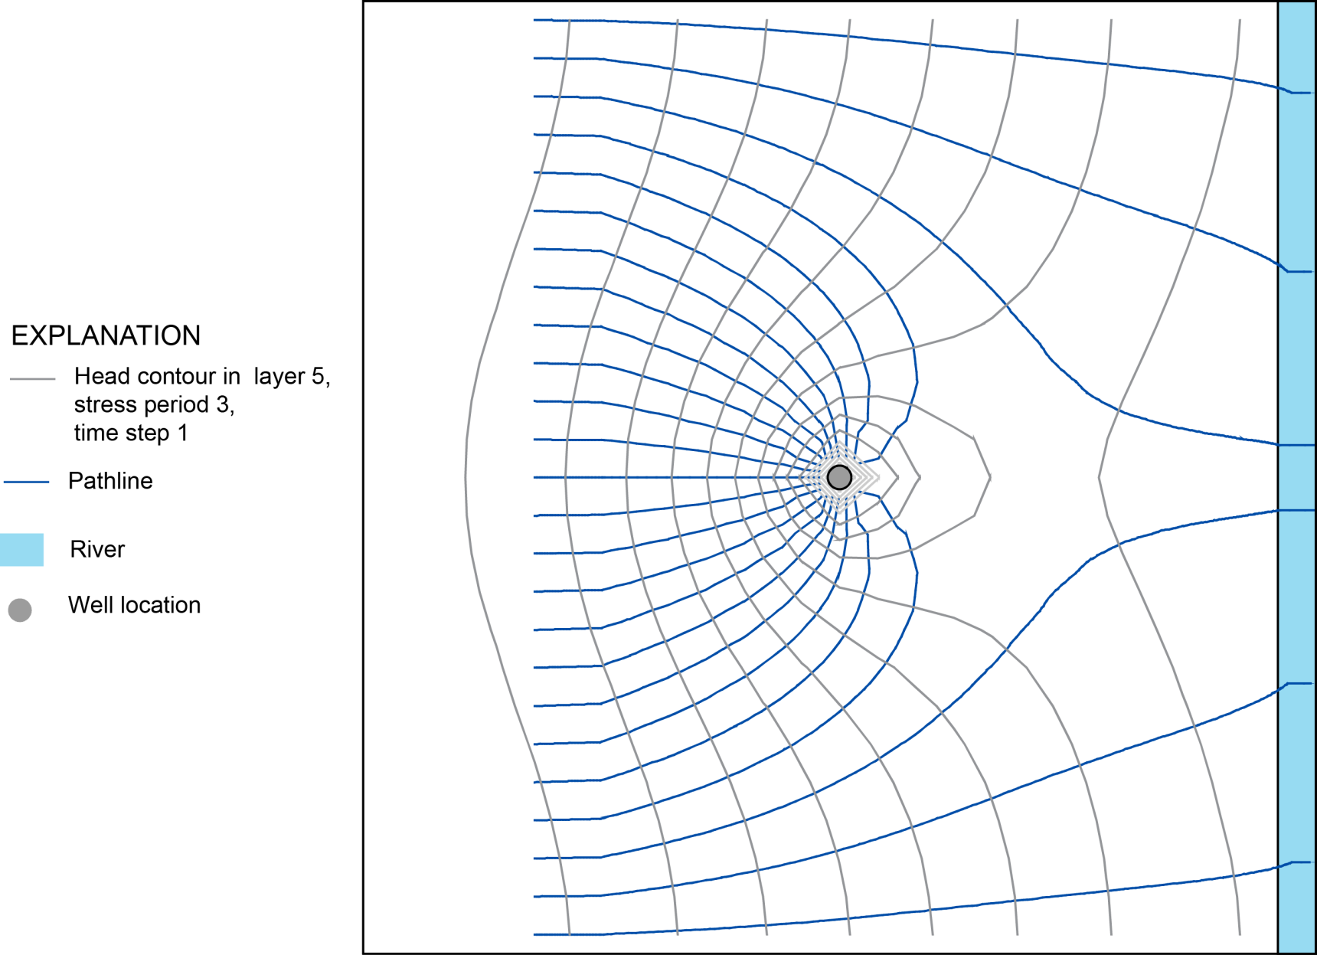
Pathline Simulation

Slide 12
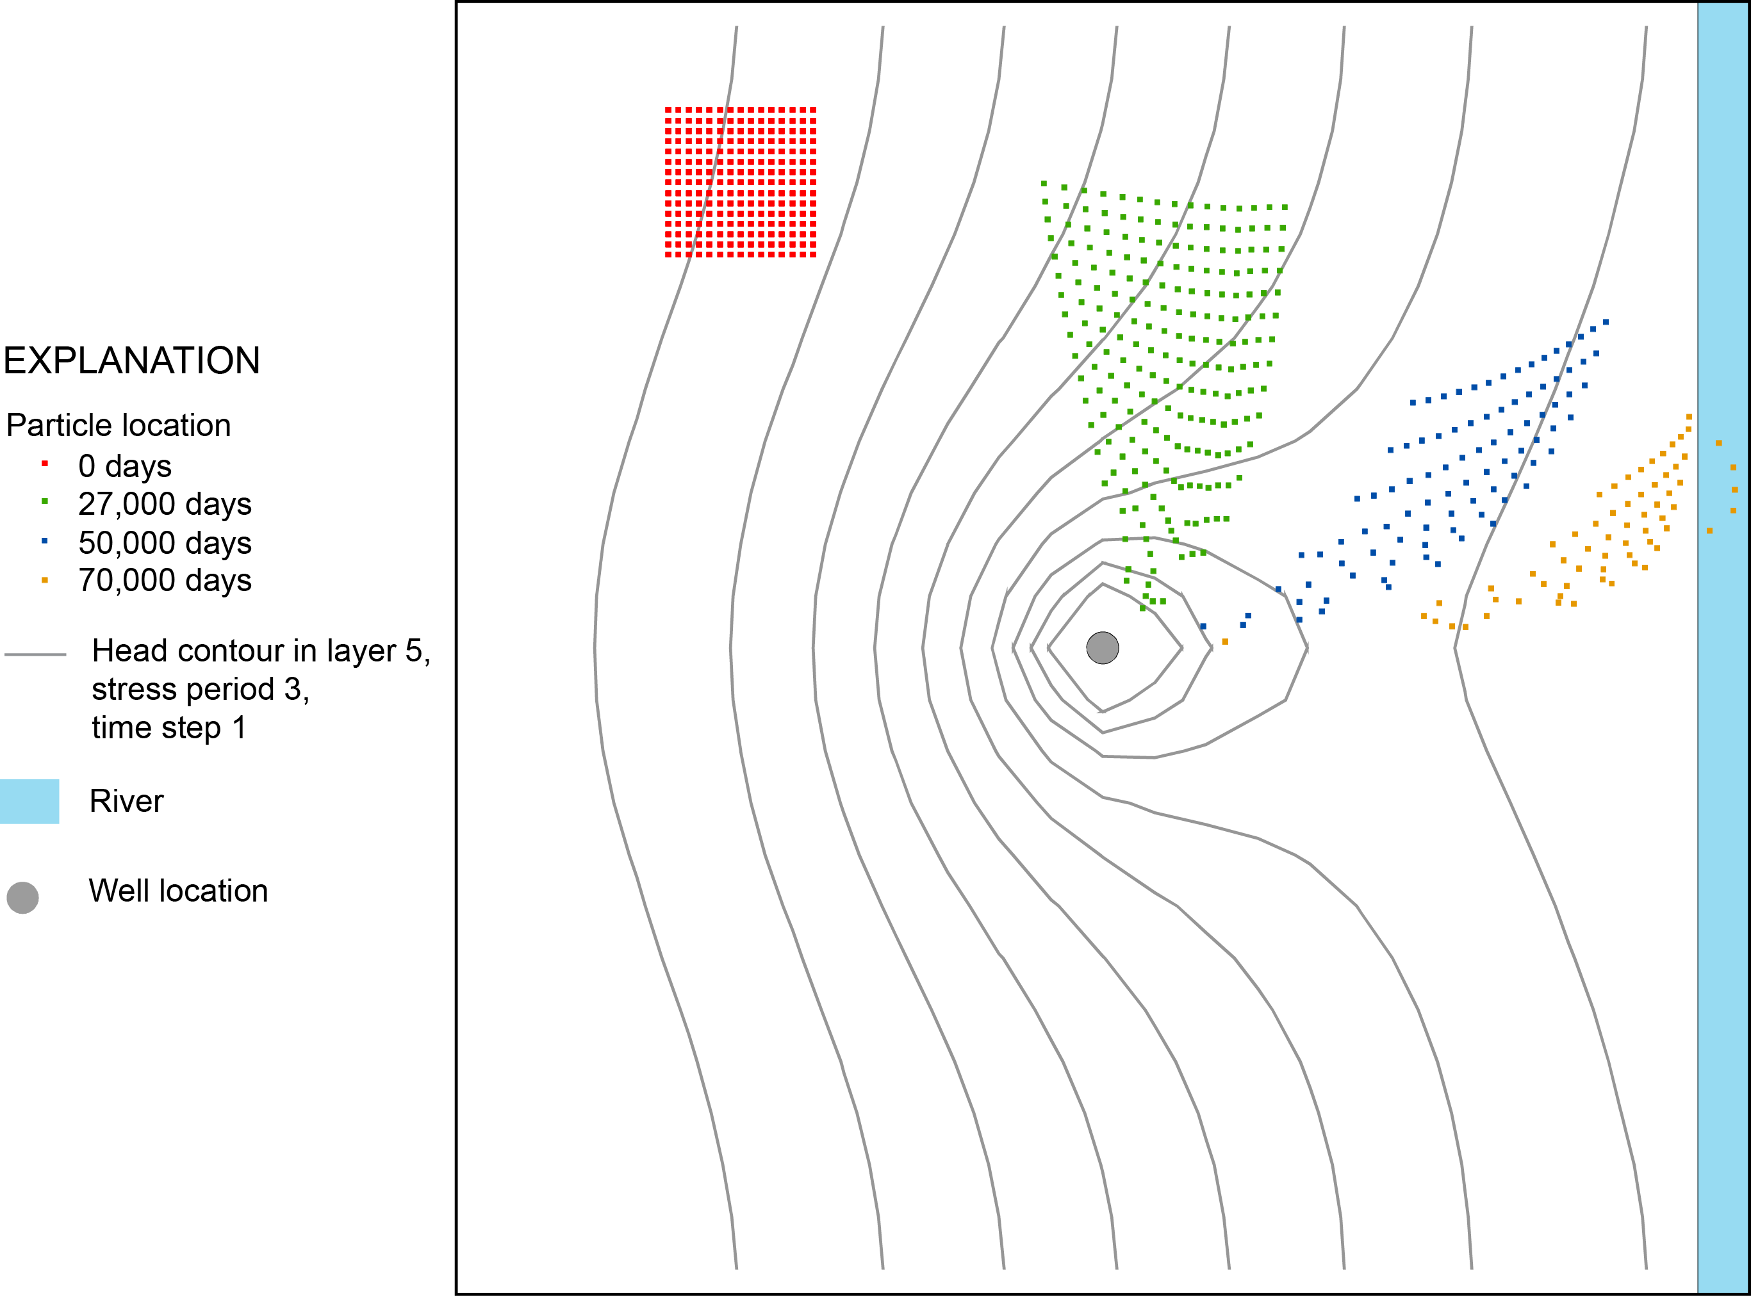
Timeseries Simulation

Slide 13
MODPATH Input Files
MODFLOW binary head file - Generated as output from MODFLOW
MODFLOW compact budget file - Generated as output from MODFLOW - Include IFACE as auxiliary data item
MODFLOW discretization file - DIS package data file
- TDIS file: MF6
MODPATH basic data file - Includes data that define the structure of the flow system.
MODPATH name file
MODPATH simulation file - Defines data for a specific MODPATH simulation - Replaces the old-style keyboard input

Slide 14
MODPATH Basic Data File
Description - Defines the basic structure of the flow system. - Consists primarily of a combination of data found in the MODFLOW BAS and LPF packages
Data - No-flow and dry cell head flags (HNOFLO and HDRY: omitted for MF6) - Default IFACE flags for stress package components - Layer type (LAYTYP) - Boundary array (IBOUND: Omitted for MF6) - Porosity

Slide 15
MODPATH Simulation File
Description
Defines options for a MODPATH simulation
Data
Output file names
Tracking direction (forward or backward)
Simulation type and output options
Particle starting location data
Options for terminating particles
Notes:
“simulation type” refers to: “pathline”, “endpoint”, “timeseries”, combined.

Slide 16
Steps in a MODPATH Simulation
Prepare MODFLOW data and run MODFLOW - Provides input data for MODPATH Discretization file (Binary grid file “.dis.grb”: MF6)
Time discretization file: MF6 Head output file Compact budget output file
Prepare MODPATH data - MODPATH basic data file - Simulation file
Run MODPATH - Generates particle output files (endpoint, path line, time series)
Examine output - Post-processing analysis based on particle output files

Slide 17
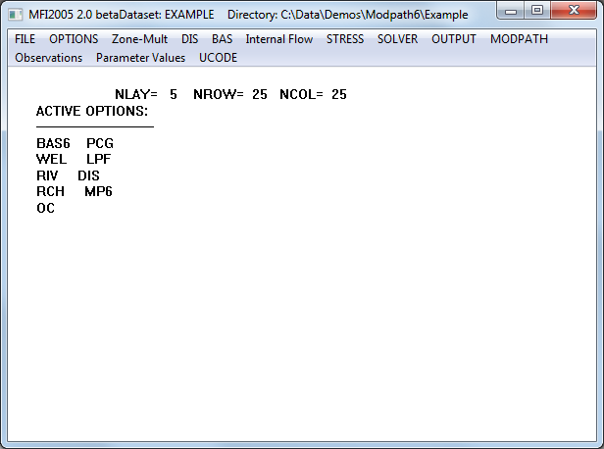
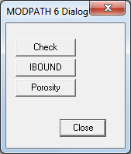
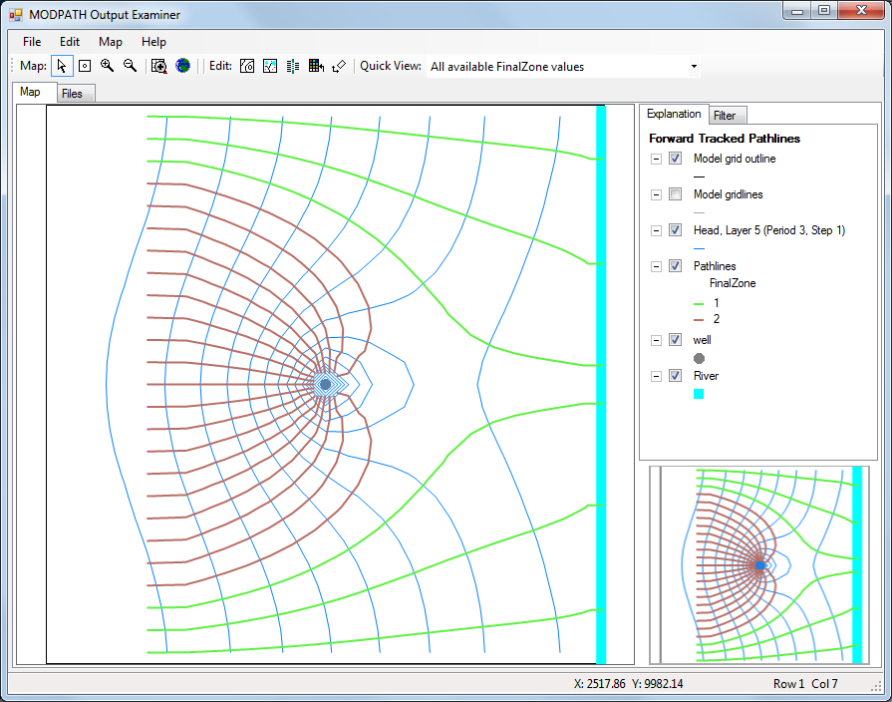
MFI
Pre- and Post-Processors
MPSIM
MODPATH Output Examiner
Notes:
MFI2005: data input program for modflow
MPSIM: Not sure what this is?
MODPATH output examiner: MODPATH 6

Slide 18
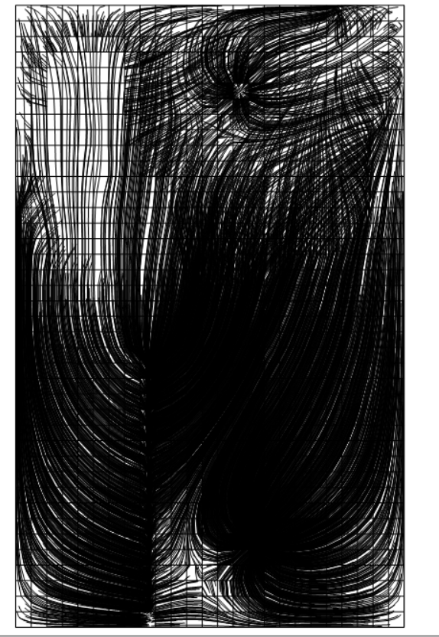
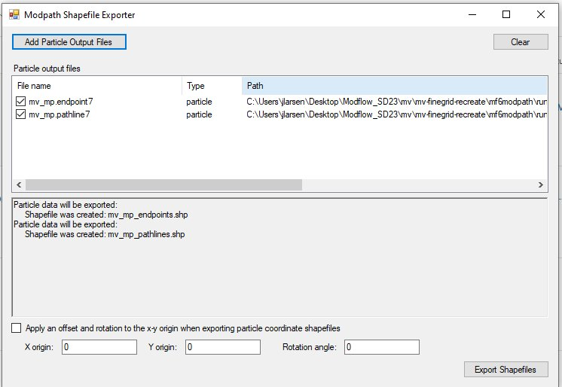
Pre- and Post-Processors
Modpath shapefile exporter
Notes:
ModelMuse!

Slide 19
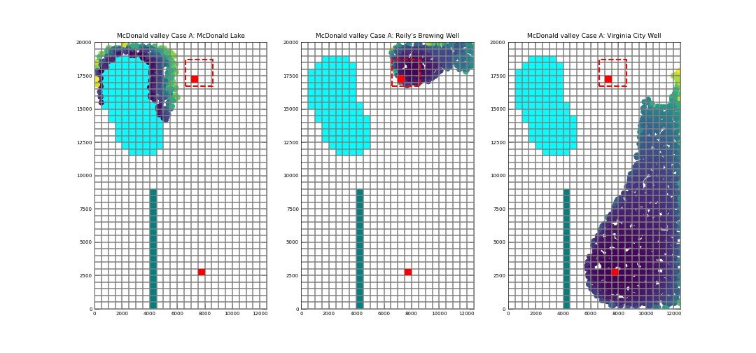
Pre- and Post-Processors
FloPy
Notes:
ModelMuse!

Slide 20
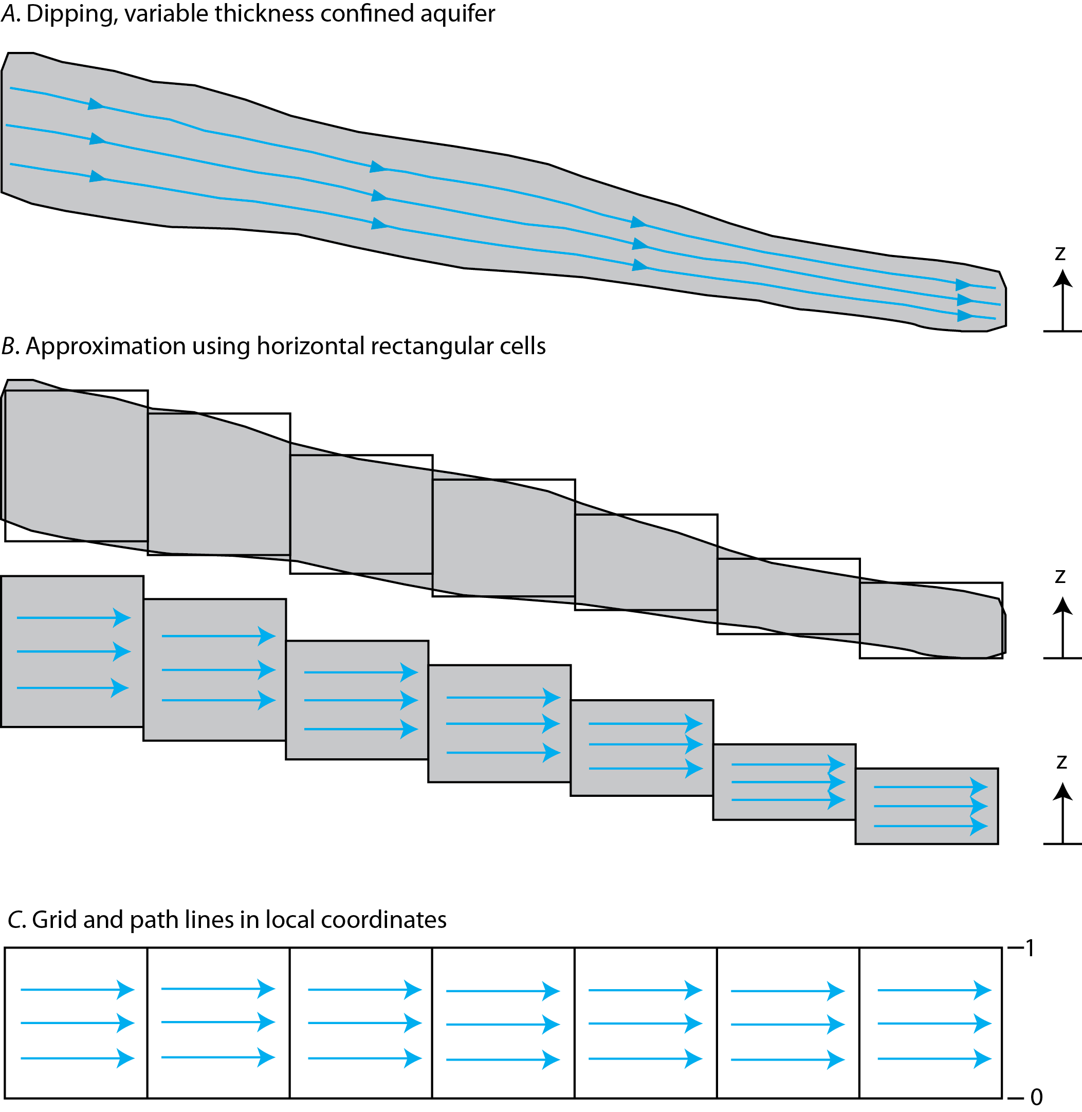
Using MODPATH With Deformed Grids

