Slide 1
McDonald Valley
A Model Calibration Exercise for MODFLOW

Slide 2
Exercise Outline
Stage 1 – Planning phase
Evaluate project objectives and develop conceptual model
Stage 2 – Initial model development
Build MODFLOW dataset and calibrate model using existing data
Stage 3 – Improve model
Collect new field data and refine model calibration
Stage 4 – Prediction phase
Simulate development scenarios to evaluate project objectives

Slide 3
Stage 3 – Improve Model
Data collection options
Drill wells
Shallow well (to a max of -100 ft)
Deep well (to bedrock)
Hydraulic tests
Slug test (local value of horizontal K)
Aquifer test (large scale value of K and possibly Kv)
Can only be done on a new deep well
Seismic Analysis
N-S or E-W
Bedrock elevation along that row/column
Streamflow (baseflow) measurements
Several points along Straight River

Slide 4
Stage 3 – Improve Model
Budget: $200,000
Costs
Drill wells
Shallow well – $1,000
Deep wells – $3,000
Hydraulic tests
Slug tests (limit of 7 on existing wells) – $250
Aquifer test – $4,000 (including drilling)
Seismic Section – $2,000
Streamflow measurement – $500

Slide 5
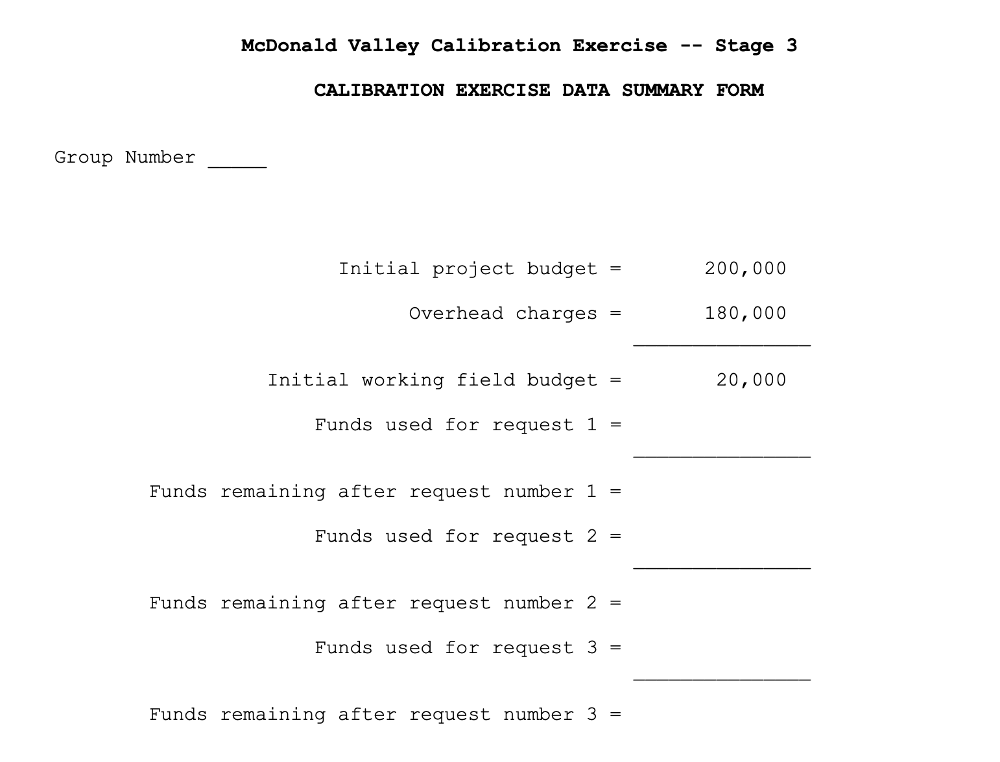

Slide 6
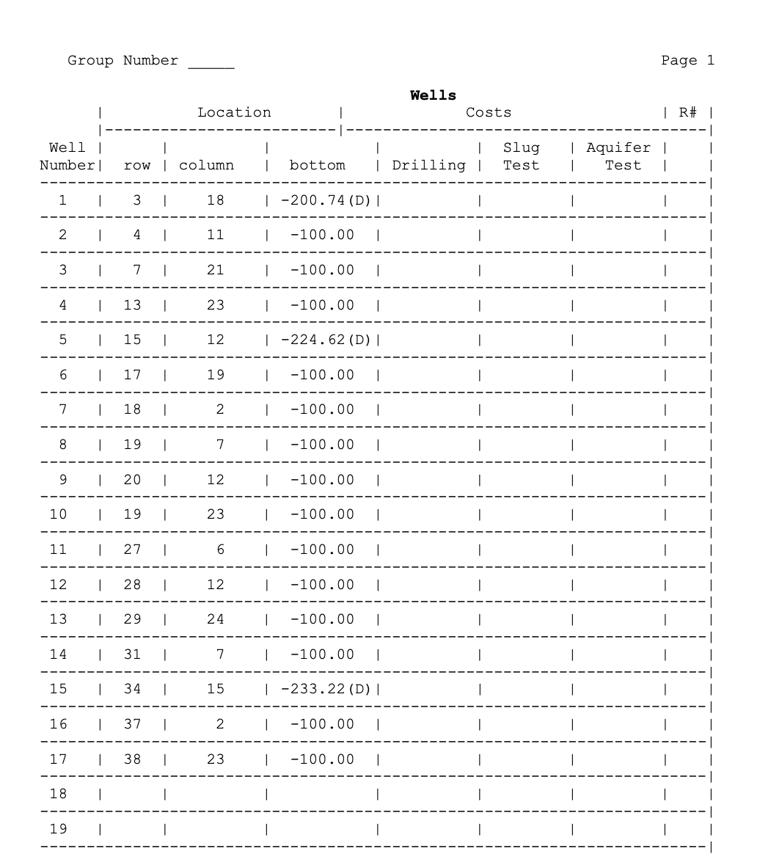
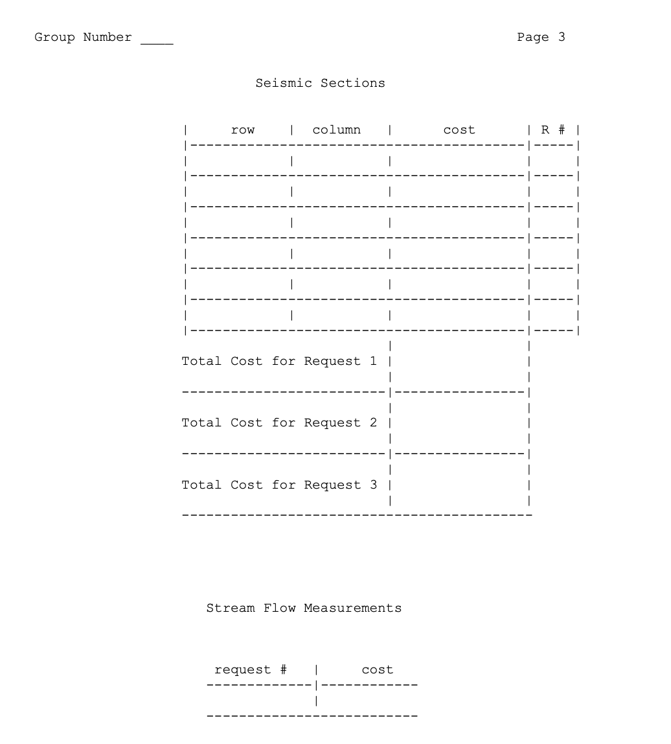

Slide 7
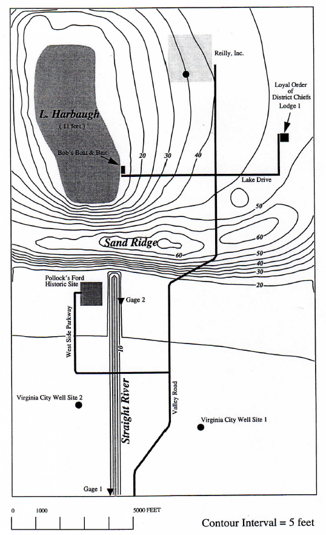
Stage 3 – Improve Model
Figure 2 – Topographic Map of McDonald Valley
Well in southern part of the valley at either of two sites
Well at Reilly’s Premium Beverages, Inc.
Objectives
Limit drawdown to no more than 2 ft
Limit stream flow reduction at Pollock’s Ford to less than 20%
Do not induced infiltration along Straight River
Lake
Harbaugh
L & H Lounge

