Slide 1
McDonald Valley
A Model Calibration Exercise for MODFLOW
Stage 1 – Planning phase Evaluate project objectives and develop conceptual model
Stage 2 – Build MODFLOW dataset and calibrate model using existing data
Stage 3 – Collect new field data and refine model calibration
Stage 4 – Prediction phase Simulate development scenarios to evaluate project objectives

Slide 2
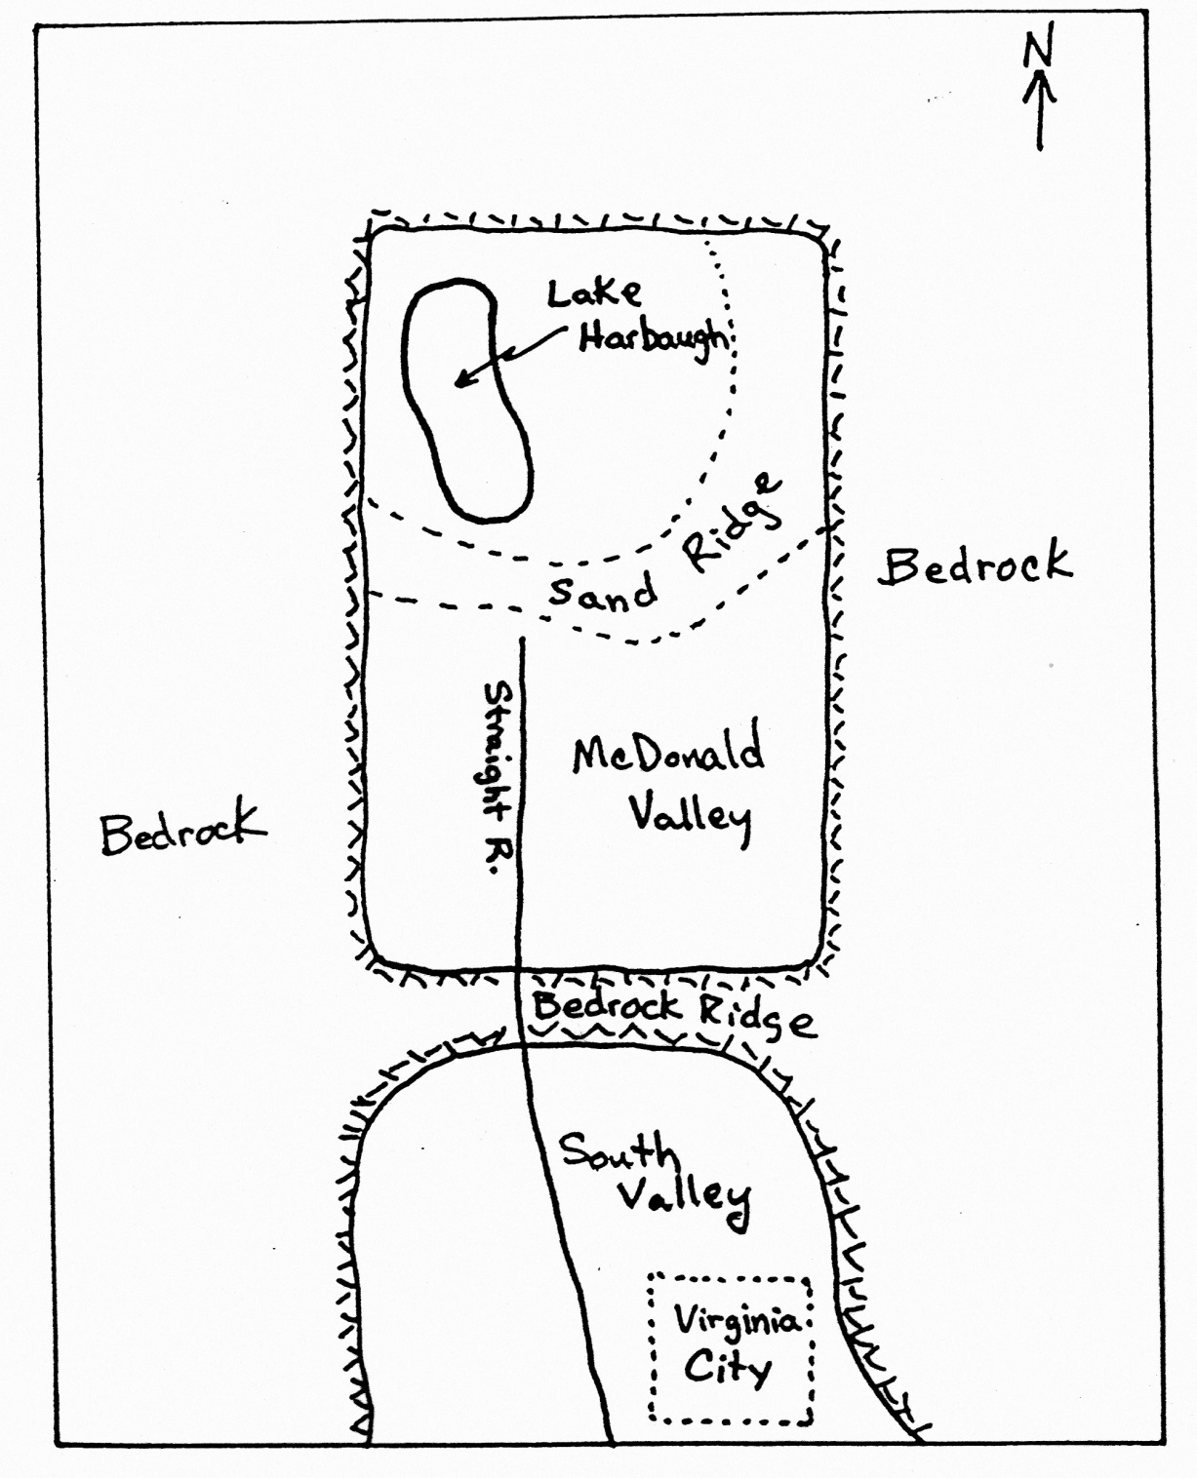
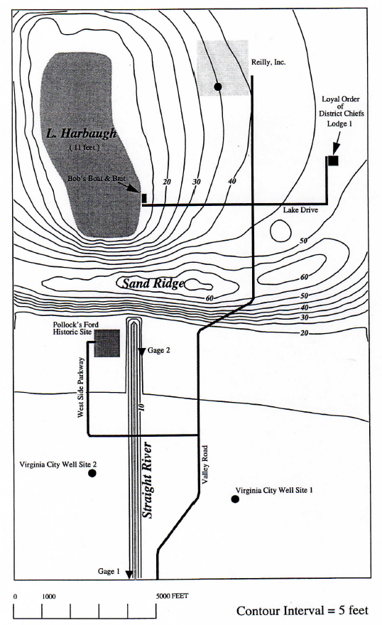
Figure 1 – Regional Map
Figure 2 – Topographic Map of McDonald Valley
Lake
Harbaugh
L & H Lounge

Slide 3
Proposed Groundwater Development
Figure 2 – Topographic Map of McDonald Valley
Well in southern part of the valley at either of two sites
Well at Reilly’s Premium Beverages, Inc.
County Cooperator
Doesn’t want excessive water-table declines (no more than 2 ft)
Must not reduce stream flow at Pollock’s Ford by more than 20%
No induced infiltration at all along Straight River
Lake
Harbaugh
L & H Lounge

Slide 4
Proposed Groundwater Development
Figure 2 – Topographic Map of McDonald Valley
Lake
Harbaugh
County Cooperator
Wants to regulate septic systems in northern part of valley
Cooperator want the source area for groundwater into Lake Harbaugh
Capture zone analysis of the Reilly well
Capture zone analysis of the proposed Virginia City wells
L & H Lounge

Slide 5
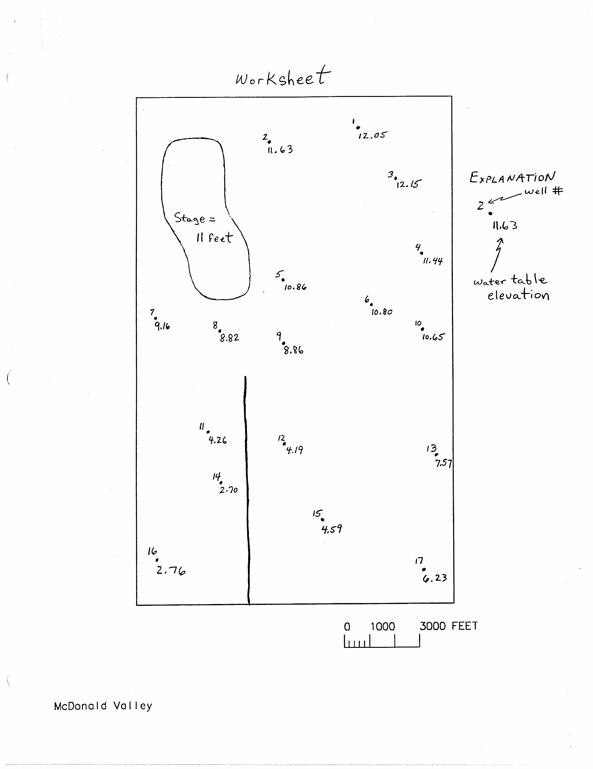
McDonald Valley
Contains unconsolidated valley-fill alluvium (sands/gravels)
No hydraulic tests but estimated K ranges from 10-500 ft/day
Low permeability lake clay in some boreholes
Valley has 17 existing observations wells

Slide 6
McDonald Valley
Figure 2 – Topographic Map of McDonald Valley
Lake
Harbaugh
No significant seasonal or short-term fluctuations in conditions
Mean annual precipitation of 36 in/year
No surface-water inflow
Straight River
Stage at end of valley = 0 ft
Gradient is 0.0002 ft/ft → 1.8 ft at headwaters
100 ft wide and 1 ft deep
Stream gages at end of valley and Pollock’s Ford
L & H Lounge

Slide 7
McDonald Valley
Figure 2 – Topographic Map of McDonald Valley
Lake
Harbaugh
Lake Harbaugh
Stage = 11 ft
Area of the lake = 1.625 x 10⁷ ft²
Lake Evaporation = 27 in/year (2.25 ft/year)
Precipitation = 36 in/year (3 ft/year)
No surface-water inflow
Steep sloping shore → uniform depth of 16 ft
Sandy bottom
L & H Lounge

Slide 8
Stage 1 – Planning phase
Develop a conceptual model
Contour water level data
Elements of the system that are important?
How to model features
Boundary conditions
Discretization?
Lake effects?
Recharge?

Slide 9
Stage 1 – Planning phase
Each team designs an approach for simulating McDonald Valley. After about 1 hour we will reconvene as a class and discuss the design plans.

Slide 11
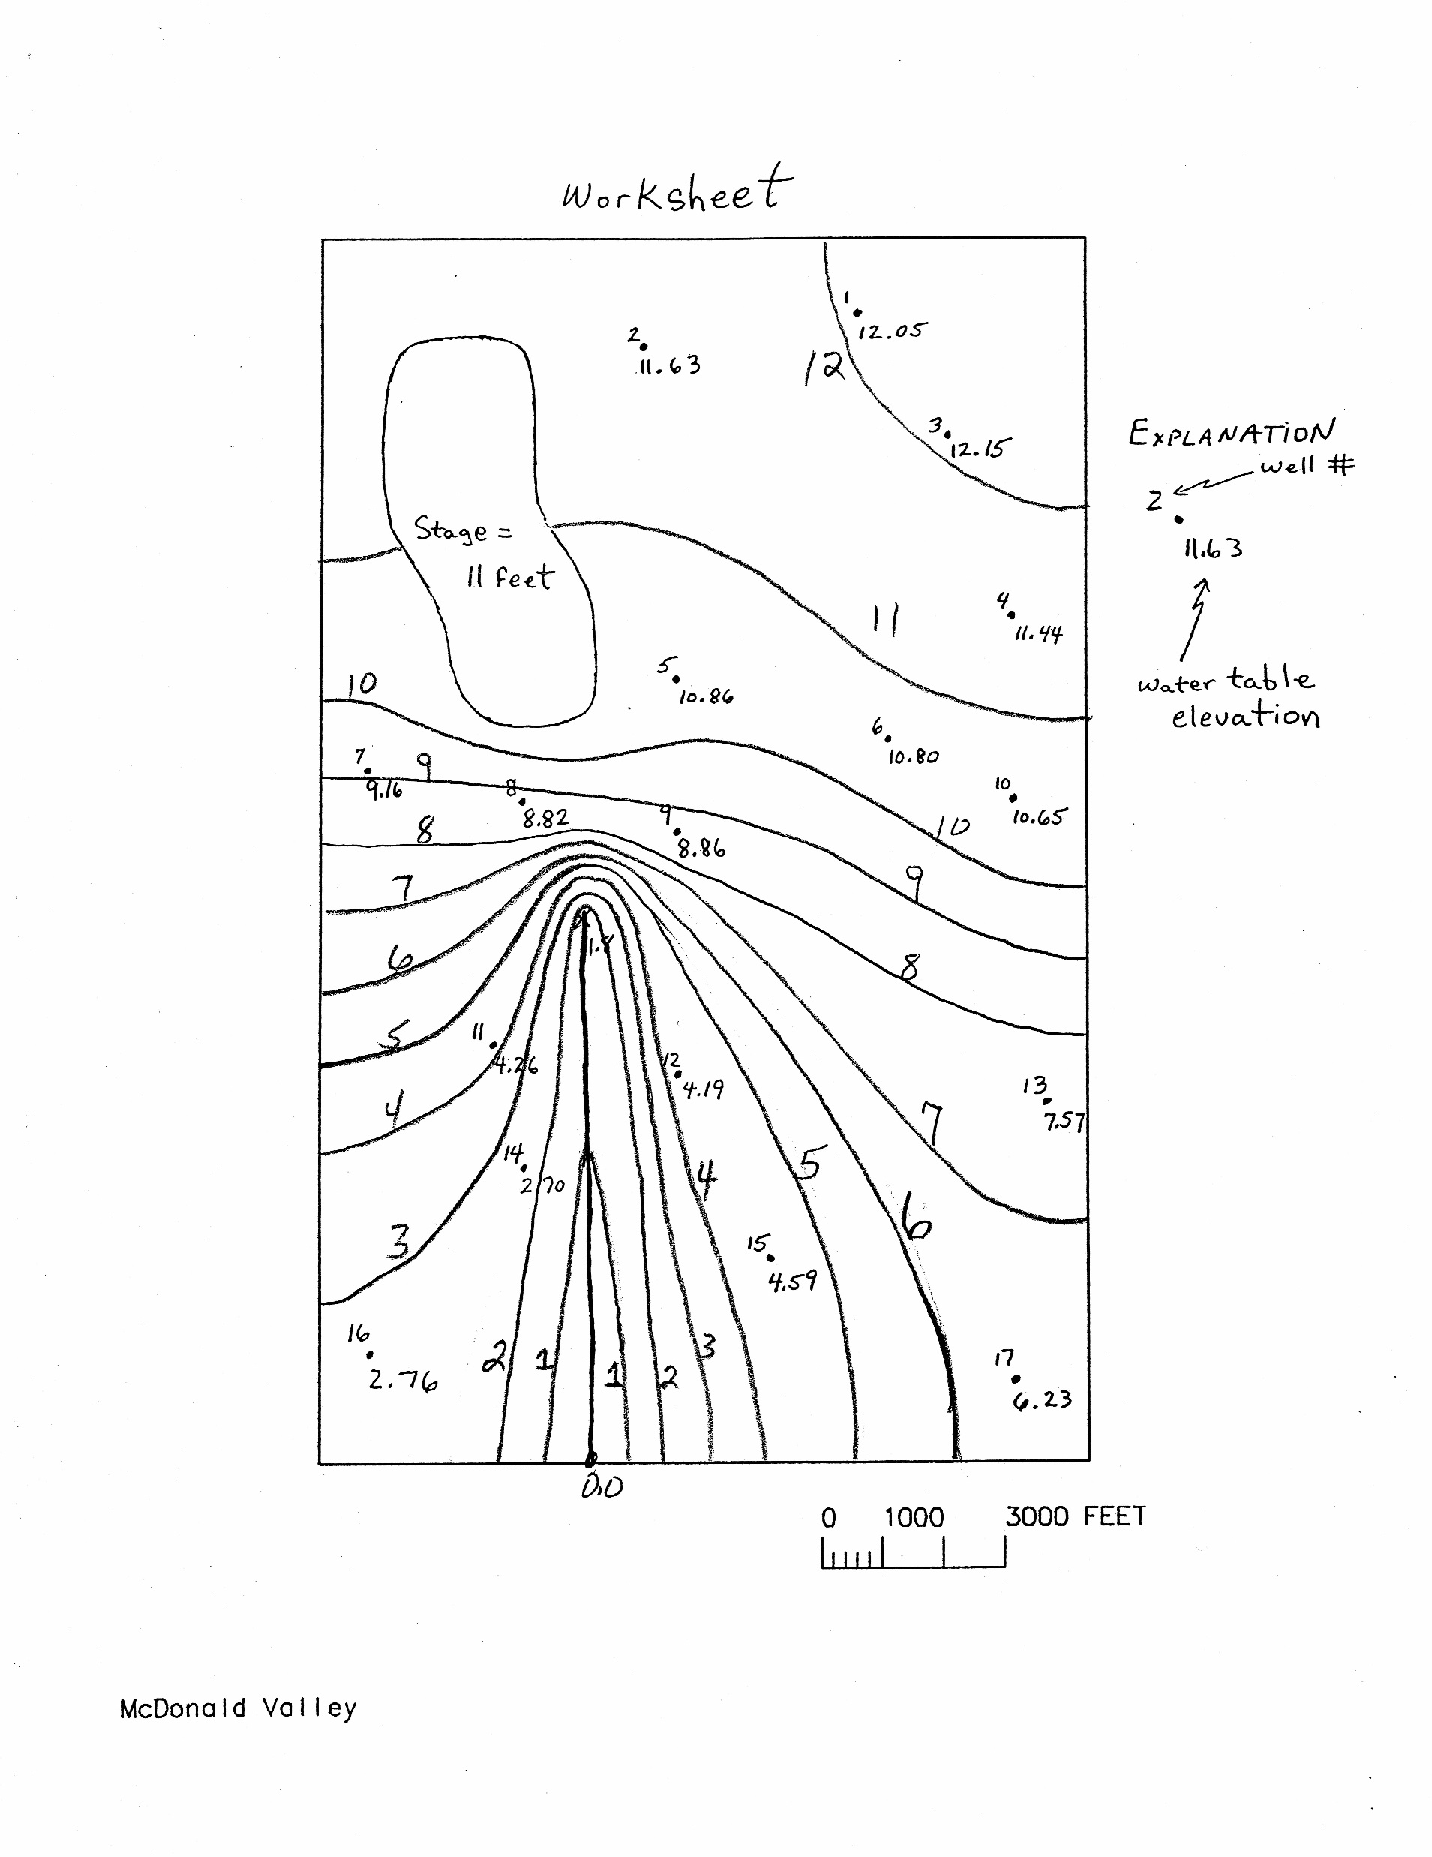
Figure 2 – Topographic Map of McDonald Valley
Lake
Harbaugh
L & H Lounge

Slide 12
Lake Budget

Slide 13
Recharge Rate for the Aquifer

Slide 14
Stage 2 – Building and Calibration Phase
Implement your conceptual model into a numerical model
Calibrate to existing conditions
Adjust hydraulic parameters, boundary conditions so that model results are close to observations
Adjust within justifiable ranges
Avoid adjusting when it can’t be supported
Your model will be wrong, but hopefully will tell you something

Slide 15
Figure 1 – Regional Map
Figure 2 – Topographic Map of McDonald Valley
Lake
Harbaugh
L & H Lounge

Slide 16
