Slide 1
Introduction to Groundwater Modeling using MODFLOW January 9-13, 2023 SDSU – San Diego, California

Slide 2
Instructors
Chris Langevin (langevin@usgs.gov)
Integrated Modeling and Prediction Division, USGS WMA
Joe Hughes (jdhughes@usgs.gov)
Integrated Modeling and Prediction Division, USGS WMA
Mike Fienen (mnfienen@usgs.gov)
Upper Midwest Water Science Center, Madison WI
Josh Larsen (jlarsen@usgs.gov)
California Water Science Center, Sacramento, CA

Slide 3
Logistics
Facilities
Lunch
Transportation
Class dinner
Internet
Software
Agenda

Slide 4
Please Introduce Yourself
Where are you from?
What is your background in groundwater modeling?
What do you hope to get out of this class?

Slide 5
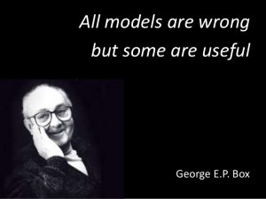

Slide 6
