Slide 1
Matrix Solution Techniques

Slide 2
Calculus
Linear Algebra
n equations
n unknowns

Slide 3
Why do we need to know about matrix solution techniques?
Because matrix solutions to the flow equation using default parameters can fail to achieve convergence or can be modified to improve performance.

Slide 4
Direct Solution of a Matrix
Example using Gaussian Elimination

Slide 5
Gaussian Elimination example
Solve a set of 3 simultaneous equations:
1) 2x + 3y + 4z = 29
2) x + y + z = 9
3) y + 5z = 23
In matrix form these equations are written as:
Ax = b

Slide 6
Gaussian Elimination example
Step 1 – Make sure that A(1,1) is non-zero, if it is not then switch the order of the equations until it is.
Step 2 – Divide equation 1 by A(1,1) to make the diagonal 1.

Slide 7
Gaussian Elimination example
Step 3 – Subtract a multiple of equation 1 from all lower equations to eliminate X from those equations. That is, make the coefficient 0 for all rows in the column below A(1,1). Subtract 1 times equation 1 from equation 2 and 0 times equation 1 from equation 3.

Slide 8
Gaussian Elimination example
Step 4 – Divide equation 2 by A(2,2) to make the diagonal 1. If A(2,2) is zero, switch equations until a non-zero one is found.

Slide 9
Gaussian Elimination example
Step 5 – Subtract a multiple of equation 2 from all lower equations to eliminate Y from those equations. That is, make the coefficient 0 for all rows in the column below A(2,2). Subtract 1 times equation 2 from equation 3.

Slide 10
Gaussian Elimination example
Step 6 – Divide equation 3 by A(3,3) to make the diagonal 1.

Slide 11
Gaussian Elimination example
This leaves an upper triangular matrix, which we can back substitute to solve.

Slide 12
Gaussian Elimination example
Solve as follows:
From equation 3,
z = 4.
Substituting z = 4 into equation 2 gives an equation in which we can solve for y.
y + 2 (4) = 11, and therefore
y = 3.
Substituting z = 4 and y = 3 into equation 1 gives an equation in which we can solve for x.
x + 3/2 (3) + 2 (4) = 29/2, and therefore
x = 2.

Slide 13


Excellent Online Resources

Slide 14
Iterative Solvers
What is an iterative matrix solver?
Approximate solution that improves each iteration
Heads from the previous iteration used to formulate matrix and known component of head dependent part of the equation is moved to the right-hand side.
Start with
Head from previous time step in transient models
Initial head for the first stress period
Stop iterating when maximum change in head and flow residual reach specified values.

Slide 15
Iterative Solvers – continued
Why use an iterative matrix solver?
Lower cost – less CPU time and less computer memory (sparseness)
Non-linear terms are handled automatically

Slide 16
Iterative Solvers – continued
LINEAR MATRIX EQUATION
Ax = b confined aquifer
NON-LINEAR MATRIX EQUATION
A(x)x = b unconfined aquifer

Slide 17
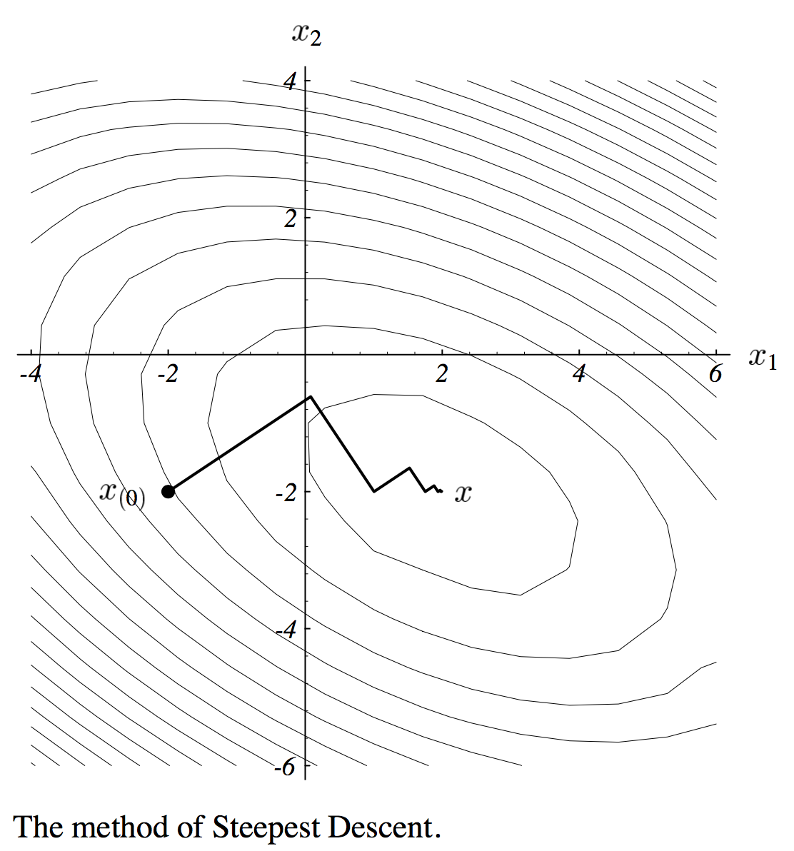
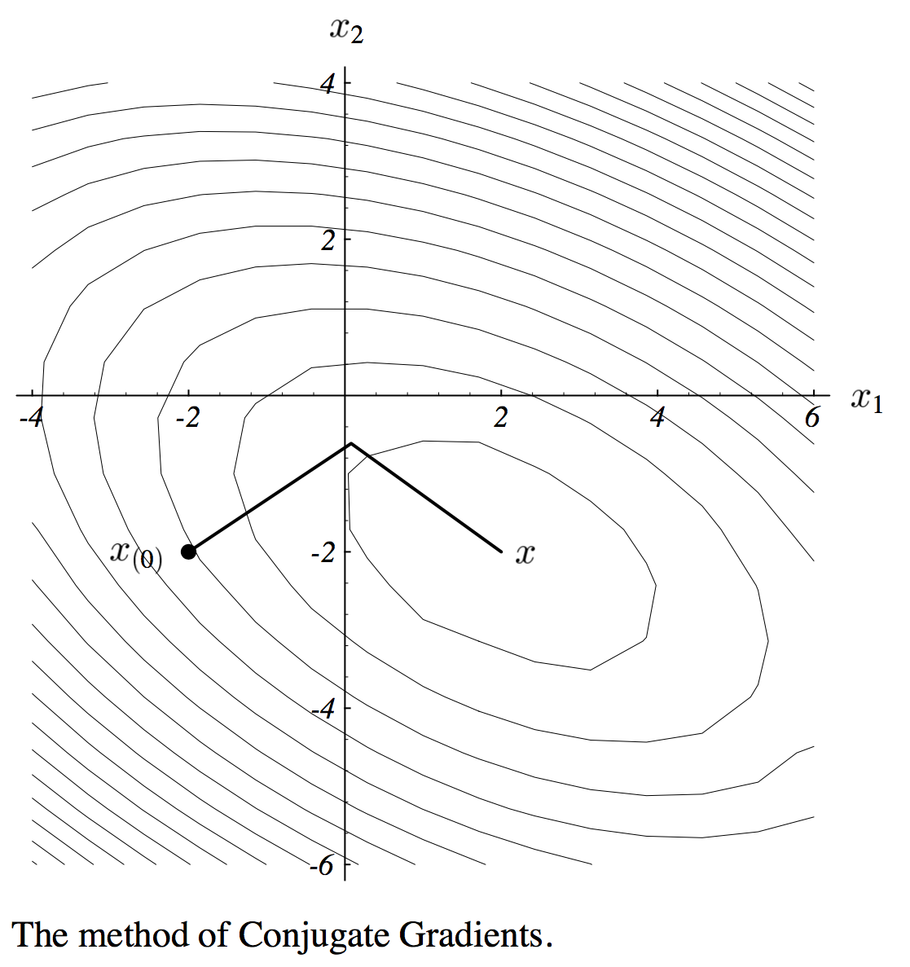
Iterative Solvers – continued

Slide 18
Iterative Solvers – continued
Common iterative solver terms
Convergence
Divergence
Oscillation
Head Closure Criteria – HCLOSE
Residual Closure Criteria – RCLOSE
Volumetric Balance (Mass Balance)
Dampening Parameters
Non-Linear Terms

Slide 19
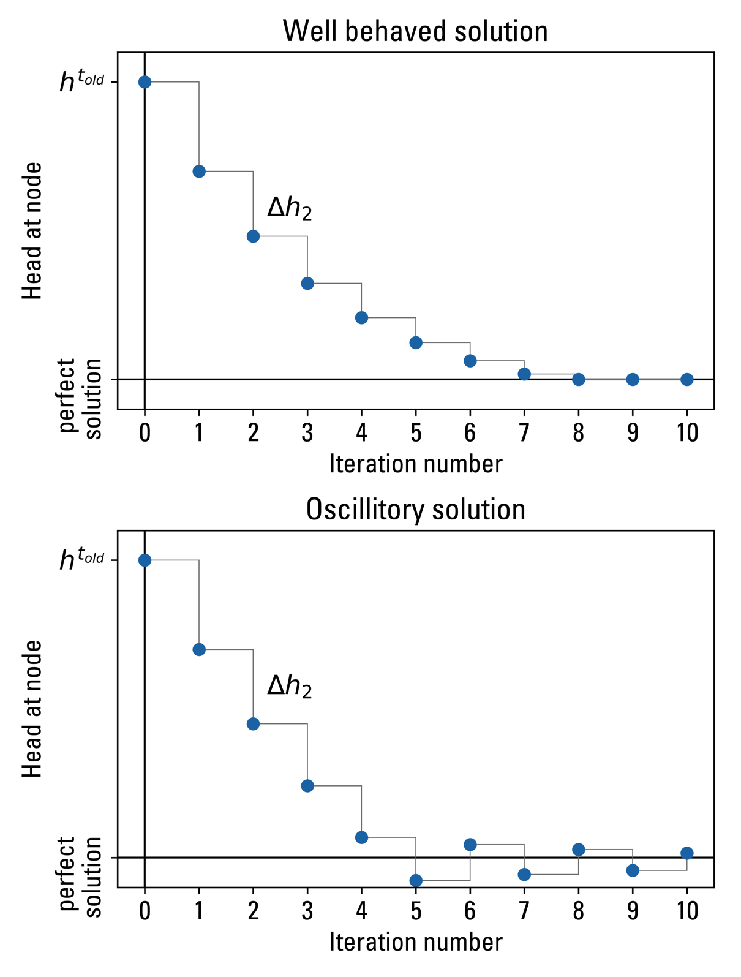

Slide 20
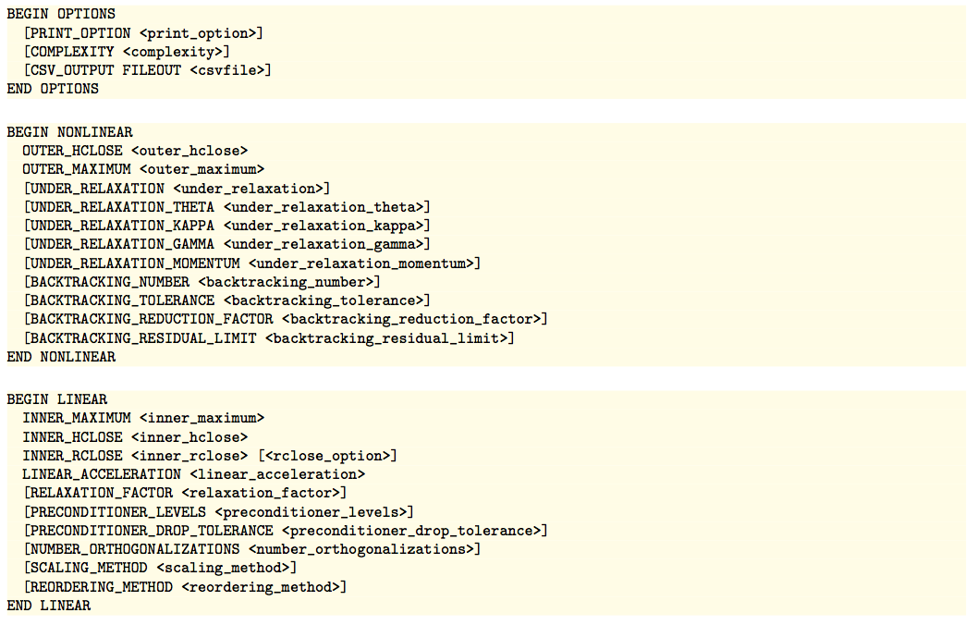
Iterative Model Solution (IMS)

Slide 21
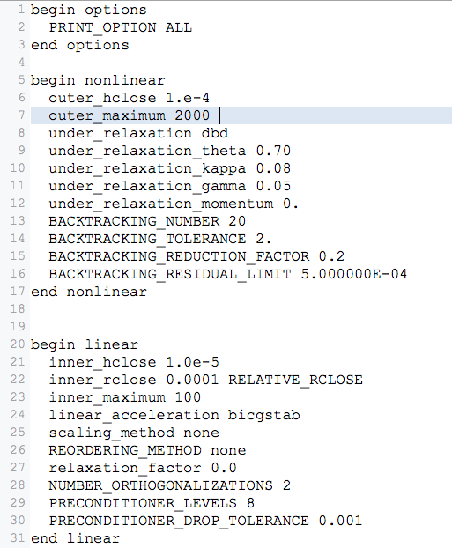
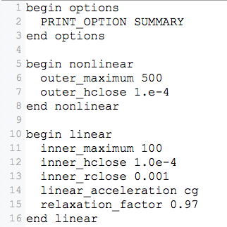
Iterative Model Solution (IMS)

Slide 22
MODFLOW 6 Program Structure

Slide 23
Iterative Model Solution Iteration Output
STRESS PERIOD NO. 1, LENGTH = 1.000000
-----------------------------------------------
NUMBER OF TIME STEPS = 1
MULTIPLIER FOR DELT = 1.000
INITIAL TIME STEP SIZE = 1.000000
PSEUDO-TRANSIENT CONTINUATION WILL BE APPLIED TO MODEL 1 ("GWF_1") DURING THIS TIME STEP
OUTER ITERATION SUMMARY
----------------------------------------------------------------------
OUTER INNER MAXIMUM MAXIMUM CHANGE
ITERATION ITERATION CHANGE MODEL-(CELLID)
----------------------------------------------------------------------
1 2 4.69817 1_GWF-(1,1,2)
2 2 4.28196 1_GWF-(1,1,2)
3 2 5.14804 1_GWF-(1,1,3)
4 2 5.77241 1_GWF-(1,1,5)
5 2 5.60236 1_GWF-(1,1,6)
6 2 5.26931 1_GWF-(1,1,7)
7 2 4.73380 1_GWF-(1,1,8)
8 2 3.97119 1_GWF-(1,1,9)
9 2 5.69875 1_GWF-(1,1,11)
10 2 1.89574 1_GWF-(1,1,13)
--- DELETED OUTPUT ---
130 2 1.283997E-04 1_GWF-(1,1,14)
131 2 6.565490E-05 1_GWF-(1,1,14)
132 2 6.839853E-05 1_GWF-(1,1,14)
132 CALLS TO NUMERICAL SOLUTION IN TIME STEP 1 STRESS PERIOD 1
264 TOTAL ITERATIONS
Summary Output
In mfsim.lst

Slide 24
Iterative Model Solution Iteration Output – cont.
STRESS PERIOD NO. 1, LENGTH = 3650.000
-----------------------------------------------
NUMBER OF TIME STEPS = 1
MULTIPLIER FOR DELT = 1.000
INITIAL TIME STEP SIZE = 3650.000
PSEUDO-TRANSIENT CONTINUATION WILL BE APPLIED TO MODEL 1 ("GWF_1") DURING THIS TIME STEP
OUTER ITERATION SUMMARY
--------------------------------------------------------------------------------------------------------------------------
OUTER INNER BACKTRACK BACKTRACK INCOMING OUTGOING MAXIMUM MAXIMUM CHANGE
ITERATION ITERATION FLAG NUMBER RESIDUAL RESIDUAL CHANGE MODEL-(CELLID)
--------------------------------------------------------------------------------------------------------------------------
1 0 0 1358.81 1358.81
1 1 -104.299 1_GWF-(80,1,399)
2 0 0 861.141 861.141
2 1 -91.2889 1_GWF-(80,1,399)
--- DELETED OUTPUT ---
1495 1 3.575820E-06 1_GWF-(1,1,242)
1496 0 0 6.654849E-07 6.654849E-07
1496 1 8.817771E-06 1_GWF-(11,1,242)
1496 CALLS TO NUMERICAL SOLUTION IN TIME STEP 1 STRESS PERIOD 1
12631 TOTAL ITERATIONS
INNER ITERATION SUMMARY
--------------------------------------------------------------------------------------------------------------------------------
TOTAL OUTER INNER MAXIMUM CHANGE MAXIMUM MAXIMUM RESIDUAL MAXIMUM
ITERATION ITERATION ITERATION MODEL-(CELLID) CHANGE MODEL-(CELLID) RESIDUAL
--------------------------------------------------------------------------------------------------------------------------------
1 1 1 1_GWF-(80,1,399) -104.2986 1_GWF-(80,1,398) 0.2839609E-03
2 2 1 1_GWF-(80,1,399) -91.28890 1_GWF-(77,1,399) 0.1378092E-03
3 3 1 1_GWF-(80,1,399) -72.86832 1_GWF-(79,1,391) 0.7505842E-03
12628 1493 1 1_GWF-(80,1,399) 0.4007301E-07 1_GWF-(37,1,119) -0.3574527E-07
--- DELETED OUTPUT ---
12629 1494 1 1_GWF-(80,1,399) 0.3882955E-07 1_GWF-(37,1,119) -0.3472589E-07
12630 1495 1 1_GWF-(80,1,399) 0.4379174E-07 1_GWF-(37,1,119) -0.3352793E-07
12631 1496 1 1_GWF-(80,1,399) 0.1042437E-06 1_GWF-(37,1,119) -0.3055896E-07
All Output
In mfsim.lst

Slide 25
GWF Volumetric Budget
VOLUME BUDGET FOR ENTIRE MODEL AT END OF TIME STEP 4, STRESS PERIOD 3
---------------------------------------------------------------------------------------------------
CUMULATIVE VOLUME L**3 RATES FOR THIS TIME STEP L**3/T PACKAGE NAME
------------------ ------------------------ ----------------
IN: IN:
--- ---
STO-SS = 11305695.4808 STO-SS = 9.7013E-06 STORAGE
STO-SY = 52475165.9043 STO-SY = 0.0000 STORAGE
WEL = 0.0000 WEL = 0.0000 WEL-1
RCH = 9320218146.2500 RCH = 851083.7500 RCH-1
SFR = 0.0000 SFR = 0.0000 SFR-1
LAK = 938014117.6950 LAK = 84973.8588 LAK-1
TOTAL IN = 10322013125.3301 TOTAL IN = 936057.6088
OUT: OUT:
---- ----
STO-SS = 4077869.7750 STO-SS = 12.1236 STORAGE
STO-SY = 21777604.5660 STO-SY = 53.6439 STORAGE
WEL = 3668250000.0000 WEL = 335000.0000 WEL-1
RCH = 0.0000 RCH = 0.0000 RCH-1
SFR = 6070881183.4998 SFR = 547967.0883 SFR-1
LAK = 556952694.9202 LAK = 53009.1636 LAK-1
TOTAL OUT = 10321939352.7609 TOTAL OUT = 936042.0193
IN - OUT = 73772.5691 IN - OUT = 15.5895
PERCENT DISCREPANCY = 0.00 PERCENT DISCREPANCY = 0.00
In GWF lst file

Slide 26
Reasons Solvers Fail
Input errors
Mistakes in boundary stress locations
Incorrect hydraulic property and stress units
Excessively small convergence criteria
Conceptual model errors
Missing boundary stresses
Isolated cells
Difficult numerical problems
Widely varying hydraulic properties
Non-linear problems (water-table problems)

Slide 27
Reasons Solvers Fail
Always check to make sure the model has converged before using results
If MODFLOW 6 does not converge
“Normal Termination” is not written to the the Command window/Terminal at the end of the simulation
“****FAILED TO CONVERGE IN TIME STEP _ OF STRESS PERIOD _****” is written to mfsim.lst and the GWF lst file

Slide 28
Evaluate Solver Failure
Identify problem areas based on nodes with recurring maximum head changes (in mfsim.lst) prior to diagnosing potential problems.
Input data errors
Check input files in problem areas
Conceptual model errors
Examine the conceptual model and its translation to a numerical model
Evaluate problem areas relative to the conceptual model

Slide 29
Evaluate Solver Failure – cont.
Difficult numerical problems
Adjust solver input data – add under-relaxation or dampening
Use Newton-Raphson
Use different initial heads (steady-state models)
Temporarily make convertible layers non-convertible (confined) to make the system more linear to assess the problem and perhaps generate good initial heads.
Do a transient simulation to get to a steady state solution in order to smooth head changes.

