Slide 1
Storage and Stress Packages

Slide 2
Packages
Internal Packages
Storage (STO) Package
Time-Varying Storage (TVS) Package¹
Skeletal Storage, Compaction and Subsidence (CSUB) Package ¹
Horizontal Flow Barrier (HFB) Package¹
Buoyancy (BUY) Package¹
Viscosity (VSC) Package¹
¹ Will not be covered
Standard Stress Packages
Constant Head (CHD)
Recharge (RCH)
Well (WEL)
River (RIV)
Drain (DRN)
General Head Boundary (GHB)
Evapotranspiration (EVT)
Advanced Stress Packages²
² Will be covered later

Slide 3


Storage (STO) Packages
Steady state if STO Package not specified for a simulation
Aquifer storage properties are specified
Individual stress periods are marked as steady state or transient

Slide 4
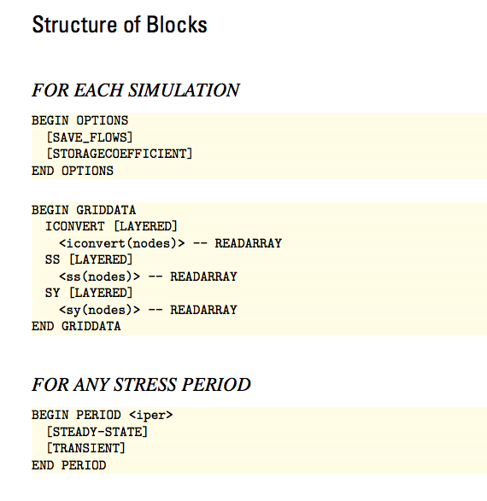
STO Input File

Slide 5
STO Input File
ICONVERT=0: cell is treated as confined for storage calculations
ICONVERT=1: cell converts between confined and unconfined depending on head

Slide 6
STO Input File

Slide 7
STO Input File
Stress periods can be marked as “STEADY-STATE” or “TRANSIENT”

Slide 8
Recharge package

Slide 9
Recharge Definition
Evapotranspiration
Precipitation
Runoff
Recharge
Recharge = Precipitation – Runoff – Evapotranspiration

Slide 10

Recharge Formulation
Q_{R} = I x A
I is recharge rate (L/T) entered by user
A is the cell area
Negative values indicate discharge
Applied directly to a cell – percolation time through the unsaturated zone is not represented
RHS = -Q_{R}
Only complication is deciding which cells receive recharge

Slide 11
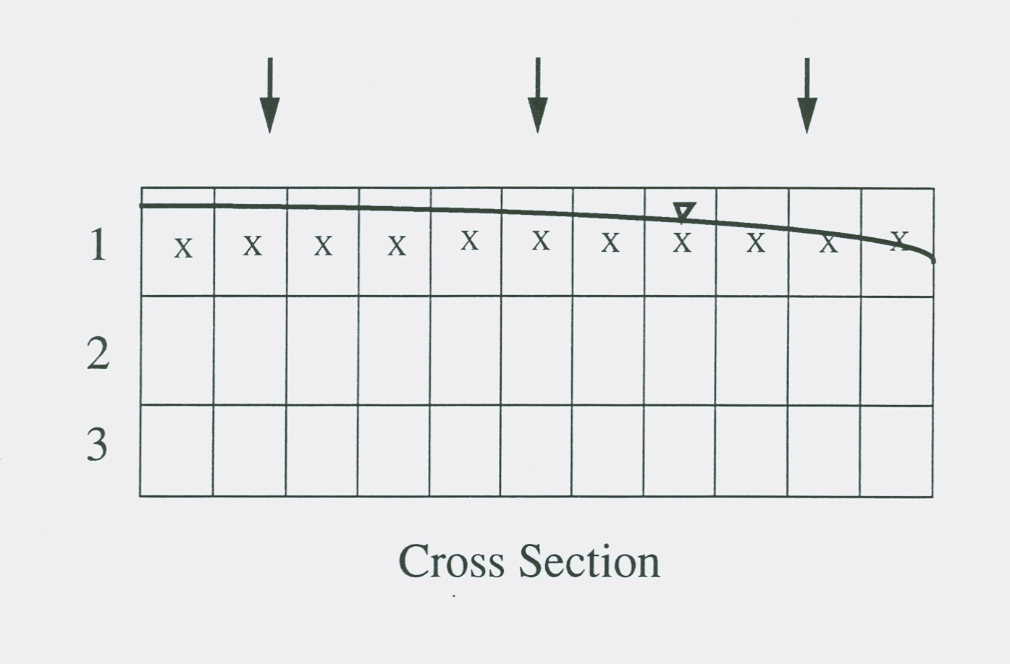
Apply Recharge to Top Layer
Recharge applied to cells with an X

Slide 12
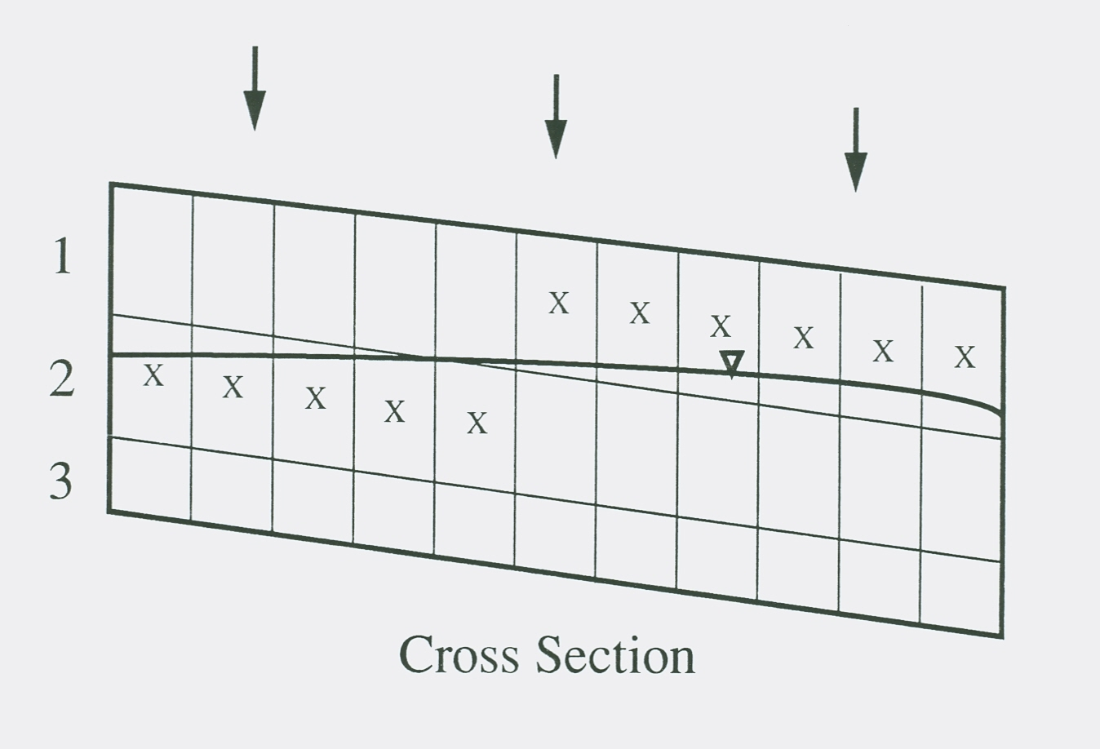
Apply Recharge to Specified Layers
Recharge applied to cells with an X

Slide 13
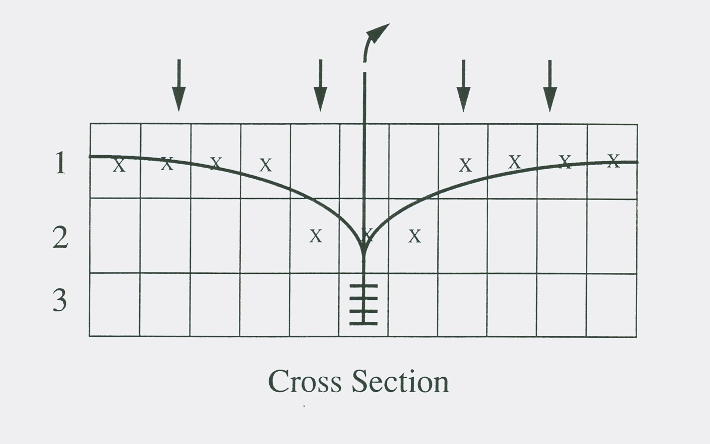
Apply Recharge to Highest Active Layers (default)
Recharge applied to cells with an X

Slide 14
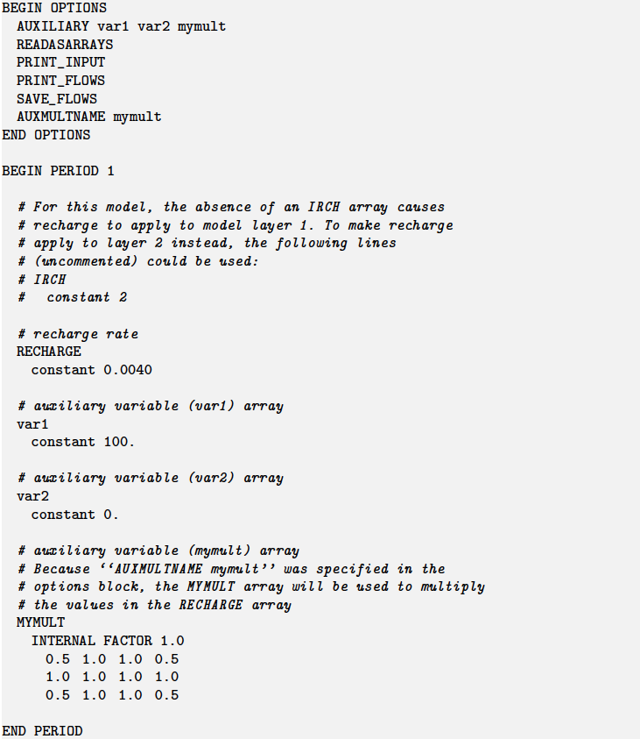
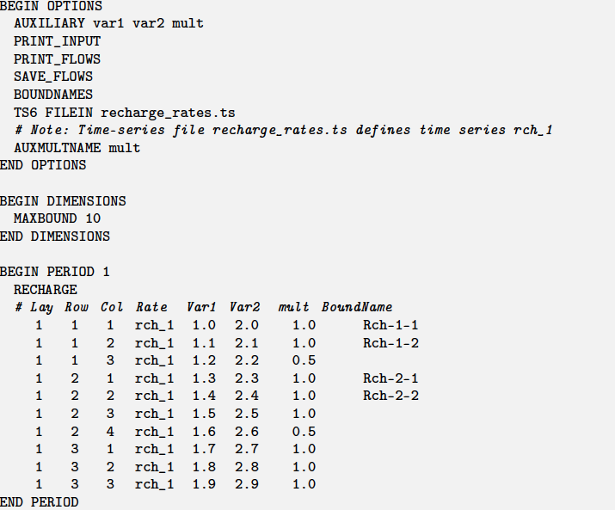
Recharge Package Example
Array-based input
List-based input

Slide 15
Well package

Slide 16
Well Package
Q = User-specified Q
Use consistent units (L3/T)
Negative values indicate discharge
Positive values indicate injection
RHS = -Q

Slide 17
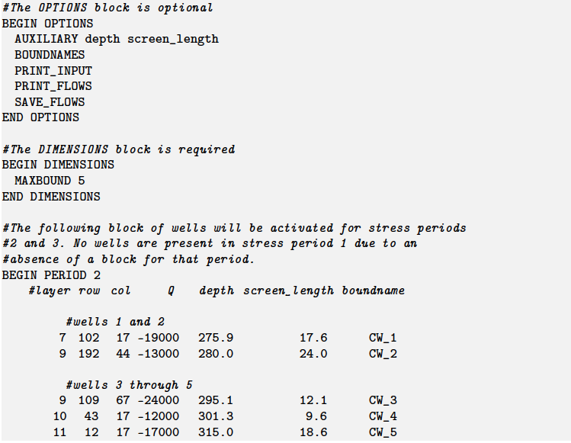
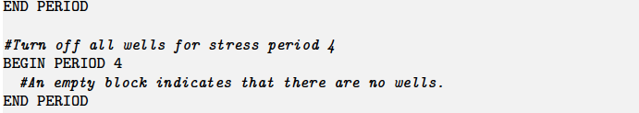
Well Package Input

Slide 18
River package

Slide 19
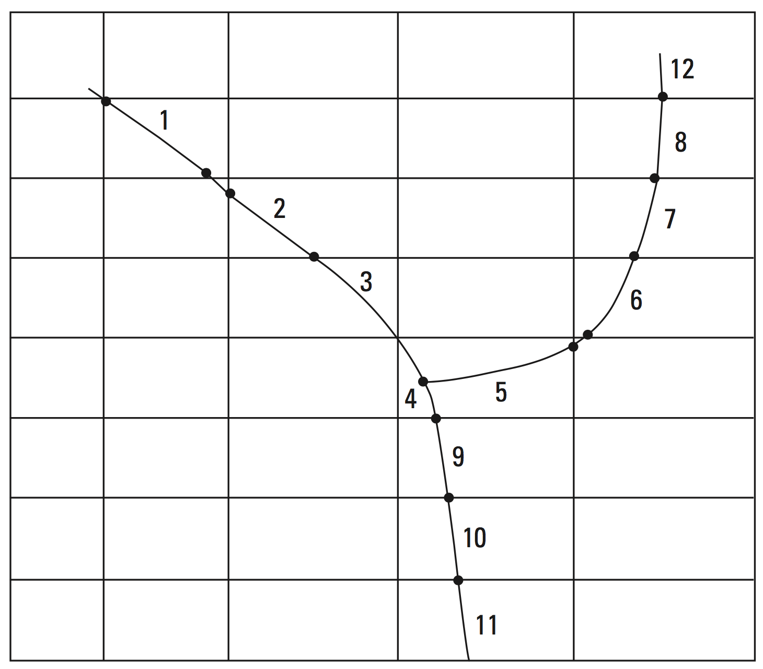
River Package
Simulates the impact of rivers on the aquifer – not the river itself

Slide 20
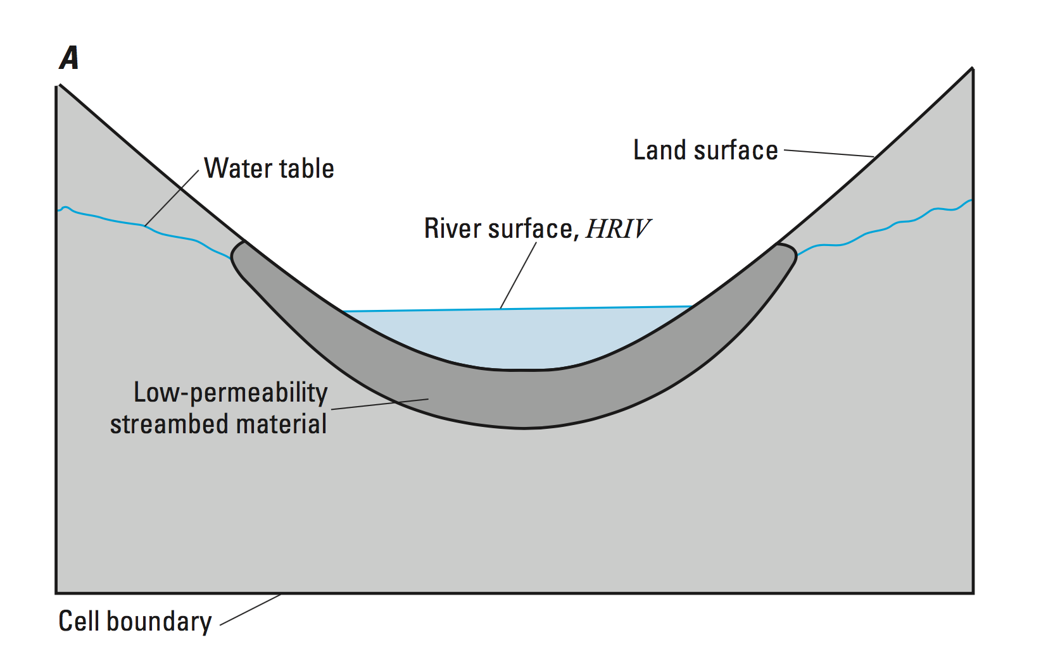
River Package – Conceptual Model

Slide 21
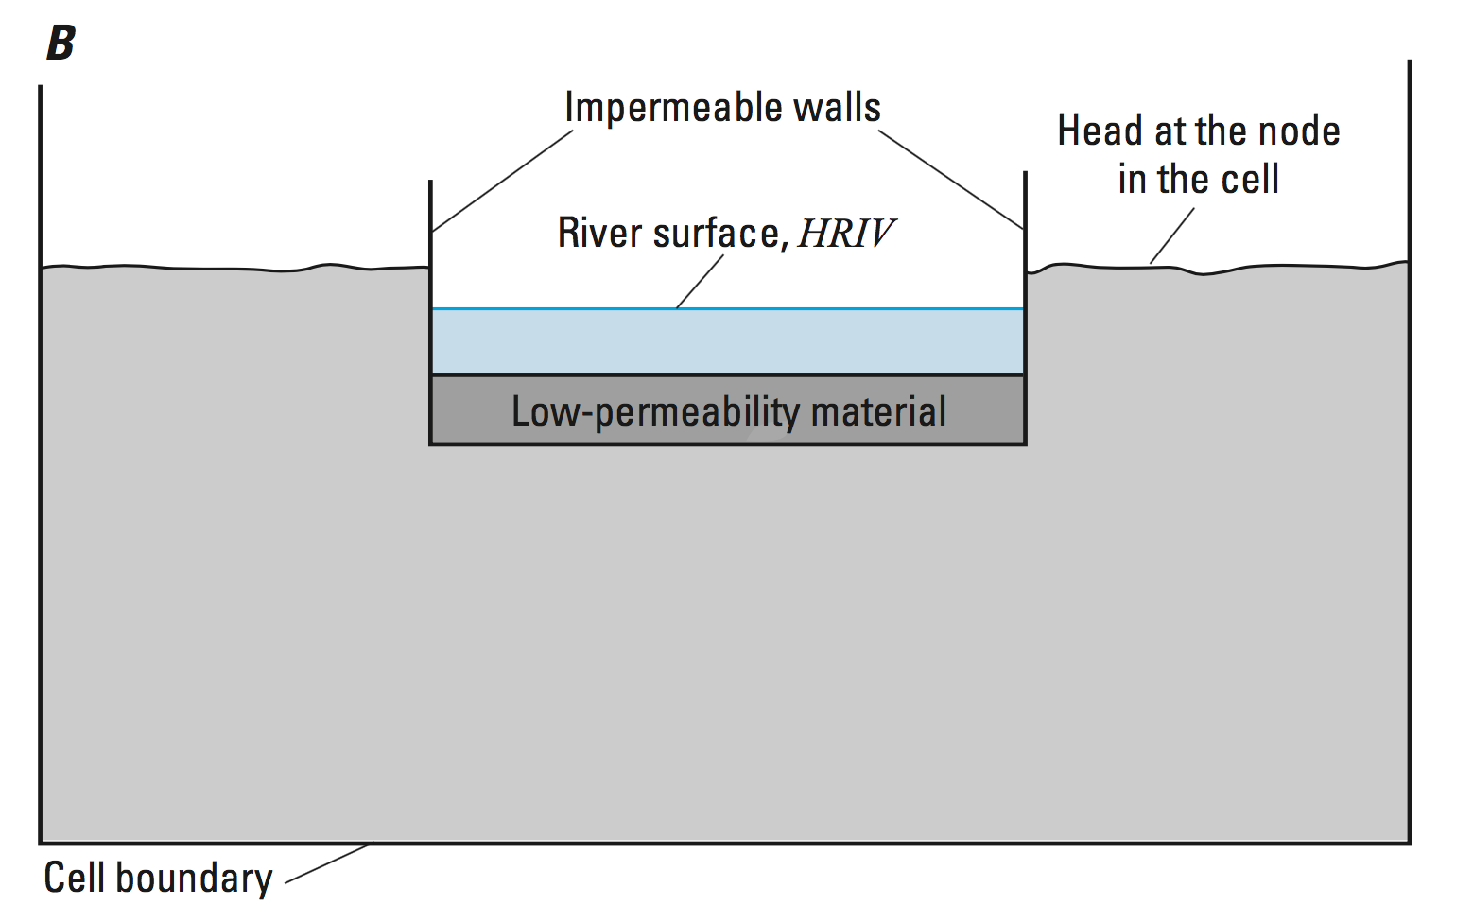
River Package – Conceptual Model

Slide 22
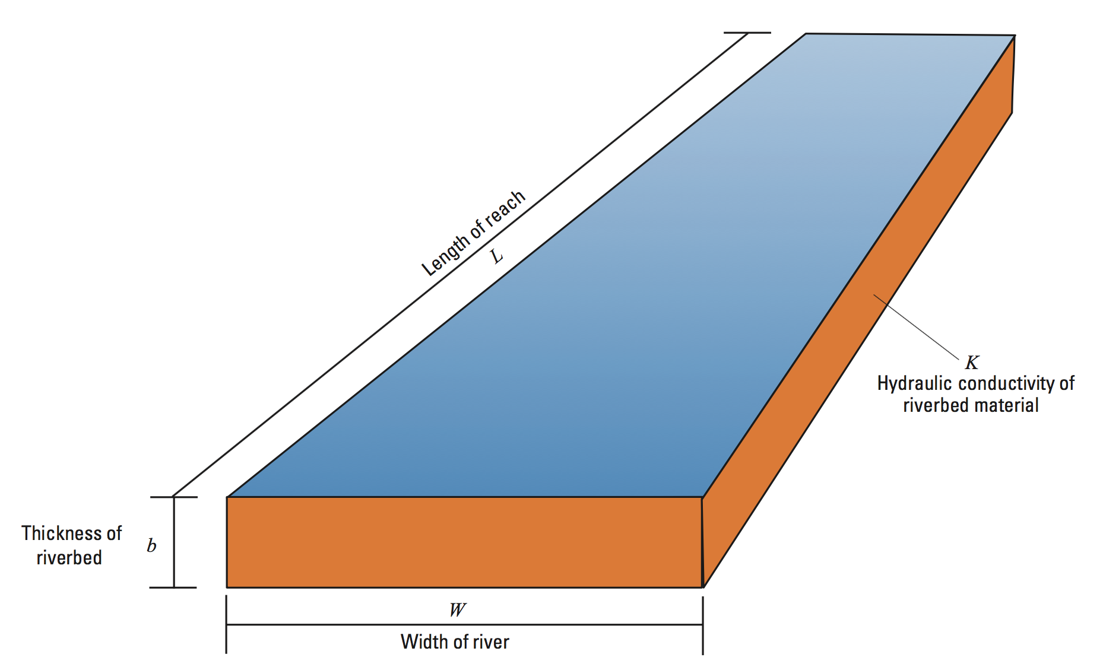
River Package – Conductance Conceptualization
Riverbed conductance = KLW/b

Slide 23
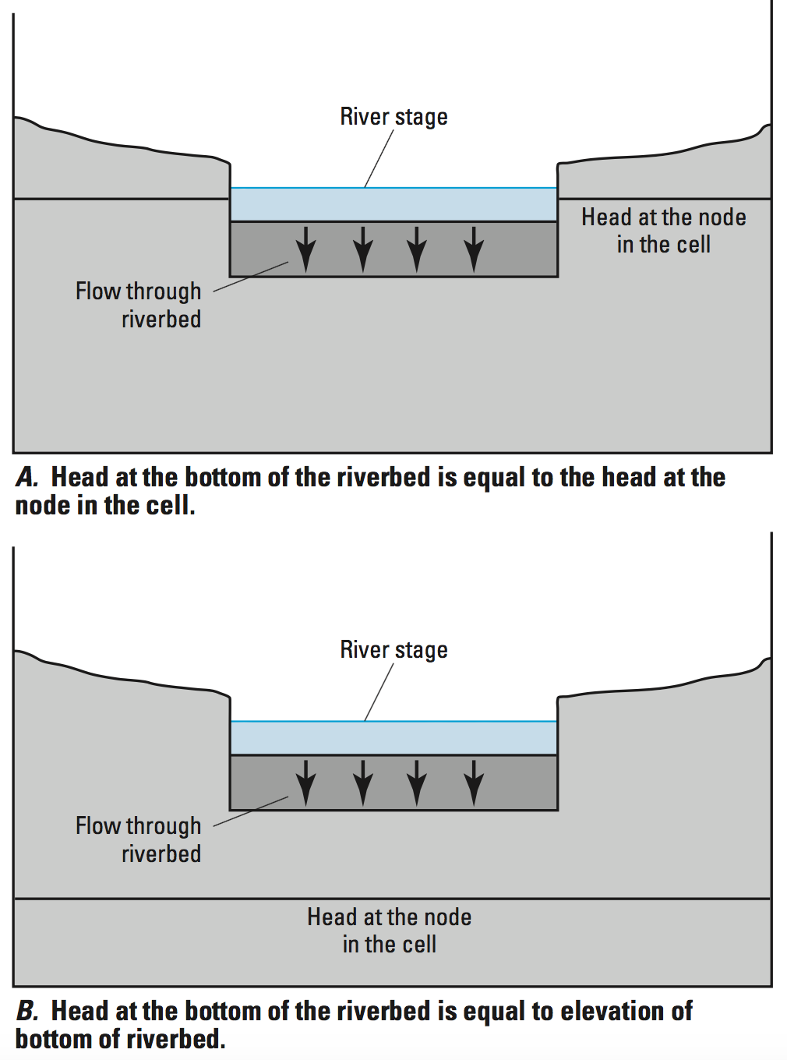
River Package – Aquifer/River Connection
Q_{RIV} = CRIV(HRIV – h_{cell})
If h_{cell} > RBOT
Q_{RIV} = CRIV(HRIV – RBOT)
If h_{cell} <= RBOT

Slide 24
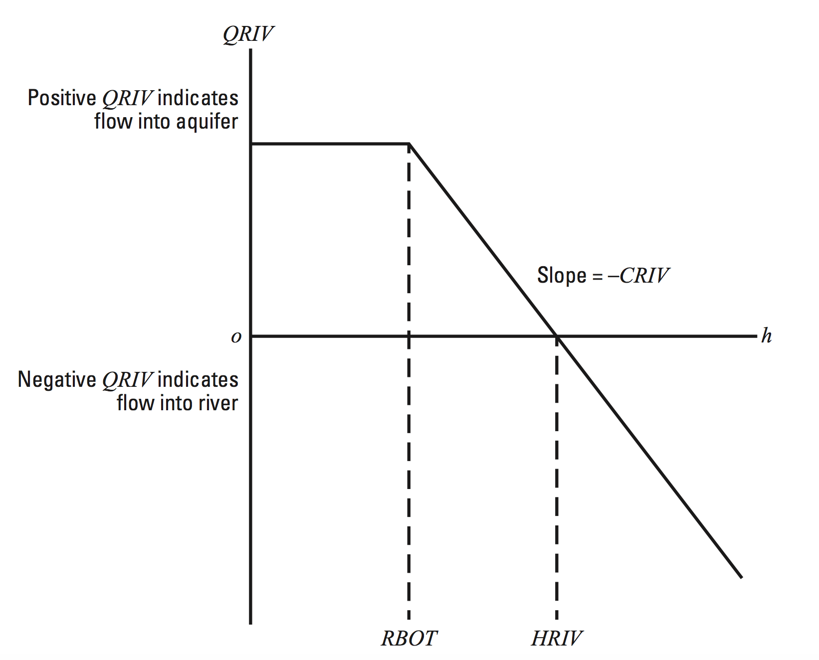
River Package – Head-Dependent Flow

Slide 25
River Package – Discretization Issues
The river equation is a simplification
Each reach is independent of the other reaches
Things to consider:
Are there multiple reaches in cell?
What is the length of a reach in cell?
What is the appropriate river head for a reach?
Are multiple reaches needed or can a composite/average river cell be used?
If a preprocessor is used, how does it define a river cell?

Slide 26
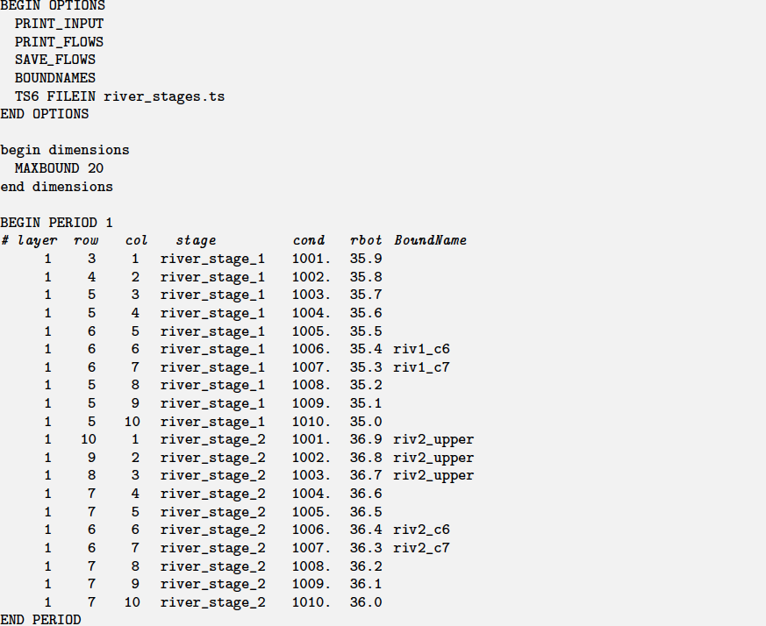
River Package Example

Slide 27
Drain package

Slide 28
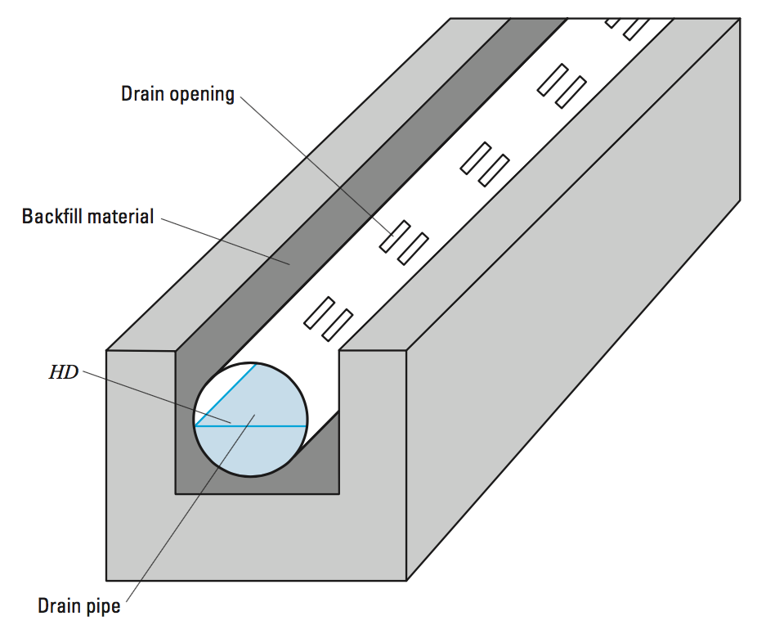
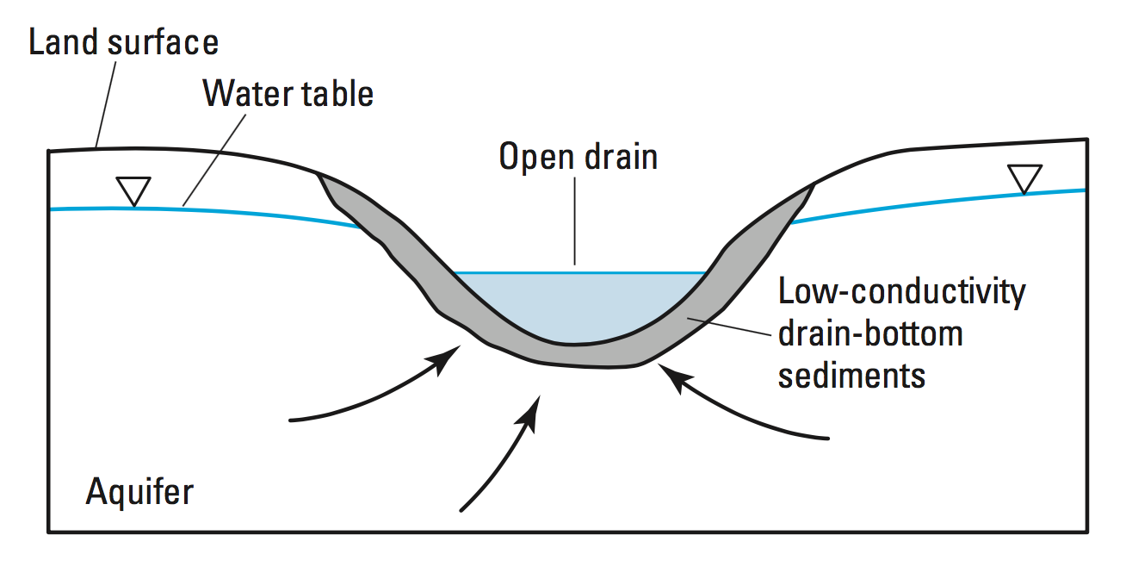
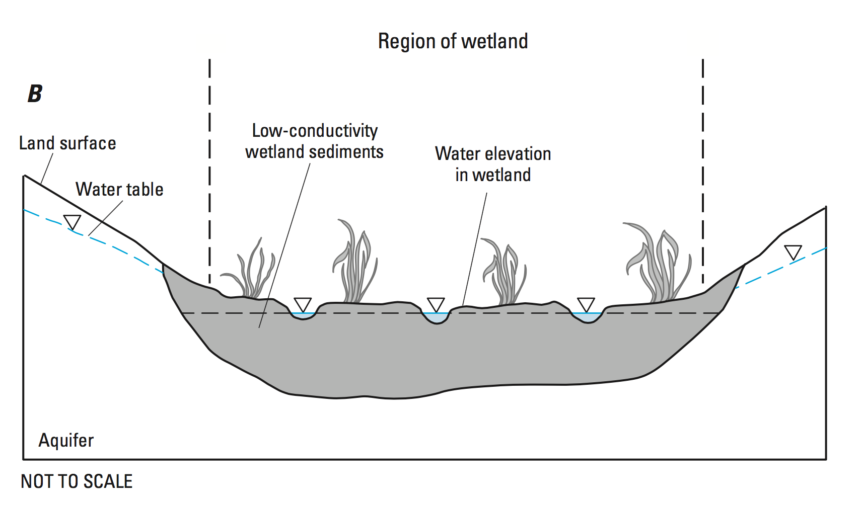
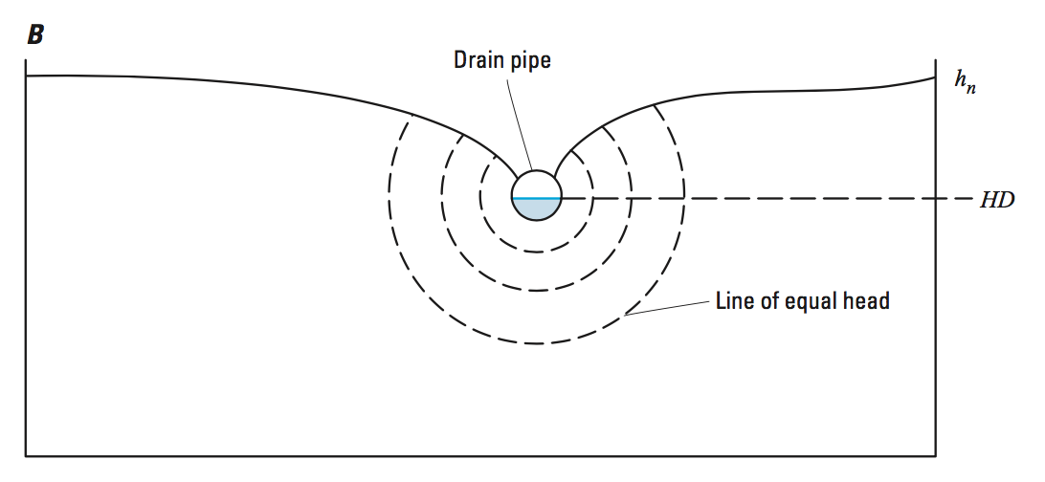
Drain Package

Slide 29
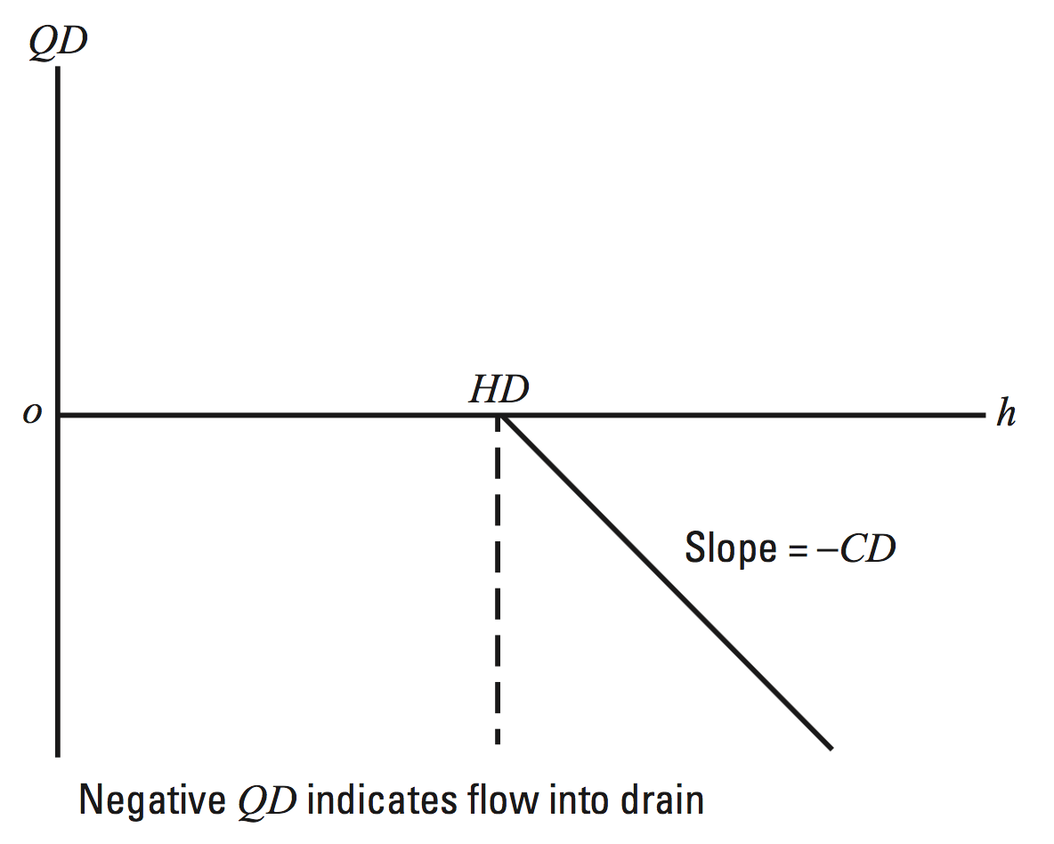
Drain Package – Head-Dependent Flow

Slide 30
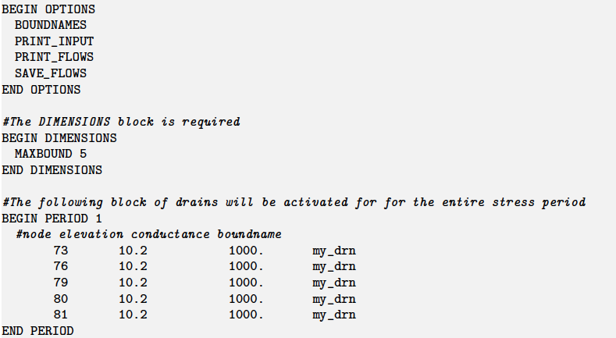
Drain Package Example

Slide 31
General-head boundary package

Slide 32
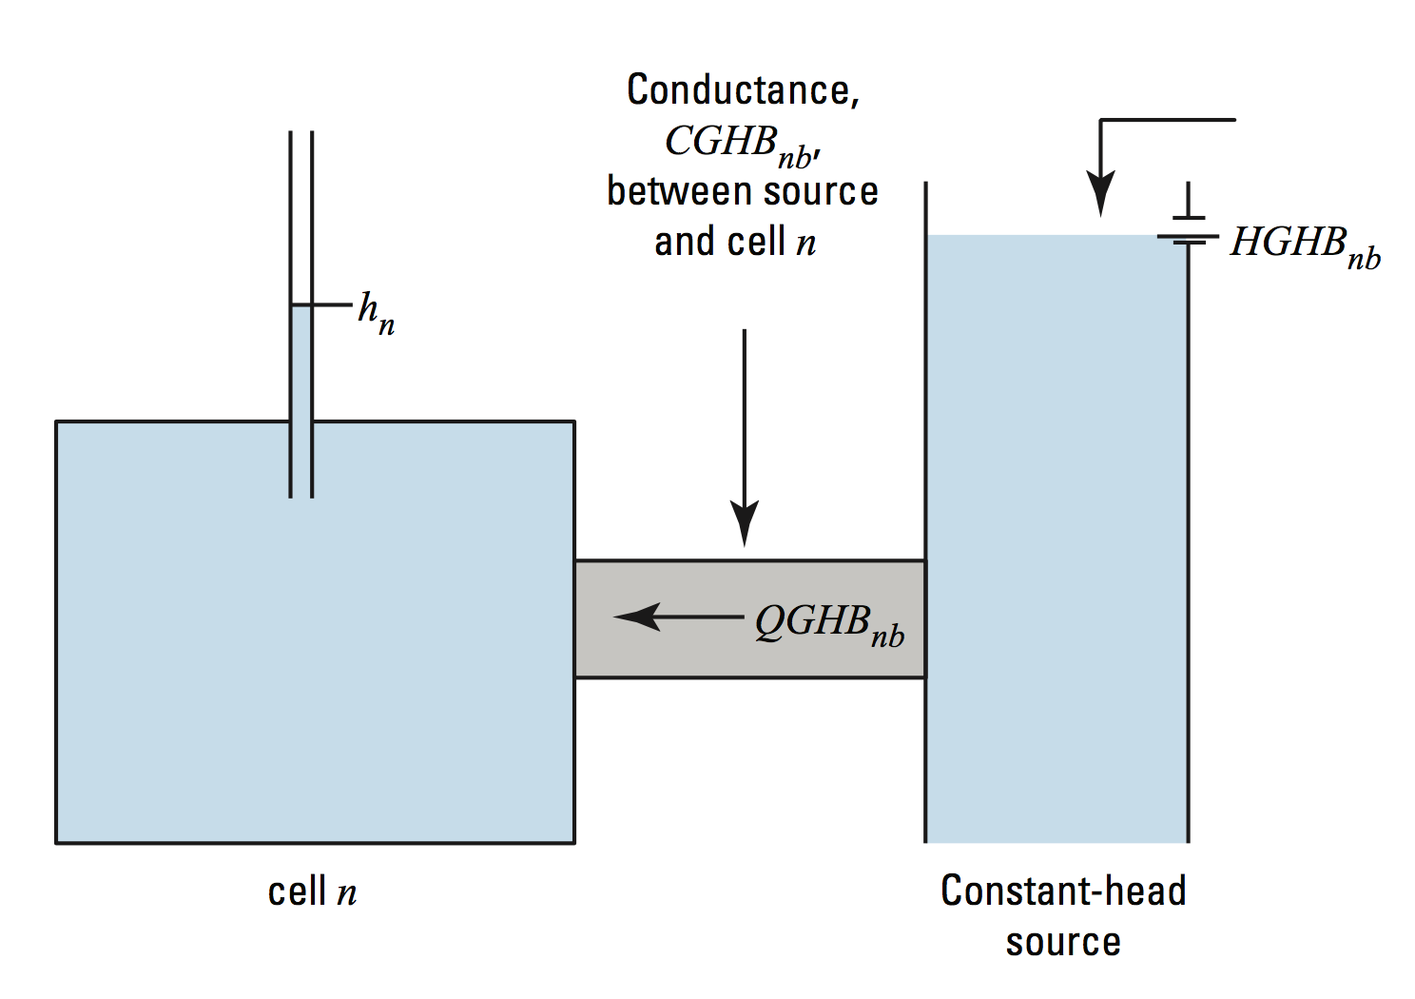
General-Head Boundary Package
QGHB = CGHB (HGHB – hcell)

Slide 33
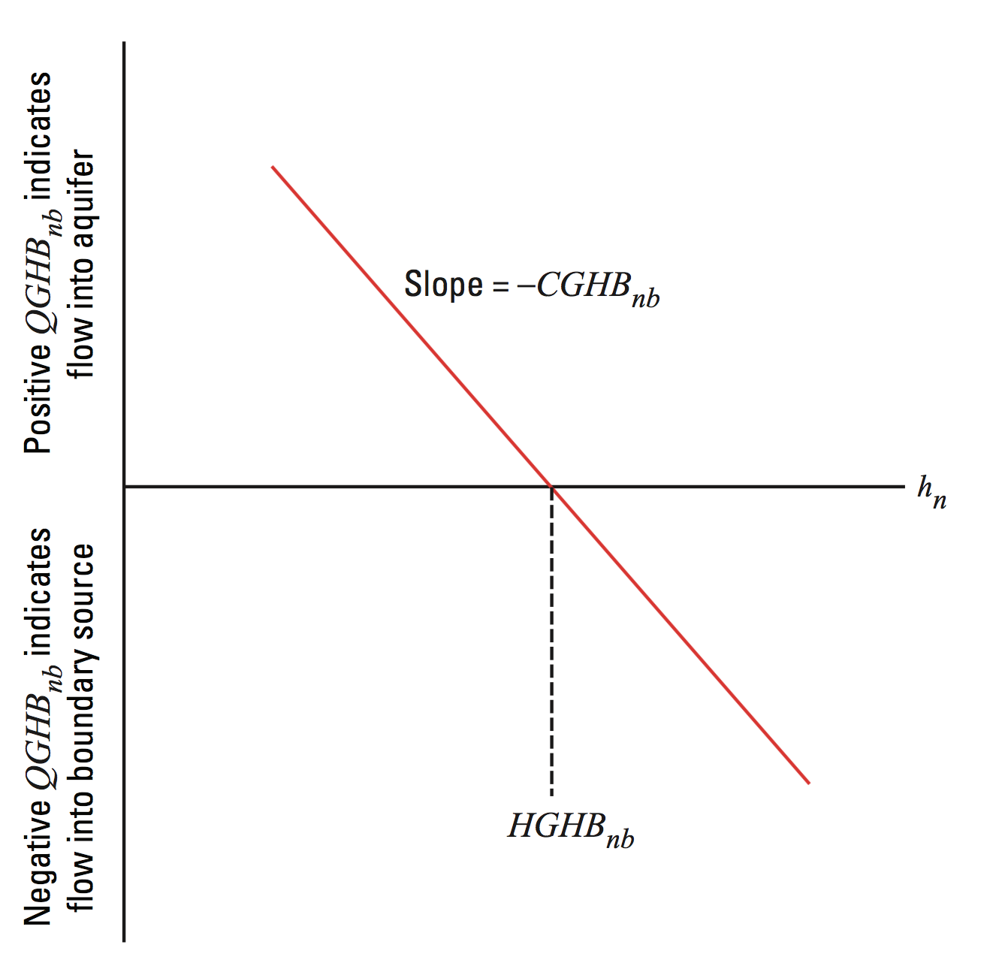
General Head Boundary – Head-Dependent Flow

Slide 34
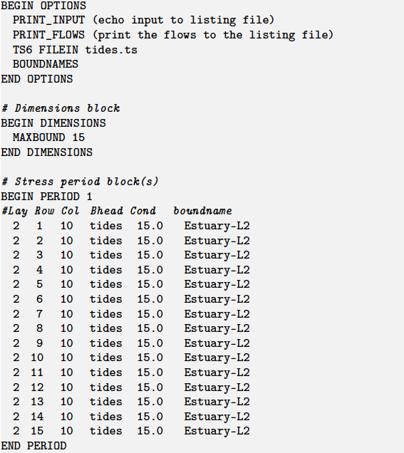
General Head Boundary Example

Slide 35
Evapotranspiration package

Slide 36
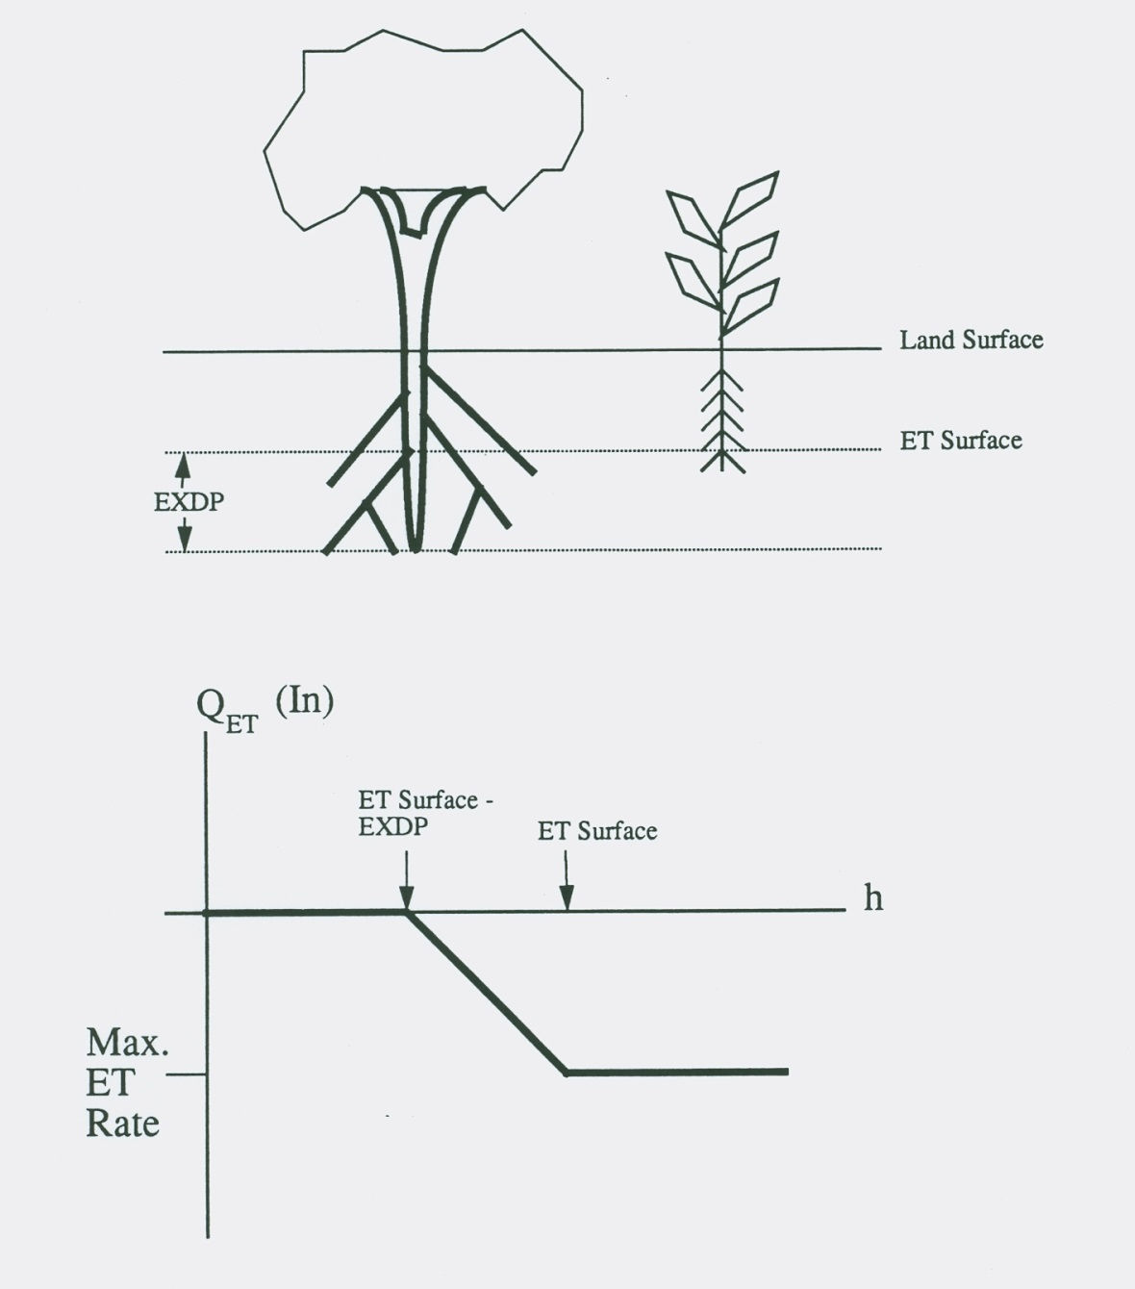
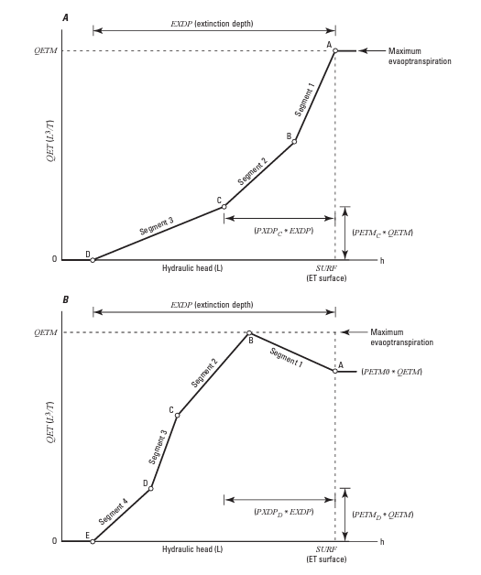
Evapotranspiration Package

Slide 37
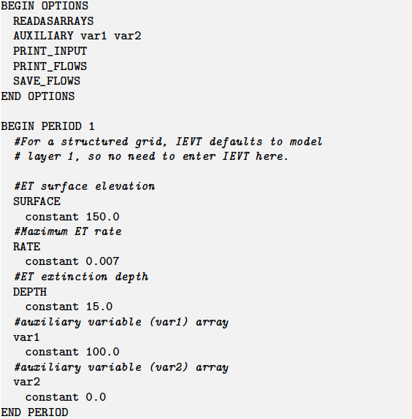
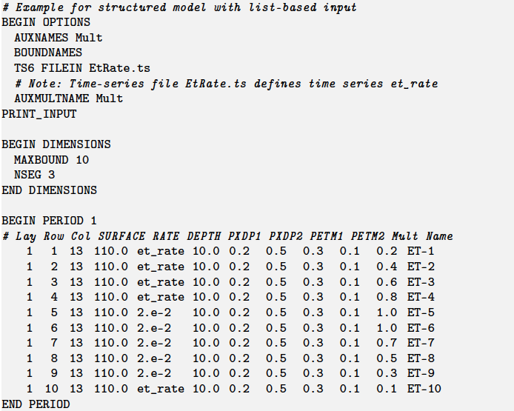
Evapotranspiration Package Example
Array-based input
List-based input

Slide 38
Comparison of stress packages

Slide 39
