Slide 1
ZONEBUDGET
/bin/zbud6

Slide 2
Stand-Alone Program
zbud6 works with MODFLOW 6 output (separate versions are available for MODFLOW-2005 and for MODFLOW-USG
Works with GWF Model budget file or with advanced package budget files
Calculates a separate water budget for each zone
Zones are groups of cells that are assigned the same integer zone number
For the GWF Model, zbud6 reads four files:
zbud.nam
zbud.zon
gwfmodel.bud
gwfmodel.dis.grb

Slide 3
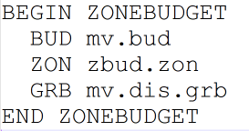
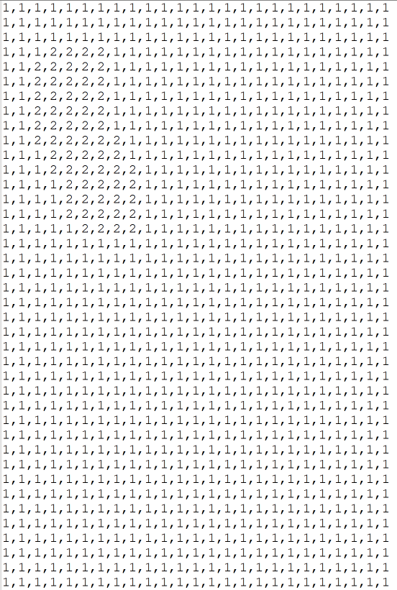
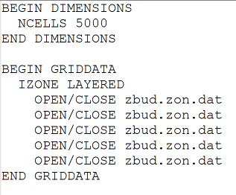
Files Read by zbud6
zbud.nam
zbud.zon.dat
zbud.zon
MODFLOW 6 Output
gwfmodel.bud
gwfmodel.dis.grb

Slide 4
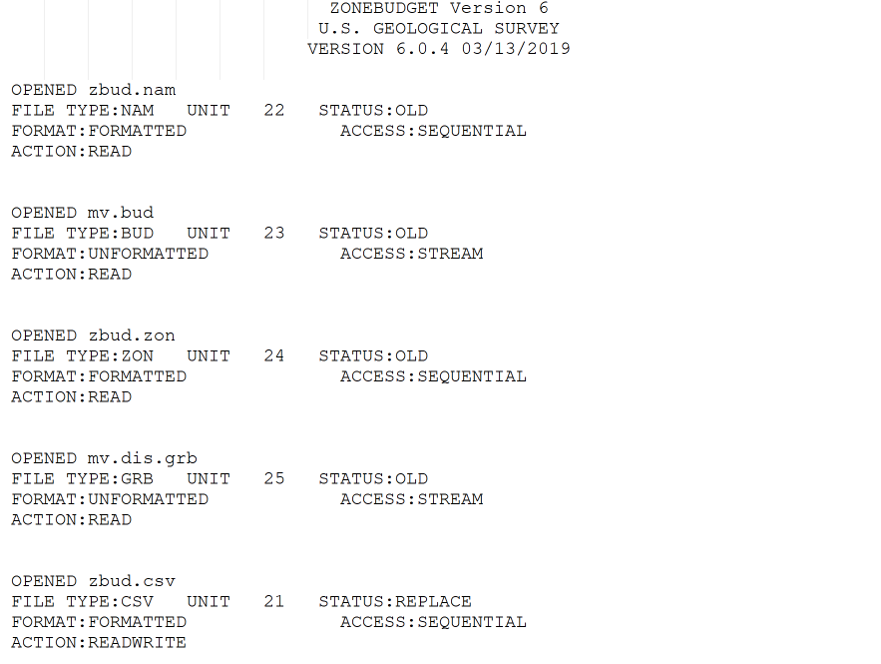
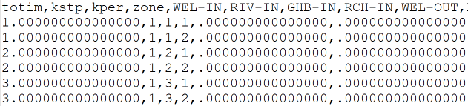
zbud6 Output
zbud.csv
zbud.lst

Slide 5
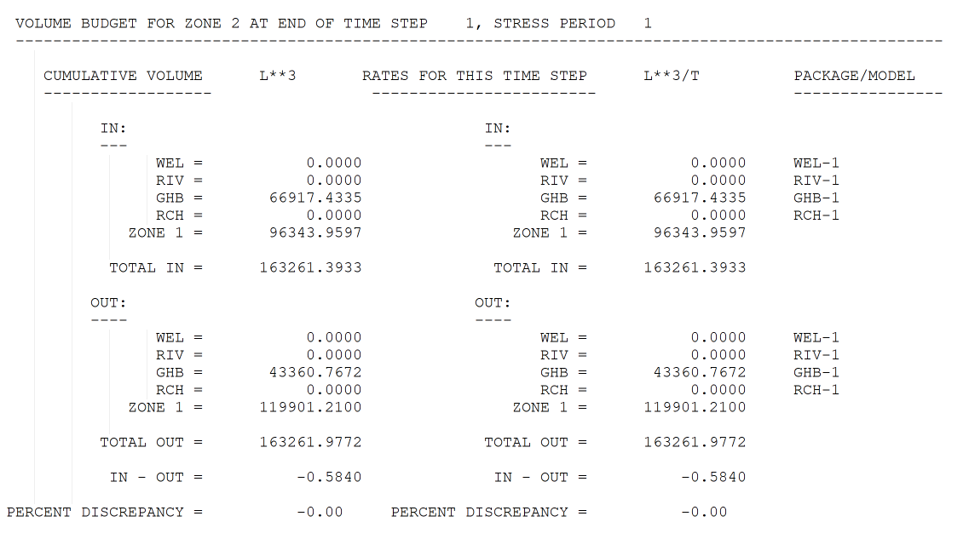
Budget Information by Zone

