Slide 1
McDonald Valley
A Model Calibration Exercise for MODFLOW

Slide 2
Exercise Outline
Stage 1 – Planning phase
Evaluate project objectives and develop conceptual model
Stage 2 – Initial model development
Build MODFLOW dataset and calibrate model using existing data
Stage 3 – Improve model
Collect new field data and refine model calibration
Stage 4 – Prediction phase
Simulate development scenarios to evaluate project objectives

Slide 3
Stage 2 – Initial Model Development
Implement your conceptual model into a numerical model
Calibrate to existing conditions
Adjust hydraulic parameters, boundary conditions so that model results are close to observations
Adjust within justifiable ranges
Avoid adjusting when it can’t be supported
Your model will be wrong, but hopefully will tell you something

Slide 4
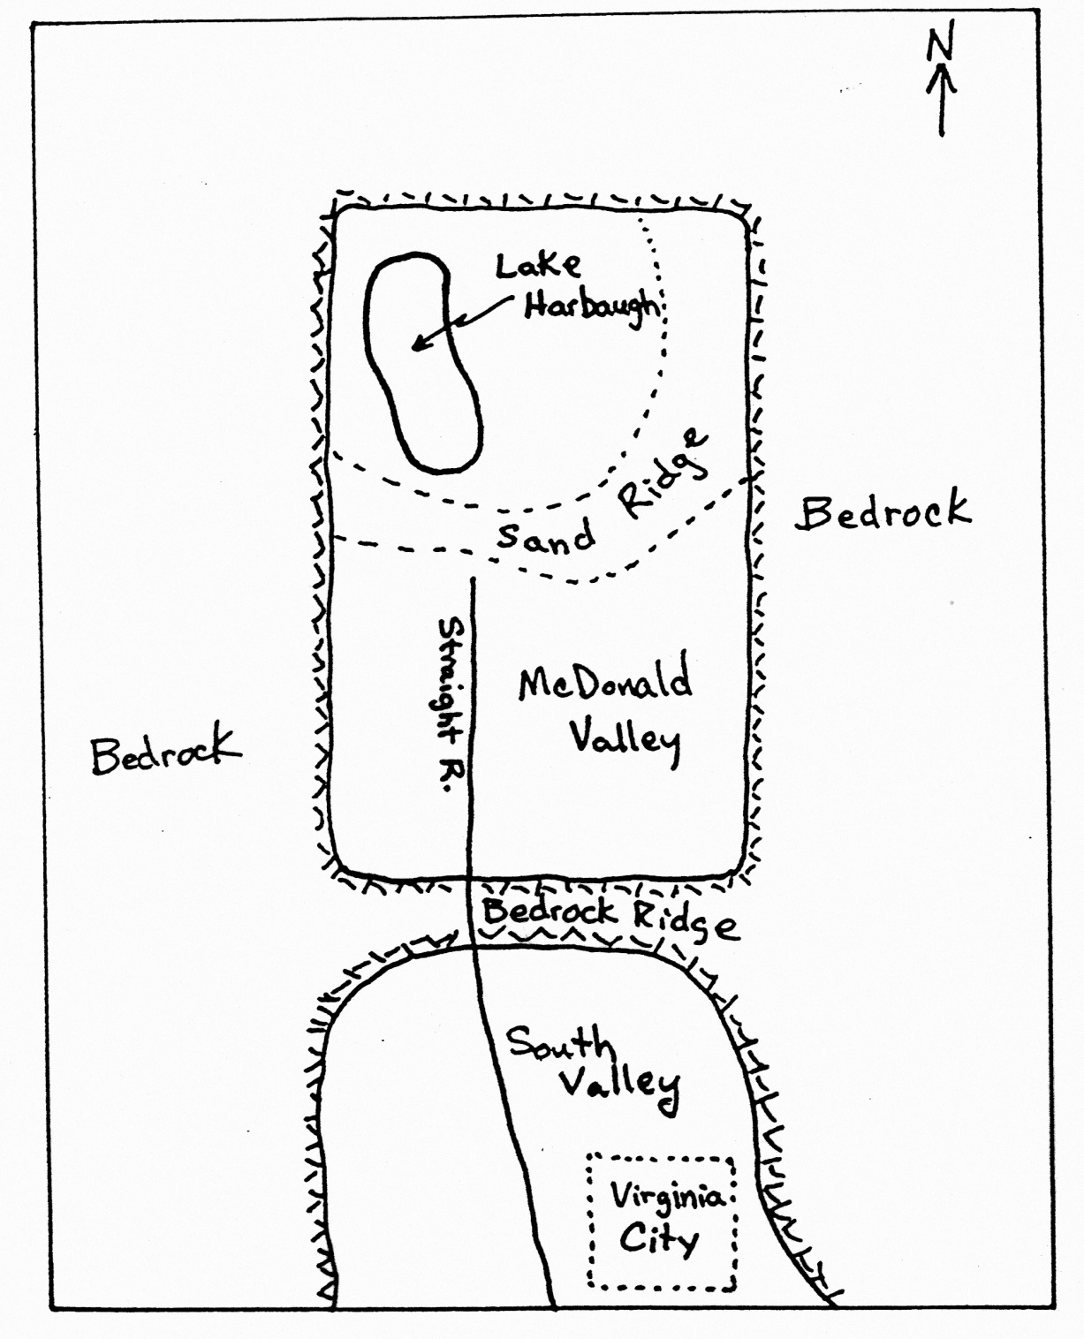
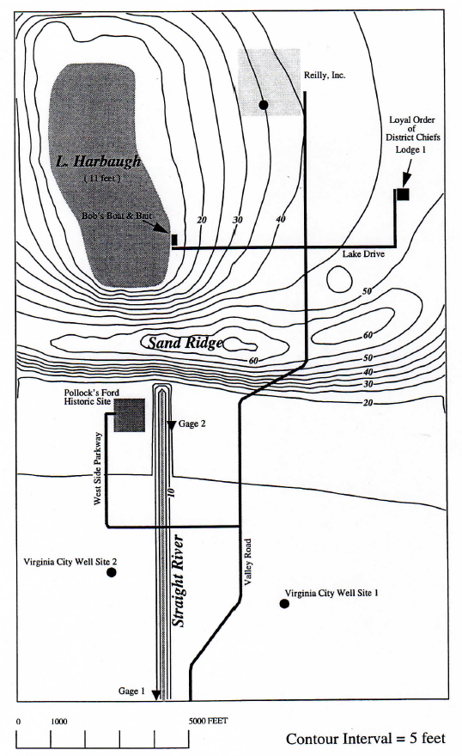
Stage 2 – Initial Model Development
Figure 1 – Regional Map
Figure 2 – Topographic Map of McDonald Valley
Lake
Harbaugh
L & H Lounge

Slide 5
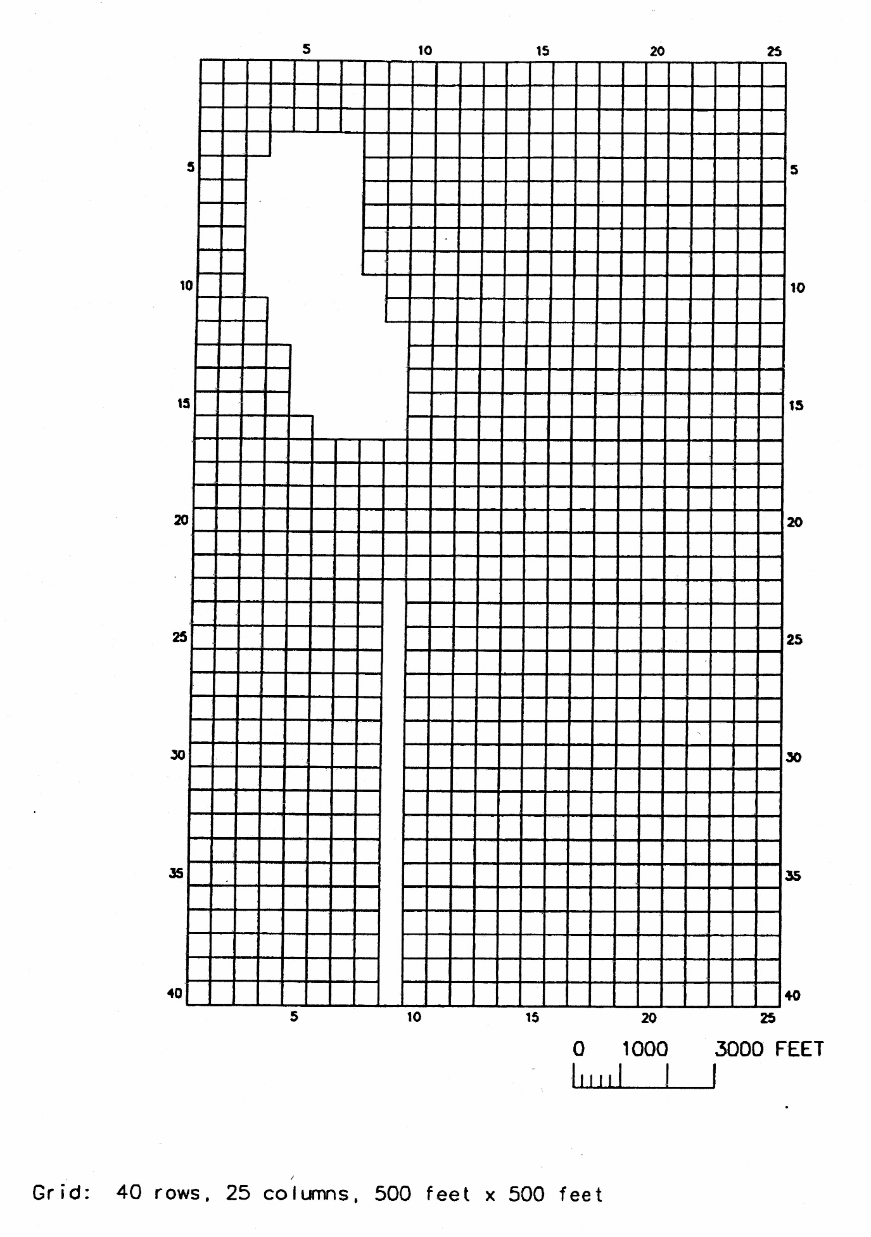
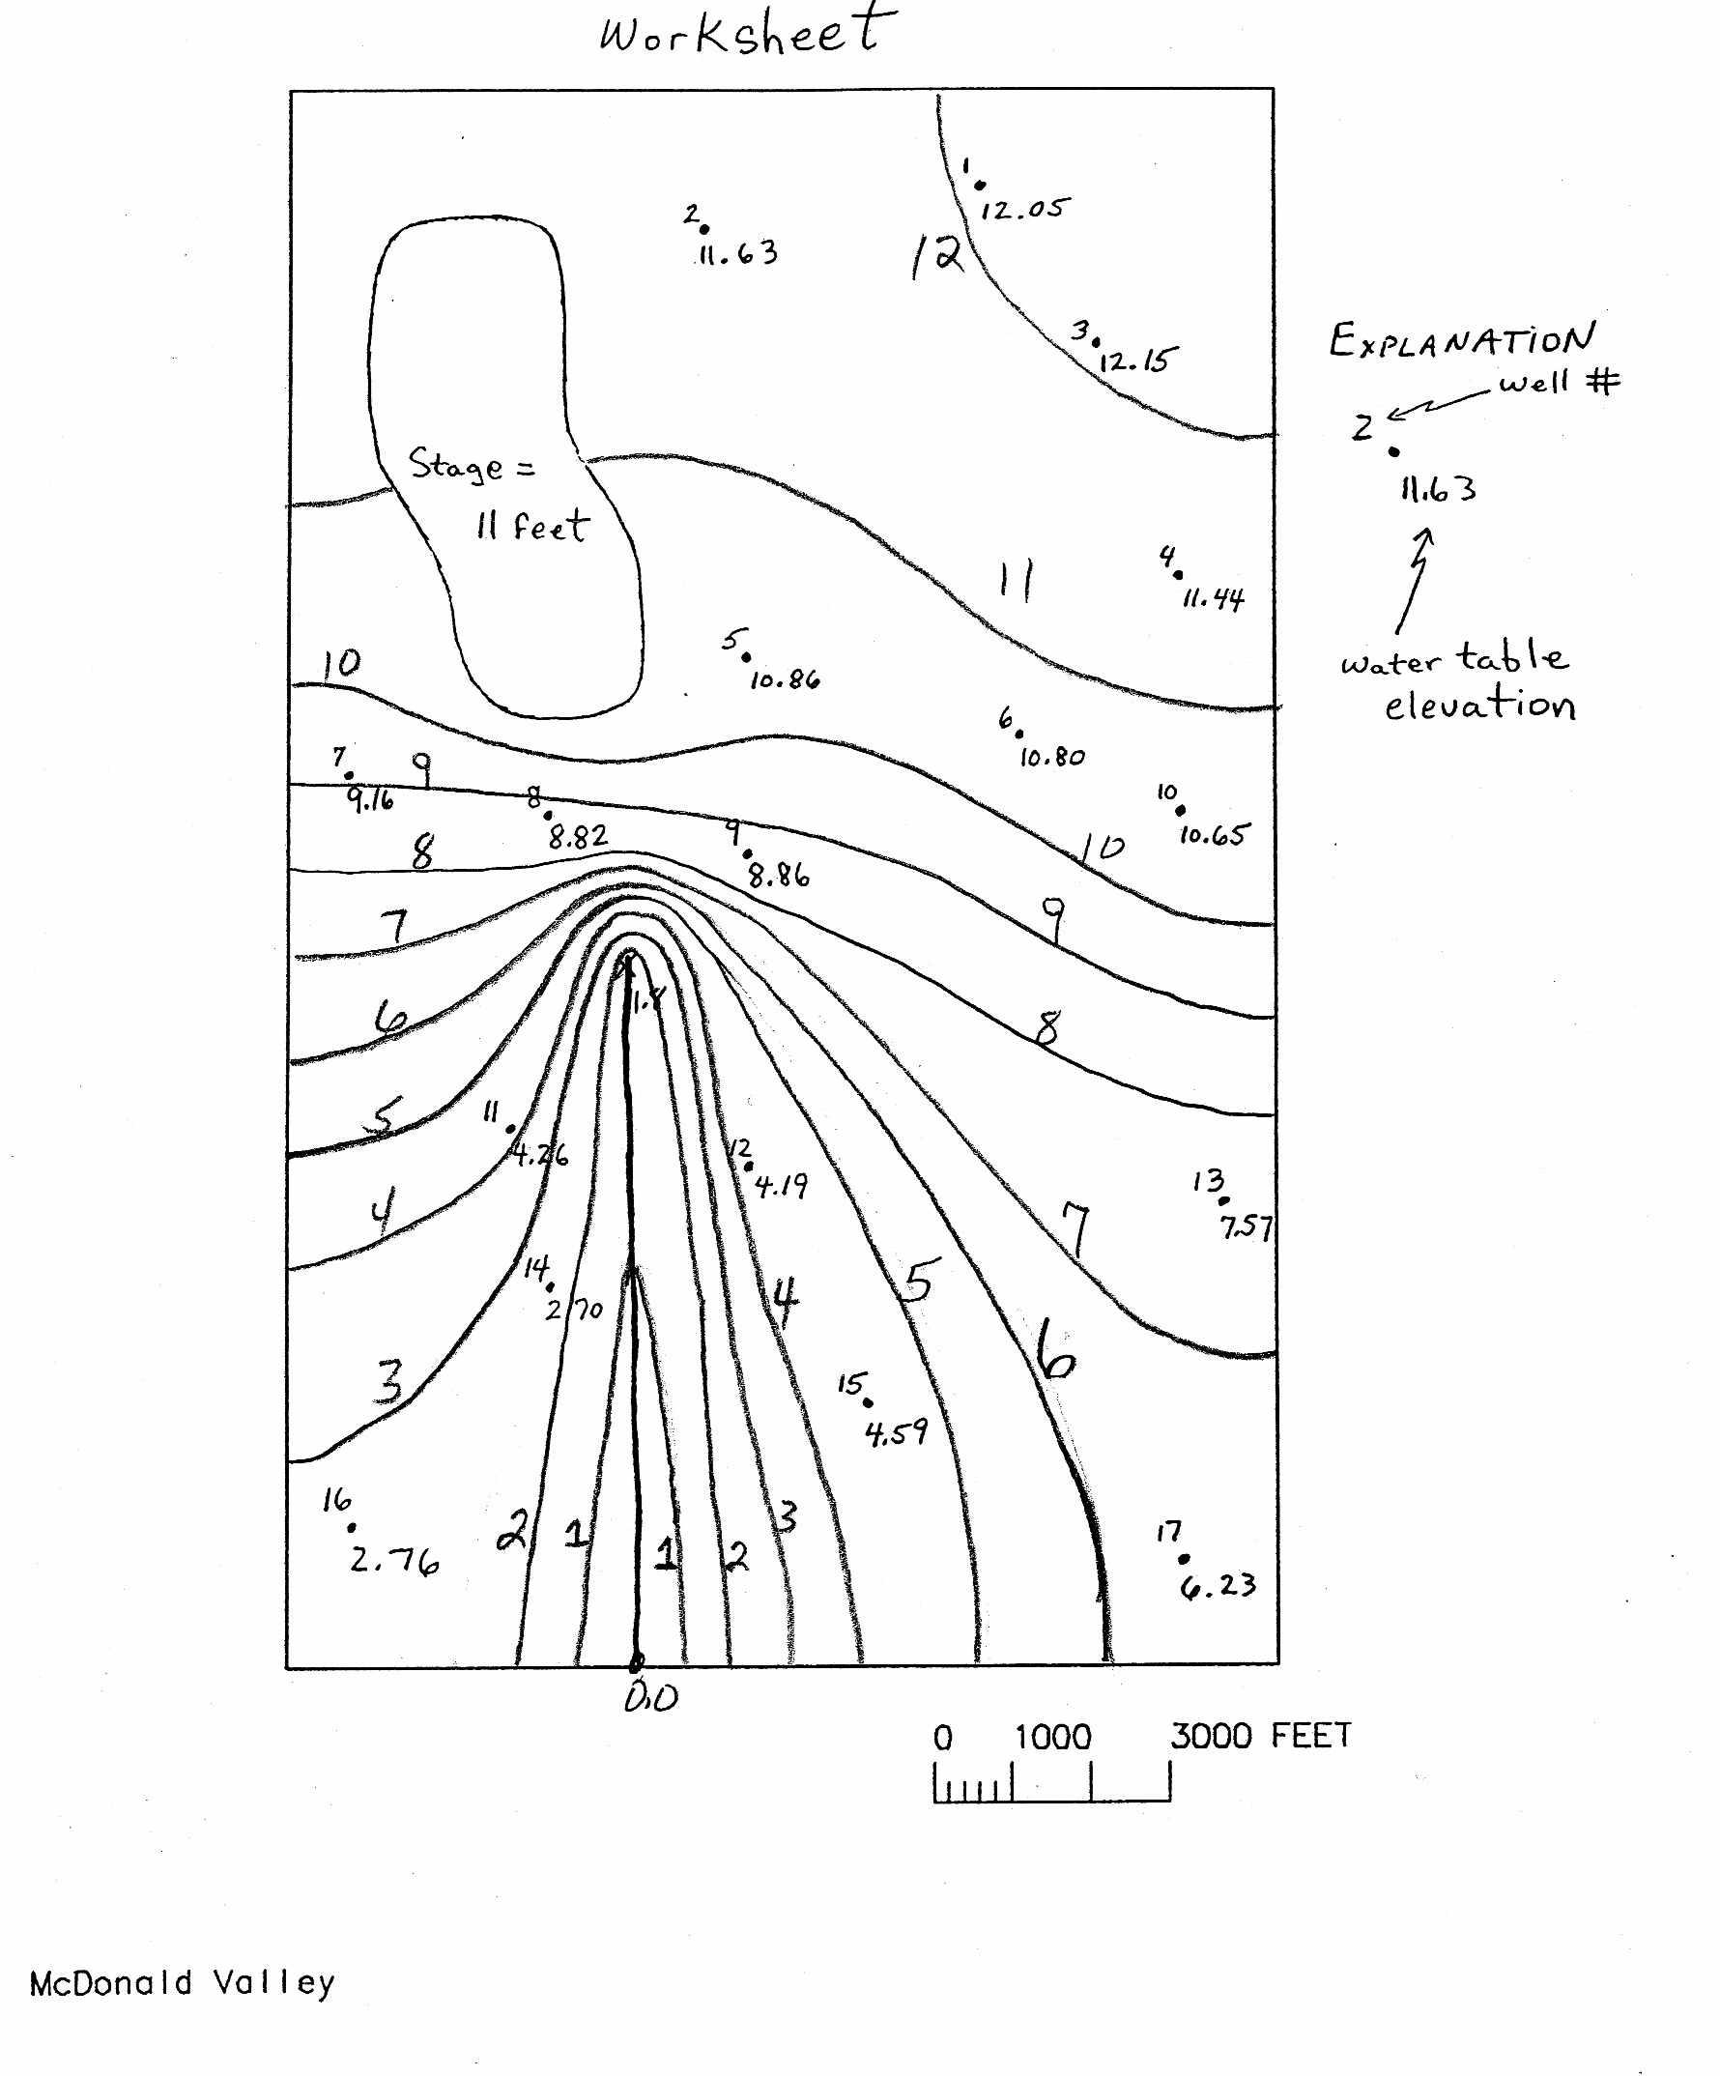
Stage 2 – Initial Model Development

