Slide 1
Advanced Stress Packages
Lake (LAK) Package

Slide 2
LAK Package Capabilities
Capabilities
multiple outlets per lake using 3 outlet equation options (specified, Manning, weir)
lakes on top of model (overlying), incised lakes, embedded lakes (sub-grid scale lakes)
constant stage and inactive lakes
explicitly defined lake connectivity
currently no UZF under lakes

Slide 3
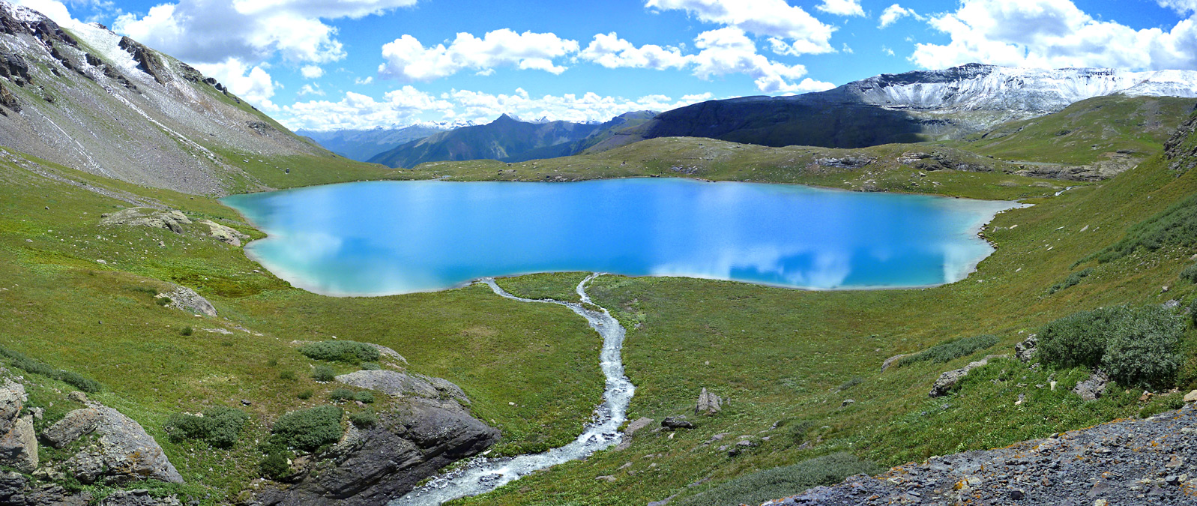
LAK Package Continuity Equation

Slide 4
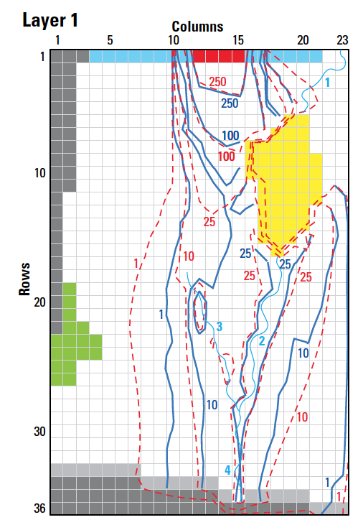
LAK Package Input
BEGIN Options
PRINT_INPUT
PRINT_STAGE
PRINT_FLOWS
SAVE_FLOWS
STAGE FILEOUT mf6-gwt.lak.stage.bin
BUDGET FILEOUT mf6-gwt.lak.cbc
MOVER
DEV_GROUNDWATER_HEAD_CONDUCTANCE
TIME_CONVERSION 86400.000
END Options
BEGIN DIMENSIONS
NLAKES 2
NOUTLETS 1
END DIMENSIONS
BEGIN PACKAGEDATA
# LAKENO STRT NLAKECONN
1 44.000000 78
2 35.200001 32
END PACKAGEDATA
BEGIN CONNECTIONDATA
# LAKENO ICONN CELLID CLAKTYPE BEDLEAK BELEV TELEV CONNLEN CONNWIDTH
1 1 1 5 19 HORIZONTAL 1.000000 0.000000 0.000000 201.8585 405.6650
1 2 1 5 20 HORIZONTAL 1.000000 0.000000 0.000000 201.8585 405.6650
1 3 1 6 18 HORIZONTAL 1.000000 0.000000 0.000000 202.8325 403.7170
1 4 1 6 18 HORIZONTAL 1.000000 0.000000 0.000000 201.8585 405.6650
--- DELETED INPUT ---

Slide 5
LAK Package Input – cont.
--- DELETED INPUT ---
2 22 2 23 2 VERTICAL 1.000000 0.000000 0.000000 0.000000 0.000000
2 23 2 23 3 VERTICAL 1.000000 0.000000 0.000000 0.000000 0.000000
2 24 2 23 4 VERTICAL 1.000000 0.000000 0.000000 0.000000 0.000000
2 25 2 24 1 VERTICAL 1.000000 0.000000 0.000000 0.000000 0.000000
2 26 2 24 2 VERTICAL 1.000000 0.000000 0.000000 0.000000 0.000000
2 27 2 24 3 VERTICAL 1.000000 0.000000 0.000000 0.000000 0.000000
2 28 2 24 4 VERTICAL 1.000000 0.000000 0.000000 0.000000 0.000000
2 29 2 25 1 VERTICAL 1.000000 0.000000 0.000000 0.000000 0.000000
2 30 2 25 2 VERTICAL 1.000000 0.000000 0.000000 0.000000 0.000000
2 31 2 26 1 VERTICAL 1.000000 0.000000 0.000000 0.000000 0.000000
2 32 2 26 2 VERTICAL 1.000000 0.000000 0.000000 0.000000 0.000000
END CONNECTIONDATA
BEGIN OUTLETS
# OUTLETNO LAKEIN LAKEOUT COUTTYPE INVERT WIDTH ROUGH SLOPE
1 1 0 MANNING 44.5 5.000000 0.30000000E-01 0.2187500E-02
END OUTLETS
BEGIN PERIOD 1
1 RAINFALL 0.0000000
1 EVAPORATION 0.0000000
1 RUNOFF 0.0000000
1 WITHDRAWAL 0.0000000
2 RAINFALL 0.0000000
2 EVAPORATION 0.0000000
2 RUNOFF 0.0000000
2 WITHDRAWAL 0.0000000
END PERIOD

Slide 6
LAK Package Output
LAK-1 BUDGET FOR ENTIRE MODEL AT END OF TIME STEP 1, STRESS PERIOD 1
------------------------------------------------------------------------------
CUMULATIVE LAK-1 L**3 RATES FOR THIS TIME STEP L**3/T
------------------ ------------------------
IN: IN:
--- ---
EXT-INFLOW = 0.0000 EXT-INFLOW = 0.0000
FROM-MVR = 873431546.1767 FROM-MVR = 191332.2116
RAINFALL = 0.0000 RAINFALL = 0.0000
RUNOFF = 0.0000 RUNOFF = 0.0000
GWF = 1637700230.5291 GWF = 358751.4196
EVAPORATION = 0.0000 EVAPORATION = 0.0000
WITHDRAWAL = 0.0000 WITHDRAWAL = 0.0000
EXT-OUTFLOW = 0.0000 EXT-OUTFLOW = 0.0000
TO-MVR = 0.0000 TO-MVR = 0.0000
STORAGE = 0.0000 STORAGE = 0.0000
CONSTANT = 0.0000 CONSTANT = 0.0000
TOTAL IN = 2511131776.7058 TOTAL IN = 550083.6313
OUT: OUT:
---- ----
EXT-INFLOW = 0.0000 EXT-INFLOW = 0.0000
FROM-MVR = 0.0000 FROM-MVR = 0.0000
RAINFALL = 0.0000 RAINFALL = 0.0000
RUNOFF = 0.0000 RUNOFF = 0.0000
GWF = 1281783019.2116 GWF = 280784.8892
EVAPORATION = 0.0000 EVAPORATION = 0.0000
WITHDRAWAL = 0.0000 WITHDRAWAL = 0.0000
EXT-OUTFLOW = 284.8235 EXT-OUTFLOW = 6.2393E-02
TO-MVR = 1229229296.0636 TO-MVR = 269272.5731
STORAGE = 0.0000 STORAGE = 0.0000
CONSTANT = 0.0000 CONSTANT = 0.0000
TOTAL OUT = 2511012600.0987 TOTAL OUT = 550057.5247
IN - OUT = 119176.6071 IN - OUT = 26.1066
PERCENT DISCREPANCY = 0.00 PERCENT DISCREPANCY = 0.00

Slide 7
LAK Package Output – cont.
LAKE (LAK-1) STAGE PERIOD 1 STEP 1
------------------
LAKE LAKE
NO. STAGE
------------------
1 45.08
2 37.14
LAKE (LAK-1) FLOWS PERIOD 1 STEP 1
------------------------------------------------------------------------------------------------------------------------------------------------------------------------------------------------------
LAKE LAKE INTERNAL LAKE LAKE LAKE LAKE LAKE LAKE LAKE LAKE EXTERNAL INTERNAL LAKE CONSTANT LAKE PERCENT
NO. INFLOW INFLOW RUNOFF FROM MVR RAINFALL LEAKAGE IN LEAKAGE OUT EVAPORATION WITHDRAWAL STORAGE OUTFLOW OUTFLOW TO MVR FLOW IN - OUT DIFFERENCE
------------------------------------------------------------------------------------------------------------------------------------------------------------------------------------------------------
1 0.000 0.000 0.000 0.1913E+06 0.000 0.2138E+06 -0.1358E+06 -0.000 0.000 0.000 -0.6239E-01 0.000 -0.2693E+06 0.000 0.6135 0.1514E-03
2 0.000 0.000 0.000 0.000 0.000 0.1450E+06 -0.1449E+06 -0.000 0.000 0.000 0.000 0.000 0.000 0.000 25.49 0.1759E-01

