Slide 1
Advanced Stress Packages
Streamflow Routing (SFR) Package

Slide 2
SFR Package Capabilities
Capabilities
multiple diversions from a single reach
downstream outflow from a reach to multiple segments using user-specified time-varying discharge fractions.
diversion priority scheme can be implemented based on diversion order
Inactive reaches
rectangular reaches
stream data are specified by reach
explicitly defined reach connectivity
currently no UZF under reaches
no Kinematic Routing (no reach storage changes)

Slide 3
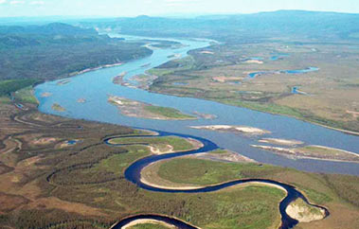
SFR Package Continuity Equation

Slide 4
SFR Package Connectivity

Slide 5
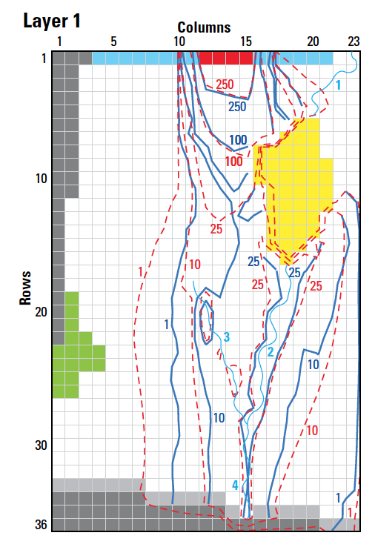
SFR Package Input
BEGIN OPTIONS
PRINT_STAGE
PRINT_FLOWS
UNIT_CONVERSION 128390.00
MOVER
SAVE_FLOWS
STAGE FILEOUT mf6-gwt.sfr.stage.bin
BUDGET FILEOUT mf6-gwt.sfr.cbc
END OPTIONS
BEGIN DIMENSIONS
NREACHES 38
END DIMENSIONS
BEGIN PACKAGEDATA
#RNO CELLID RLEN RWID RGRD RBTP RBTH RBHK MAN NCON USTRF NDV
1 1 1 23 400.0000 5.000000 0.1818182E-02 48.63636 1.000000 100.0000 0.3000000E-01 1 1.0000 0
2 1 2 23 200.0000 5.000000 0.1818182E-02 48.09091 1.000000 100.0000 0.3000000E-01 2 1.0000 0
3 1 2 22 400.0000 5.000000 0.1818182E-02 47.54546 1.000000 100.0000 0.3000000E-01 2 1.0000 0
4 1 3 21 400.0000 5.000000 0.1818182E-02 46.81818 1.000000 100.0000 0.3000000E-01 2 1.0000 0
5 1 4 20 400.0000 5.000000 0.1818182E-02 46.09091 1.000000 100.0000 0.3000000E-01 2 1.0000 0
6 1 5 20 400.0000 5.000000 0.1818182E-02 45.36364 1.000000 100.0000 0.3000000E-01 1 1.0000 0
7 1 17 18 400.0000 5.000000 0.2187500E-02 44.06250 1.000000 100.0000 0.3000000E-01 1 1.0000 0
8 1 18 18 400.0000 5.000000 0.2187500E-02 43.18750 1.000000 100.0000 0.3000000E-01 2 1.0000 0
9 1 19 18 400.0000 5.000000 0.2187500E-02 42.31250 1.000000 100.0000 0.3000000E-01 2 1.0000 0
--- DELETED INPUT ---

Slide 6
SFR Package Input – cont.
--- DELETED INPUT ---
34 1 31 15 400.0000 5.000000 0.2428571E-02 31.57143 1.000000 100.0000 0.3000000E-01 2 1.0000 0
35 1 32 15 400.0000 5.000000 0.2428571E-02 30.60000 1.000000 100.0000 0.3000000E-01 2 1.0000 0
36 1 33 15 400.0000 5.000000 0.2428571E-02 29.62857 1.000000 100.0000 0.3000000E-01 2 1.0000 0
37 1 34 15 400.0000 5.000000 0.2428571E-02 28.65714 1.000000 100.0000 0.3000000E-01 2 1.0000 0
38 1 35 15 400.0000 5.000000 0.2428571E-02 27.68571 1.000000 100.0000 0.3000000E-01 1 1.0000 0
END PACKAGEDATA
BEGIN CONNECTIONDATA
1 -2
2 1 -3
3 2 -4
4 3 -5
5 4 -6
6 5
7 -8
8 7 -9
9 8 -10
10 9 -11
11 10 -12
12 11 -13
13 12 -14
14 13 -15
15 14 -16
16 15 -17
17 16 -18
--- DELETED INPUT ---

Slide 7
SFR Package Input – cont.
--- DELETED INPUT ---
18 17 -32
19 -20
20 19 -21
21 20 -22
22 21 -23
23 22 -24
24 23 -25
25 24 -26
26 25 -27
27 26 -28
28 27 -29
29 28 -30
30 29 -31
31 30 -32
32 18 31 -33
33 32 -34
34 33 -35
35 34 -36
36 35 -37
37 36 -38
38 37
END CONNECTIONDATA
BEGIN PERIOD 1
1 INFLOW 86400.000
END PERIOD
BEGIN PERIOD 2
1 INFLOW 95040.
END PERIOD

Slide 8
SFR Package Output
SFR-1 BUDGET FOR ENTIRE MODEL AT END OF TIME STEP 1, STRESS PERIOD 1
------------------------------------------------------------------------------
CUMULATIVE SFR-1 L**3 RATES FOR THIS TIME STEP L**3/T
------------------ ------------------------
IN: IN:
--- ---
EXT-INFLOW = 394416000.0000 EXT-INFLOW = 86400.0000
FROM-MVR = 1229229296.0636 FROM-MVR = 269272.5731
RAINFALL = 0.0000 RAINFALL = 0.0000
RUNOFF = 0.0000 RUNOFF = 0.0000
GWF = 1083367995.0924 GWF = 237320.4809
EVAPORATION = 0.0000 EVAPORATION = 0.0000
EXT-OUTFLOW = 0.0000 EXT-OUTFLOW = 0.0000
TO-MVR = 0.0000 TO-MVR = 0.0000
TOTAL IN = 2707013291.1560 TOTAL IN = 592993.0539
OUT: OUT:
---- ----
EXT-INFLOW = 0.0000 EXT-INFLOW = 0.0000
FROM-MVR = 0.0000 FROM-MVR = 0.0000
RAINFALL = 0.0000 RAINFALL = 0.0000
RUNOFF = 0.0000 RUNOFF = 0.0000
GWF = 973384747.4528 GWF = 213227.7650
EVAPORATION = 0.0000 EVAPORATION = 0.0000
EXT-OUTFLOW = 860196997.5266 EXT-OUTFLOW = 188433.0772
TO-MVR = 873431546.1767 TO-MVR = 191332.2116
TOTAL OUT = 2707013291.1560 TOTAL OUT = 592993.0539
IN - OUT = 0.0000 IN - OUT = 0.0000
PERCENT DISCREPANCY = 0.00 PERCENT DISCREPANCY = 0.00

Slide 9
SFR Package Output – cont.
SFR (SFR-1) STAGE PERIOD 1 STEP 1
------------------------------------------------------------------------------------------------
REACH REACH REACH REACH REACH GWF STREAMBED STREAMBED
NO. (LAYER,ROW,COLUMN) STAGE DEPTH WIDTH HEAD CONDUCTANCE GRADIENT
------------------------------------------------------------------------------------------------
1 (1,1,23) 48.87 0.2330 5.000 48.81 0.2000E+06 0.5916E-01
2 (1,2,23) 48.31 0.2158 5.000 48.23 0.1000E+06 0.7507E-01
3 (1,2,22) 47.79 0.2398 5.000 47.96 0.2000E+06 -0.1737
4 (1,3,21) 47.11 0.2953 5.000 47.29 0.2000E+06 -0.1767
5 (1,4,20) 46.43 0.3415 5.000 46.58 0.2000E+06 -0.1506
6 (1,5,20) 45.74 0.3767 5.000 45.86 0.2000E+06 -0.1203
--- DELETED OUTPUT ---
33 (1,30,15) 32.93 0.3870 5.000 32.91 0.2000E+06 0.2451E-01
34 (1,31,15) 31.95 0.3823 5.000 31.93 0.2000E+06 0.1949E-01
35 (1,32,15) 30.98 0.3778 5.000 30.96 0.2000E+06 0.2165E-01
36 (1,33,15) 30.00 0.3724 5.000 29.97 0.2000E+06 0.2780E-01
37 (1,34,15) 29.02 0.3657 5.000 28.99 0.2000E+06 0.3262E-01
38 (1,35,15) 28.04 0.3590 5.000 28.02 0.2000E+06 0.2771E-01
SFR (SFR-1) FLOWS PERIOD 1 STEP 1
----------------------------------------------------------------------------------------------------------------------------------------------------------------------------
REACH REACH EXTERNAL REACH REACH REACH REACH REACH REACH REACH EXTERNAL REACH REACH PERCENT
NO. (LAYER,ROW,COLUMN) INFLOW INFLOW FROM MVR RAINFALL RUNOFF LEAKAGE EVAPORATION OUTFLOW OUTFLOW TO MVR IN - OUT DIFFERENCE
----------------------------------------------------------------------------------------------------------------------------------------------------------------------------
1 (1,1,23) 0.8640E+05 0.000 0.000 0.000 0.000 -0.1183E+05 0.000 -0.7457E+05 0.000 0.000 0.000 0.000
2 (1,2,23) 0.000 0.7457E+05 0.000 0.000 0.000 -7507. 0.000 -0.6706E+05 0.000 0.000 0.000 0.000
3 (1,2,22) 0.000 0.6706E+05 0.000 0.000 0.000 0.3475E+05 0.000 -0.1018E+06 0.000 0.000 0.000 0.000
4 (1,3,21) 0.000 0.1018E+06 0.000 0.000 0.000 0.3534E+05 0.000 -0.1371E+06 0.000 0.000 0.000 0.000
5 (1,4,20) 0.000 0.1371E+06 0.000 0.000 0.000 0.3013E+05 0.000 -0.1673E+06 0.000 0.000 0.000 0.000
6 (1,5,20) 0.000 0.1673E+06 0.000 0.000 0.000 0.2406E+05 0.000 0.000 -0.8168E-02 -0.1913E+06 0.000 0.000
--- DELETED OUTPUT ---
33 (1,30,15) 0.000 0.2192E+06 0.000 0.000 0.000 -4901. 0.000 -0.2143E+06 0.000 0.000 0.000 0.000
34 (1,31,15) 0.000 0.2143E+06 0.000 0.000 0.000 -3898. 0.000 -0.2104E+06 0.000 0.000 0.000 0.000
35 (1,32,15) 0.000 0.2104E+06 0.000 0.000 0.000 -4329. 0.000 -0.2061E+06 0.000 0.000 0.000 0.000
36 (1,33,15) 0.000 0.2061E+06 0.000 0.000 0.000 -5561. 0.000 -0.2005E+06 0.000 0.000 0.000 0.000
37 (1,34,15) 0.000 0.2005E+06 0.000 0.000 0.000 -6525. 0.000 -0.1940E+06 0.000 0.000 0.000 0.000
38 (1,35,15) 0.000 0.1940E+06 0.000 0.000 0.000 -5541. 0.000 0.000 -0.1884E+06 0.000 0.000 0.000

