Slide 1
Advanced Stress Packages
Mover (MVR) Package

Slide 2
MVR Package
CONSTRAINTS
PROVIDER
RECEIVER
Package
Discharge
One to One
Provider 1
Receiver 1
One to Many
Receiver 2
Provider 2
Receiver 3
Many to One
Provider 3
Receiver 4
Provider 4

Slide 3
MVR Package Providers and Receivers
Provider
Drain package
General-head boundary package
River package
Well package
Provider and Receiver
Lake package
Multi-aquifer well package
Streamflow routing package
Unsaturated zone package
Available water for mover is reduced by multiple receivers with the same provider in order listed in Mover package

Slide 4
MVR Package Constraints
Fraction
Discharge x fraction is sent to the receiver
Excess
Any water that exceeds the user-specified rate is provided to the receiver. No water is provided to the receiver if the available water is less than the user-specified value. (Flood control)

Slide 5
MVR Package Constraints
Threshold
No flow is provided to the receiver until the available water exceeds the user-specified rate. Once the available water exceeds the user-specified rate, then the user-specified rate is provided to the receiver. (Priority)
Up To
All of the available water will be taken from the provider up to the user-specified rate. Once user-specified rate is exceeded, the receiver will continue to get the user-specified rate.

Slide 6
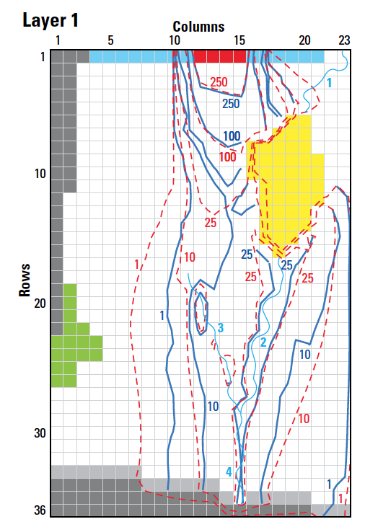
MVR Package Input
BEGIN OPTIONS
PRINT_INPUT
PRINT_FLOWS
BUDGET FILEOUT mvr.cbc
END OPTIONS
BEGIN DIMENSIONS
MAXMVR 3
MAXPACKAGES 2
END DIMENSIONS
BEGIN PACKAGES
SFR-1
LAK-1
END PACKAGES
BEGIN PERIOD 1
SFR-1 6 LAK-1 1 FACTOR 1.000000000000000
LAK-1 1 SFR-1 7 FACTOR 1.000000000000000
END PERIOD

Slide 7
MVR Package Input – cont.
BEGIN OPTIONS
PRINT_INPUT
PRINT_FLOWS
BUDGET FILEOUT mvr.cbc
END OPTIONS
BEGIN DIMENSIONS
MAXMVR 104
MAXPACKAGES 3
END DIMENSIONS
BEGIN PACKAGES
SFR_1
LAK_1
UZF_1
END PACKAGES
BEGIN PERIOD 1
SFR_1 23 LAK_1 1 FACTOR 1.000000000000000
LAK_1 1 SFR_1 24 FACTOR 1.000000000000000
--- DELETED INPUT ---
UZF_1 99 LAK_1 2 FACTOR 1.000000000000000
UZF_1 100 LAK_1 2 FACTOR 1.000000000000000
END PERIOD

Slide 8
MVR Package Output
WATER MOVER BUDGET FOR ENTIRE MODEL AT END OF TIME STEP 1, STRESS PERIOD 1
------------------------------------------------------------------------------
CUMULATIVE WATER MOVER L**3 RATES FOR THIS TIME STEP L**3/T
------------------ ------------------------
IN: IN:
--- ---
SFR-1 = 873431546.1767 SFR-1 = 191332.2116
LAK-1 = 1229229296.0636 LAK-1 = 269272.5731
TOTAL IN = 2102660842.2403 TOTAL IN = 460604.7847
OUT: OUT:
---- ----
SFR-1 = 1229229296.0636 SFR-1 = 269272.5731
LAK-1 = 873431546.1767 LAK-1 = 191332.2116
TOTAL OUT = 2102660842.2403 TOTAL OUT = 460604.7847
IN - OUT = 0.0000 IN - OUT = 0.0000
PERCENT DISCREPANCY = 0.00 PERCENT DISCREPANCY = 0.00

