Slide 1
Advanced Stress Packages
Multi-Aquifer Well (MAW) and Unsaturated Zone Flow (UZF) Packages

Slide 2
MAW Package Capabilities
Capabilities
Solved as part of the matrix solution
Simplified data input
Flexible connectivity
Several well conductance formulations
Constraints (flow reduction and well shutdown)
Flowing well option
Can account for interbore storage changes
Constant and inactive wells
Differences
No support for
horizontal wells
partial penetration
non-linear head losses

Slide 3
MAW Package Input
BEGIN OPTIONS
PRINT_INPUT
PRINT_FLOWS
BOUNDNAMES
AUXILIARY AUX1 AUX2
TS6 FILEIN maw_rates.ts
OBS6 FILEIN NT_Transient.maw.obs
NO_WELL_STORAGE
end options
BEGIN DIMENSIONS
NMAWWELLS 1
END DIMENSIONS
BEGIN PACKAGEDATA
# NO RADIUS BOTTOM STRT CONDEQN NGWNODES AUX1 AUX2 NAME
1 0.15 -514.9 9.14 SPECIFIED 2 100 1.0 NTWELL
END PACKAGEDATA
BEGIN CONNECTIONDATA
# CONN L R C STOP SBOT K RSKIN
1 1 1 51 51 -50 -514.9 111.53 0
1 2 2 51 51 -50 -514.9 446.62 0
END CONNECTIONDATA
BEGIN PERIOD 1
1 RATE MAWQ1
END PERIOD

Slide 4
MAW Package Output
MAW-NT_WELL BUDGET FOR ENTIRE MODEL AT END OF TIME STEP 50, STRESS PERIOD 3
------------------------------------------------------------------------------
CUMULATIVE MAW-NT_WELL L**3 RATES FOR THIS TIME STEP L**3/T
------------------ ------------------------
IN: IN:
--- ---
GWF = 32931.1497 GWF = 2767.0000
RATE = 0.0000 RATE = 0.0000
CONSTANT = 0.0000 CONSTANT = 0.0000
TOTAL IN = 32931.1497 TOTAL IN = 2767.0000
OUT: OUT:
---- ----
GWF = 1170.8715 GWF = 0.0000
RATE = 31760.2781 RATE = 2767.0000
CONSTANT = 0.0000 CONSTANT = 0.0000
TOTAL OUT = 32931.1497 TOTAL OUT = 2767.0000
IN - OUT = 3.8031E-07 IN - OUT = 4.3552E-08
PERCENT DISCREPANCY = 0.00 PERCENT DISCREPANCY = 0.00

Slide 5
MAW Package Output – cont.
MULTI-AQUIFER WELL (MAW-NT_WELL) HEAD PERIOD 3 STEP 50
----------------------------------
WELL WELL WELL
NAME NO. HEAD
----------------------------------
NTWELL 1 0.2729
MULTI-AQUIFER WELL (MAW-NT_WELL) FLOWS PERIOD 3 STEP 50
------------------------------------------------------------------------------------------
WELL WELL GWF GWF WELL CONSTANT WELL PERCENT
NAME NO. IN OUT RATE FLOW IN - OUT DIFFERENCE
------------------------------------------------------------------------------------------
NTWELL 1 2767. 0.000 -2767. 0.000 0.4355E-07 0.1574E-08

Slide 6
UZF Package Continuity Equation
Kinematic-wave Equation for vertical unsaturated flow provides a solution for gravity flow with internal drainage.
Water Content
Internal drainage
Wetting
Front
Water
Table

Slide 7
UZF Package Variables
Brooks-Corey Equation
Required input variables

Slide 8
UZF Package Capabilities
Intended for basin scale studies
Simulates:
ET (unsaturated and saturated)
Spring discharge (groundwater discharge to land surface)
Saturation excess (rejected infiltration)
Exchanges with Lakes, Streams, and Multi-Aquifer Wells

Slide 9
UZF Package
Head/Elevation
Head/Elevation
Recharge
Recharge
Problem!
Smooth
0.0
0.0
Discharge
Discharge
Land surface
Land surface
No micro topography
With micro topography
Micro Topography Solves Infiltration/Discharge Discontinuity Problem

Slide 10
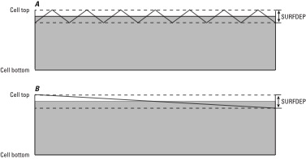
UZF Package Infiltration

Slide 11
UZF Package Groundwater Seepage
Groundwater Seepage – Water Table is Close to Land Surface

Slide 12
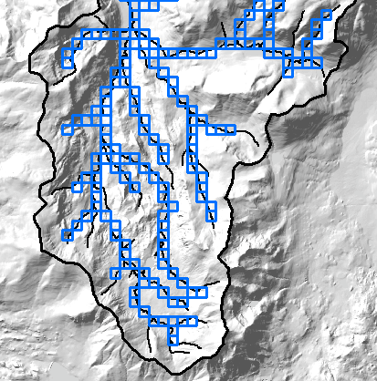
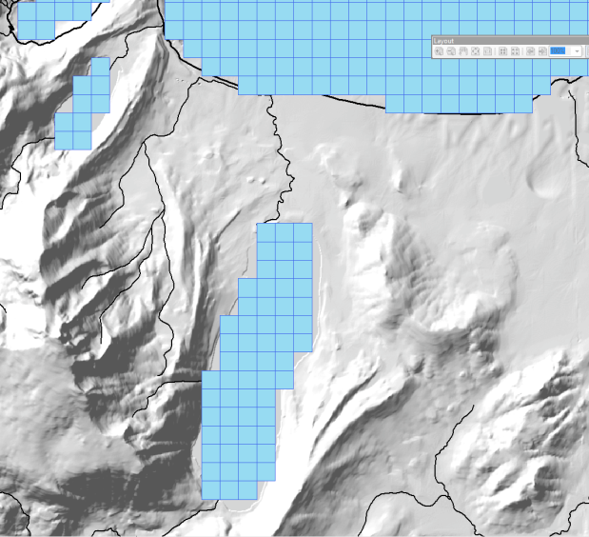
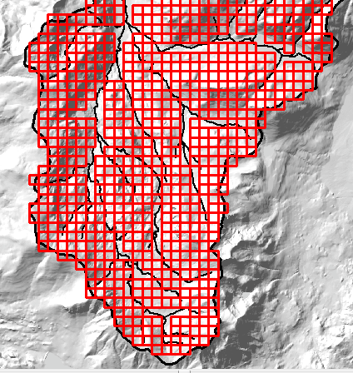
UZF Package – multiple packages
UZF package 1
UZF package 2
UZF package 3
Stream seepage
Ponds/lakes
Mountain slope

Slide 13
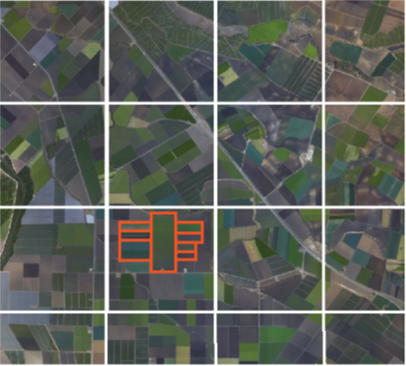
UZF Package – sub-grid features
Coarse GWF grid
UZF cells correspond to GWF grid in areas with less data
UZF cells corresponding to different land use types

Slide 14
UZF Package Input
BEGIN OPTIONS
BOUNDNAMES
PRINT_INPUT
PRINT_FLOWS
SAVE_FLOWS
SIMULATE_ET
LINEAR_GWET
SIMULATE_GWSEEP
MOVER
OBS6 FILEIN uzfp3_lakmvr_v2_uzf.obs
BUDGET FILEOUT uzf.cbc
END OPTIONS
BEGIN DIMENSIONS
NUZFCELLS 200
NTRAILWAVES 10
NWAVESETS 50
END DIMENSIONS
BEGIN PACKAGEDATA
# NO CELLID LFLG VCON SURFDEP VKS THTR THTS THTI EPS BOUNDANAME
1 1 1 1 1 101 0.1 1.00E-06 0.1 0.3 0.11 3.5 uzfcells
2 1 1 2 1 102 0.1 1.00E-06 0.1 0.3 0.11 3.5 uzfcells
3 1 2 1 1 103 0.1 1.00E-06 0.2 0.3 0.21 3.5 uzfcells
--- DELETED INPUT ---

Slide 15
UZF Package Input – cont.
--- DELETED INPUT ---
198 2 15 4 0 0 0.1 1.00E-06 0.2 0.3 0.21 3.5 uzfcells
199 2 15 5 0 0 0.1 1.00E-06 0.2 0.3 0.21 3.5 uzfcells
200 2 15 6 0 0 0.1 1.00E-06 0.2 0.3 0.21 3.5 uzfcells
END PACKAGEDATA
BEGIN PERIOD 1
# uzfid finf pet extdp extwc ha hroot rootact
1 3.34E-10 1.00E-08 15 0.100005 0.0 0.0 0.0
2 6.68E-10 1.00E-08 15 0.100005 0.0 0.0 0.0
3 6.68E-10 1.00E-08 15 0.20001 0.0 0.0 0.0
--- DELETED INPUT ---
98 2.68E-09 1.00E-08 15 0.20001 0.0 0.0 0.0
99 2.68E-09 1.00E-08 15 0.20001 0.0 0.0 0.0
100 2.68E-09 1.00E-08 15 0.20001 0.0 0.0 0.0
END PERIOD

Slide 16
UZF Package Output
UZF_1 BUDGET FOR ENTIRE MODEL AT END OF TIME STEP 15, STRESS PERIOD 24
------------------------------------------------------------------------------
CUMULATIVE UZF_1 L**3 RATES FOR THIS TIME STEP L**3/T
------------------ ------------------------
IN: IN:
--- ---
INFILTRATION = 6044703271.2000 INFILTRATION = 7.6500
FROM-MVR = 0.0000 FROM-MVR = 0.0000
REJ-INF = 0.0000 REJ-INF = 0.0000
REJ-INF-TO-MVR = 0.0000 REJ-INF-TO-MVR = 0.0000
GWF = 0.0000 GWF = 0.0000
UZET = 0.0000 UZET = 0.0000
STORAGE = 3703929635.3310 STORAGE = 63.3814
TOTAL IN = 9748632906.5310 TOTAL IN = 71.0314
OUT: OUT:
---- ----
INFILTRATION = 0.0000 INFILTRATION = 0.0000
FROM-MVR = 0.0000 FROM-MVR = 0.0000
REJ-INF = 1640.8837 REJ-INF = 0.0000
REJ-INF-TO-MVR = 24978080.1659 REJ-INF-TO-MVR = 5.0001E-02
GWF = 2902536811.0348 GWF = 45.0327
UZET = 1336852282.2118 UZET = 22.7992
STORAGE = 5484263955.0108 STORAGE = 3.1496
TOTAL OUT = 9748632769.3070 TOTAL OUT = 71.0314
IN - OUT = 137.2240 IN - OUT = 1.7748E-06
PERCENT DISCREPANCY = 0.00 PERCENT DISCREPANCY = 0.00

Slide 17
UZF Package Output – cont.
UZF (UZF_1) FLOWS PERIOD 24 STEP 15
-----------------------------------------------------------------------------------------------------------------------------------------------------------
UZF UZF UZF UZF-UZF UZF UZF UZF REJ-INF UZF UZF UZF-UZF UZF UZF PERCENT
NAME NO. INFILT. INFLOW FROM MVR REJ-INF TO MVR UZET GWRCH OUTFLOW STORAGE IN - OUT DIFFERENCE
-----------------------------------------------------------------------------------------------------------------------------------------------------------
UZFCELLS 1 0.2500E-01 0.000 0.000 0.000 0.000 -0.2109 0.000 -0.6988E-03 0.1866 -0.2211E-10 -0.1045E-07
UZFCELLS 2 0.5000E-01 0.000 0.000 0.000 0.000 -0.2500 0.000 -0.6988E-03 0.2007 -0.3919E-13 -0.1563E-10
UZFCELLS 3 0.5000E-01 0.000 0.000 0.000 0.000 -0.2500 0.000 -0.9262 1.126 0.1825E-12 0.1552E-10
UZFCELLS 4 0.2500E-01 0.000 0.000 0.000 0.000 -0.2109 0.000 -0.6988E-03 0.1866 -0.2211E-10 -0.1045E-07
UZFCELLS 5 0.5000E-01 0.000 0.000 0.000 0.000 -0.2500 0.000 -0.6988E-03 0.2007 -0.3919E-13 -0.1563E-10
UZFCELLS 6 0.2000 0.000 0.000 0.000 0.000 -0.2500 0.000 -0.8730 0.9230 -0.5684E-13 -0.5062E-11
UZFCELLS 7 0.2000 0.000 0.000 0.000 0.000 -0.2500 0.000 -0.8730 0.9230 -0.5684E-13 -0.5062E-11
UZFCELLS 8 0.1250 0.000 0.000 0.000 0.000 -0.2500 0.000 -0.8888 1.014 -0.1732E-13 -0.1521E-11
UZFCELLS 9 0.1250 0.000 0.000 0.000 0.000 -0.2500 0.000 -0.8888 1.014 -0.1732E-13 -0.1521E-11
UZFCELLS 10 0.2500E-01 0.000 0.000 0.000 0.000 -0.2109 0.000 -0.6988E-03 0.1866 -0.2211E-10 -0.1045E-07
UZFCELLS 11 0.2500E-01 0.000 0.000 0.000 0.000 -0.2109 0.000 -0.6988E-03 0.1866 -0.2211E-10 -0.1045E-07
UZFCELLS 12 0.2000 0.000 0.000 0.000 0.000 -0.2500 0.000 -0.8730 0.9230 -0.5684E-13 -0.5062E-11
UZFCELLS 13 0.2000 0.000 0.000 0.000 0.000 -0.2500 0.000 -0.8730 0.9230 -0.5684E-13 -0.5062E-11
UZFCELLS 14 0.1250 0.000 0.000 0.000 0.000 -0.2500 -0.8094 0.000 0.9344 -0.2731E-13 -0.2578E-11
--- DELETED OUTPUT ---
UZFCELLS 187 0.000 0.000 0.000 0.000 0.000 0.000 0.000 0.000 -0.000 0.000 0.000
UZFCELLS 188 0.000 0.000 0.000 0.000 0.000 0.000 0.000 0.000 -0.000 0.000 0.000
UZFCELLS 189 0.000 0.000 0.000 0.000 0.000 0.000 0.000 0.000 -0.000 0.000 0.000
UZFCELLS 190 0.000 0.000 0.000 0.000 0.000 0.000 0.000 0.000 -0.000 0.000 0.000
UZFCELLS 191 0.000 0.000 0.000 0.000 0.000 0.000 0.000 0.000 -0.000 0.000 0.000
UZFCELLS 192 0.000 0.000 0.000 0.000 0.000 0.000 0.000 0.000 -0.000 0.000 0.000
UZFCELLS 193 0.000 0.000 0.000 0.000 0.000 0.000 0.000 0.000 -0.000 0.000 0.000
UZFCELLS 194 0.000 0.000 0.000 0.000 0.000 0.000 0.000 0.000 -0.000 0.000 0.000
UZFCELLS 195 0.000 0.000 0.000 0.000 0.000 0.000 0.000 0.000 -0.000 0.000 0.000
UZFCELLS 196 0.000 0.000 0.000 0.000 0.000 0.000 0.000 0.000 -0.000 0.000 0.000
UZFCELLS 197 0.000 0.8730 0.000 0.000 0.000 0.000 -0.7460 0.000 -0.1270 0.7972E-07 0.9132E-05
UZFCELLS 198 0.000 0.8730 0.000 0.000 0.000 0.000 -0.7484 0.000 -0.1246 0.7972E-07 0.9132E-05
UZFCELLS 199 0.000 0.8730 0.000 0.000 0.000 0.000 -0.7562 0.000 -0.1169 0.7972E-07 0.9132E-05
UZFCELLS 200 0.000 0.8730 0.000 0.000 0.000 0.000 -0.7650 0.000 -0.1080 0.7972E-07 0.9132E-05

