Slide 1
Newton Raphson Formulation
For water-table problems

Slide 2
Standard Formulation Issues
Originally developed for groundwater flow problems with standard boundary conditions to solve linear (confined) to well-behaved non-linear (unconfined) problems.
Empirical wetting and drying approach added by McDonald and others (1992) to allow cell conversion to simulate more difficult unconfined problems.
Three-dimensional unconfined applications and head-dependent stress packages can create additional nonlinearities.

Slide 3
Wetting/Drying Nonlinearities
Standard Formulation approach:
Dry cells are inactivated. This creates discontinuities and oscillations. Furthermore, wetting/drying results in varying stresses (for example, wells disappear from dry cells).
Newton-Raphson Formulation approach:
Keep all cells active even when the head in a cell is below the bottom of the cell

Slide 4
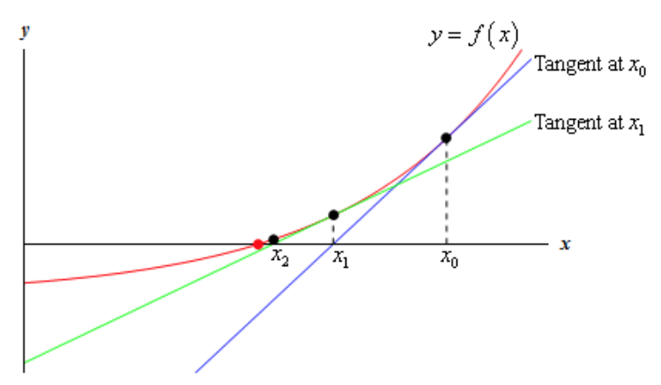
Newton-Raphson method
Standard Formulation:
Newton-Raphson:
Jacobian:
http://tutorial.math.lamar.edu/Classes/CalcI/NewtonsMethod.aspx
Modified Newton-Raphson:

Slide 5
Standard Formulation
dry
wet
h_{n} = 90
S_{Fn} = 0
BOT_{n} = 90
h_{m} = 95
S_{Fm} = 5
BOT_{m} = 90
Standard Formulation intercell conductance based on saturated thickness will prevent flow from a wet cell to a dry cell.

Slide 6
Newton-Raphson Formulation
dry
wet
h_{n} = 90
S_{Fn} = 0
BOT_{n} = 90
h_{m} = 95
S_{Fm} = 5
BOT_{m} = 90
Conductance is calculated based on saturated thickness of cell with higher head. Thus, there will be flow from the wet cell to the dry cell.

Slide 7
Newton-Raphson Formulation
Conductance transitions from head-dependent to constant
0
Cell
bottom
Cell
top
Transition causes to change from 1 to zero, discontinuous derivative

Slide 8
Newton-Raphson Formulation
Smooth saturated thickness function over the discontinuity.

Slide 9
Newton-Raphson Formulation
Since cells remain active, simulated heads can be less than the cell bottom.

Slide 10
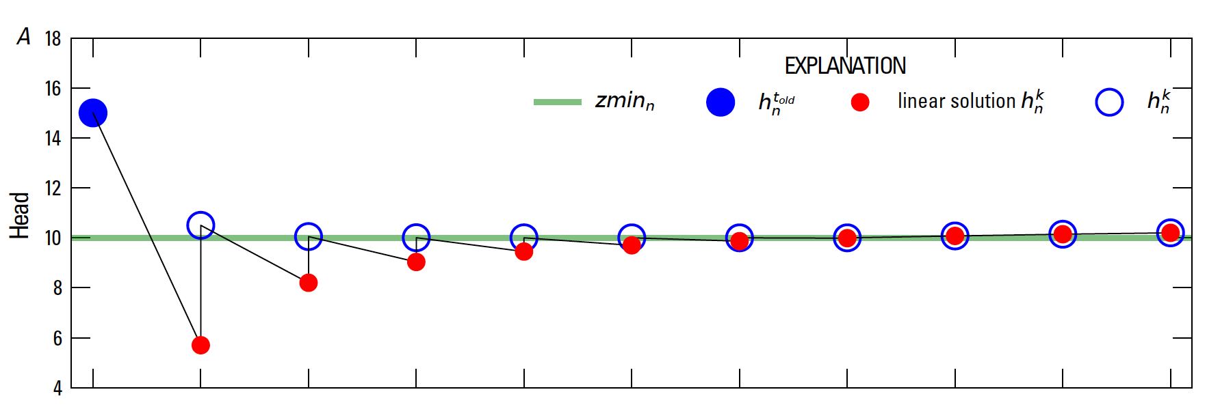
Newton-Raphson Formulation
Under-relaxation for Newton Solutions

Slide 11
Newton-Raphson Formulation
GWF name file
BEGIN Options
NEWTON UNDER_RELAXATION
END Options
BEGIN Packages
DIS6 uzfp3_lakmvr_v2.dis
IC6 uzfp3_lakmvr_v2.ic
NPF6 uzfp3_lakmvr_v2.npf
STO6 uzfp3_lakmvr_v2.sto
OC6 uzfp3_lakmvr_v2.oc
SFR6 uzfp3_lakmvr_v2.sfr 'SFR_1'
LAK6 uzfp3_lakmvr_v2.lak 'LAK_1'
GHB6 uzfp3_lakmvr_v2.ghb
UZF6 uzfp3_lakmvr_v2.uzf 'UZF_1'
MVR6 uzfp3_lakmvr_v2.mvr
OBS6 uzfp3_lakmvr_v2_head.obs
END Packages

Slide 12
Newton-Raphson Formulation
Once Newton-Raphson is enabled in the GWF name file Newton-Raphson is also used for GWF terms formulated by
Storage Package
Skeletal storage, compaction and subsidence Package (CSUB)
Well Package (auto flow reduce)
Lake Package*
Multi-aquifer Well Package
Streamflow Routing Package*
Unsaturated Zone Flow Package*
* Stress package continuity equation also solved using Newton-Raphson

Slide 13
Newton-Raphson Formulation
Newton-Raphson formulation is more robust than Picard for strongly non-linear problems.
Newton-Raphson formulation results in a asymmetric matrix.
Asymmetric matrix requires different linear accelerators, line search methods, and under-relaxation methods

Slide 14
Iterative Model Solution (IMS) Package
Nonlinear methods
Backtracking
Under-relaxation Methods
Simple (equivalent to MODFLOW-2005 PCG package under-relaxation and sufficient for many problems)
Cooley
Delta-Bar-Delta
Pseudo-Transient Continuation for steady-state Newton-Raphson problems

Slide 15
Iterative Model Solution (IMS8) Package
Linear methods
Linear accelerators
Conjugate Gradient
Bi-Conjugate Gradient Stabilized
ILU Factorization preconditioners
Row sum agreement
Level-fill
Drop-tolerance
RCM and Minimum Degree reordering

Slide 16
Iterative Model Solution (IMS) Package
Steady-state problems that use the Newton-Raphson method can be difficult to solve numerically, especially when initial conditions are not sufficiently near the roots where the residual is zero. Pseudo-transient continuation is a method that improves convergence of steady-state models that use the Newton-Raphson method.

Slide 17
Iterative Model Solution (IMS) Input
BEGIN OPTIONS
PRINT_OPTION ALL
CSV_OUTPUT FILEOUT NWTP3LOW.IMS.CSV
END OPTIONS
BEGIN NONLINEAR
OUTER_HCLOSE 1.E-3
OUTER_MAXIMUM 1500
UNDER_RELAXATION DBD
UNDER_RELAXATION_THETA 0.90
UNDER_RELAXATION_KAPPA 0.
UNDER_RELAXATION_GAMMA 0.
UNDER_RELAXATION_MOMENTUM 0.
BACKTRACKING_NUMBER 20
BACKTRACKING_TOLERANCE 2.
BACKTRACKING_REDUCTION_FACTOR 0.6
BACKTRACKING_RESIDUAL_LIMIT 1.0
END NONLINEAR
BEGIN LINEAR
INNER_MAXIMUM 200
INNER_HCLOSE 1.0E-6
INNER_RCLOSE .0 RELATIVE_RCLOSE
LINEAR_ACCELERATION BICGSTAB
REORDERING_METHOD NONE
PRECONDITIONER_LEVELS 5
NUMBER_ORTHOGONALIZATIONS 7
PRECONDITIONER_DROP_TOLERANCE 1.0E-4
END LINEAR

Slide 18
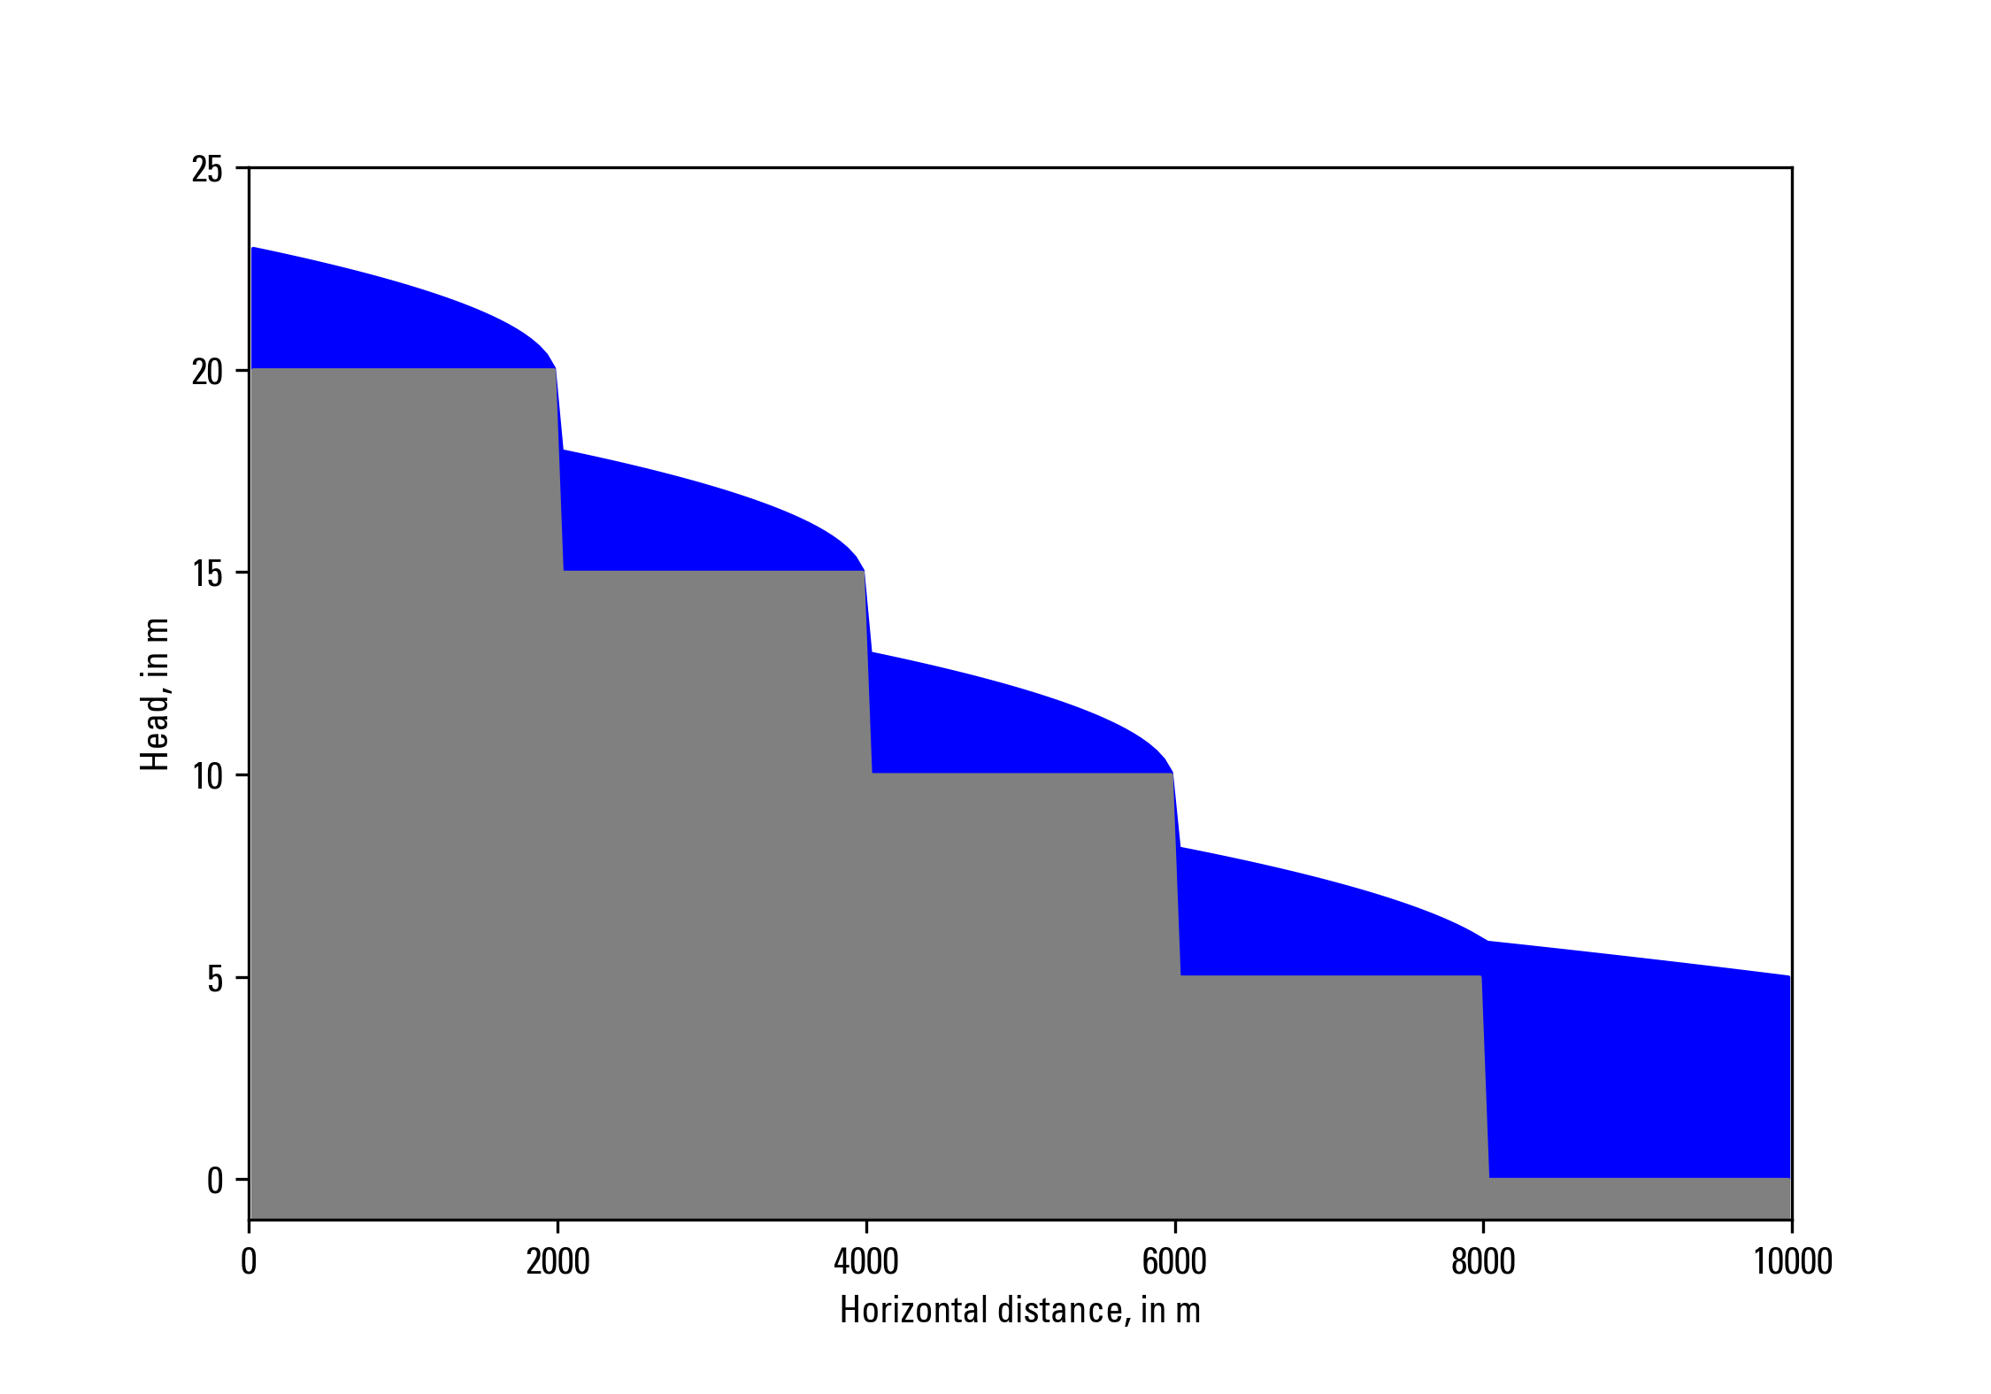
Newton-Raphson Formulation
Zaidel, Jacob, 2013, Discontinuous steady-state analytical solutions of the Boussinesq equation and their numerical representation by MODFLOW: Groundwater, v. 51, p. 952–959. doi: 10.1111/gwat.12019.

Slide 19
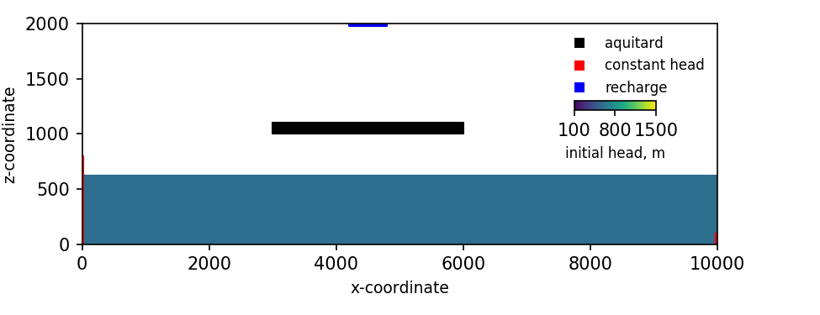
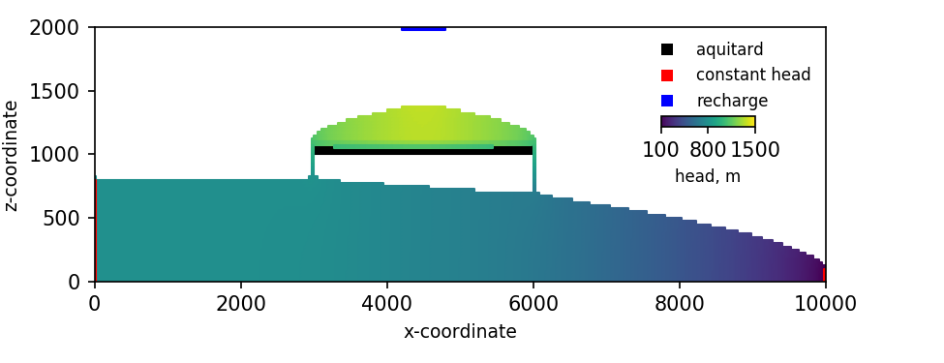
Newton-Raphson Formulation
Keating, Elizabeth, and Zyvoloski, George, 2009, A stable and efficient numerical algorithm for unconfined aquifer analysis: Ground Water, v. 47, no. 4, p. 569–579, accessed June 27, 2017, at https://doi.org/10.1111/ j.1745-6584.2009.00555.x.

Slide 20
Summary
Newton-Raphson formulations includes:
Solution using a modified form of Newton-Raphson method.
Upstream weighting of the horizontal conductance using a smoothed upstream saturation, which will result in “slightly” different results relative to default harmonic mean.
All cells remain active and simulated heads can be below cell bottoms.
Convergence may improve with Newton under-relaxation.

Slide 21
Summary – continued
Newton-Raphson formulation requires:
Use of asymmetric linear solver
Convergence may improve with
Under-relaxation
Backtracking
Additional preconditioner levels
Preconditioner drop tolerance > 0
Convergence may improve for steady-state stress periods with pseudo-transient continuation
Can be disabled

