Slide 1
MODFLOW 6—XT3D
Introduction to Groundwater Modeling using MODFLOW
January 9-13, 2023
SDSU, San Diego California

Slide 2
Challenge
Allow MODFLOW 6 to simulate groundwater flow with fully 3D anisotropy
Unstructured, cell-centered, finite-volume grids

Slide 3
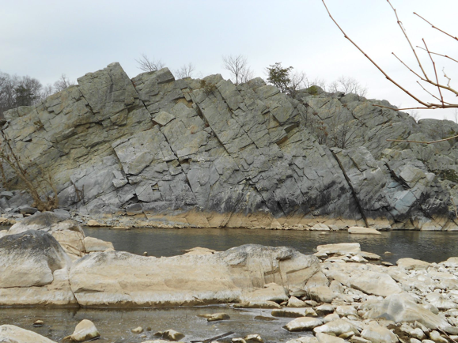
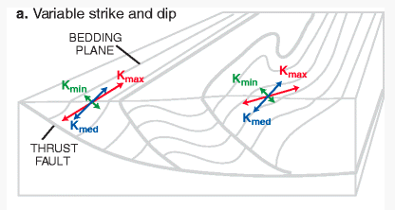
Representation of Anisotropy
Representation of full 3D anisotropy may be required for some problems (fractured aquifers, structurally deformed aquifers)
Some capabilities available but needed generalized CVFD method

Slide 4
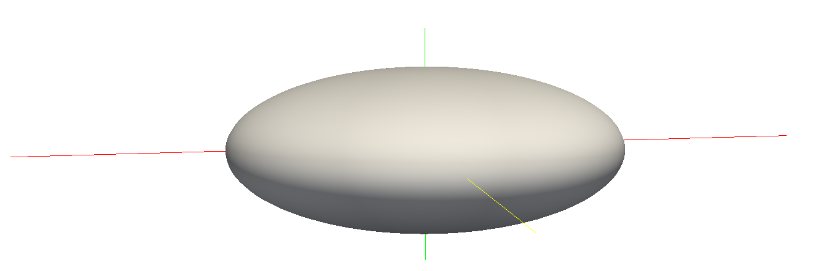
Hydraulic Conductivity Ellipsoid
Defined by three user-provided values on a cell by cell basis
For unrotated case,
K11 = Kx
K22 = Ky
K33 = Kz
K11
K22
K33

Slide 5
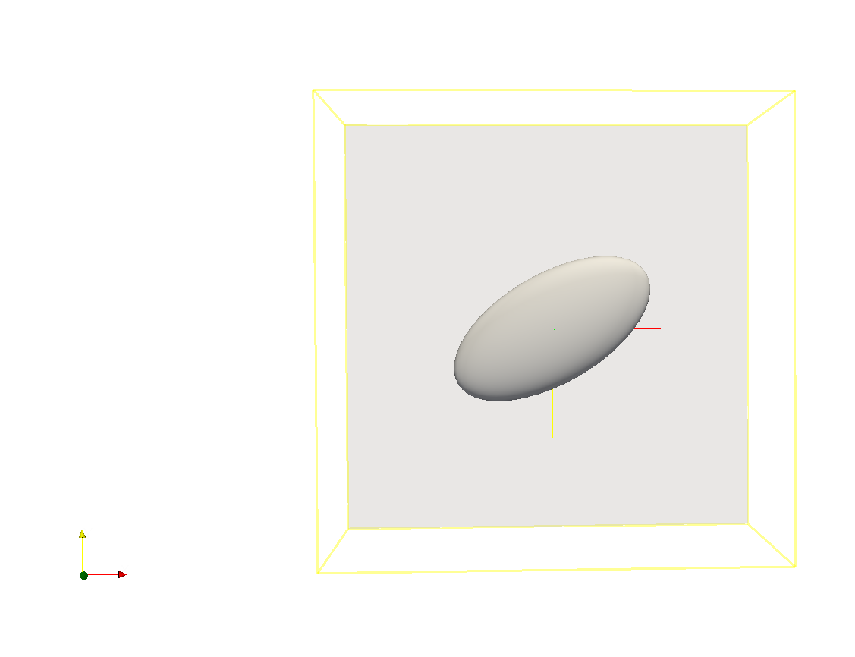
Ellipsoid Rotation
Users can optionally provide ANGLE1, ANGLE2, and ANGLE3 on a cell by cell basis
ANGLE1 is counter-clockwise rotation in the x, y plane

Slide 6
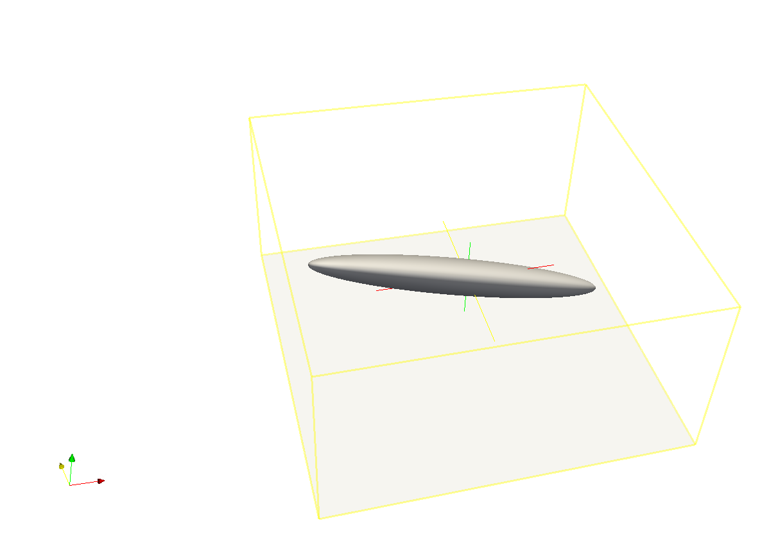
Ellipsoid Rotation (cont.)
All three angles can be specified to represent ellipsoid orientation

Slide 7
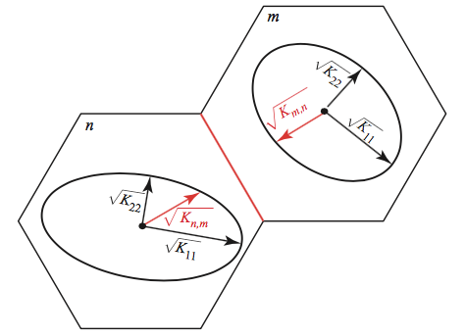
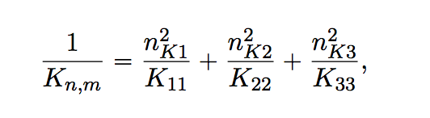
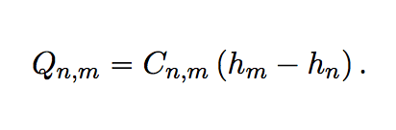
Effective Conductivity Approach
Large errors for certain ellipsoid configurations
Approximate, but relatively fast
Simple to implement

Slide 8
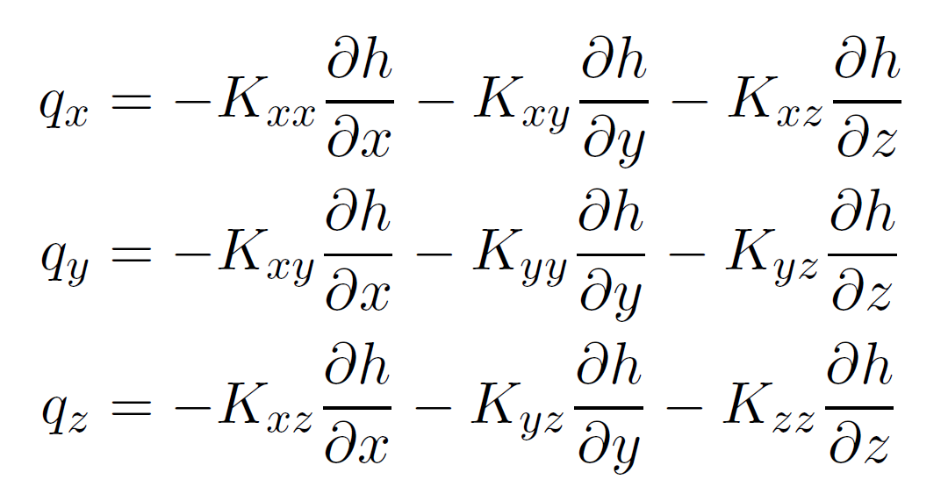
Darcy’s Law with full 3D anisotropy

Slide 9
Darcy’s Law with full 3D anisotropy
x component
need all three components of head gradient

Slide 10
Gradient estimation - rectangular grid
y
x

Slide 11
Gradient estimation - rectangular grid
y
x

Slide 12
Gradient estimation - rectangular grid
spatial interpolation
y
x

Slide 13

Gradient estimation - rectangular grid
x component
y
x

Slide 14

Gradient estimation - rectangular grid
y component
y
x

Slide 15
Gradient estimation - rectangular grid
average of two estimates
y
x

Slide 16
Gradient estimation - rectangular grid
y component, other side
y
x

Slide 17
Gradient estimation - rectangular grid
combine
estimates
y
x

Slide 18
Gradient estimation - rectangular grid
weight by
distance
y
x

Slide 19
Gradient estimation - rectangular grid
weight by
orientation
x
x
y
x

Slide 20
Gradient estimation - rectangular grid
y
x

Slide 21
Main ideas
Use weighted averaging to incorporate gradient information from neighboring connections

Slide 22
Main ideas
Use weighted averaging to incorporate gradient information from neighboring connections
Weight depends on distance

Slide 23
Main ideas
Use weighted averaging to incorporate gradient information from neighboring connections
Weight depends on distance
Weight depends on orientation

Slide 24
Main ideas
Use weighted averaging to incorporate gradient information from neighboring connections
Weight depends on distance
Weight depends on orientation
Combine estimates from both sides of the interface

Slide 25
XT3D – regular and irregular grids

Slide 26
XT3D – regular and irregular grids
spatial interpolation

Slide 27
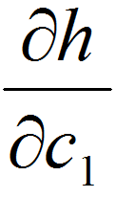
XT3D – regular and irregular grids
component along primary connection

Slide 28
XT3D – regular and irregular grids
“unknown” head
component along primary connection

Slide 29
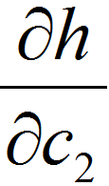
XT3D – regular and irregular grids
component ⊥ to primary connection
= weighted average

Slide 30
XT3D – regular and irregular grids
component ⊥ to primary connection
= weighted average
indirect information:
spatially removed from primary interface
components along neighboring connections (not ⊥)
need to do some math

Slide 31
XT3D – regular and irregular grids
component ⊥ to primary connection
= weighted average
indirect information:
spatially removed from primary interface
components along neighboring connections (not ⊥)
need to do some math
weight by:
distance: closer = more weight

Slide 32
XT3D – regular and irregular grids
component ⊥ to primary connection
= weighted average
indirect information:
spatially removed from primary interface
components along neighboring connections (not ⊥)
need to do some math
x
weight by:
distance: closer = more weight
orientation: more ⊥ = more weight

Slide 33
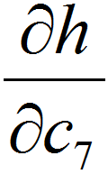
XT3D – regular and irregular grids
component ⊥ to primary connection, other side

Slide 34
XT3D – regular and irregular grids
combine estimates
(continuity of normal flux)

Slide 35
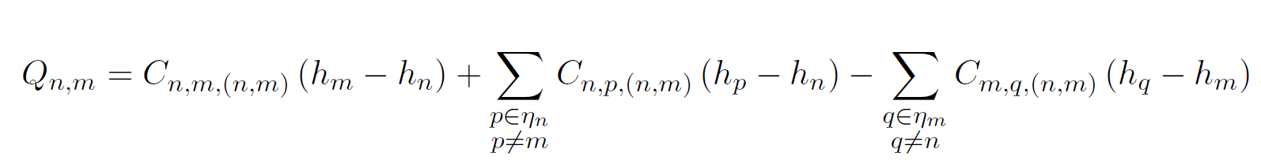
XT3D flow expression
Flow between two cells expressed in terms of conductance-like coefficients that can involve all neighbors of the two cells

Slide 36
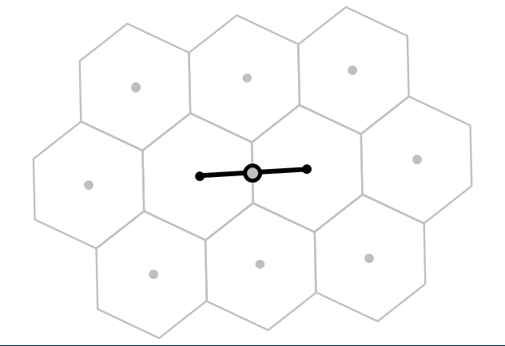
XT3D flow expression
Flow between two cells expressed in terms of conductance-like coefficients that can involve all neighbors of the two cells

Slide 37
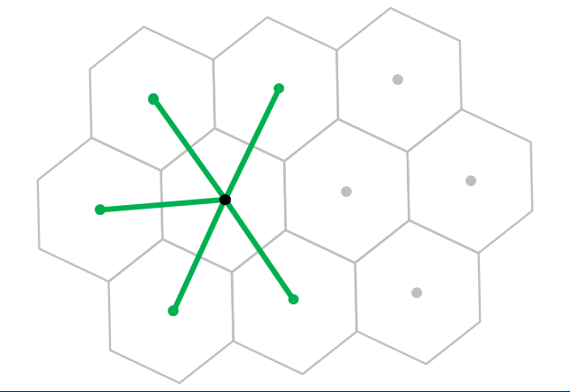
XT3D flow expression
Flow between two cells expressed in terms of conductance-like coefficients that can involve all neighbors of the two cells

Slide 38
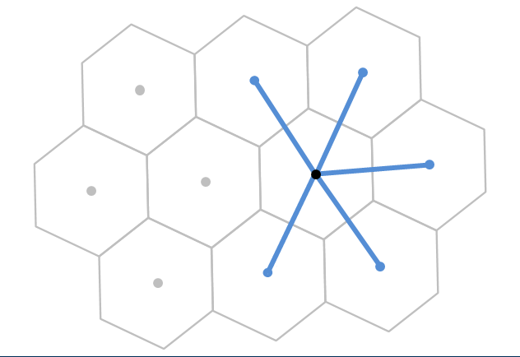
XT3D flow expression
Flow between two cells expressed in terms of conductance-like coefficients that can involve all neighbors of the two cells

Slide 39
XT3D flow expression
Flow between two cells expressed in terms of conductance-like coefficients that can involve all neighbors of the two cells
Larger stencil than in standard conductance-based MODFLOW formulation

Slide 40
XT3D performance
Longer run times than standard MODFLOW formulation
Requires more memory than standard MODFLOW formulation
“RHS” suboption makes memory requirement comparable to default formulation (same stencil)

Slide 41
Usage notes
To use XT3D, “flip a switch” in Node Property Flow (NPF) Package input
Matrix not necessarily symmetric → use BICGSTAB for linear acceleration
Don’t use ghost nodes (GNC) at the same time
Works with horizontal flow barriers (HFB)
Has a Newton-Raphson formulation
Vertical contribution to “conductances” currently based on fully saturated cell thickness

Slide 42
Conclusions
XT3D handles arbitrarily oriented 3D anisotropy on structured and unstructured grids
“Ghost-node-like” correction on unstructured grids
Also applicable to dispersion

