Slide 1
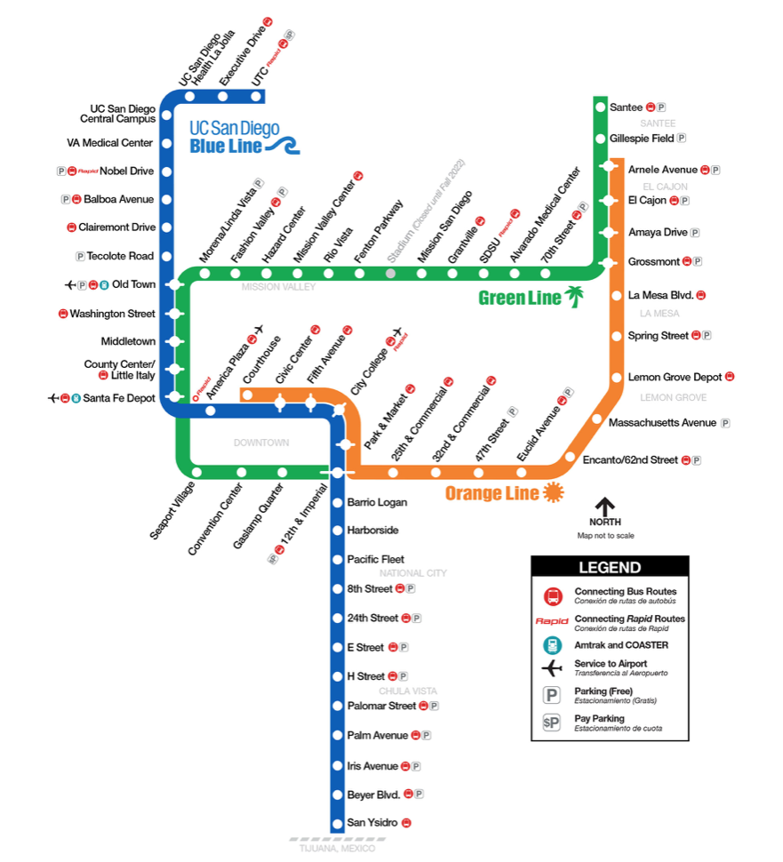

Slide 2
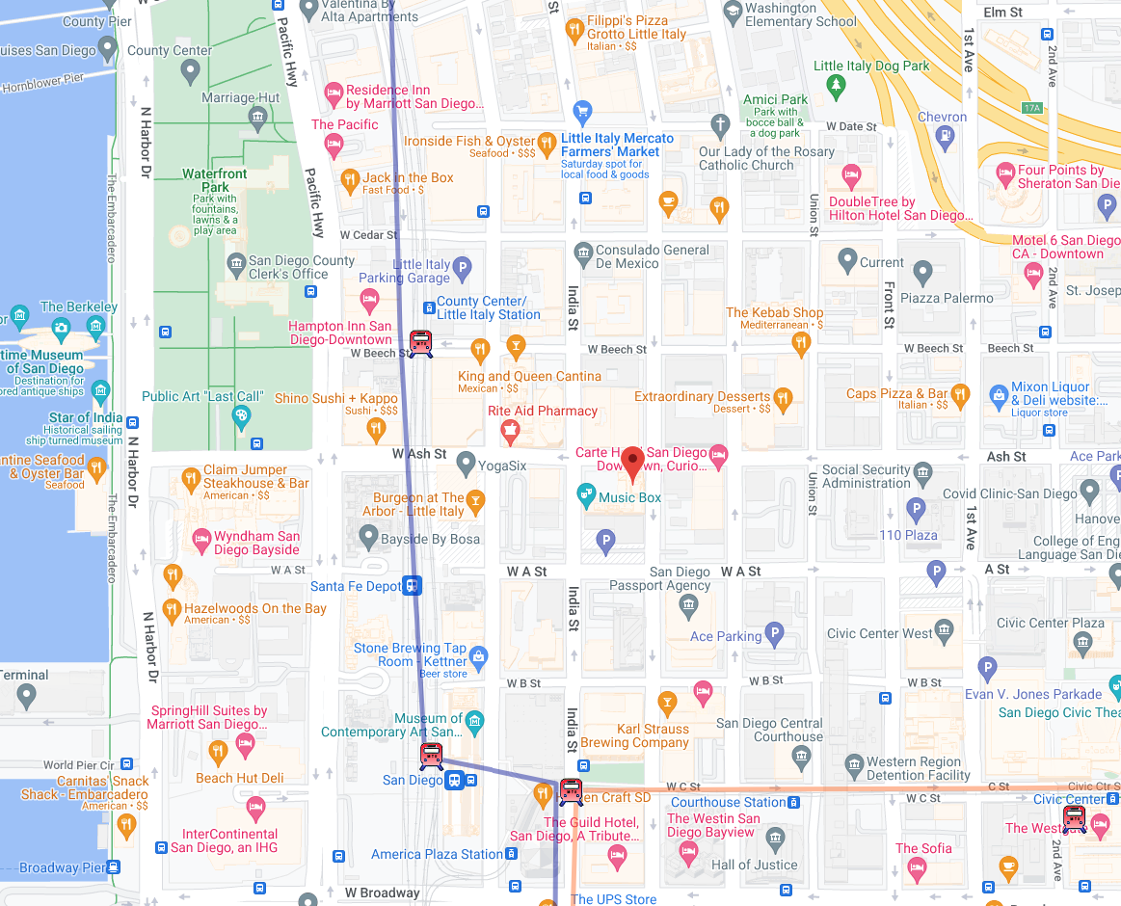
Little Italy Trolley Station
Best Western

Slide 3
