Slide 1
McDonald Valley
A Model Calibration Exercise for MODFLOW

Slide 2
Exercise Outline
Stage 1 – Planning phase
Evaluate project objectives and develop conceptual model
Stage 2 – Initial model development
Build MODFLOW dataset and calibrate model using existing data
Stage 3 – Improve model
Collect new field data and refine model calibration
Stage 4 – Prediction phase
Simulate development scenarios to evaluate project objectives

Slide 3
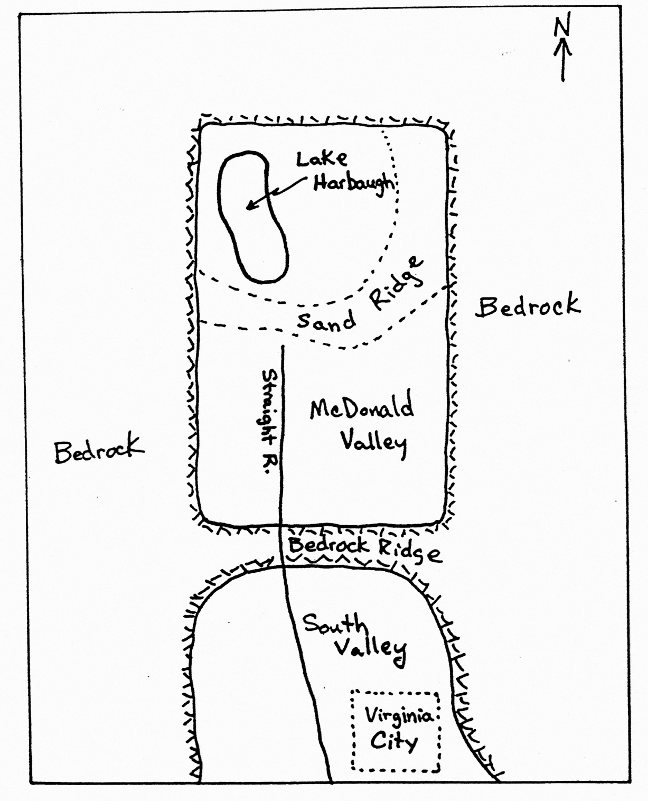
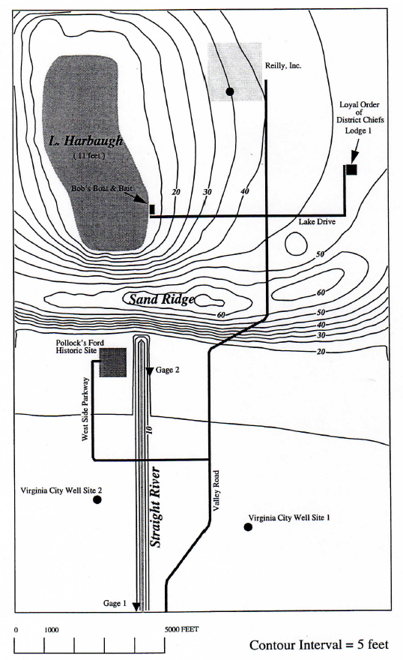
Study Area
Figure 1 – Regional Map
Figure 2 – Topographic Map of McDonald Valley
Lake
Harbaugh
L & H Lounge

Slide 4
Proposed Groundwater Development
Figure 2 – Topographic Map of McDonald Valley
Well in southern part of the valley at either of two sites
Well at Reilly’s Premium Beverages, Inc.
County Cooperator
Doesn’t want excessive water-table declines (no more than 2 ft)
Must not reduce stream flow at Pollock’s Ford by more than 20%
No induced infiltration at all along Straight River
Lake
Harbaugh
L & H Lounge

Slide 5
Proposed Groundwater Development
Figure 2 – Topographic Map of McDonald Valley
County Cooperator – cont.
Wants to regulate septic systems in northern part of valley
Cooperator want the source area for groundwater into Lake Harbaugh
Capture zone analysis of the Reilly well
Capture zone analysis of the proposed Virginia City wells
Lake
Harbaugh
L & H Lounge

Slide 6
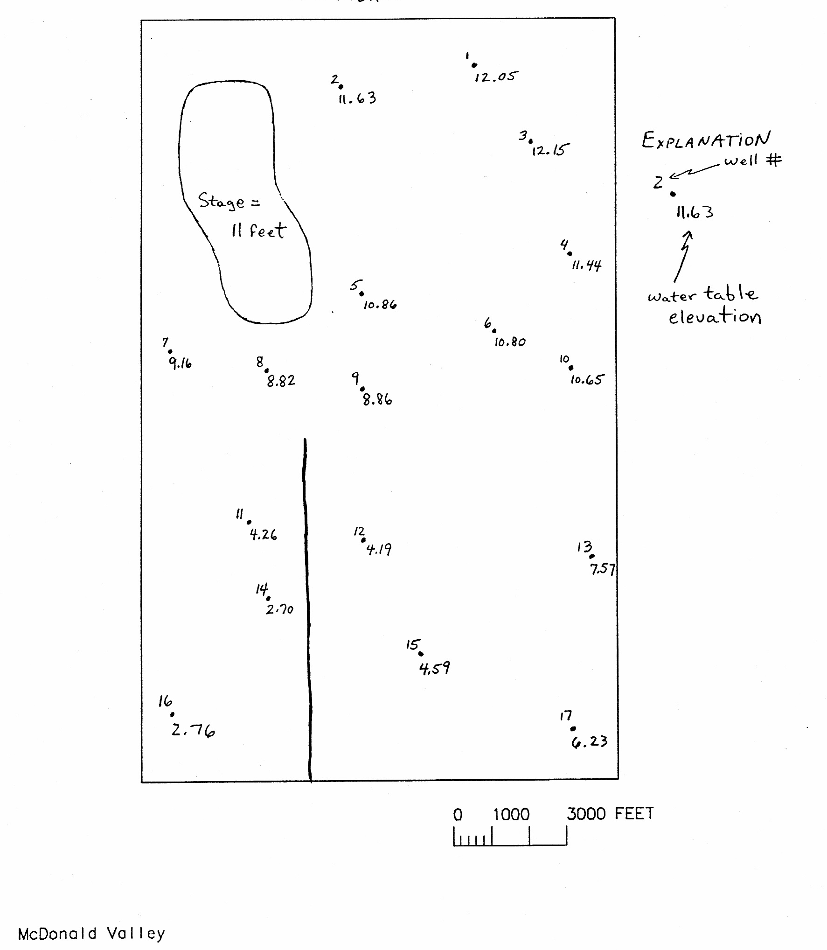
McDonald Valley Study Area Information
Contains unconsolidated valley-fill alluvium (sands/gravels)
No hydraulic tests but estimated K ranges from 10-500 ft/day
Low permeability lake clay in some boreholes
Valley has 17 existing observations wells

Slide 7
McDonald Valley Study Area Information
Figure 2 – Topographic Map of McDonald Valley
No significant seasonal or short-term fluctuations in conditions
Mean annual precipitation of 36 in/year
No surface-water inflow
Straight River
Streamflow gages at Pollock’s for and down stream end (884,494 ft³/s)
Headwater stage = 1.8 ft
Downstream stage = 0 ft
Gradient is 0.0002 ft/ft
100 ft wide and 1 ft deep
Lake
Harbaugh
L & H Lounge

Slide 8
McDonald Valley Study Area Information
Figure 2 – Topographic Map of McDonald Valley
Lake Harbaugh
Stage = 11 ft
Uniform water depth of 16 ft
Area of the lake = 1.625 x 10⁷ ft²
Lake Evaporation = 27 in/year (2.25 ft/year)
Precipitation = 36 in/year (3 ft/year)
No surface-water inflow
Steep sloping shore
Sandy bottom
Lake
Harbaugh
L & H Lounge

Slide 9
Stage 1 – Planning Phase
Figure 2 – Topographic Map of McDonald Valley
Develop a conceptual model
Contour water level data
Elements of the system that are important?
Decide how to model features
Decide what boundary conditions to use
Decide what vertical discretization to use
Decide how to represent the Lake
Constant Head Boundary
General Head Boundary
High hydraulic conductivity
Decide how to represent recharge
Lake
Harbaugh
L & H Lounge

Slide 10
Stage 1 – Planning Phase
Figure 2 – Topographic Map of McDonald Valley
Each team designs an approach for simulating McDonald Valley. After about 1 hour we will reconvene as a class and discuss the design plans.
Lake
Harbaugh
L & H Lounge

Slide 12
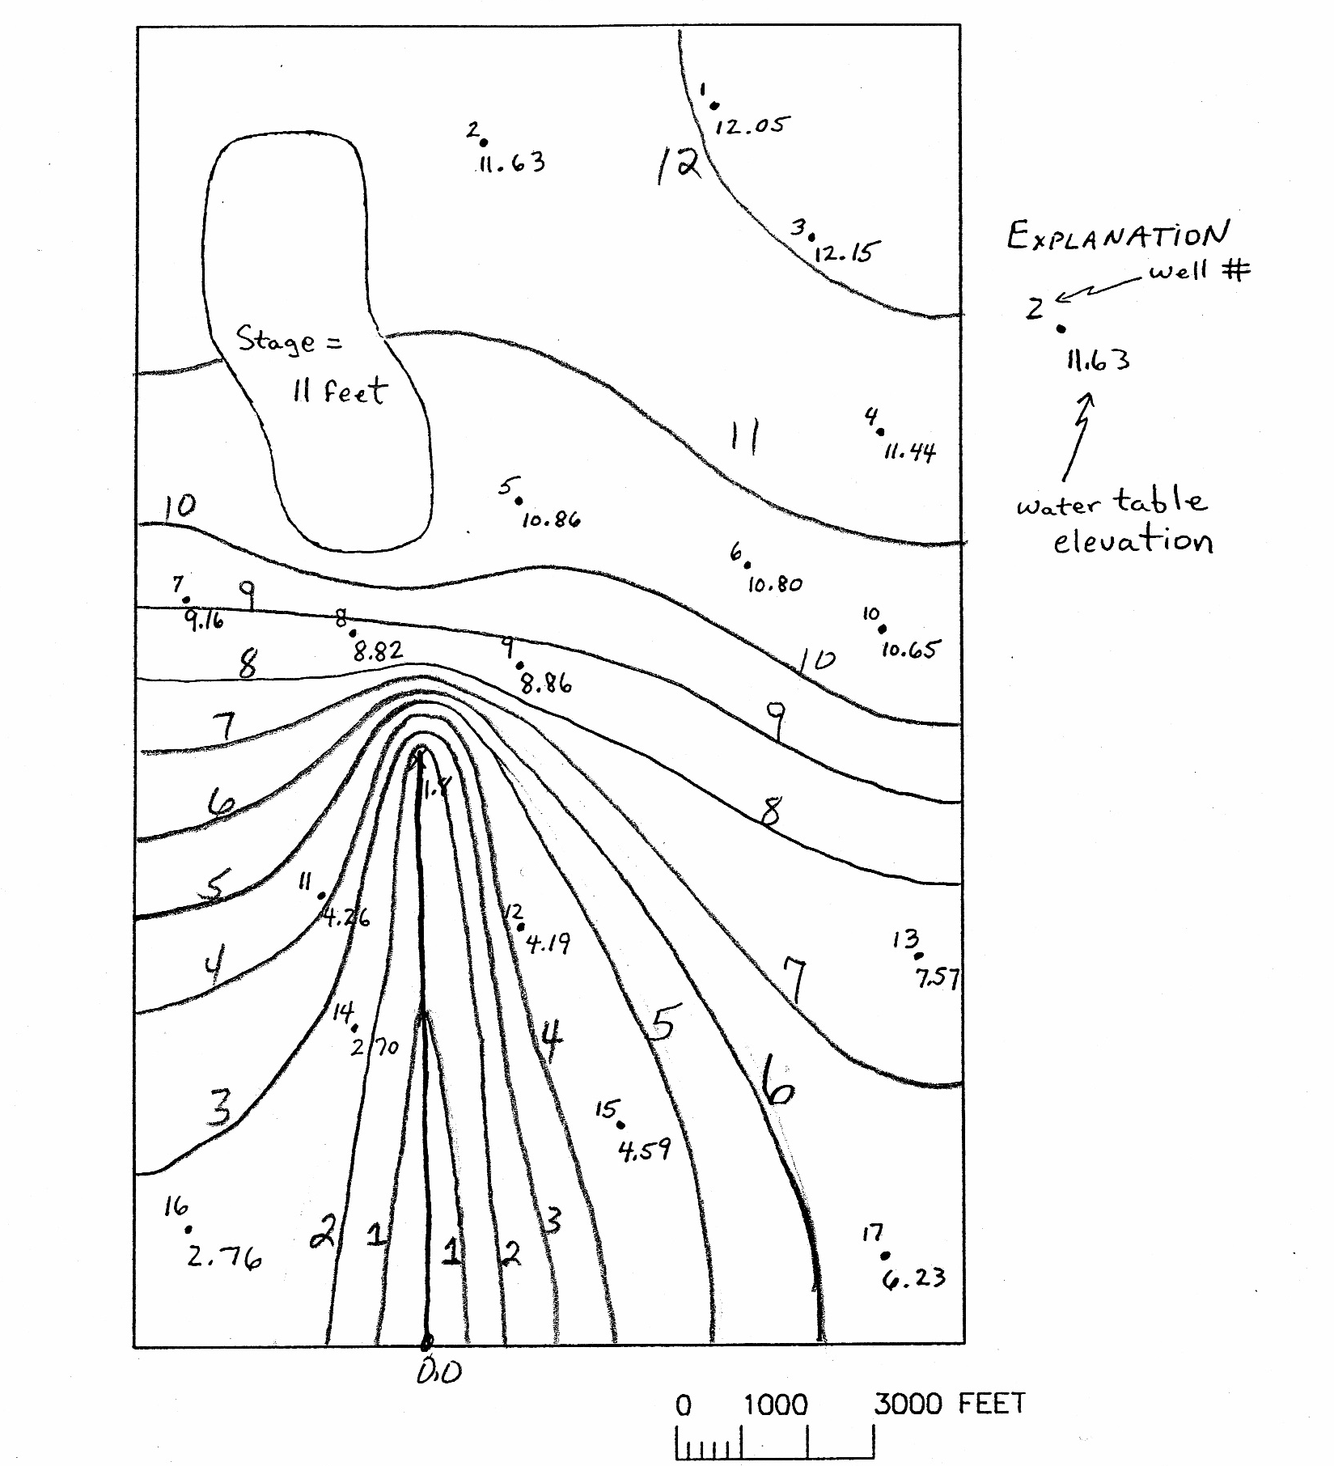
Stage 1 – Planning Phase
Figure 2 – Topographic Map of McDonald Valley
Lake
Harbaugh
L & H Lounge

Slide 13
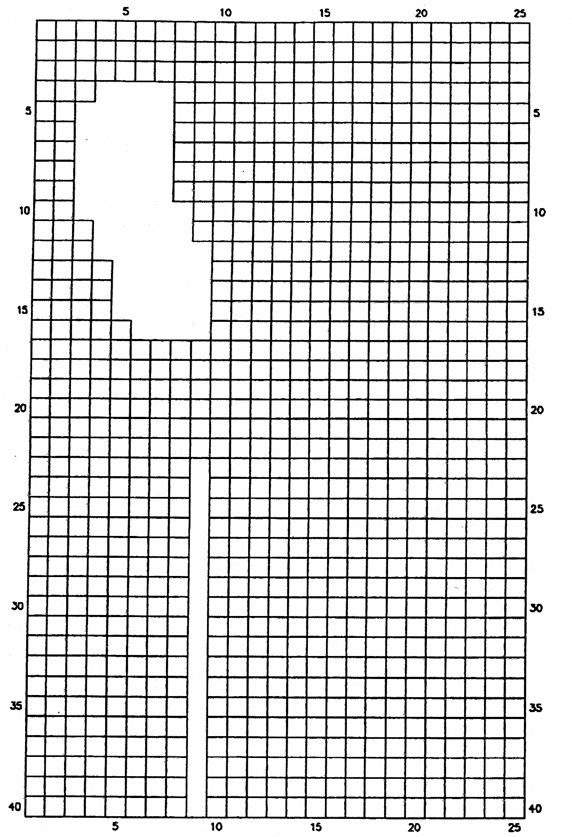
Stage 1 – Planning Phase
Net groundwater recharge
Downstream flow = net groundwater recharge
Net groundwater recharge (I_{total}) = 888,494 ft³/d
I_{total} = I_{lake} + I_{land}
Water budget
Q_{ds} = Q_{lake} + Q_{land}
Q_{lake} = A_{lake} I_{lake} = A_{lake} (R_{lake} – E_{lake}) = A_{lake} (36 in/y – 27 in/y) = 9 A_{lake}
Q_{land} = A_{land} I_{land} = A_{land} (R_{land} – ET_{land}) = A_{land} (36 in/y – ET_{land})
Simplify
ET_{land} = ( 9 A_{lake} + 36 A_{land} – Q_{ds} ) / A_{land}

Slide 14
Stage 1 – Planning Phase
Net groundwater recharge – cont.
Unit conversion (convert to feet and days)
ET_{land} = ( 0.0021 A_{lake} + 0.0082 A_{land} – 888,494 ) / A_{land}
Horizontal areas
A_{total} = 500 ft x 500 ft x 40 x 25 = 250,000,000 ft²
A_{lake} = 16,250,000 ft²
A_{land} = A_{total} – A_{lake} = 233,750,000 ft²

Slide 15
Phase 1 – Planning Phase
Calculated evapotranspiration rates
ET_{land} = ( 0.0021 A_{lake} + 0.0082 A_{land} – 888,494 ) / A_{land}
ET_{land} = ( 34,125 + 1,916,750 – 888,494 ) / 233,750,000
ET_{land} = 1,062,381 / 233,750,000 = 0.0045 ft/d = 19.921 in/yr
Calculated net recharge rates
I_{land} = (0.0082 – 0.0045) = 0.0037 ft/day = 16.217 in/yr
I_{lake} = 0.0021 ft/day = 9 in/yr
Calculated evapotranspiration/rainfall ratio
ET_{land} / R_{land} = 0.0045 / 0.0082 = 54.88 %
Elake / Rlake = 0.0062 / 0.0082 = 75.12 %

Slide 16
Stage 1 – Planning Phase
Figure 2 – Topographic Map of McDonald Valley
Discussion
How did you decide to represent the lake?
Constant Head Boundary
General Head Boundary
High hydraulic conductivity
How does this affect how you apply recharge?
Lake
Harbaugh
L & H Lounge

