Slide 1
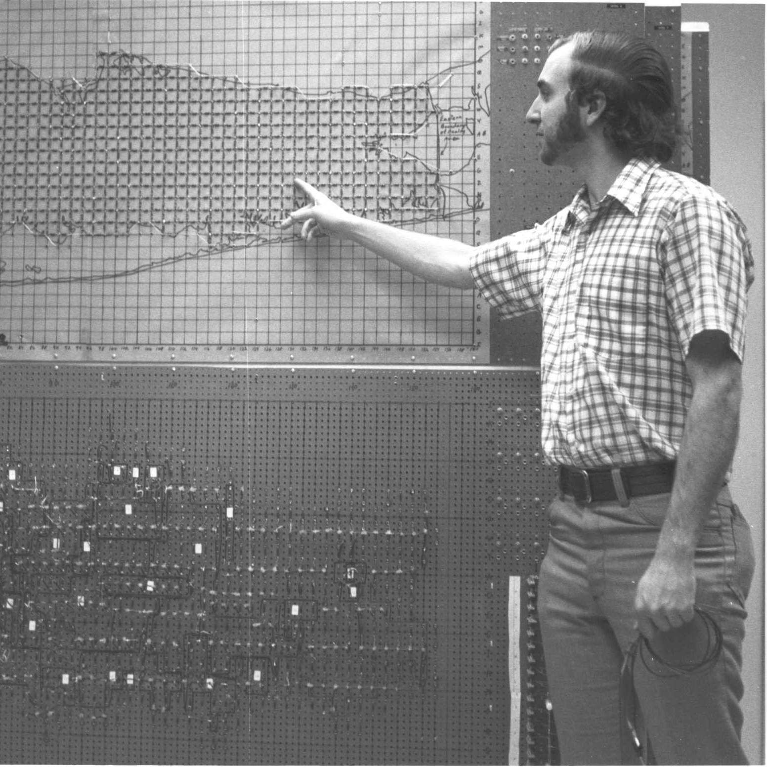
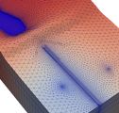
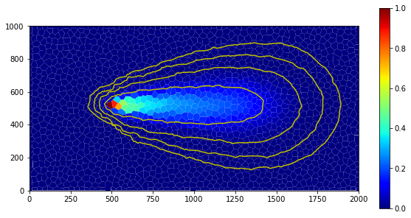
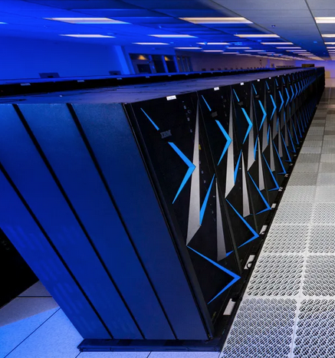


Parallel MODFLOW on Denali
Parallel MODFLOW Training Class, July 13-14, 2023, Lakewood, CO

Slide 2
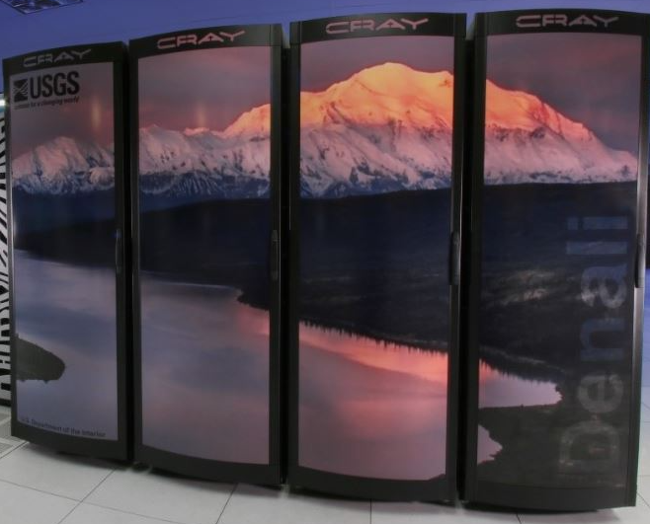
Denali
Interactive jobs
~>salloc --partition=workq --account=training –reservation=modflow --ntasks=2 --time=00:05:00
~>module load modflow/6.4.2
~>parallel-modflow6-class/examples/par_gwf01-1d/
~>srun –n 2 mf6 -p
https://hpcportal.cr.usgs.gov/training/courses/Intro_to_HPC/Running_Jobs/interactive.html

Slide 3

Denali
Batch jobs
#!/bin/bash
#SBATCH --job-name=par_gwf01-1d
#SBATCH --nodes=1
#SBATCH --ntasks=2
#SBATCH --account=training
#SBATCH --time=00:02:00
#SBATCH --output=slurm-%j.out
# load appropriate modules
module load modflow/6.4.2
# run example
srun mf6 -p
~>sbatch --account=training --reservation=mudflow slurm.batch
SLURM Commands
~>squeue –u username
~>scancel –u username
~>scancel jobid
https://hpcportal.cr.usgs.gov/training/courses/Intro_to_HPC/Running_Jobs/sbatch.html

