Slide 1
Hands-On Exercise
Coupling of two adjacent models

Slide 2
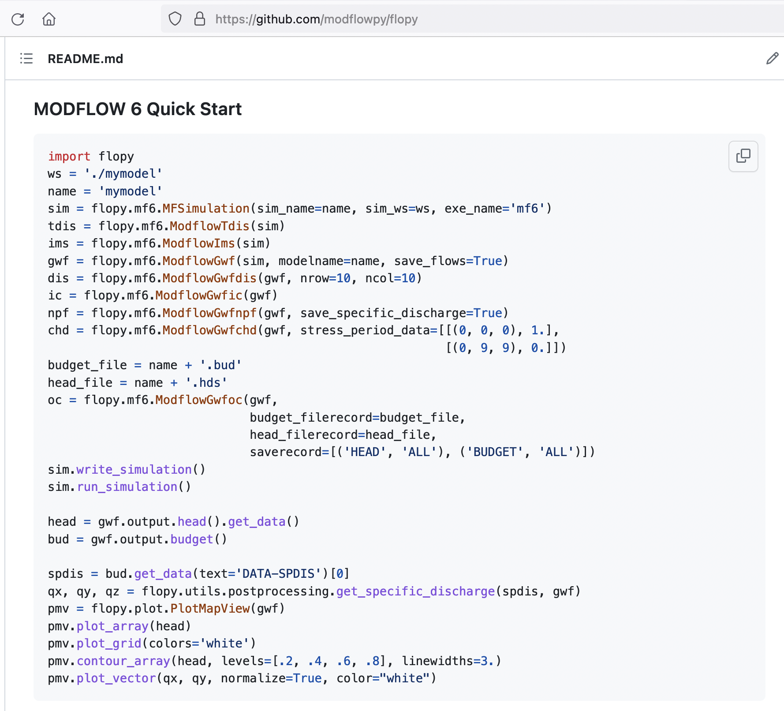
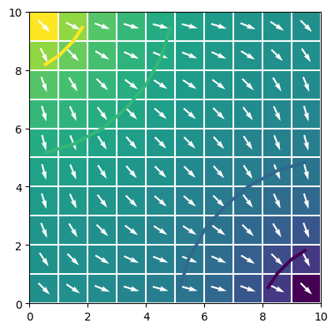
FloPy Quickstart

Slide 3
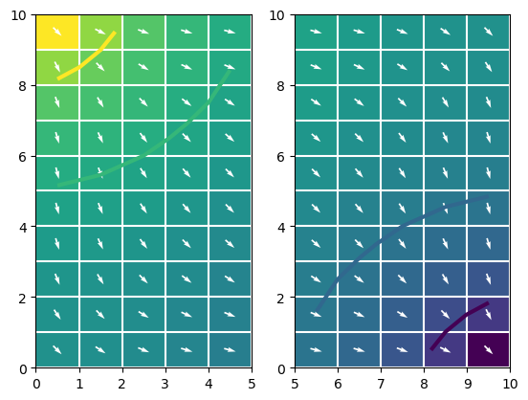
Exercise: Split Model into Two Connected Models

Slide 4
Exercise Workflow
Step 0 – Start up a fresh notebook
Step 1 – Copy and run the quickstart example from the FloPy website (quickstart1)
Step 2 – Modify the script to create two disconnected models: a left model and a right model (quikstart2)
Create “left” model and “right” model
Modify plot to show both models
Step 3 – Connect the two GWF Models (quickstart3)
Add GWF-GWF exchange using: flopy.mf6.ModflowGwfgwf

Slide 5
Hands-On Exercise
Local Grid Refinement (LGR)

Slide 6
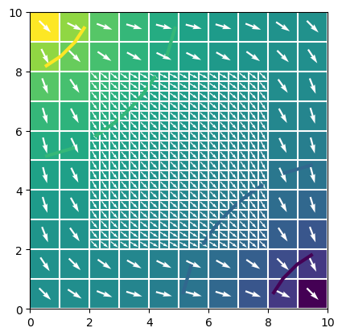
Exercise: Construct an LGR Simulation

Slide 7
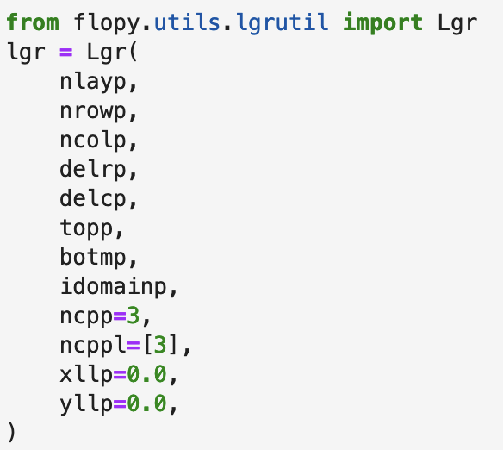
flopy.utils.lgrutil.Lgr
FloPy utility for helping create child grid and exchange data

Slide 8
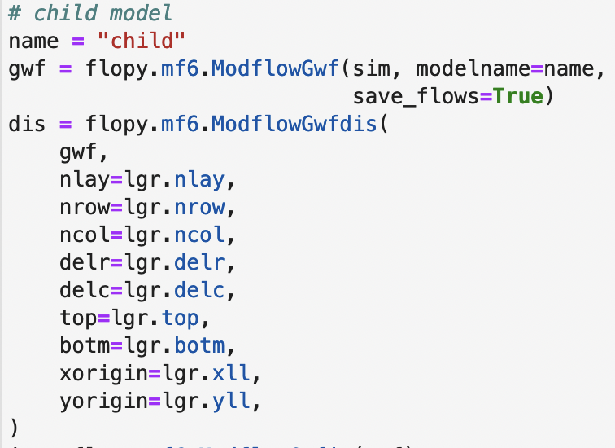
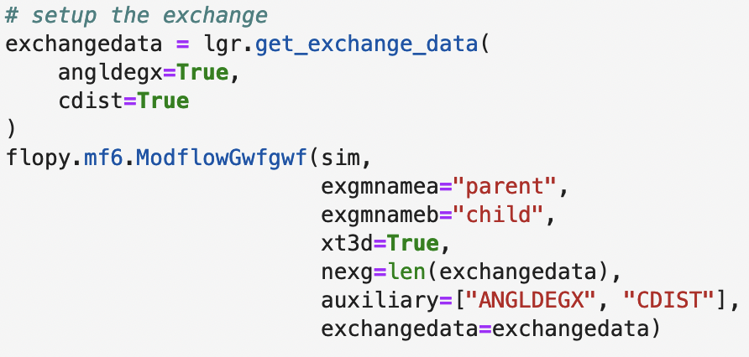
flopy.utils.lgrutil.Lgr

Slide 9
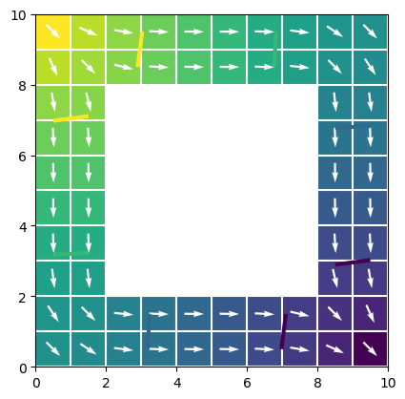
Exercise Workflow
Step 0 – Start up a fresh notebook
Step 1 – Copy and run the quickstart example from the FloPy website (lgr1)
Step 2 – Use IDOMAIN to zero out the middle part of the grid (which will be replaced next with an inset model), and run the simulation (lgr2)
Step 3 – Create an LGR Simulation (lgr3)
Use the flopy.utils.lgrutil.Lgr to help construct an inset child model
Add GWF-GWF exchange (parent-child) using: flopy.mf6.ModflowGwfgwf

