Slide 1
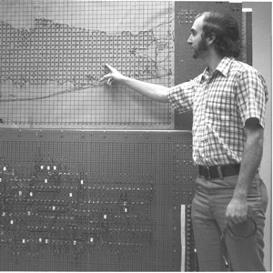
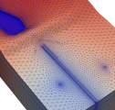
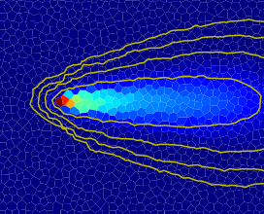
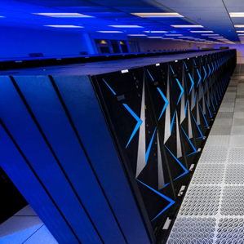


MODFLOW 6 Multi-Model Coupling
Parallel MODFLOW Training Class, July 13-14, 2023, Lakewood, CO

Slide 2
Exchanges
SOLUTION
MODEL
EXCHANGE
MODEL

Slide 3
GWF-GWF Exchange
Numerical Solution
GWF Model 1
GWF-GWF Exchange
GWF Model 2

Slide 4
MODFLOW 6 GWF-GWF Exchange
Can be used to make hydraulic connections between cells in different models
User provides a list of cells and connection information in a file of type GWF6-GWF6, which is specified in the EXCHANGES block of the simulation name file

Slide 5
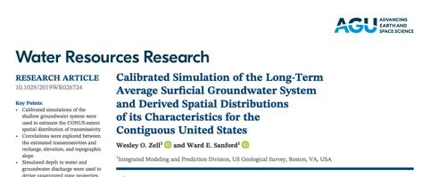
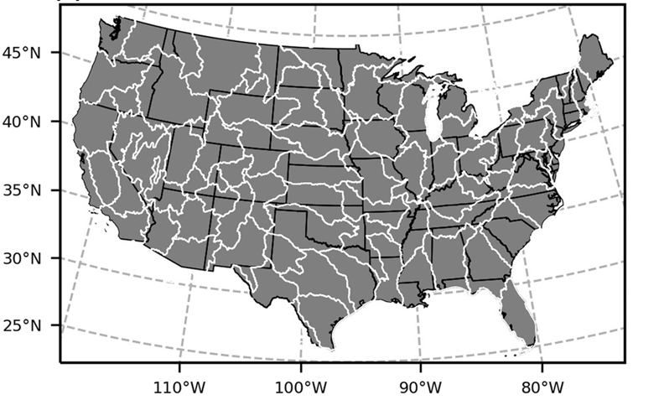
GWF-GWF Applications
Local grid refinement (LGR)
Coupling adjacent groundwater models

Slide 6
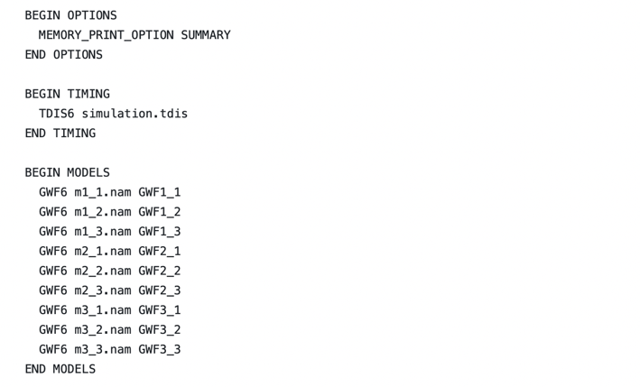
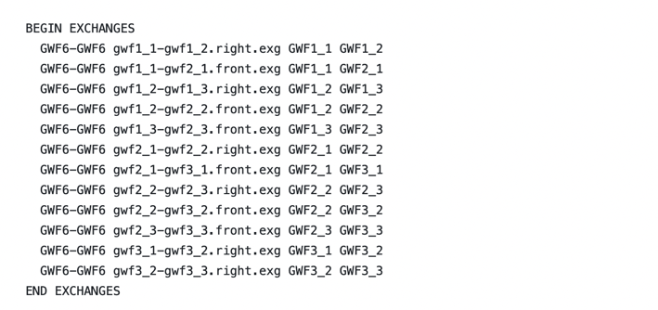

Multi-Model Simulation
GWF1_1
GWF1_2
GWF1_3
GWF2_1
GWF2_2
GWF2_3
GWF3_1
GWF3_2
GWF3_3

Slide 7
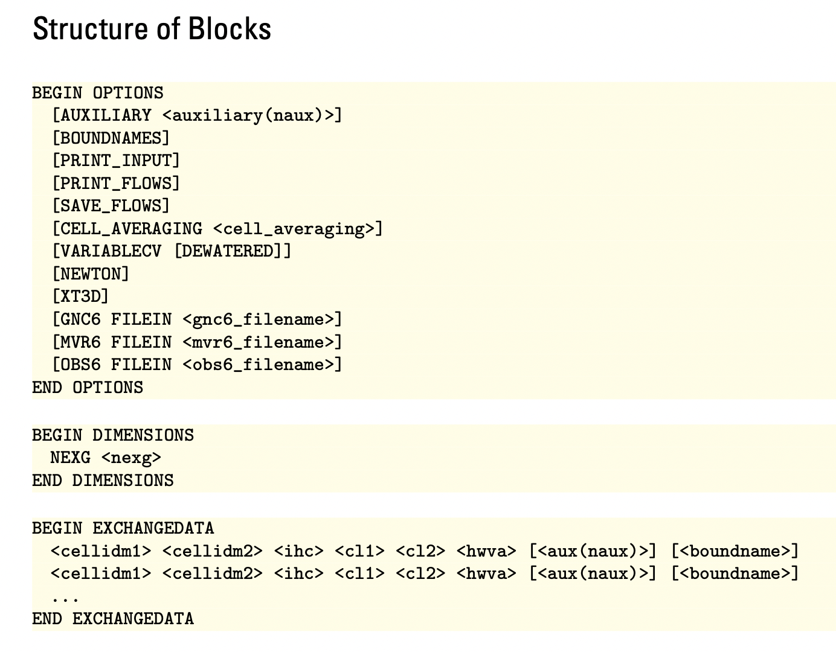
GWF6-GWF6 Exchange Input File
# File generated by Flopy version 3.4.2.dev0 on 07/12/2023 at 07:30:42.
BEGIN OPTIONS
AUXILIARY ANGLDEGX CDIST
END OPTIONS
BEGIN DIMENSIONS
NEXG 10
END DIMENSIONS
BEGIN EXCHANGEDATA
# cellid1 cellid2 ihc cl1 cl2 hwva angldegx cdist
1 1 5 1 1 1 1 0.50 0.50 1.000 0.000000 1.000
1 2 5 1 2 1 1 0.50 0.50 1.000 0.000000 1.000
1 3 5 1 3 1 1 0.50 0.50 1.000 0.000000 1.000
1 4 5 1 4 1 1 0.50 0.50 1.000 0.000000 1.000
1 5 5 1 5 1 1 0.50 0.50 1.000 0.000000 1.000
1 6 5 1 6 1 1 0.50 0.50 1.000 0.000000 1.000
1 7 5 1 7 1 1 0.50 0.50 1.000 0.000000 1.000
1 8 5 1 8 1 1 0.50 0.50 1.000 0.000000 1.000
1 9 5 1 9 1 1 0.50 0.50 1.000 0.000000 1.000
1 10 5 1 10 1 1 0.50 0.50 1.000 0.000000 1.000
END EXCHANGEDATA

Slide 8
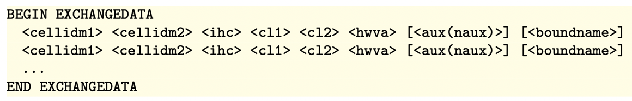
GWF-GWF “EXCHANGEDATA”
Model 1
Model 2

Slide 9
GWF-GWF “EXCHANGEDATA”
Model 1
Model 2
cellidm1 = (layer, row, col)

Slide 10
GWF-GWF “EXCHANGEDATA”
Model 1
Model 2
cellidm2 = (layer, row, col)

Slide 11
GWF-GWF “EXCHANGEDATA”
Model 1
Model 2
ihc = “is horizontal connection”
= 0 (vertical connection)
= 1 regular horizontal connection
= 2 “staggered” horizontal connection

Slide 12
GWF-GWF “EXCHANGEDATA”
Model 1
Model 2
cl1 = connection length for model 1
cl1

Slide 13
GWF-GWF “EXCHANGEDATA”
Model 1
Model 2
cl2 = connection length for model 2
cl2

Slide 14
GWF-GWF “EXCHANGEDATA”
Model 1
Model 2
hwva = “horizontal width or vertical flow area”
hwva

Slide 15
GWF-GWF “EXCHANGEDATA”
Model 1
Model 2
aux = for most simulations, users will need to specify two “auxiliary variables”: angldegx and cdist

Slide 16
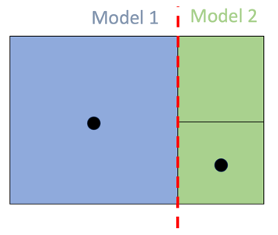
GWF-GWF “EXCHANGEDATA”
Model 1
Model 2
angldegx = angle of an “outward normal of the shared face” relative to the x axis (between 0 and 360 degrees)
x axis

Slide 17
GWF-GWF “EXCHANGEDATA”
Model 1
Model 2
cdist = connection distance. Distance between the two nodes.
cdist

Slide 18
Horizontal Connections: Map View
Model 1
Model 2
hwva
cl1
cl2
ihc = 1 or 2 (horizontal connection)

Slide 19
Connection Types
Model 1
Model 2
Model 1
Model 2
TOP
TOP
BOT
BOT
ihc = 2
ihc = 1
“vertically staggered”

Slide 20
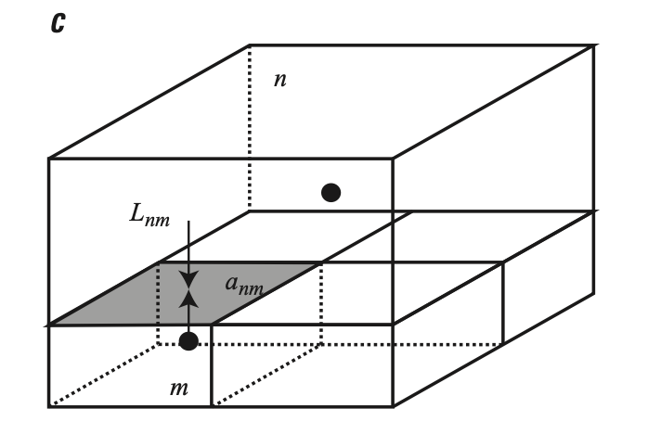
Vertical Connections
ihc = 0
hwva is the area of the connection
cl1 is the half cell thickness of the cell in model 1
cl2 is the half cell thickness of the cell in model 2

