Slide 1

A TEI Web Annotator
Demonstration and Architecture
Annotator Software by Claudius Teodorescu
eXist server-side code by Joe Wicentowski and Dan McCreary
Thanks to Joe Wicentowski for funding and the sample TEI files

Slide 2



Introductions
Dr. Joe Wicentowski, Historian
US Department of State Department of the Historian
TEI, XQuery, XSLT, URL Rewriting, CSS, Lucene indexing, search, e-Pub, document publishing
Claudius Teodorescu, Web Developer
(X)HTML, CSS, JavaScript, XForms, XQuery, XPath, XSLT, XProc, XML, XML Schema, SVG, PHP, SQL, Java
Dan McCreary, Web Application Architect
XML, XQuery, XForms, XRX, Semantic Web, SVG, SQL, XML Schema, XSLT, UNIX

Slide 3
Project Scope
Create a web-based tool for adding and editing TEI annotations from TEI text stored in an XML database (eXist)
Leverage an existing frameworks of web-based rich-text editors (XForms, XSLTForms, eXSLTForms, and CKEditor)
Make it easy for non-programmers to configure and customize
Create a proof of concept with 20 sample annotators for the most common TEI elements

Slide 4
Customization Goals
Create a TEI annotator framework that is easy for non-programmers (with about a day of training) to customize
A single XML file specification file will configure the behavior of all TEI annotators
Users should be able to customize simple annotators by just changing the XML file
Complex dialog panels from a library of panels will also be configurable
Make it easy to integrate with server-side ID services by just specifying the REST URL

Slide 5
Basic TEI Annotator Types
Inserters – inserts new TEI element at the cursor selection point
Example: line break
Simple Wrappers – wraps TEI content around the selected text but no parameters
Examples: bold, italic, underline, strikethrough
Dialog Wrappers – wraps TEI content around the selected text and then prompts users for parameters
Example: dates
Dialog Wrappers with Services – wraps that need to use an external web service to get an authoritative list of identifiers
Examples: person, term, geo-location, links

Slide 6
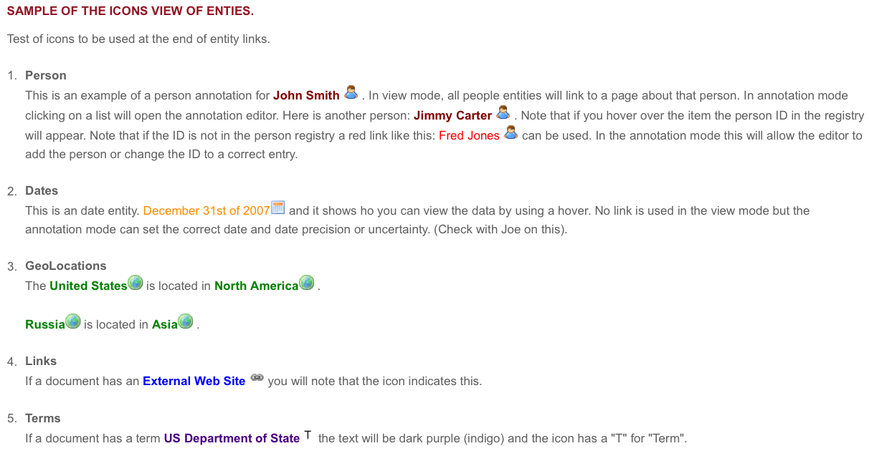
TEI Annotations
Inline annotations such as People, Dates, Places, Links, Terms
Not just the fact that this text is a person…but a specific person

Slide 7
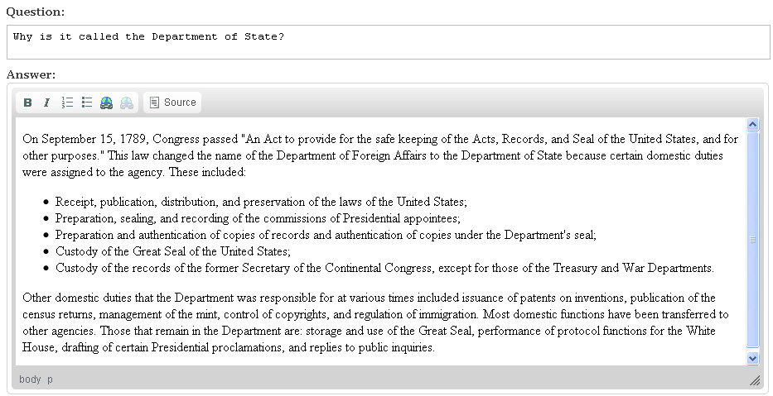
Example Mature Web-Based Editor: CKEditor
Standard HTML editor within a web page.
Uses <div> tags to edit HTML within and HTML page.

Slide 8
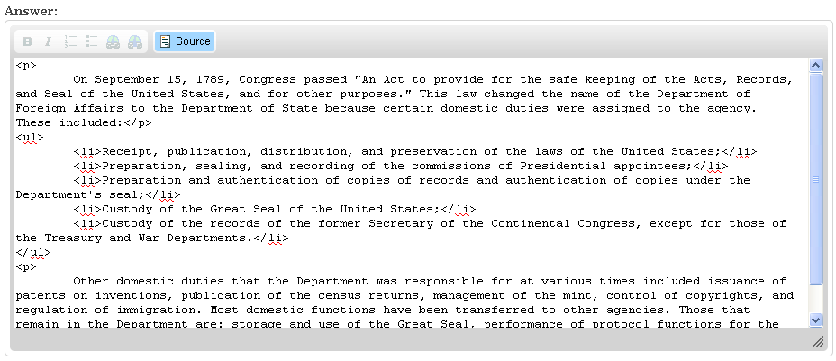
Source View of CKEditor

Slide 9
CKEditor Add-on Architecture
CKEditor already works within XSLTForms using eXSLTForms Rich Text Editor extensions (no JavaScript required!)
Build a simple "plugin" extension of the existing CKEditor, a popular and well-maintained open source editor
Code base is continually updated to support new browser features and extensions
Features allow users to define custom <div> tags

Slide 10
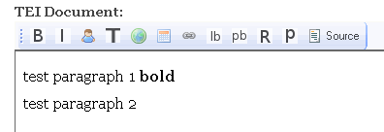
TEI "Toolbar"

Slide 11
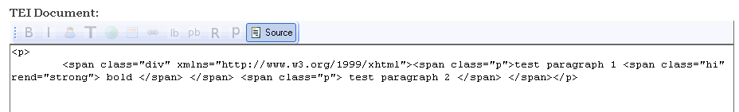
Source View of TEI
Note the use of HTML span tags for all TEI elements. This
Is not TEI native markup, only an encoding of TEI elements so they can be edited by CKEditor

Slide 12
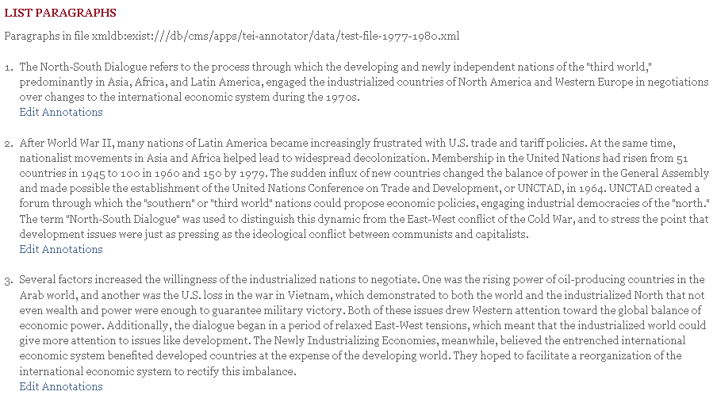
Sample List of TEI Test Paragraphs
Clicking on this link will open this paragraph in Edit mode

Slide 13
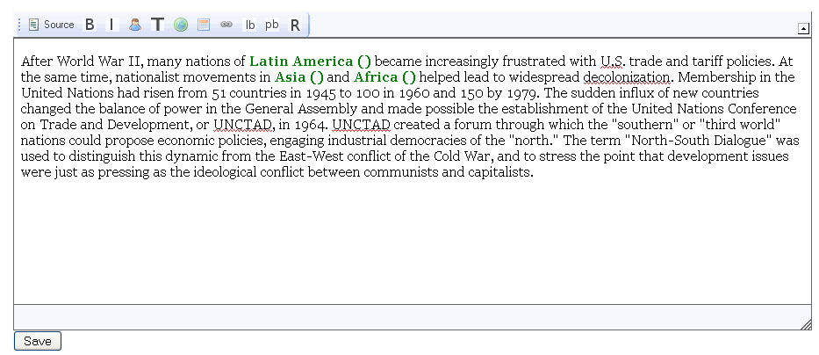
Sample CSS Coloring
This can be easily customized by a single CSS file. (link)

Slide 14
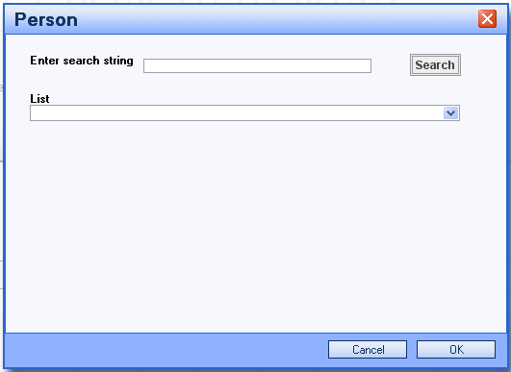
Sample Person ID for Test
How do we add a person ID in the TEI tag?
Answer: The person selector annotator.
This is tied to the person search service.
For testing and demos we will just have a very short list of names. In production we will have 20,000+ names so we will be an AJAX as-you-type selector.

Slide 15
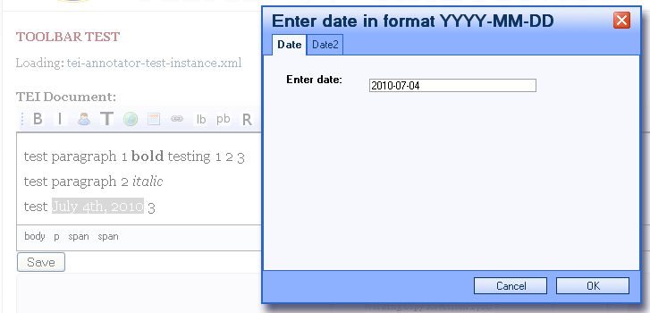
Highlight a Date

Slide 16
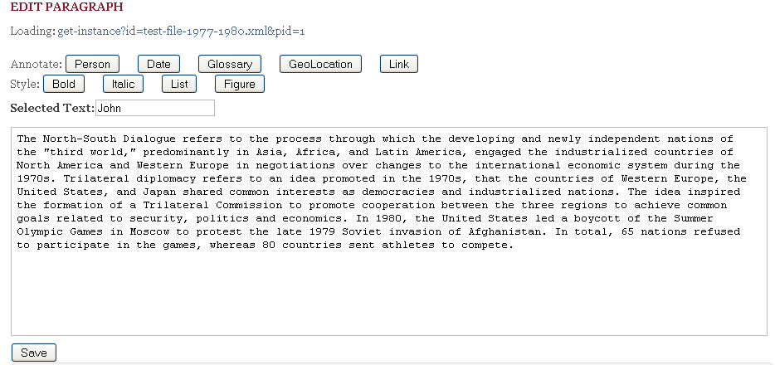
Sample UI Mockup
These will be icons
Just for testing
This will be rich text

Slide 17
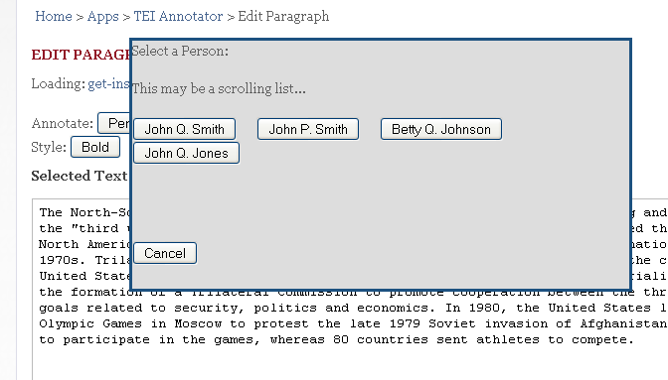
Sample Person Selector

Slide 18
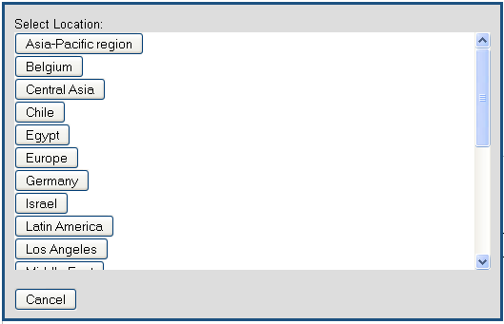
Selecting Geolocations

Slide 19
Functions on Model Dialog Panels
Tab 1 – suggested item
Tab 2 – search for item ("starts with" and "contains" options)
Tab 3 – create a new item – if you can not find an existing person/term/location you might be able to create one right here.
Suggestions
Search
Create New
Item 1
Item 2
Item 3
Item 4

Slide 20
Entity ID Services
Joe has already written an entity services that will support these annotators:
Each returns a series of "items" with label/value pairs (like XForms select items)
XForms "submissions" load the results of these searches into an instance

Slide 21
Get Entities REST parameters
get-entities.xq?entity=people&q=keyword&type=prefix
Entity
Type
(people, term, geolocation)
Keyword
Search Type
(prefix, contains)

Slide 22
Code Fragment from Server-Side
let $hits := if ($type = 'prefix') then $data-collection//item[starts-with(lower-case(label), $q)] (: for anything other than prefix we do a contains :) else $data-collection//item[contains(lower-case(label), $q)] return <results> <entity>{$entity}</entity> <type>{$type}</type> <q>{$q}</q> <items>{ for $hit in $hits let $label := $hit/label/text() order by $label return $hit } </items> </results>

Slide 23
Sample Results from Entity ID Service
<results> <entity>people</entity> <type>contains</type> <q>e</q> <items> <item> <value>sakharov-andrei</value> <label>Andrei Sakharov</label> </item> <item> <value>rockefeller-david</value> <label>David Rockefeller</label> </item> <item> <value>carter-jimmy</value> <label>Jimmy Carter</label> </item> <item> <value>reagan-ronald</value> <label>Ronald Reagan</label> </item> <item> <value>brzezinski-zbigniew</value> <label>Zbigniew Brzezinski</label> </item> </items> </results>

Slide 24
Transforms to and from CKEditor
CKEditor (WYSIWYG View)
TEI XML in eXist
before editing
XHTML
tei-2-xhtml.xq
Save
TEI XML in eXist after
editing
xhtml-2-tei.xq
We transform the TEI tags into XHTML span tags when we need to edit in the browser
We also need to convert XHTML to TEI when the user does a save
All transforms done by easy-to-maintain XQuery typeswitch transforms

Slide 25
Sample Encoded POST data and Decoded ready to Store in eXist
<echo-post-data> <incomming-post-data> <data> <description>Test Data Set. The text uses encoded XML to test the TEI annotator.</description> <text>&lt;div&gt; &lt;p&gt; test paragraph 1 &lt;hi rend="strong" &gt; bold &lt;/hi&gt; testing 1 2 3 &lt;/p&gt; &lt;p&gt; test paragraph 2 &lt;hi rend='italic'&gt; italic &lt;/hi&gt; &lt;/p&gt; &lt;p&gt; test paragraph 3 &lt;/p&gt; &lt;/div&gt;</text> </data> </incomming-post-data> <decoding-of-post-data> <div> <p> test paragraph 1 <hi rend="strong"> bold </hi> testing 1 2 3 </p> <p> test paragraph 2 <hi rend="italic"> italic </hi> </p> <p> test paragraph 3 </p> </div> </decoding-of-post-data>
</echo-post-data>

Slide 26
Display in HTML Options
Your TEI to HTML tei:render module should has a configuration options to generate both the read-only and annotation views.
In general readers do not want to see the annotations, or they should be unobtrusive.
Entities that have IDS and do not have proper entries in the registries can be highlighted in red or have a broken link icon

Slide 27
Overview of Steps
View document (read only HTML viewer)
Select section or paragraph that you want to annotate
Select "Edit Annotations" button near text
View Paragraph in Rich Text Editor with icons for annotation types in a tool-bar ribbon
Select text
Select Annotation type (Person, Date, Term etc.)
Enter data on model window
Save form data to database

Slide 28
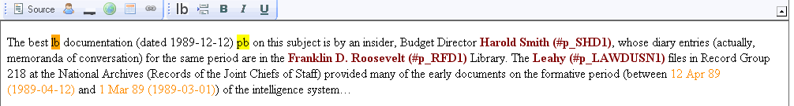
Sample User Interface Options
Shows Person IDs

Slide 29
Sample Annotator Configuration File
<Annotator id="teiannBoldBtn" name="hi" typeCode="selected-wrap">
<AnnotatorDescriptionText>Wrap bold tags around the selected text.</AnnotatorDescriptionText> <AnnotatorPossibleParentElementNames>teiHeader p div</AnnotatorPossibleParentElementNames> <AnnotatorPossiblePrecedingSiblingElementNames/> <AnnotatorIconName>bold.gif</AnnotatorIconName> <AnnotatorAttribute name="rend" value="strong"/>
</Annotator>
Rules to enable buttons
Before:
Selected word that will be highlighted in bold.
After:
Selected <hi rend="strong">word<hi> that will be highlighted in bold.

Slide 30
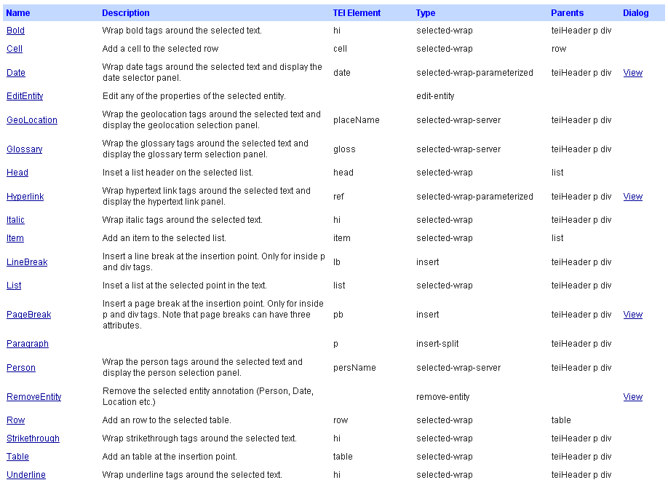
Sample Annotators

Slide 31
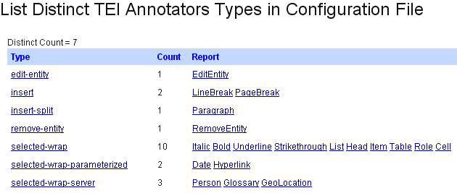
Type Report

Slide 32
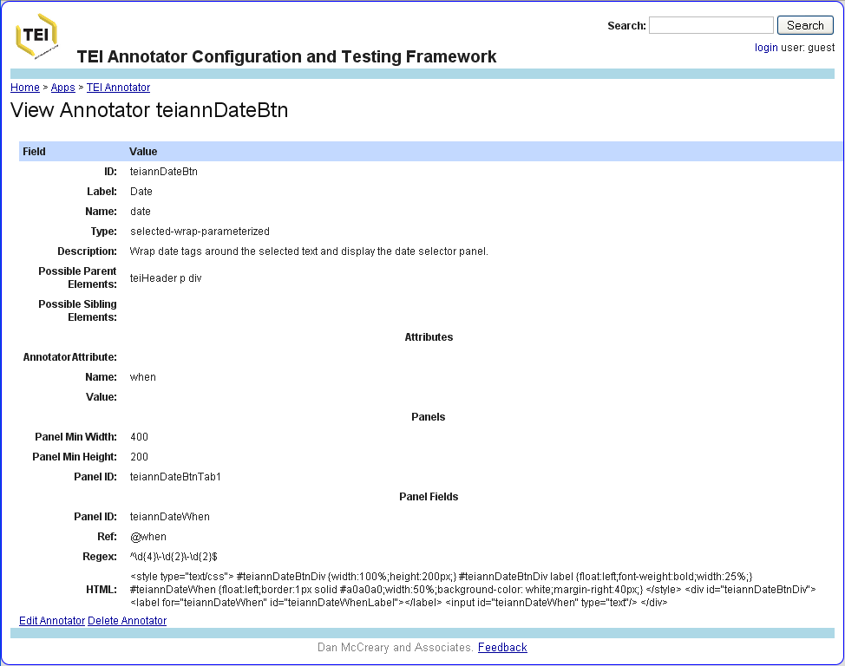
Annotator HTML Viewer

Slide 33
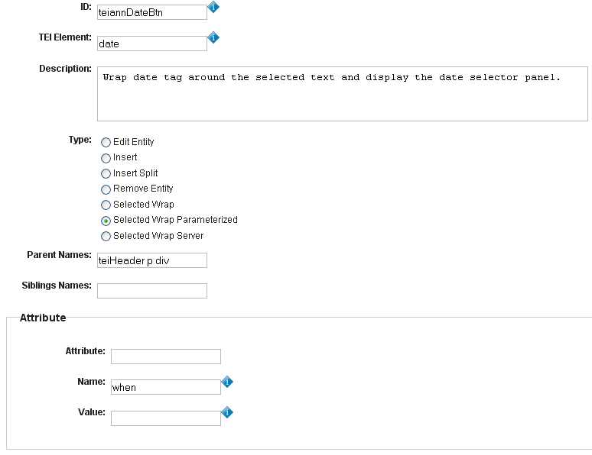
Annotator Edit Form
All options displayed for
demo purposes only.

Slide 34
Annotator Panels
<AnnotatorPanel> <AnnotatorPanelMinWidth>400</AnnotatorPanelMinWidth> <AnnotatorPanelMinHeight>200</AnnotatorPanelMinHeight> <AnnotatorPanelTab id="teiannHyperlinkBtnTab1"> <AnnotatorPanelField id="teiannHyperlinkTarget"> <AnnotatorPanelFieldRef>@target</AnnotatorPanelFieldRef> <AnnotatorPanelFieldValidationRegex/> </AnnotatorPanelField> <AnnotatorPanelTabHtmlContent> &lt;style type="text/css"&gt; #teiannHyperlinkBtnDiv {width:100%;height:200px;} #teiannHyperlinkBtnDiv label {float:left;font-weight:bold;width:25%;} #teiannHyperlinkTarget {float:left;border:1px solid #a0a0a0;width:50%;background-color: white;margin-left:50px;} &lt;/style&gt; &lt;div id="teiannHyperlinkBtnDiv"&gt; &lt;label for="teiannHyperlinkTarget" id="teiannHyperlinkTargetLabel"&gt;&lt;/label&gt; &lt;input id="teiannHyperlinkTarget" type="text"/&gt; &lt;/div&gt; </AnnotatorPanelTabHtmlContent> </AnnotatorPanelTab>
</AnnotatorPanel>
Form CSS
Form Labels and Inputs
You can also specify how the dialog panels will work. Note that the config file currently stores the HTML content in "escaped" format.

Slide 35
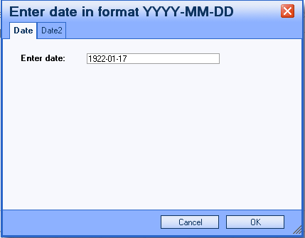
Sample Date Selector Dialog
The CSS section determines positioning, fonts, colors etc
The form part determines the input

Slide 36
Logical Model
Config
File
TEI Annotators
Dialog Panel
1 to 1
Tab
Field
1 to Many
Each Dialog Panel could have multiple tabs and each tab could have many fields
The Edit form currently only supports 1 to 1

Slide 37
ID Services Dialogs
Many TEI annotations allow you to put in identifiers to unique items in a reference database
Examples:
<persName corresp="NRM1">President Nixon</persName>
<term xml:id="ABC1">ABC</term>
<note xml:id="d3fn4" n="4">
<pb xml:id="pg_XXVI" n="XXVI" facs="page-134.jpg" />
<div type="section" xml:id="preface">

Slide 38
Configuring ID Services
Each Annotator has an element to use to store a REST interface for a service.
<AnnotatorIDServiceURI>
/rest/db/dma/apps/tei-annotator/services/suggest-person.xq?prefix=
</AnnotatorIDServiceURI>
Each service must return XML using standard XForms item label/item pairs.
<item>
<label>Display this Label</label>
<value>insert-this-value</value>
</ item >

Slide 39
Example of ID Service Response
<results> <entity>person</entity> <description>Case insensitive last name starts with query.</description> <duration>-PT0.187S</duration> <prefix>Abe</prefix> <items> <item> <label>Abercrombie, Neil</label> <value>400001</value> </item> <item> <label>Abercrombie, James</label> <value>400675</value> </item> <item> <label>Abercrombie, John</label> <value>400676</value> </item> </items> </results>

Slide 40
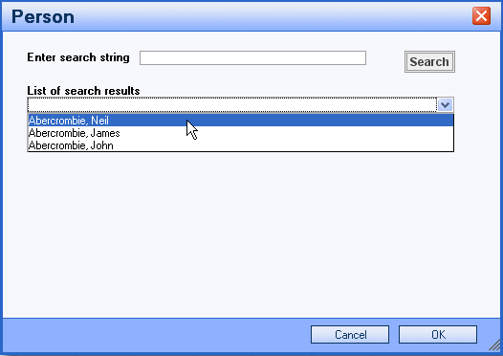
Selection List of Search Results
This interface may use a scrolling list of items in the future

Slide 41
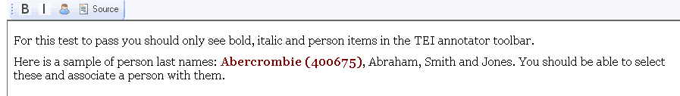
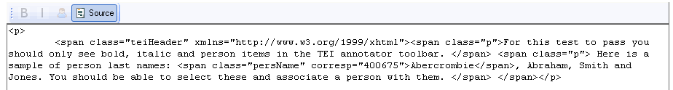
Viewing Source
View Source
Person ID Inserted
You can verify that the correct person ID has been inserted by clicking on the "Source" button

Slide 42
Questions for Discussion
What should the "Enter" (Carriage Return) key do?
In traditional word processors it would add a new paragraph
Annotators may not want this function
Make sure your users understand what they intend to do and that your preferences are configured to do this

Slide 43
Code to Add Paragraph on Enter
See CKEditor configuration file options
See plugin.js line 24…
//overriding the current behavior of Enter key
editor.on( 'key', function( ev ) {
var keyCode = ev.data.keyCode;//alert( ev.data.name );
if ( keyCode == 13 ) {
ev.cancel();
editor.execCommand( 'teiannParagraphBtn' );
}
});

Slide 44
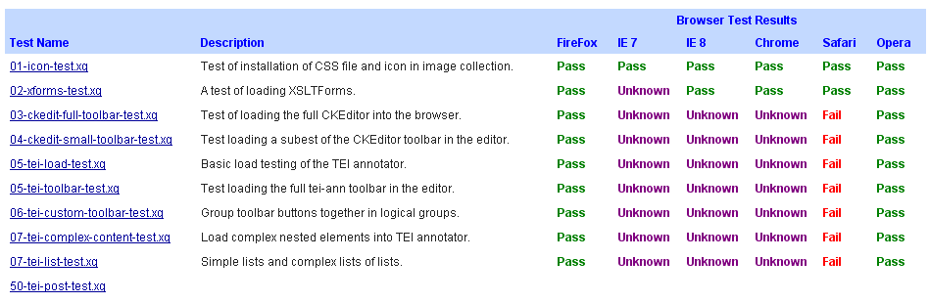
Unit Testing Example
Note that we now know why Webkit (IE and Safari) were not passing tests.

Slide 45
Sample To Do List
Testing and Debugging
Documentation of configuration file options
Testing of Annotators on multiple browsers
Development of custom annotators library
Provide samples of complex annotators
Integration with eXist role-based authentication and workflows for use in public "Crowd sourcing" of TEI documents
Extend XForms editor for the Annotator Specification files to support multiple tabs in dialog panel

