Slide 2
IQVIA Primary Slide Bank
DO NOT MODIFY
REUSE OR COPY THE SLIDE(S) YOU NEED OR SAVE TO YOUR COMPUTER
January 01, 2026

Slide 3
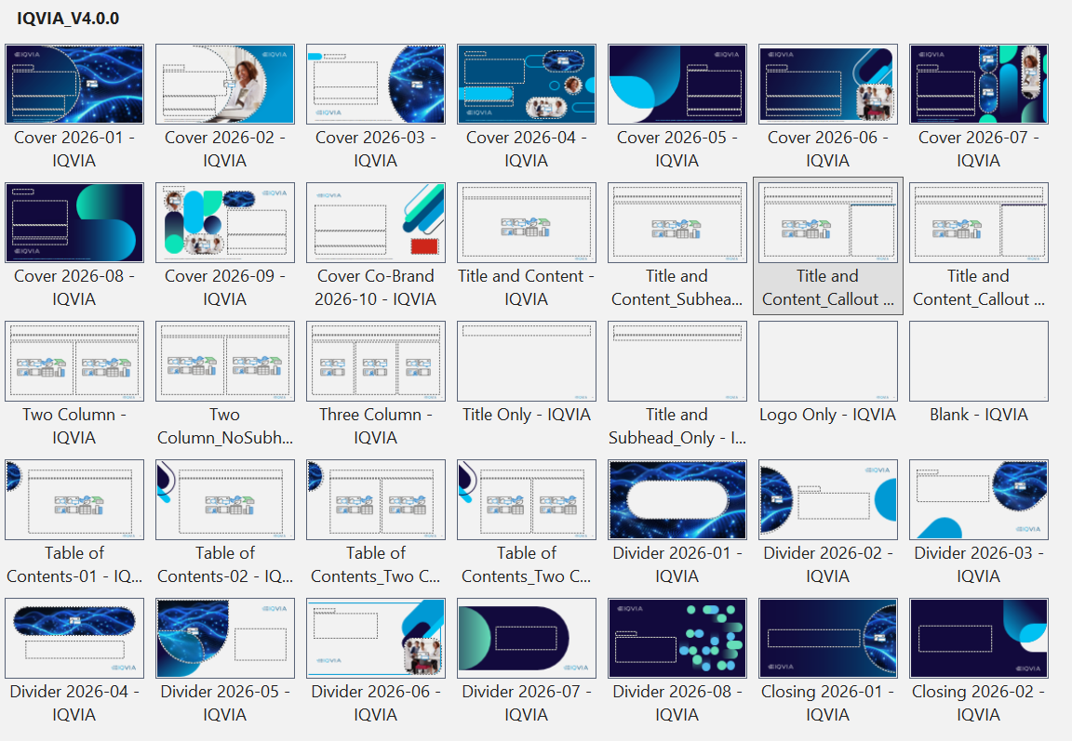
Welcome to the new PowerPoint IQVIA V4.0.0 template
Updated slide designs are available from the “Layout” dropdown in the ribbon
Broader swatch samples are now available off the slide canvas →
100% 50% 75% 25%
Bright Blue
Indigo
Bright Teal
Emerald
Bright Green
Red
5% Charcoal

Slide 4
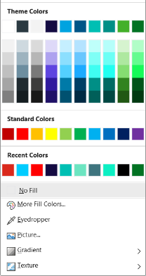
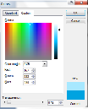
Colors within PowerPoint
100% 50% 75% 25%
In the right margin of each Layout, there are IQVIA color palette swatches with all the colors and tinted values. To use, select the Eyedropper from the Theme Colors menu and click the swatch that you would like to use
Use these colors in the vertical order they appear. Try to only use the 100% tint values
IQVIA color palette
Bright Blue
DO NOT use these colors because these are not IQVIA brand colors
Indigo
Bright Teal
Emerald
Use the eyedropper tool to select from the
Bright Green
Do NOT use the Transparency function. Transparent colors do not print correctly from PPT or render correctly in PDFs. Make colors lighter by dragging the arrow next to the hue bar up instead
Red
5% Charcoal
Notes:
PowerPoint presentations are widely used across IQVIA, so understanding the appropriate use of colors within PowerPoint is important.
There are approved Corporate PowerPoint Templates for each IQVIA brand that can be found in Brand World. The IQVIA Brand & Creative Studio makes annual updates to every PowerPoint template, so you should always make sure you are using the latest PowerPoint template.
Only the top row of the PowerPoint drop-down color palette contains IQVIA colors. All the variations under it should NEVER be used since these are Microsoft approximations to our colors that are NOT part of our palette.
In the right margin of each PowerPoint slide, there are IQVIA color palette swatches with all the colors and tinted values.
To use, select the Eyedropper from the Theme Colors menu and click the swatch that you would like to use.
Use these colors in the vertical order they appear. Only use the 100% tint values
Do NOT use the Transparency function. Transparent colors do not print correctly from PPT or render correctly in PDFs. Make colors lighter by dragging the arrow next to the hue bar up instead.

