Slide 1

The Product Launcher Suite
TechIQ 2026
From new product to ready sellers — faster Every day between a new product and a ready sales team is lost revenue.

Slide 2
Where Launches Lose Time
Subject matter experts have little time to advise Sales Enablement
Sales managers are stretched thin by ride-alongs, meetings, and admin
Researching and designing new training takes weeks
Building slide decks is slow
Instructors cost money — and only speak one language Result: launches slip, and revenue slips with them
© 2026. All rights reserved. IQVIA® is a registered trademark of IQVIA Inc. in the United States, the European Union, and various other countries.

Slide 3
Build Training Faster
Researcher
gathers trusted source material on a new topic in minutes, not days
Course Designer
turns those sources into a course outline, slides, and instructor notes, dramatically faster
© 2026. All rights reserved. IQVIA® is a registered trademark of IQVIA Inc. in the United States, the European Union, and various other countries.

Slide 4
Make Every Deck Look Right
Deck Re-Styler
converts a finished deck into your company's own template
Add a PPTX Template Style
teach the system a new brand template once, then reuse it every time
© 2026. All rights reserved. IQVIA® is a registered trademark of IQVIA Inc. in the United States, the European Union, and various other countries.

Slide 5
Deliver to Every Seller
Available instantly
Speaks and translates slides in 16 languages
No instructor fees One-to-one marketing, at any hour
Answers questions and helps qualify prospects
Course Publisher
publishes a course to a live AI teacher
Presenter
an AI presenter for your products and services
© 2026. All rights reserved. IQVIA® is a registered trademark of IQVIA Inc. in the United States, the European Union, and various other countries.

Slide 6
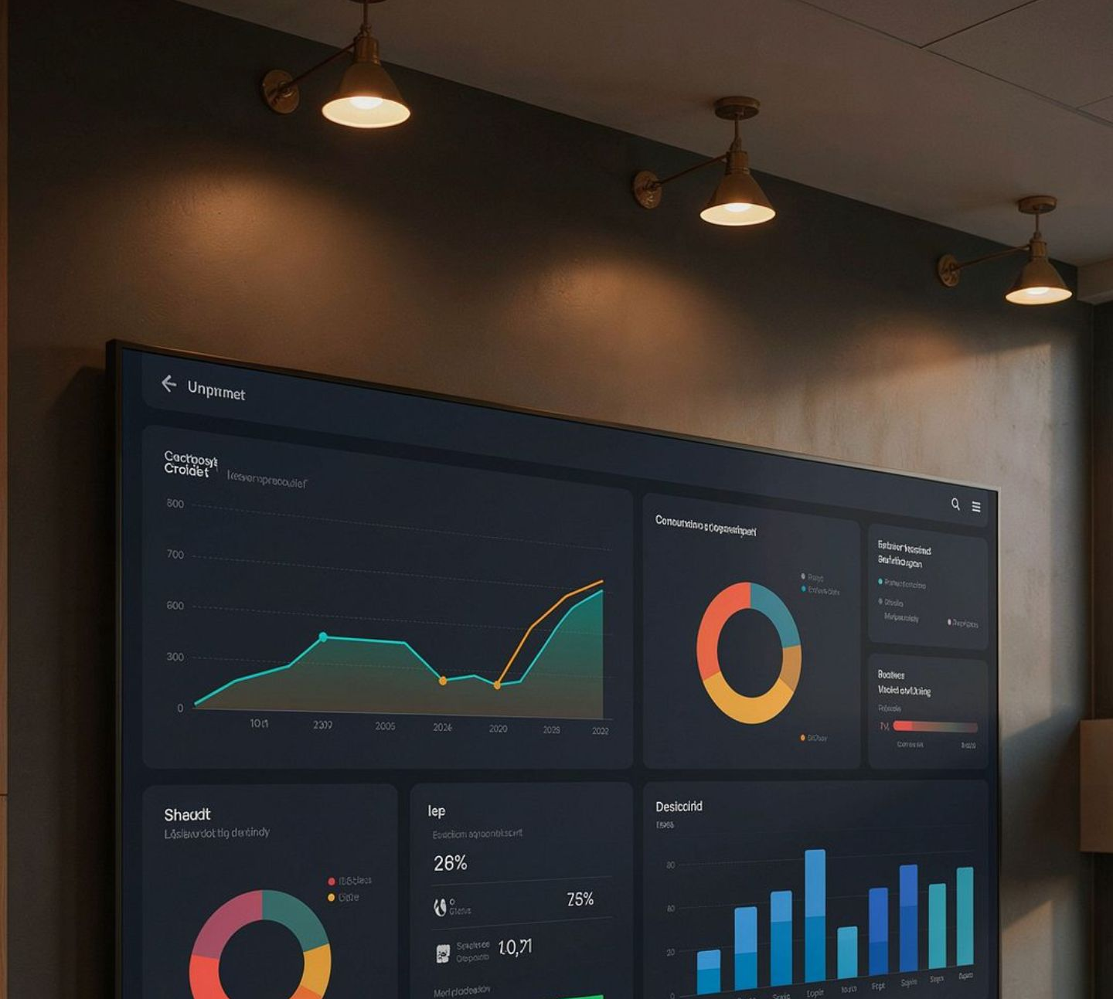
See What's Working
Dashboard — shows each course, each learner, and where they are Know who is ready before launch day
© 2026. All rights reserved. IQVIA® is a registered trademark of IQVIA Inc. in the United States, the European Union, and various other countries.

Slide 7
Digital Teammates
Digital SMEs
your experts' knowledge, available whenever Sales Enablement needs it, so launch materials aren't delayed
Digital Sales Managers
extend each manager's coaching to every seller, one by one, so sales are maximized
© 2026. All rights reserved. IQVIA® is a registered trademark of IQVIA Inc. in the United States, the European Union, and various other countries.

Slide 8
Create Capacity, Then Grow
Frees people for higher-value, revenue-producing work
Example: IKEA turned about 8,500 freed-up roles into interior designers — adding over a billion in new sales
TaskMappr
interviews employees to map current jobs and the time each task takes, then plans AI to remove lower-level work
MasterMind Group
customer personas and digital teammates (SMEs, sales managers, finance) brainstorm new products, services, new logos, and ways to grow revenue
© 2026. All rights reserved. IQVIA® is a registered trademark of IQVIA Inc. in the United States, the European Union, and various other countries.

Slide 9

Start With One Launch
© 2026. All rights reserved. IQVIA® is a registered trademark of IQVIA Inc. in the United States, the European Union, and various other countries.

