Slide 1

What Do You Know About Your Rights at Work?
TechIQ 2026
You work here starting today — or you have for years. Either way, this course puts the policies you need in plain language. By the end, you will know exactly what to do and who to call in any situation.

Slide 2
What We Will Cover Together
Module 1
Your employment relationship and who is protected
Module 2
Harassment, discrimination, retaliation, and how to report
Module 3
Pay, classification, timekeeping, and conduct
Module 4
Safety, time off, and your legal rights
© 2026. All rights reserved. IQVIA® is a registered trademark of IQVIA Inc. in the United States, the European Union, and various other countries.

Slide 3

Employment At-Will — What It Means for You
At J. F. Pennebaker Co., employment is at-will: either you or the company may end the relationship at any time, with or without cause, with or without notice.
No manager, handbook language, or verbal promise can change that.
Only ONE exception exists: a signed written agreement made by the CEO or President. If no one handed you that document, you are at-will.
© 2026. All rights reserved. IQVIA® is a registered trademark of IQVIA Inc. in the United States, the European Union, and various other countries.

Slide 4

The Handbook Is Not a Contract
This handbook is a set of guidelines — it is not a promise of employment for any set period.
The company may update policies at any time. Written changes will be shared with all employees.
Verbal statements cannot alter what is written here.
© 2026. All rights reserved. IQVIA® is a registered trademark of IQVIA Inc. in the United States, the European Union, and various other countries.

Slide 5

Who Is Protected Here
The company is an equal opportunity employer. Every employment decision is based on merit.
Protected categories include: race, color, religion, national origin, sex (including pregnancy, sexual orientation, and gender identity), age 40 or older, disability, genetic information, military or veteran status, and more.
Association counts too: discrimination based on your connection to someone in a protected category is also prohibited.
Pay discrimination is prohibited. You may lawfully discuss your wages with coworkers.
© 2026. All rights reserved. IQVIA® is a registered trademark of IQVIA Inc. in the United States, the European Union, and various other countries.

Slide 6
Your First Point of Contact
• For any policy question, concern, or accommodation request, reach out to:
• Melissa Massey — m.massey@johnpennebaker.com
678-546-8858
TAKEAWAY
© 2026. All rights reserved. IQVIA® is a registered trademark of IQVIA Inc. in the United States, the European Union, and various other countries.

Slide 7

Who the Anti-Harassment Policy Covers
This policy covers everyone in the workplace environment.
Employees, supervisors, managers, vendors, customers, contractors, and other third parties — all of them.
Applicants, unpaid interns, and volunteers are protected too.
No one is outside this policy.
© 2026. All rights reserved. IQVIA® is a registered trademark of IQVIA Inc. in the United States, the European Union, and various other countries.

Slide 8
Two Types of Sexual Harassment — Know the Difference
Note: sexual harassment does not require sexual motivation — hostile conduct based on gender alone violates policy.
Quid pro quo
A benefit is offered or a threat is made in exchange for sexual attention.
Examples: offering better shifts for sexual favors; threatening termination for refusing an advance.
Hostile work environment
Unwelcome conduct based on a protected class that is severe or pervasive enough to affect working conditions.
Examples: slurs, offensive jokes, unwanted touching, derogatory images or gestures.
© 2026. All rights reserved. IQVIA® is a registered trademark of IQVIA Inc. in the United States, the European Union, and various other countries.

Slide 9

Retaliation Is Prohibited
Reporting discrimination, harassment, suspected fraud, or unethical conduct is protected.
Participating in an investigation is protected.
The company will not tolerate retaliation from any source — managers, coworkers, or third parties.
One limit: knowingly filing a false, bad-faith report is not protected conduct.
© 2026. All rights reserved. IQVIA® is a registered trademark of IQVIA Inc. in the United States, the European Union, and various other countries.

Slide 10
How to Report a Concern
Go to your direct supervisor, any member of management, or Melissa Massey.
If your complaint involves your direct supervisor, skip that person and go directly to another manager or Melissa Massey.
Be as detailed as possible: describe what happened, who was involved, and who witnessed it.
Written complaints are preferred but not required.
Investigations are thorough, objective, and kept confidential to the extent possible.
© 2026. All rights reserved. IQVIA® is a registered trademark of IQVIA Inc. in the United States, the European Union, and various other countries.

Slide 11
Melissa Massey — Report Here
• To report any concern or file a complaint, contact:
• Melissa Massey — m.massey@johnpennebaker.com
678-546-8858
TAKEAWAY
© 2026. All rights reserved. IQVIA® is a registered trademark of IQVIA Inc. in the United States, the European Union, and various other countries.

Slide 12
Requesting an Accommodation
Need an adjustment for a disability, pregnancy, or religious belief? Contact Melissa Massey — written requests are preferred.
The company engages in a two-way interactive process to find a workable solution.
Under the federal Pregnant Workers Fairness Act, leave is not automatically required if another reasonable accommodation is available.
No one will be retaliated against for requesting an accommodation.
GINA reminder: do not share family medical history or genetic test results when responding to any company medical information request.
© 2026. All rights reserved. IQVIA® is a registered trademark of IQVIA Inc. in the United States, the European Union, and various other countries.

Slide 13

Scenario Drill — Module 2 Activity
You have just learned about quid pro quo harassment, hostile work environment harassment, and retaliation.
Your instructor is ready to walk through some real-world situations with you.
Ask your instructor to run the scenario drill when you are ready to begin.
You will identify what type of situation is described and say what you would do next.
© 2026. All rights reserved. IQVIA® is a registered trademark of IQVIA Inc. in the United States, the European Union, and various other countries.

Slide 14
Your Employment Classification
Your classification determines your overtime eligibility and your access to benefits.
Full-Time Non-Exempt
40 or more hours per week — eligible for overtime and company benefits.
Part-Time Non-Exempt
Fewer than 40 hours per week — eligible for overtime, generally no company benefits.
Temporary
Hired for a specific task — no company benefits, does not convert to full-time by passage of time.
Exempt
Salaried, meets federal and state exemption criteria — not eligible for overtime, receives company benefits.
© 2026. All rights reserved. IQVIA® is a registered trademark of IQVIA Inc. in the United States, the European Union, and various other countries.

Slide 15
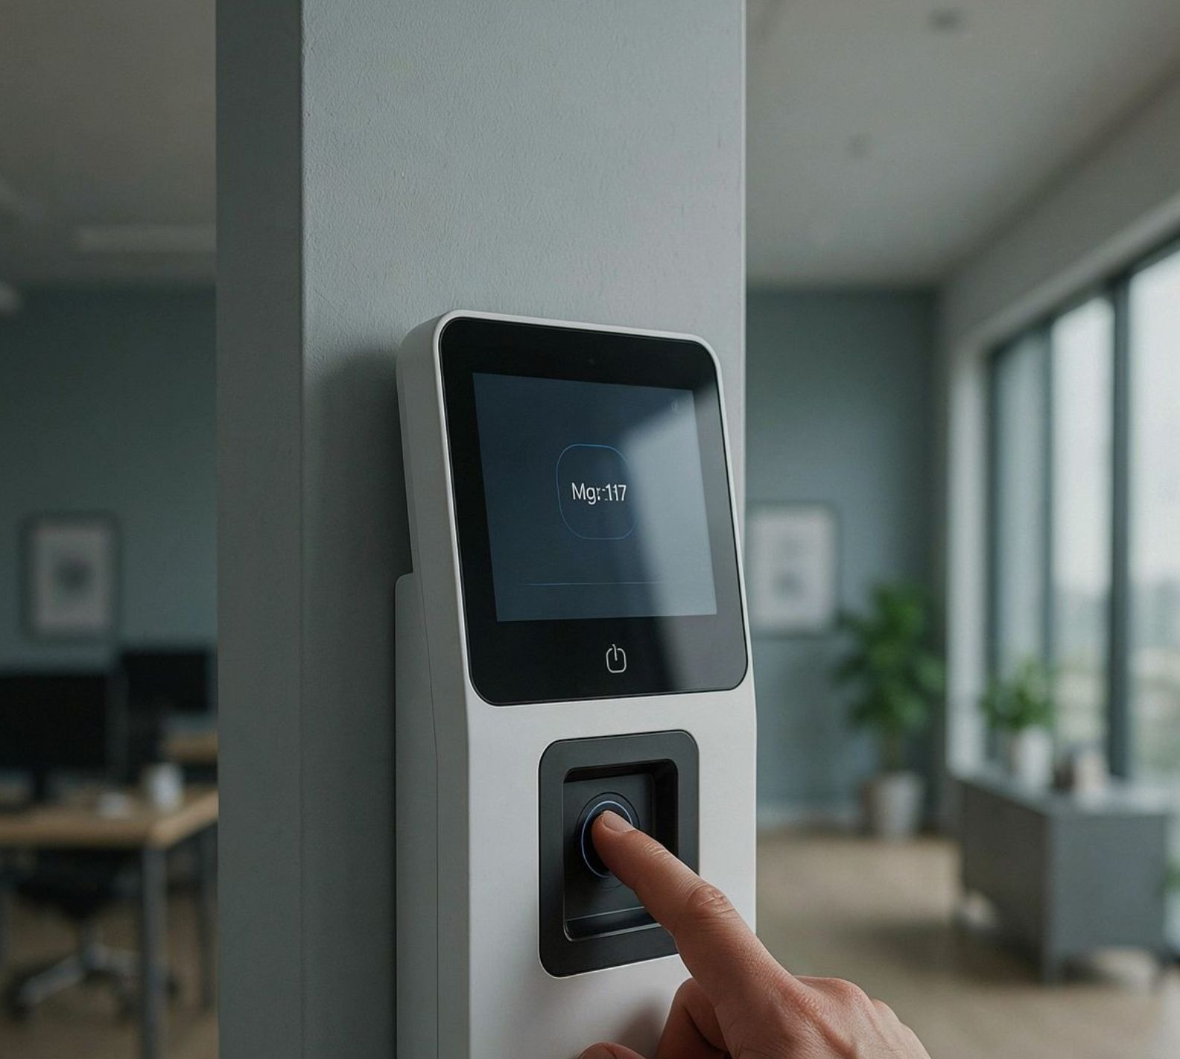
Overtime, Timekeeping, and the Workweek
The fixed workweek is 168 consecutive hours — workweeks cannot be averaged together.
Non-exempt employees must record all hours worked. Working off the clock is never permitted, for any reason.
Exempt employees receive a salary. If you believe a deduction was made in error, report it — the company has a safe harbor policy to correct improper deductions.
Nursing employees: the company provides reasonable break time and a private, non-bathroom space to express milk.
© 2026. All rights reserved. IQVIA® is a registered trademark of IQVIA Inc. in the United States, the European Union, and various other countries.

Slide 16

Conduct, Confidentiality, and Company Systems
Be at your assigned work area, ready to work, when your shift starts. Notify your supervisor as early as possible if you will be late or absent.
Company computers, email, and communications tools are not private. The company may monitor them at any time. Use them for business purposes.
Protect company information during and after your employment — the confidentiality obligation does not end when you leave.
Conflicts of interest must be disclosed. When in doubt about any conduct, ask your supervisor or Melissa Massey.
© 2026. All rights reserved. IQVIA® is a registered trademark of IQVIA Inc. in the United States, the European Union, and various other countries.

Slide 17

Your NLRA Rights — These Cannot Be Taken Away
Section 7 of the National Labor Relations Act gives you the right to discuss wages, hours, and working conditions with coworkers.
You may engage in protected concerted activity.
Nothing in the handbook removes these rights. They belong to you regardless of any other policy.
© 2026. All rights reserved. IQVIA® is a registered trademark of IQVIA Inc. in the United States, the European Union, and various other countries.

Slide 18

Classification Activity — Module 3
Tell your instructor your employment classification.
Your instructor will confirm whether you are eligible for overtime, company benefits, or both — and explain what that means for your day-to-day timekeeping.
Ask your instructor to walk through it with you now.
© 2026. All rights reserved. IQVIA® is a registered trademark of IQVIA Inc. in the United States, the European Union, and various other countries.

Slide 19
Safety Rules You Must Follow
Drug and alcohol policy — Report for work fit for duty. Impairment is not permitted on the job.
Smoke-free workplace — Smoking and tobacco use are prohibited in all company facilities and vehicles.
Workplace violence and bullying — Prohibited and must be reported immediately.
Work-related injuries — All work-related injuries must be reported to your supervisor promptly, no matter how minor they seem.
Company property inspections — The company may inspect company property — vehicles, equipment, and workspaces — at any time.
© 2026. All rights reserved. IQVIA® is a registered trademark of IQVIA Inc. in the United States, the European Union, and various other countries.

Slide 20

Time Off and Leave at a Glance
Available leave includes: company holidays, vacation (note: unused vacation is not paid out upon separation), military leave under USERRA, jury duty leave, witness leave, voting leave, and other approved leaves of absence.
Your eligibility depends on your employment classification.
Temporary and part-time employees generally do not receive company benefits except where law requires.
© 2026. All rights reserved. IQVIA® is a registered trademark of IQVIA Inc. in the United States, the European Union, and various other countries.

Slide 21

Rights the Handbook Cannot Restrict
You may report concerns to any government agency at any time without fear of retaliation.
You retain full Section 7 NLRA rights: discuss wages, hours, and working conditions freely and engage in concerted activity.
These protections belong to every employee, in every classification, on every day of employment.
© 2026. All rights reserved. IQVIA® is a registered trademark of IQVIA Inc. in the United States, the European Union, and various other countries.

Slide 22

Optional Knowledge Check
A brief knowledge check is available to help you confirm what you have learned across all four modules.
Topics include classification, reporting procedures, harassment types, and safety rules.
It is optional and completely private — nothing is recorded.
Ask your instructor to start the knowledge check when you are ready.
© 2026. All rights reserved. IQVIA® is a registered trademark of IQVIA Inc. in the United States, the European Union, and various other countries.

Slide 23

You Are Ready — Here Is What to Do Next
Thank you for completing the J. F. Pennebaker Co. Employee Handbook course.
Your next step: acknowledge the handbook as directed by your supervisor or HR.
Any question at any time — contact Melissa Massey:
© 2026. All rights reserved. IQVIA® is a registered trademark of IQVIA Inc. in the United States, the European Union, and various other countries.

